Slide 1
2
1
The /j/ sound spelled –dge at the end of words. This spelling is used after the short vowel sounds

Slide 2
2
The /j/ sound spelled –dge at the end of words. This spelling is used after the short vowel sounds
1
Introduction | The /j/ sound at the end of a word can be spelled using ‘dge’. The rule is that this sound follows a short vowel sound,
Main Teaching Activity | Show children the spelling list and say the words. Can they hear a sound that appears in each word? If they correctly spot the /j/ sound then ask them to speak with a partner for 20 seconds and then write down, on a whiteboard, the letters that they think are creating the sound /j/. Share the answers and discuss the spelling rule. In pairs, can they think of any other words that end with the ‘dge’ spelling?
Independent Activity | Look at the images, can children work out what they are and how to spell them? Remember that each image will have the spelling rule ending!
Spellings
badge
edge
bridge
dodge
fudge
ridge
smudge
judge
wedge
lodge

Slide 3
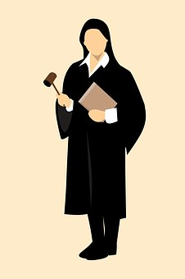
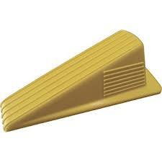
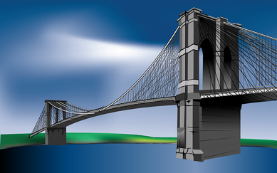
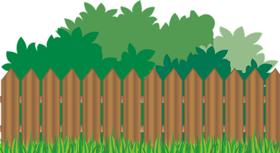
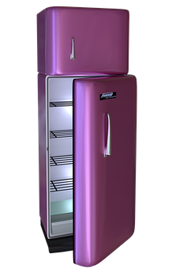
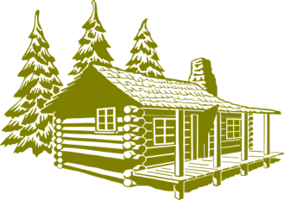
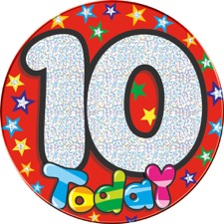
What can you see? Write down what these images are:
j u d _ _
w _ d _ _
_ r _ d _ _
h _ d _ e
l o _ _ _
_ a _ _ e
f r _ _ _ _

Slide 4
What can you see? Write down what these images are:
Answers:
j u d g e
w e d g e
b r i d g e
h e d g e
l o d g e
b a d g e
f r i d g e

Slide 5
Stage: 2 | The /j/ sound spelled –dge at the end of words. Name:
List: 1
Spellings | 1st Attempt | 2nd Attempt | 3rd Attempt | 4th Attempt | 5th Attempt
badge
edge
bridge
dodge
fudge
ridge
smudge
judge
wedge
lodge

Slide 6
Stage: 2 | The /j/ sound spelt –dge at the end of words. Name:
List: 1
Spellings
badge
edge
bridge
dodge
fudge
ridge
smudge
judge
wedge
lodge
a
o
Use your spellings to try and work out which words fit in the boxes.
e
i
Which words have been left out?

Slide 7
Stage: 2 | The /j/ sound spelt –dge at the end of words. Answers:
List: 1
d
b
d
d
d
Spellings
badge
edge
bridge
dodge
fudge
ridge
smudge
judge
wedge
lodge
e
g
e
a
g
e
o
g
e
Use your spellings to try and work out which words fit in the boxes.
b
d
r
i
g
e
d
w
e
g
e
d
d
r
i
g
e
s
m
u
g
e
Which words have been left out?

