Slide 1

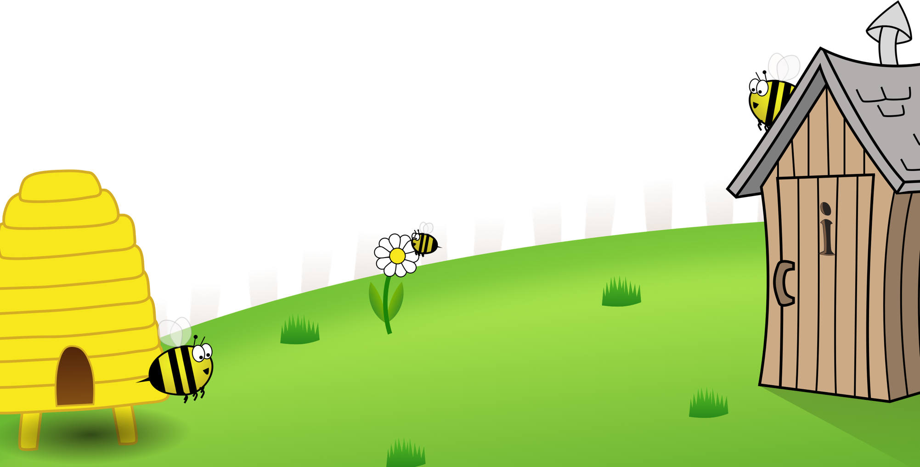


Spelling Scheme of Work
Sample
All elements of this scheme are copyright © The Spelling Shed Ltd and may not be redistributed without permission.
11/01/20

Slide 2
Spelling Scheme of Work
Stage 1
All elements of this scheme are copyright © The Spelling Shed Ltd and may not be redistributed without permission.
11/01/20

Slide 3
Spelling lists – Stage 1
The /f/, /l/, /s/, /z/ and /k/ sounds are usually spelt as ff, ll, ss, zz and ck if they come straight after a single vowel letter in short words.
The /k/ sound spelled ‘k’ before e, I and y. The /nk/ sound found at the end of words usually comes after a vowel.
The -tch This sound is usually spelled as ‘tch’ when it comes after a single vowel letter.
Some words end with an /e/ sound spelled ‘y’. English words hardly ever end with the letter ‘v’, so if a word ends with a /v/ sound, the letter ‘e’ usually needs to be added after the ‘v’.
Adding s and es to words (plurals) If the ending sounds like /s/ or /z/, it is spelled as –s. If it forms an extra syllable, then it is spelled as –es.
Adding the suffixes – ing and –ed to verbs. If the verb ends in two consonant letters (the same or different), the ending is simply added on.
Adding –er, –est and un- to words.
Words of more than one syllable often have an unstressed syllable in which the vowel sound is unclear. Sometimes words can be joined together to form compound words.
The /ai/ and /oi/ digraphs. These digraphs are virtually never used at the end of words in English.
The ay and oy digraphs. These digraphs are used for those sounds at the ends of words and syllables.
The long vowel sound /a/ spelled with the split digraph a-e
The long vowel sound /e/ spelled with the split digraph e-e.
The long vowel sound /i/ spelled with a split digraph i-e.
The long vowel sound /o/ spelled with the split digraph o_e.
The long vowel /oo/ and /yoo/ sounds spelled as u-e. These sounds are usually found in the middle or at the end of words.
The /ar/ consonant digraph. This digraph may be used at the beginning, middle or end of words.
Long vowel sound /e/ spelled ee. The letters ‘ee’ make a long vowel sound like in the word see. This is a common way of spelling the sound and is found in the middle of words and sometimes at the end.
The long vowel sound /e/ spelled ea. Another common spelling of the sound which is often found in the middle and end of words.
The short vowel sound /e/ spelled ea.
The vowel digraph er. In these words the sound is stressed
The vowel digraph er. In these words the sound is unstressed and found at the end of words.
The digraphs ir and ur. Often found in the middle of words and occasionally at the beginning of words.
The long vowel sound /oo/ as in Zoo. Very few words start or end with /oo/
The short vowel sound ‘oo’ as in foot. *Standard English pronunciation has been used here. In some parts of England the –ook words may have a longer sound.
The ‘oa’ digraph can come at the beginning or in the middle of words but very rarely at the end. The ’oe’ digraph can be sometimes found at the end of words.
The ’ou’ digraph. This digraph can be can be found at the beginning and in the middle of words. The only common English word ending in ‘ou’ is you.
The ‘ow’ digraph. This digraph can make two different sounds like in ‘cow’ or in ‘blow.’
The ‘oo’ and ‘yoo’ sounds can be spelled as u-e, ue and ew. If words end in the /oo/ sound, then it is likely that they will be spelled ew or ue.
The digraph ‘ie’ making the /aɪ / sound as in pie.
The digraph ‘ie’ making the /ee/ sound.
The long vowel sound /i/ spelled ‘igh.’ This is usually found in the middle of words but sometimes at the end of words too.
The /or/ sound. The vowel digraph ‘or’ and trigraph ‘ore.’ It is more likely that when at the end of a word then it will be spelled with an ‘e.’
The /or/ sound spelled with the digraph aw or au. If it is at the end of a word it is more likely to be spelled with an aw and at the beginning of a word with au.
The trigraphs ‘air’ and ‘ear’. These spellings are commonly found in the middle or at the end of words but can sometimes used at the beginning of words too.
The /er/ sound spelled with ’ear’ or ‘are’
Words with ’ph’ or ‘wh’ spellings.

Slide 4
1
1
Words ending with the /f/, /l/, /s/, /z/ or /k/ sound in English almost always have double consonant.

Slide 5
1
Words ending with the /f/, /l/, /s/, /z/ or /k/ sound in English almost always have double consonant.
1
Introduction | Words ending with the /f/, /l/, /s/, /z/ or /k/ sound in English almost always have double consonant. This week’s words are shown in random order. Sound the words out and count the sounds. Ask the children if they can see a pattern with the last sound. Discuss that the /k/ sound is usually written as “ck”.
Main Teaching Activity | Read the sentence for each word and ask children for the word and spelling to reinforce the double-consonant rule.
Independent Activity | Ask the children to choose one of their words to complete the two sentences. Then ask them to choose three more words and write their own sentences. Work in pairs or with support if necessary. Share sentences and spellings with the class.
Spellings
puff
fluff
bell
doll
grass
kiss
buzz
fizz
clock
back

Slide 6
Stage: 1 | Words ending with the /f/, /l/, /s/, /z/ or /k/ sound in English almost always have double consonant. Name:
List: 1
puff
doll
back
clock
grass
kiss
fluff
bell
buzz
fizz

Slide 7
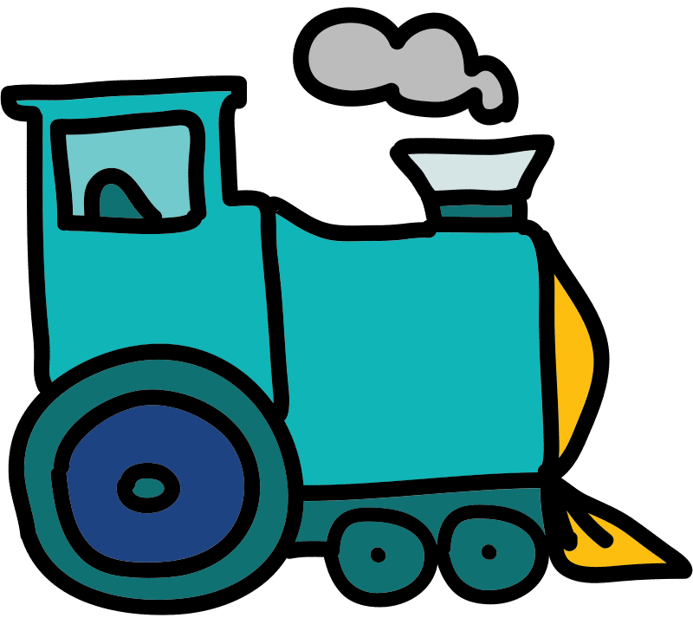
A _______ of smoke came from the train.

Slide 8
A _puff_ of smoke came from the train.
Answer:

Slide 9
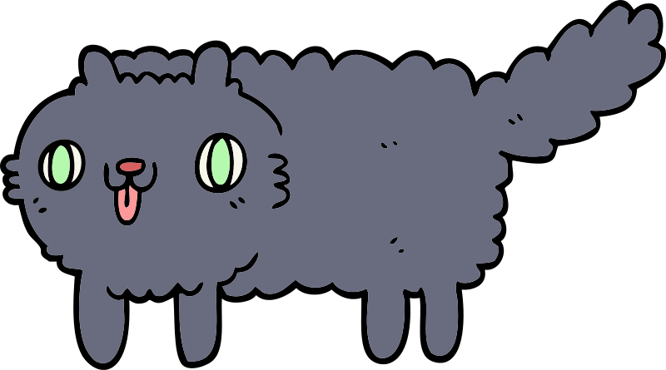
The kitten was covered in _______.

Slide 10
The kitten was covered in _fluff_.
Answer:

Slide 11

The teacher rang the _______.

Slide 12
Answer:
The teacher rang the _bell_.

Slide 13
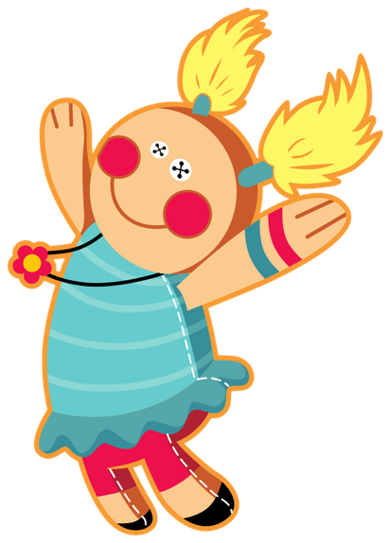
The _______ has a blue dress.

Slide 14
The _doll_ has a blue dress.
Answer:

Slide 15

The _______ on the field is green.

Slide 16
The _grass_ on the field is green.
Answer:

Slide 17
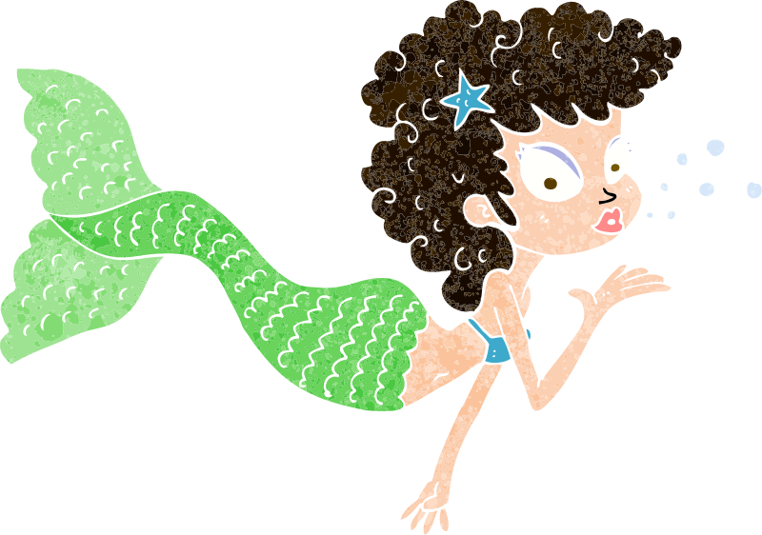
The mermaid blew a _______.

Slide 18
Answer:
The mermaid blew a _kiss_.

Slide 19
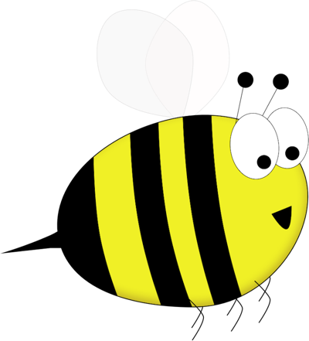
Bumble’s wings _______.

Slide 20
Bumble’s wings _buzz_.
Answer:

Slide 21
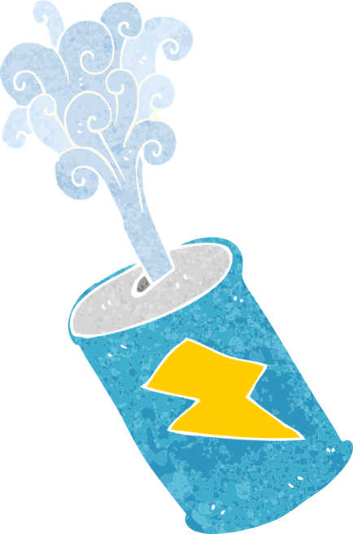
The can was full of _______.

Slide 22
Answer:
The can was full of _fizz_.

Slide 23

You tell the time by using a _______.

Slide 24
You tell the time by using a _clock_.
Answer:

Slide 25

The girl’s hair ran down her _______.

Slide 26
The girl’s hair ran down her _back_.
Answer:

Slide 27
Stage: 1 | Words ending with the /f/, /l/, /s/, /z/ or /k/ sound in English almost always have double consonant.
List: 1
Chose one of your words to complete the two sentences. Try to write three sentences of your own.
Spellings
puff
fluff
bell
doll
grass
kiss
buzz
fizz
clock
back
Your word
Your sentence
The clouds looked like balls of _________ in the sky.
“Can you hear the church _________?” asked mum.

Slide 28
Stage: 1 | Words ending with the /f/, /l/, /s/, /z/ or /k/ sound in English almost always have double consonant. Answers
List: 1
Chose one of your words to complete the two sentences. Try to write three sentences of your own.
Spellings
puff
fluff
bell
doll
grass
kiss
buzz
fizz
clock
back
Your word
Your sentence
The clouds looked like balls of _fluff_ in the sky.
“Can you hear the church _bell_?” asked mum.

Slide 29
Stage: 1 | Words ending with the /f/, /l/, /s/, /z/ or /k/ sound in English almost always have double consonant. Name:
List: 1
Spellings | 1st Attempt | 2nd Attempt | 3rd Attempt | 4th Attempt | 5th Attempt
puff
fluff
bell
doll
grass
kiss
buzz
fizz
clock
back

Slide 30
Stage: 1 | Words ending with the /f/, /l/, /s/, /z/ or /k/ sound in English almost always have double consonant. Name:
List: 1
Spellings
puff
fluff
bell
doll
grass
kiss
buzz
fizz
clock
back
p | u | f | f | q | d | b | e | l | l
a | v | r | f | l | u | f | f | o | p
j | d | o | l | l | n | b | l | k | g
w | v | e | i | s | p | q | j | n | r
f | b | u | z | z | a | c | h | i | a
c | l | o | c | k | g | r | n | o | s
v | g | a | h | y | s | k | i | s | s
a | b | a | c | k | f | b | c | f | m
k | x | l | z | c | f | i | z | z | z
Find and colour your spellings which are hiding in this grid.

Slide 31
Stage: 1 | Words ending with the /f/, /l/, /s/, /z/ or /k/ sound in English almost always have double consonant. Answers:
List: 1
Spellings
puff
fluff
bell
doll
grass
kiss
buzz
fizz
clock
back
p | u | f | f | q | d | b | e | l | l
a | v | r | f | l | u | f | f | o | p
j | d | o | l | l | n | b | l | k | g
w | v | e | i | s | p | q | j | n | r
f | b | u | z | z | a | c | h | i | a
c | l | o | c | k | g | r | n | o | s
v | g | a | h | y | s | k | i | s | s
a | b | a | c | k | f | b | c | f | m
k | x | l | z | c | f | i | z | z | z
Find and colour your spellings which are hiding in this grid.

Slide 32
1
2
The /k/ sound is spelt as k rather than as c before e, i and y. The /nk/ sound found at the end of words and usually comes after a vowel.

Slide 33
1
The /k/ sound is spelt as k rather than as c before e, i and y. The /nk/ sound found at the end of words and usually comes after a vowel.
2
Introduction | Say some of the words to the children, can they pick up the sound that appears in every word? Ask them to sound out the words and clap when they hear the /k/ sound. Explain the spelling rules: The /k/ sound is spelt as k rather than as c before e, i and y. The /nk/ sound is often found at the end of words and usually comes after a vowel.
Main Teaching Activity | Using the power point slide, discuss the meaning of the spelling list this week. Get children to come out and underline the /k/ or /nk/ sound in each word.
Independent Activity | Get children to work in small groups, one child picks one of the spelling list words and writes the first letter on a mini whiteboard, then passes the board to their left, the next child writes the next letter of the word and so on until the word is complete. The child that writes the final letter checks the spelling is correct and then picks another word from the board to start again.
Spellings
bank
honk
tank
pink
think
kit
skin
frisky
sketch
basket

Slide 34
Circle the /k/ or /nk/ sound in each word. What do the words mean? Can you use them in a sentence?
honk | bank | tank | pink | think
kit | skin | frisky | sketch | basket

Slide 35
Circle the /nk/ sound in each word. What do the words mean? Can you use them in a sentence?
Answers:
honk | bank | tank | pink | think
kit | skin | frisky | sketch | basket

Slide 36
Stage: 1 | The /nk/ sound found at the end of words. This sound usually comes after a vowel. Name:
List: 2
Spellings | 1st Attempt | 2nd Attempt | 3rd Attempt | 4th Attempt | 5th Attempt
bank
honk
tank
pink
think
kit
skin
frisky
sketch
basket

Slide 37
Stage: 1 | The /nk/ sound found at the end of words. This sound usually comes after a vowel. Name:
List: 2
Spellings
bank
honk
tank
pink
think
kit
skin
frisky
sketch
basket
ba__ | ta__ | ho__
fris__y | Add “k” or “nk” to these words and read them out loud. | s__in
thi__ |  | __it
bas__et | pi__ | s__etch

Slide 38
Stage: 1 | The /nk/ sound found at the end of words. This sound usually comes after a vowel. Answers:
List: 2
Spellings
bank
honk
tank
pink
think
kit
skin
frisky
sketch
basket
bank | tank | honk
frisky | Add “k” or “nk” to these words and read them out loud. | skin
think |  | kit
basket | pink | sketch

Slide 39
Spelling Scheme of Work
Stage 2
All elements of this scheme are copyright © The Spelling Shed Ltd and may not be redistributed without permission.
11/01/20

Slide 40
Spelling lists – Stage 2
The /j/ sound spelled –dge at the end of words. This spelling is used after the short vowel sounds.
The /j/ sound spelled –ge at the end of words. This spelling comes after all sounds other than the ‘short vowels.’
The /j/ sound spelled with a g.
The /s/ sound spelled c before e, i and y.
The /n/ sound spelled kn and gn at the beginning of words.
Challenge Words
The /r/ sound spelled ’wr’ at the beginning of words.
The /l/ or /ul/ sound spelled ’-le’ at the end of words.
The /l/ or /ul/ sound spelled ‘-el’ at the end of words. This spelling is used after m, n, r, s, v, w and commonly s.
The /l/ or /ul/ sound spelled ‘-al’ at the end of words.
Words ending in ’-il.’
Challenge Words
The long vowel ‘i’ spelled with a y at the end of words.
Adding ‘-es’ to nouns and verbs ending in ‘y.’
Adding ‘-ed’ to words ending in y. The y is changed to an i.
Adding ‘-er’ to words ending in y. The y is changed to an i.
Adding ‘ing’ to words ending in ‘e’ with a consonant before it.
Challenge Words
Adding ‘er’ to words ending in ‘e’ with a consonant before it.
Adding ‘-ing’ to words of one syllable. The last letter is doubled to keep the short vowel sound.
Adding ‘–ed'’ to words of one syllable. The last letter is doubled to keep the short vowel sound.
The ‘or’ sound spelled ’a’ before ll and ll
The short vowel sound ‘o.’
Challenge Words
The /ee/ sound spelled ‘–ey’
Words with the spelling ‘a’ after w and qu.
The /er/ sound spelled with o or ar.
The /z/ sound spelled s.
The suffixes ‘-ment’ and ‘-ness’
The suffixes ‘-ful’ and ‘-less’ If a suffix starts with a consonant letter. It is added straight onto most root words.
These words are homophones or near homophones. They have the same pronunciation but different spellings and/or meanings
These words are homophones or near homophones. They have the same pronunciation but different spellings and/or meanings.
Words ending in ‘-tion.’
Contractions – the apostrophe shows where a letter or letters would be if the words were written in full.
The possessive apostrophe (singular)
Challenge Words

Slide 41
2
1
The /j/ sound spelled –dge at the end of words. This spelling is used after the short vowel sounds

Slide 42
2
The /j/ sound spelled –dge at the end of words. This spelling is used after the short vowel sounds
1
Introduction | The /j/ sound at the end of a word can be spelled using ‘dge’. The rule is that this sound follows a short vowel sound,
Main Teaching Activity | Show children the spelling list and say the words. Can they hear a sound that appears in each word? If they correctly spot the /j/ sound then ask them to speak with a partner for 20 seconds and then write down, on a whiteboard, the letters that they think are creating the sound /j/. Share the answers and discuss the spelling rule. In pairs, can they think of any other words that end with the ‘dge’ spelling?
Independent Activity | Look at the images, can children work out what they are and how to spell them? Remember that each image will have the spelling rule ending!
Spellings
badge
edge
bridge
dodge
fudge
ridge
smudge
judge
wedge
lodge

Slide 43
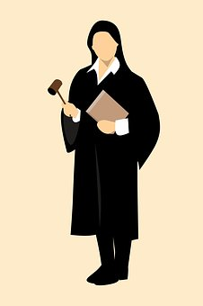
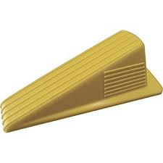
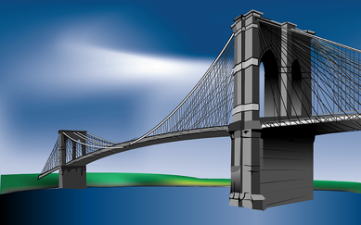
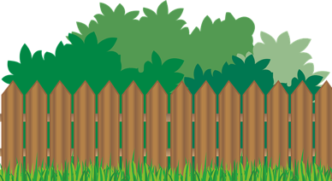
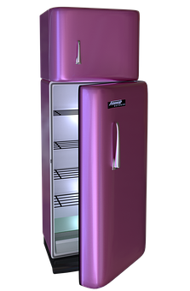


What can you see? Write down what these images are:
j u d _ _
w _ d _ _
_ r _ d _ _
h _ d _ e
l o _ _ _
_ a _ _ e
f r _ _ _ _

Slide 44
What can you see? Write down what these images are:
Answers:
j u d g e
w e d g e
b r i d g e
h e d g e
l o d g e
b a d g e
f r i d g e

Slide 45
Stage: 2 | The /j/ sound spelled –dge at the end of words. Name:
List: 1
Spellings | 1st Attempt | 2nd Attempt | 3rd Attempt | 4th Attempt | 5th Attempt
badge
edge
bridge
dodge
fudge
ridge
smudge
judge
wedge
lodge

Slide 46
Stage: 2 | The /j/ sound spelt –dge at the end of words. Name:
List: 1
Spellings
badge
edge
bridge
dodge
fudge
ridge
smudge
judge
wedge
lodge
a
o
Use your spellings to try and work out which words fit in the boxes.
e
i
Which words have been left out?

Slide 47
Stage: 2 | The /j/ sound spelt –dge at the end of words. Answers:
List: 1
d
b
d
d
d
Spellings
badge
edge
bridge
dodge
fudge
ridge
smudge
judge
wedge
lodge
e
g
e
a
g
e
o
g
e
Use your spellings to try and work out which words fit in the boxes.
b
d
r
i
g
e
d
w
e
g
e
d
d
r
i
g
e
s
m
u
g
e
Which words have been left out?

Slide 48
2
2
The /j/ sound spelt –ge at the end of words. This spelling comes after all sounds other than the short vowels.

Slide 49
2
The /j/ sound spelt –ge at the end of words. This spelling comes after all sounds other than the short vowels.
2
Introduction | Words that end with a /j/ sound that is spelling ‘ge’ have a sound that is not a short vowel.
Main Teaching Activity | Ask children to listen to the words and spot the sound that is the same in each. Use the power point slide to show the spelling list. Ask children to copy the words on their whiteboards and circle the sound that comes before the /j/ sound. Feedback and discuss how this spelling occurs only in words without a short vowel sound.
Independent Activity | Using the spelling list words get children to work in pairs to try and find two new words that they can make from each word. For example: charge – rage – hag orange – range – ran
Spellings
age
huge
change
charge
bulge
village
range
orange
hinge
stage

Slide 50
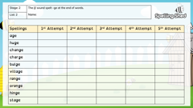
Stage: 2 | The /j/ sound spelt –ge at the end of words. Name:
List: 2
Spellings | 1st Attempt | 2nd Attempt | 3rd Attempt | 4th Attempt | 5th Attempt
age
huge
change
charge
bulge
village
range
orange
hinge
stage

Slide 51
Stage: 2 | The /j/ sound spelt –ge at the end of words. Name:
List: 2
Spellings
age
huge
change
charge
bulge
village
range
orange
hinge
stage
s | t | a | g | e | t | h | u | g | e
c | h | a | r | g | e | s | p | q | u
h | l | t | r | f | i | o | u | n | d
i | t | y | a | g | e | k | l | l | i
n | z | w | t | c | h | a | n | g | e
g | b | u | l | g | e | r | n | p | t
e | m | v | i | l | l | a | g | e | y
w | l | k | r | a | n | g | e | p | j
o | r | a | n | g | e | r | g | i | k
Can you find your spellings hidden in the word search?

Slide 52
Stage: 2 | The /j/ sound spelt –ge at the end of words. Answers:
List: 2
Spellings
age
huge
change
charge
bulge
village
range
orange
hinge
stage
s | t | a | g | e | t | h | u | g | e
c | h | a | r | g | e | s | p | q | u
h | l | t | r | f | i | o | u | n | d
i | t | y | a | g | e | k | l | l | i
n | z | w | t | c | h | a | n | g | e
g | b | u | l | g | e | r | n | p | t
e | m | v | i | l | l | a | g | e | y
w | l | k | r | a | n | g | e | p | j
o | r | a | n | g | e | r | g | i | k
Can you find your spellings hidden in the word search?

Slide 53
Spelling Scheme of Work
Stage 3
All elements of this scheme are copyright © The Spelling Shed Ltd and may not be redistributed without permission.
11/01/20

Slide 54
Spelling lists – Stage 3
The /ow/ sound spelled ‘ou.’ Found often in the middle of words, sometimes at the beginning and very rarely at the end of words.
The /u/ sound spelled ‘ou.’ This digraph is only found in the middle of words.
Spelling Rule: The /i/ sound spelled with a ‘y.’
Words with endings that sound like /ze/ as in measure are always spelled with ‘-sure.’
Words with endings that sound like /ch/ is often spelled –’ture’ unless the root word ends in (t)ch.
Challenge words
Words with the prefix ’re-’ ‘re-’ means ‘again’ or ‘back.’
The prefix ’dis-’ which has a negative meaning. It often means ‘does not’ as in does not agree = disagree.
The prefix ’mis-’ This is another prefix with negative meanings.
Adding suffixes beginning with vowel letters to words of more than one syllable. The consonant letter is not doubled if the syllable is unstressed.
Adding suffixes beginning with vowel letters to words of more than one syllable. If the last syllable of a word is stressed and ends with one consonant letter which has just one vowel letter before it, the final consonant letter is doubled.
Challenge words
The long vowel /a/ sound spelled ‘ai’
The long /a/ vowel sound spelled ’ei.’
The long /a/ vowel sound spelled ’ey.’
Adding the suffix –ly. Adding the –ly suffix to an adjective turns it into an adverb.
Homophones – words which have the same pronunciation but different meanings and/or spellings.
Challenge Words
The /l/ sound spelled ‘-al’ at the end of words.
The /l/ sound spelled ‘-le’ at the end of words.
Adding the suffix ‘–ly’ when the root word ends in ‘-le’ then the ‘-le’ is changed to ‘-ly.’
Adding the suffix ‘-ally’ which is used instead of ‘-ly’ when the root word ends in ‘–ic.’
Adding the suffix –ly. Words which do not follow the rules.
Challenge Words
Words ending in ‘-er’ when the root word ends in (t)ch.
Words with the /k/ sound spelled ‘ch.’ These words have their origins in the Greek language.
Words ending with the /g/ sound spelled ‘–gue’ and the /k/ sound spelled ‘–que.’ These words are French in origin.
Words with the /s/ sound spelled ’sc’ which is Latin in its origin.
Homophones: Words which have the same pronunciation but different meanings and/or spellings.
Challenge Words
The suffix ‘–sion’ pronounced /ʒən/
Revision – spelling rules we have learned in Stage 3.
Revision – spelling rules we have learned in Stage 3.
Revision – spelling rules we have learned in Stage 3.
Revision – spelling rules we have learned in Stage 3.
Revision – spelling rules we have learned in Stage 3.

Slide 55
3
1
The /ow/ sound spelled ‘ou’. Found often in the middle of words, sometimes at the beginning and very rarely at the end of words.

Slide 56
3
The /ow/ sound spelled ‘ou.’ Found often in the middle of words, sometimes at the beginning and very rarely at the end of words.
Introduction | The digraph ‘ou’ is pronounced as /ow/, explain that this sound is most common in the middle of words and sometimes at the start. It is rare at the end of words where the ‘ow’ spelling is usually found (e.g. cow).
Main Teaching Activity | Using the power point slide, discuss the meaning of the spelling list this week. Get children to come out and underline the /ow/ sound in each word. Notice that most often the sound comes in the middle of the word.
Independent Activity | Get children to work in small groups, one child picks one of the spelling list words and writes the first letter on a mini whiteboard, then passes the board to their left, the next child writes the next letter of the word and so on until the word is complete. The child that writes the final letter checks the spelling is correct and then picks another word from the board to start again.
Spellings
mouth
around
sprout
sound
spout
ouch
hound
trout
found
proud

Slide 57
Discuss the meanings of the words below and then ask children to come out and underline the /ow/ sound in each word
mouth | around | sprout | sound | spout
ouch | hound | trout | outside | found

Slide 58
Answers:
Discuss the meanings of the words below and then ask children to come out and underline the /ow/ sound in each word
mouth | around | sprout | sound | spout
ouch | hound | trout | outside | found

Slide 59
Stage: 3 | The /ow/ sound spelled ‘ou.’ Found often in the middle of words, sometimes at the beginning and very rarely at the end of words. Name:
List: 1
Spellings | 1st Attempt | 2nd Attempt | 3rd Attempt | 4th Attempt | 5th Attempt
mouth
around
sprout
sound
spout
ouch
hound
trout
found
proud

Slide 60
Stage: 3 | The /ow/ sound spelled ‘ou.’ Found often in the middle of words, sometimes at the beginning and very rarely at the end of words. Name:
List: 1
Find and unscramble your spellings in the grids.
Spellings
mouth
around
sprout
sound
spout
ouch
hound
trout
found
proud
h | t | m | o | u
n | a | r | o | u | d
t | s | u | p | o
p | r | u | t | o | s
d | n | f | o | u
t | t | r | u | o
o | p | u | d | r
o | s | u | n | d
n | u | d | o | h
h | u | c | o

Slide 61
Stage: 3 | The /ow/ sound spelled ‘ou.’ Found often in the middle of words, sometimes at the beginning and very rarely at the end of words. Answers:
List: 1
Find and unscramble your spellings in the grids.
Spellings
mouth
around
sprout
sound
spout
ouch
hound
trout
found
proud
h | t | m | o | u
m | o | u | t | h
n | a | r | o | u | d
a | r | o | u | n | d
t | s | u | p | o
s | p | o | u | t
p | r | u | t | o | s
s | p | r | o | u | t
d | n | f | o | u
f | o | u | n | d
t | t | r | u | o
t | r | o | u | t
o | p | u | d | r
p | r | o | u | d
o | s | u | n | d
s | o | u | n | d
n | u | d | o | h
h | o | u | n | d
h | u | c | o
o | u | c | h

Slide 62
3
2
The /u/ sound spelled ‘ou’.
This digraph is only found in the middle of words.

Slide 63
3
The /u/ sound spelled ‘ou.’ This digraph is only found in the middle of words.
2
Introduction | The digraph ‘ou’ which is pronounced /u/ is only found in the middle of words. Ask children to think of words with an /u/ sound and write down any that they say with the ‘ou’ digraph in.
Main Teaching Activity | Using the power point slide, get the children to complete the sentences choosing an appropriate word by writing their chosen word on a mini whiteboard and holding it up. Ensure the words are being spelled with the ‘ou’ spelling and discuss any errors or misconceptions before moving on.
Independent Activity | Children to become the teacher by marking Evie’s work and helping her to work out which 6 words are spelled incorrectly. Remind children that the /u/ sound should be spelled with /ou/ in this week’s spellings. After the children have had a minute to look at it, click the powerpoint slide to hide the spelling list for this activity.
Spellings
touch
double
country
trouble
young
cousin
enough
encourage
flourish
couple

Slide 64

Stage: 3 | The /u/ sound spelled ‘ou’. This digraph is only found in the middle of words.
List: 2
Cover your spellings for this task
Evie has scored 4/10 in her spelling test.
Can you help her to work out which spellings are wrong and write them correctly?
Spellings
touch
double
country
trouble
young
cousin
enough
encourage
flourish
couple
tuch double truble yung cusin country enough encurage flurish couple

Slide 65
Stage: 3 | The /u/ sound spelled ‘ou’. This digraph is only found in the middle of words. Answers:
List: 2
Cover your spellings for this task
Evie has scored 4/10 in her spelling test.
Can you help her to work out which spellings are wrong and write them correctly?
Spellings
touch
double
country
trouble
young
cousin
enough
encourage
flourish
couple
tuch double truble yung cusin country enough encurage flurish couple
touch
double
country
trouble
young
cousin
enough
encourage
flourish
couple

Slide 66
Stage: 3 | The /u/ sound spelled ‘ou.’ This digraph is only found in the middle of words. Name:
List: 2
Spellings | 1st Attempt | 2nd Attempt | 3rd Attempt | 4th Attempt | 5th Attempt
touch
double
country
trouble
young
cousin
enough
encourage
flourish
couple

Slide 67
Stage: 3 | The /u/ sound spelled ‘ou.’ This digraph is only found in the middle of words. Name:
List: 2
Spellings
touch
double
country
trouble
young
cousin
enough
encourage
flourish
couple
Ask someone to time you. Can you find your spellings hidden in the grid? How long did it take? Try it again and improve your speed!
touch | torch | trouble | troupe
youth | double | flourish | flour
young | grout | cousin | enough
cloud | country | count | sound
couple | toupee | encourage | mound

Slide 68
Stage: 3 | The /u/ sound spelled ‘ou.’ This digraph is only found in the middle of words. Answers:
List: 2
Spellings
touch
double
country
trouble
young
cousin
enough
encourage
flourish
couple
Ask someone to time you. Can you find your spellings hidden in the grid? How long did it take? Try it again and improve your speed!
touch | torch | trouble | troupe
youth | double | flourish | flour
young | grout | cousin | enough
cloud | country | count | sound
couple | toupee | encourage | mound

Slide 69
Spelling Scheme of Work
Stage 4
All elements of this scheme are copyright © The Spelling Shed Ltd and may not be redistributed without permission.
11/01/20

Slide 70
Spelling lists – Stage 4
These words are homophones or near homophones. They have the same pronunciation but different spellings and/or meanings.
The prefix ’in-’ can mean both ‘not’ and ‘in’/’into.’ In these spellings the prefix ’in-’ means ‘not.’
Before a root word starting with l, the ‘in-’ prefix becomes ‘il-’. Before a root word starting with r the prefix ‘in-’ becomes ’ir-’
The prefix ‘sub-’ which means under or below.
The prefix ‘inter-’ means between, amongst or during.
Challenge Words
The suffix ’-ation’ is added to verbs to form nouns.
The suffix ’-ation’ is added to verbs to form nouns.
Adding –ly to adverbs. Remembering words ending in ‘-y’ become ‘-ily’ and words ending in ‘–le’ become ‘–ly.’
Adding ‘-ly’ to to turn an adjective into an adverb when the final letter is ‘l.’
Word with the ’sh’ sound spelled ch. These words are French in origin.
Challenge Words
Adding the suffix ‘–ion.’ When the root word ends in ’d,’ ‘de’ or ‘se’ then the suffix ’-ion’ needs to be ‘-sion.’
Adding the suffix –ous.’ Sometimes the root word is obvious and the usual rules apply for adding suffixes beginning with vowel letters. Sometimes there is no obvious root word though.
The suffix ‘-ous.’ The final ‘e’ of the root word must be kept if the sound of ‘g’ is to be kept.
The ‘ee’ sound spelled with an ‘i.’
The suffix ‘-ous.’ If there is an ‘ee’ sound before the ’-ous’ ending, it is usually spelled as i, but a few words have e.
Challenge Words
The ‘au’ digraph
The suffix ‘-ion’ when the root word ends in ‘t’ or ‘te’ then the suffix becomes ’-tion.’
The suffix ‘-ion’ becomes ’-ssion’ when the root word ends in ’ss’ or ‘mit.’
The suffix ‘-cian’ used instead of ‘-sion’ when the root word ends in ’c’ or ‘cs’
Adding ‘-ly’ to create adverbs of manner. These adverbs describe how the verb is occurring.
Challenge Words
Homophones – words which have the same pronunciation but different meanings and/or spellings.
The /s/ sound spelled c before ’i’ and ‘e’.
Some words have similar spellings, root words and meanings. We call these word families. ’sol word family’ and ‘real word family’
Some words have similar spellings, root words and meanings. We call these word families. ’phon word family’ and ‘sign word family’
Prefixes – ’super-’ ‘anti’ and ‘auto.’
The prefix bi- meaning two.
Challenge Words
Revision – spelling rules we have learned in Stage 4.
Revision – spelling rules we have learned in Stage 4.
Revision – spelling rules we have learned in Stage 4.
Revision – spelling rules we have learned in Stage 4.
Revision – spelling rules we have learned in Stage 4.

Slide 71
4
1
Homophones: These words are homophones or near homophones. They have the same pronunciation but different spellings and/or meanings.

Slide 72
4
These words are homophones or near homophones. They have the same pronunciation but different spellings and/or meanings.
1
Introduction | Ask the children what the word homophone means. Can they think of any examples? Define them as words which have the same pronunciation but different meanings and/or spellings. Discuss near homophones have slightly different pronunciations.
Main Teaching Activity | Using the PowerPoint, display each example on the whiteboard. Ask the children to write down the word that they think goes in each gap. After each example ask the children to share their responses and discuss any errors or misconceptions. Teacher can choose to reveal the two spellings before or after the pupil attempts.
Independent Activity | In small groups. One child writes a sentence with one of this week’s spellings missing. E.g. We travelled to France by ________. The children on their table then write down the correct spelling on their whiteboards. The child who created the question shares which they thought was the right question and check each others’ answers.
accept
except
knot
not
peace
piece
plain
plane
weather
whether

Slide 73
My shoelaces were tied in a double ____.
Which is the correct spelling?
not knot

Slide 74
My shoelaces were tied in a double knot.
Answers:
Which is the correct spelling?
not knot

Slide 75
All classes went swimming ______ year 1.
Which is the correct spelling?
accept except
Notes:
Teacher note: This is a near homophone because accept and except are no pronounced in exactly the same way.

Slide 76
All classes went swimming except year 1.
Answers:
Which is the correct spelling?
accept except
Notes:
Teacher note: This is a near homophone because accept and except are no pronounced in exactly the same way.

Slide 77
The bad ____ means that we may have to cancel sports day.
Which is the correct spelling?
whether weather

Slide 78
The bad weather means that we may have to cancel sports day.
Answers:
Which is the correct spelling?
whether weather

Slide 79
The _____ swooped down low over the airport during the air show.
Which is the correct spelling?
plane plain

Slide 80
The plane swooped down low over the airport during the air show.
Answers:
Which is the correct spelling?
plane plain

Slide 81
Each child ate a _____ of fruit at break time.
Which is the correct spelling?
piece peace

Slide 82
Each child ate a piece of fruit at break time.
Answers:
Which is the correct spelling?
piece peace

Slide 83
Stage: 4 | Homophones Name:
List: 1
Spellings | 1st Attempt | 2nd Attempt | 3rd Attempt | 4th Attempt | 5th Attempt
accept
except
knot
not
peace
piece
plain
plane
weather
whether

Slide 84
4
Homophones
Name:
1
Write the correct spelling into each sentence.
The teacher gave everyone a ________ of _________ paper.
Tim stood at the front of assembly to __________ his prize.
I had a ________ in my shoelaces.
All was dark, ________ for a tiny candle in the corner.
I like most vegetables but ______ cauliflower.
In church the people prayed for _______ on Earth.
The _________ stopped the children playing out today.
The pilot landed his ________ safely on the runway.
The children wondered ________ they should tell their teacher.
accept
except
knot
not
peace
piece
plain
plane
weather
whether

Slide 85
4
Homophones
Answers:
1
Write the correct spelling into each sentence.
The teacher gave everyone a piece of plain paper.
Tim stood at the front of assembly to accept his prize.
I had a knot in my shoelaces.
All was dark, except for a tiny candle in the corner.
I like most vegetables but not cauliflower.
In church the people prayed for peace on Earth.
The weather stopped the children playing out today.
The pilot landed his plane safely on the runway.
The children wondered whether they should tell their teacher.
accept
except
knot
not
peace
piece
plain
plane
weather
whether

Slide 86
4
2
The prefix ’in-’ can mean both ‘not’ and ‘in’/’into.’ In these spellings the prefix ’in-’ means ‘not.’

Slide 87
4
The prefix ’in-’ can mean both ‘not’ and ‘in’/’into.’ In these spellings the prefix ’in-’ means ‘not.’
2
Introduction | Explain to the children that today’s words all begin with the prefix ‘in’. Prefixes are added to words to change the meaning. In this case, the words become the opposite of their root word e.g. active becomes inactive, flexible becomes inflexible. Ask children what the opposite of correct is, if they aren’t sure then remind them of the spelling rule.
Main Teaching Activity | Using the power point, get children to write down the opposite of the words on the slides by adding the prefix ‘in’. After each example ask the children to share their responses, check they understand the meaning of the word and discuss any errors or misconceptions.
Independent Activity | Children choose five of the words from the spelling list and write a sentence for each one. Children then share their sentences with a partner to check if they are correct. In pairs, see if children can think of any more words starting with the prefix ‘in’.
inactive
incorrect
invisible
insecure
inflexible
indefinite
inelegant
incurable
inability
inadequate

Slide 88
Write down the opposite of: active
inactive

Slide 89
Write down the opposite of: correct
incorrect

Slide 90
Write down the opposite of: secure
insecure

Slide 91
Write down the opposite of: visible
invisible

Slide 92
Write down the opposite of: flexible
inflexible

Slide 93
Stage: 4 | The prefix ’in-’ can mean both ‘not’ and ‘in’/’into.’ In these spellings the prefix ’in-’ means ‘not.’ Name:
List: 2
Spellings
inactive
incorrect
invisible
insecure
inflexible
indefinite
inelegant
incurable
inability
inadequate
Cover your spellings up. Can you add in the missing letters from each word?
i n _ u r a _ l e | i n _ o r _ e c t
i n s e c u r e | i n a b _ _ i t y
i n e l _ _ a n t | i n d e f _ _ i t e
i n _ _ t i v e | i n a d e _ _ a t e
i n _ _ e _ i b l e | _ n v _ s _ b l e

Slide 94
Stage: 4 | The prefix ’in-’ can mean both ‘not’ and ‘in’/’into.’ In these spellings the prefix ’in-’ means ‘not.’ Answers:
List: 2
Spellings
inactive
incorrect
invisible
insecure
inflexible
indefinite
inelegant
incurable
inability
inadequate
Cover your spellings up. Can you add in the missing letters from each word?
i n c u r a b l e | i n c o r r e c t
i n s e c u r e | i n a b i l i t y
i n e l e g a n t | i n d e f i n i t e
i n a c t i v e | i n a d e q u a t e
i n f l e x i b l e | i n v i s i b l e

Slide 95
Stage: 4 | The prefix ’in-’ can mean both ‘not’ and ‘in’/’into.’ In these spellings the prefix ’in-’ means ‘not.’ Name:
List: 2
Spellings | 1st Attempt | 2nd Attempt | 3rd Attempt | 4th Attempt | 5th Attempt
inactive
incorrect
invisible
insecure
inflexible
indefinite
inelegant
incurable
inability
inadequate

Slide 96
Spelling Scheme of Work
Stage 5
All elements of this scheme are copyright © The Spelling Shed Ltd and may not be redistributed without permission.
11/01/20

Slide 97
Spelling lists – Stage 5
Words ending in ‘-ious.’
Words ending in ‘–cious.’ If the root word ends in –ce the sound is usually spelled ‘-cious.’
Ending ‘-cial’ and ‘-tial.’ After a vowel ‘-cial’ is most common and ‘-itial’ after a consonant. But there are many exceptions.
Ending ‘-cial’ and ‘-tial.’ After a vowel ‘-cial’ is most common and ‘-itial’ after a consonant. But there are many exceptions.
Ending ‘-cial’ and ‘-tial.’ After a vowel ‘-cial’ is most common and ‘-itial’ after a consonant. But there are many exceptions.
Challenge words
Words ending in ‘-ant.’ ‘-ant’ Is used if there is an ‘a’ or ‘ay’ sound in the right place.
Words ending in ‘-ance.’ ‘-ance’ Is used if there is an ‘a’ or ‘ay’ sound in the right place.
Use –ent and -ence after soft c (/s/ sound), soft g (/j/ sound) and qu. There many exceptions to this rule.
Words ending in ‘-able’ and ‘-ible.’ ‘-able’ is used where there is a related word ending ‘-ation.’
Words ending in ‘-ably’ and ‘-ibly.’ The ‘-able’ ending is usually but not always used if a complete root word can be heard before it. ‘y’ endings comply with previously learned rules and is replaced with ‘i’ as in rely > reliably
Challenge Words
Words ending in ‘-able.’ If this is being added to a root word ending in –ce or –ge then the e after the c or g is kept other wise they would be said with their hard sounds as in cap and gap.
Adverbs of time (temporal adverbs) these are words to develop chronology in writing.
Adding suffixes beginning with vowel letters to words ending in –fer. The r is doubled if the –fer is still stressed when the ending is added. If the –fer is not stressed then the r isn’t doubled.
Words with ‘silent’ letters at the start.
Words with ‘silent’ letters (i.e. letters whose presence cannot be predicted from the pronunciation of the word)
Challenge Words
Words spelled with ’ie’ after c.
Words with the ‘ee’ sound spelled ei after c. The ‘i before e except after c’ rule applies to words where the sound spelled by ei is /ee/ However there are exceptions like those in the spellings.
Words containing the letter string ‘ough’ where the sound is /aw/.
Words containing the letter string ’ough’ where the sound is /o/ as in boat or ‘ow’ as in cow.
Adverbs of possibility. These words show the possibility that something has of occurring.
Challenge Words
These words are homophones or near homophones. They have the same pronunciation but different spellings and/or meanings.
These words are homophones or near homophones. They have the same pronunciation but different spellings and/or meanings.
These words are homophones or near homophones. They have the same pronunciation but different spellings and/or meanings.
These words are homophones or near homophones. They have the same pronunciation but different spellings and/or meanings.
These words are homophones or near homophones. They have the same pronunciation but different spellings and/or meanings.
Challenge Words
Hyphens can be used to join a prefix to a root word, especially if the prefix ends in a vowel letter and the root word also begins with one.
Challenge Words
Revision: Year 5 words
Revision: Year 5 words
Revision: Year 5 words
Revision: Year 5 words

Slide 98
5
1
Words ending in ‘-ious’

Slide 99
5
Words ending in ‘-ious.’
1
Introduction | Today children will look at words that end in ious. Within this spelling list there are two main sounds at the end of the words – ‘tious’ (shus) and ‘ious’ (eeus).
Main Teaching Activity | Use the power point slide containing all of the words for this week. Ask children to divide the words in to two groups depending on the sound at the end of them. Share their results and discuss and patterns they can spot (e.g. words ending tious (shus) tend to have root words ending in ‘tion’.
Independent Activity | In small groups, one child picks a spelling list word and tells the others what it is. They must write the word on their whiteboard and the first child acts as teacher to check the spellings. The next child then becomes the teacher and they choose a word. Continue until all words have been spelled by the group.
Spellings
ambitious
infectious
fictitious
nutritious
repetitious
amphibious
curious
devious
notorious
obvious

Slide 100
Sort these spellings into two groups.
Those that have a ‘tious’ (shus) and ‘ious’ (eeus).
ambitious | repetitious | infectious | nutritious | curious
amphibious | fictitious | devious | notorious | obvious

Slide 101
Stage: 5 | Words ending in ‘-ious.’ Name:
List: 1
Spellings | 1st Attempt | 2nd Attempt | 3rd Attempt | 4th Attempt | 5th Attempt
ambitious
infectious
fictitious
nutritious
repetitious
amphibious
curious
devious
notorious
obvious

Slide 102
Stage: 5 | Words ending in ‘-ious.’ Name:
List: 1
Write the correct spelling into each sentence.
The ____________ creature was suited to both land and water.
The teacher’s __________ laugh was __________ around school.
He was __________ and so he auditioned for The X Factor twice.
The _________ cat found himself trapped in the garden shed.
In the school canteen they delivered __________ meals each day.
It was _________ that she did not like him.
The criminal mastermind had a _________ plan.
The job was very __________ the same task over and over again.
She gave a ___________ version of events. It wasn’t the truth.
Spellings
ambitious
infectious
fictitious
nutritious
repetitious
amphibious
curious
devious
notorious
obvious

Slide 103
Stage: 5 | Words ending in ‘-ious.’ Answers:
List: 1
Write the correct spelling into each sentence.
The _amphibious_ creature was suited to both land and water.
The teacher’s _infectious_ laugh was _notorious_ around school.
He was _ambitious_ and so he auditioned for The X Factor twice.
The _curious_ cat found himself trapped in the garden shed.
In the school canteen they delivered _nutritious_ meals each day.
It was _obvious_ that she did not like him.
The criminal mastermind had a _devious_ plan.
The job was very _repetitious_ the same task over and over again.
She gave a _fictitious_ version of events. It wasn’t the truth.
Spellings
ambitious
infectious
fictitious
nutritious
repetitious
amphibious
curious
devious
notorious
obvious

Slide 104
5
2
Words ending in ‘–cious.’ If the root word ends in –ce the sound is usually spelt ‘-cious.’

Slide 105
5
Words ending in ‘–cious.’ If the root word ends in –ce the sound is usually spelt ‘-cious’.
2
Introduction | Root words that end in ‘ce’ usually use ‘cious’ when adding the ‘ious’ suffix, however it is often not possible to identify a root word.
Main Teaching Activity | Get children to write each word on their mini white board and then, in pairs or as a table, pick two to look up in a dictionary. Feedback meanings to the class and see if a sentence can be made for some of the words.
Independent Activity | Give each pair the 10 definition cards and the 10 blank cards, get them to write the words on to the blank cards and then turn them all over and mix them up. Play a matching game, each player takes two cards, if they match then they keep them, if they don’t then they put them back – the winner has the most matching word/definition pairs.
Spellings
delicious
atrocious
conscious
ferocious
gracious
luscious
malicious
precious
spacious
suspicious

Slide 106
Cut up cards, write this week’s spellings on to a card and then turn all of the cards over and play a word/definition matching game with a partner.
Something which tastes very nice. | Extremely wicked. | Aware of and responding to one’s surroundings. | Savagely fierce, cruel or violent. | Courteous, kind and pleasant towards someone.
Appealingly strong to the senses. | Characterised by malice; intending someone to do harm. | Of great value, not to be wasted or treated carelessly. | Having a lot of space. | Showing cautious distrust of someone or something.

Slide 107
Stage: 5 | Words ending in ‘–cious.’ If the root word ends in –ce the sound is usually spelt ‘-cious.’ Name:
List: 2
Spellings | 1st Attempt | 2nd Attempt | 3rd Attempt | 4th Attempt | 5th Attempt
delicious
atrocious
conscious
ferocious
gracious
luscious
malicious
precious
spacious
suspicious

Slide 108
Stage: 5 | Words ending in ‘–cious.’ If the root word ends in –ce the sound is usually spelt ‘-cious.’ Name:
List: 2
 |  |  |  | p | r | e |  |  | o | u
 |  | s | p | a |  | i |  | u | s
 |  |  |  |  | c |  |  | s |  | i | o
 |  |  |  |  |  | a |  | r | o | c | i | o | u | s
 |  |  |  |  |  | m |  | l |  | c |  | o |  | s
 |  |  |  |  |  |  |  |  | a |  | i |  | u | s
 |  | f |  | r |  | c |  | o |  | s
 | u | s | p
 | e | l |  | c |  | o |  | s
l |  | s |  | i |  | u
Spellings
delicious
atrocious
conscious
ferocious
gracious
luscious
malicious
precious
spacious
suspicious
Insert the missing letters into your spellings to find a new word.

Slide 109
Stage: 5 | Words ending in ‘–cious.’ If the root word ends in –ce the sound is usually spelt ‘-cious.’ Answers:
List: 2
 |  |  |  | p | r | e | c | i | o | u | s
 |  | s | p | a | c | i | o | u | s
 |  |  |  |  | c | o | n | s | c | i | o | u | s
 |  |  |  |  |  | a | t | r | o | c | i | o | u | s
 |  |  |  |  |  | m | a | l | i | c | i | o | u | s
 |  |  |  |  |  |  | g | r | a | c | i | o | u | s
 |  | f | e | r | o | c | i | o | u | s
s | u | s | p | i | c | i | o | u | s
d | e | l | i | c | i | o | u | s
l | u | s | c | i | o | u | s
Spellings
delicious
atrocious
conscious
ferocious
gracious
luscious
malicious
precious
spacious
suspicious
Insert the missing letters into your spellings to find a new word.

Slide 110
Spelling Scheme of Work
Stage 6
All elements of this scheme are copyright © The Spelling Shed Ltd and may not be redistributed without permission.
11/01/20

Slide 111

Spelling lists – Stage 6
Challenge Words
Challenge Words
Challenge Words
Challenge Words
Challenge Words
Challenge Words
Challenge Words
Challenge Words
Challenge Words
Challenge Words
Spelling Rules: Words with the short vowel sound /i/ spelled y
Spelling Rules: Words with the long vowel sound /i/ spelled with a y.
Spelling Rules: Adding the prefix ‘-over’ to verbs.
Spelling Rules: Convert nouns or verbs into adjectives using suffix ‘-ful.’
Spelling Rules: Words which can be nouns and verbs.
Spelling Rules: Words with an /o/ sound spelled ‘ou’ or ‘ow.’
Spelling Rules: Words with a ‘soft c’ spelled /ce/.
Spelling Rules: Prefix dis, un, over, im. Each have a particular meaning: dis – reverse; un – not; over – above/more; im – opposite
Spelling Rules: Words with the /f/ sound spelled ph.
Spelling Rules: Words with origins in other countries
Spelling Rules: Words with unstressed vowel sounds.
Spelling Rules: Words with endings /shuhl/ after a vowel letter.
Spelling Rules: Words with endings /shuhl/ after a consonant letter.
Spelling Rules: Words with the common letter string ’acc’ at the beginning of words.
Spelling Rules: Words ending in ’-ably.’
Spelling Rules: Words ending in ’-ible’
Spelling Rules: Adding the suffix ‘-ibly’ to create an adverb.
Spelling Rules: Changing ‘-ent’ to ‘–ence.’
Spelling Rules: -er, -or, -ar at the end of words.
Spelling Rules: Adverbs synonymous with determination.
Spelling Rules: Adjectives to describe settings
Spelling Rules: Vocabulary to describe feelings.
Spelling Rules: Adjectives to describe character
Grammar Vocabulary
Grammar Vocabulary
Mathematical Vocabulary

Slide 112
6
1
Challenge Words

Slide 113
6
Challenge Words
1
Challenge week
Choose an activity from the challenge week pack.
Spellings
muscle
prejudice
available
determined
rhyme
identity
accommodate
suggest
competition
existence

Slide 114
Stage: 6 | Challenge Words Name:
List: 1
Spellings | 1st Attempt | 2nd Attempt | 3rd Attempt | 4th Attempt | 5th Attempt
muscle
prejudice
available
determined
rhyme
identity
accommodate
suggest
competition
existence

Slide 115
Stage: 6 | Challenge Words Name:
List: 1
 |  |  |  |  | p |  | e | j |  |  | i |  | e
 | c |  | o |  |  | o |  | a | t
 |  |  |  |  |  |  |  |  | n |  |  | t | y
 |  |  |  |  |  |  |  | s | t |  | n |  | e
 |  |  |  |  |  |  |  |  |  |  |  | y | m
 |  |  |  |  |  |  |  |  |  |  |  | s | c
 |  |  |  |  |  |  |  |  | a |  |  | a | b | l
 | o |  | p | e | t | i |  | i | o
 |  |  |  |  |  |  |  | g | g |  | s
 |  |  |  |  |  |  |  | t |  |  | m |  | n | e | d
Spellings
accommodate
available
competition
determined
suggest
existence
identity
muscle
prejudice
rhyme
Insert the missing letters into your spellings to find a new challenge word.

Slide 116
Stage: 6 | Challenge Words Answers:
List: 1
 |  |  |  |  | p | r | e | j | u | d | i | c | e
a | c | c | o | m | m | o | d | a | t | e
 |  |  |  |  |  | i | d | e | n | t | i | t | y
 |  |  |  |  | e | x | i | s | t | e | n | c | e
 |  |  |  |  |  |  |  |  |  | r | h | y | m | e
 |  |  |  |  |  |  |  |  |  | m | u | s | c | l | e
 |  |  |  |  |  |  | a | v | a | i | l | a | b | l | e
c | o | m | p | e | t | i | t | i | o | n
 |  |  |  |  |  | s | u | g | g | e | s | t
 |  |  |  |  |  | d | e | t | e | r | m | i | n | e | d
Spellings
accommodate
available
competition
determined
suggest
existence
identity
muscle
prejudice
rhyme
Insert the missing letters into your spellings to find a new challenge word.

Slide 117
6
2
Challenge Words

Slide 118
6
Challenge Words
2
Challenge week
Choose an activity from the challenge week pack.
Spellings
accompany
average
conscience
develop
explanation
immediately
necessary
privilege
rhythm
symbol

Slide 119
Stage: 6 | Challenge Words Name:
List: 2
Spellings | 1st Attempt | 2nd Attempt | 3rd Attempt | 4th Attempt | 5th Attempt
accompany
average
conscience
develop
explanation
immediately
necessary
privilege
rhythm
symbol

Slide 120
Stage: 6 | Challenge Words Name:
List: 2
e | d | e | v | e | l | o | p | a | s | d | f | m | b | n | c
g | h | j | k | e | x | p | l | a | n | a | t | i | o | n | o
l | z | x | p | r | i | v | i | l | e | g | e | p | v | e | n
q | w | s | v | b | n | m | a | r | a | s | w | q | c | c | s
e | r | t | y | u | i | o | p | h | d | f | g | h | x | e | c
a | c | c | o | m | p | a | n | y | j | k | l | l | z | s | i
q | w | e | r | t | b | y | u | t | i | o | p | a | s | s | e
z | x | c | v | b | n | o | m | h | q | w | e | k | d | a | n
a | v | e | r | a | g | e | l | m | r | t | y | j | f | r | c
p | i | m | m | e | d | i | a | t | e | l | y | h | g | y | e
Spellings
accompany
average
conscience
develop
explanation
immediately
necessary
privilege
rhythm
symbol
Can you find your spellings hidden in this word search?

Slide 121
Stage: 6 | Challenge Words Answers:
List: 2
e | d | e | v | e | l | o | p | a | s | d | f | m | b | n | c
g | h | j | k | e | x | p | l | a | n | a | t | i | o | n | o
l | z | x | p | r | i | v | i | l | e | g | e | p | v | e | n
q | w | s | v | b | n | m | a | r | a | s | w | q | c | c | s
e | r | t | y | u | i | o | p | h | d | f | g | h | x | e | c
a | c | c | o | m | p | a | n | y | j | k | l | l | z | s | i
q | w | e | r | t | b | y | u | t | i | o | p | a | s | s | e
z | x | c | v | b | n | o | m | h | q | w | e | k | d | a | n
a | v | e | r | a | g | e | l | m | r | t | y | j | f | r | c
p | i | m | m | e | d | i | a | t | e | l | y | h | g | y | e
Spellings
accompany
average
conscience
develop
explanation
immediately
necessary
privilege
rhythm
symbol
Can you find your spellings hidden in this word search?

