Slide 1




Quiz: QFPMDVZ
Stage 6
Autumn Block 1: Place Value
Lesson 1: To be able to represent numbers up to ten million
Autumn
Block 1 – Place Value
1

Slide 2
To be able to represent numbers up to ten million
Success criteria:
I can read, write and represent numbers up to ten million in various ways
I can use reasoning to explain my responses when reading, writing and representing numbers up to ten million in various ways

Slide 3
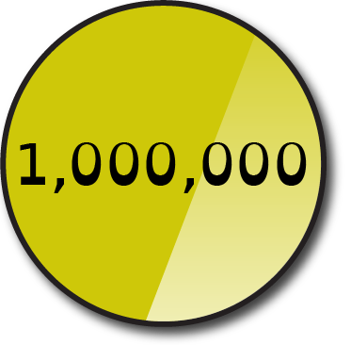

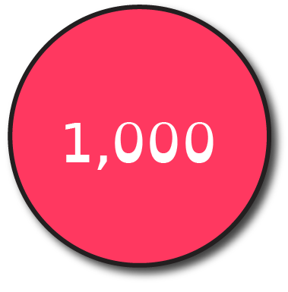
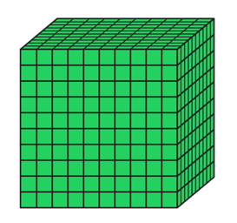
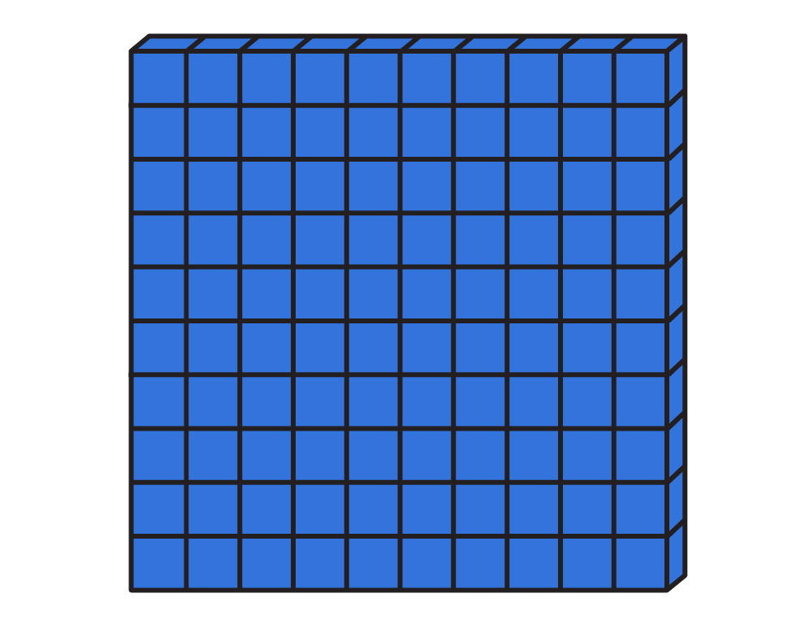
To be able to represent numbers up to ten million
Starter:
Which one doesn’t belong?
Explain your answer.
M | HTH | TTH | TH | H | T | O
one million and one thousand

Slide 4
To be able to represent numbers up to ten million
Starter:
Which one doesn’t belong?
The Base 10 pieces are the odd one out as they represent 1,100, whereas the other representations make 1,001,000
M | HTH | TTH | TH | H | T | O
one million and one thousand

Slide 5
To be able to represent numbers up to ten million
Talking Time:
Write each amount in numerals beneath its place value chart.
M | HTH | TTH | TH | H | T | O
M | HTH | TTH | TH | H | T | O
M | HTH | TTH | TH | H | T | O
M | HTH | TTH | TH | H | T | O

Slide 6
To be able to represent numbers up to ten million
Talking Time:
Write each amount in numerals beneath its place value chart.
M | HTH | TTH | TH | H | T | O
M | HTH | TTH | TH | H | T | O
30,112
M | HTH | TTH | TH | H | T | O
M | HTH | TTH | TH | H | T | O

Slide 7
To be able to represent numbers up to ten million
Talking Time:
Write each amount in numerals beneath its place value chart.
M | HTH | TTH | TH | H | T | O
M | HTH | TTH | TH | H | T | O
30,112
403,052
M | HTH | TTH | TH | H | T | O
M | HTH | TTH | TH | H | T | O

Slide 8
To be able to represent numbers up to ten million
Talking Time:
Write each amount in numerals beneath its place value chart.
M | HTH | TTH | TH | H | T | O
M | HTH | TTH | TH | H | T | O
30,112
403,052
M | HTH | TTH | TH | H | T | O
M | HTH | TTH | TH | H | T | O
1,203,055

Slide 9
To be able to represent numbers up to ten million
Talking Time:
Write each amount in numerals beneath its place value chart.
M | HTH | TTH | TH | H | T | O
M | HTH | TTH | TH | H | T | O
30,112
403,052
M | HTH | TTH | TH | H | T | O
M | HTH | TTH | TH | H | T | O
1,203,055
6,042,031

Slide 10
To be able to represent numbers up to ten million
Activity 1:
Write each amount in numerals beneath its place value chart.
M | HTH | TTH | TH | H | T | O
M | HTH | TTH | TH | H | T | O
M | HTH | TTH | TH | H | T | O
M | HTH | TTH | TH | H | T | O

Slide 11
To be able to represent numbers up to ten million
Activity 1:
Write each amount in numerals beneath its place value chart.
M | HTH | TTH | TH | H | T | O
M | HTH | TTH | TH | H | T | O
21,030
320,141
M | HTH | TTH | TH | H | T | O
M | HTH | TTH | TH | H | T | O
2,103,046
4,030,203

Slide 12
To be able to represent numbers up to ten million
Talking Time:
Make the following numbers in a place value chart…
543
forty thousand and seventeen
207,243
eight million
M | HTH | TTH | TH | H | T | O

Slide 13
To be able to represent numbers up to ten million
Talking Time:
Make the following numbers in a place value chart…
543
forty thousand and seventeen
207,243
eight million
M | HTH | TTH | TH | H | T | O

Slide 14
To be able to represent numbers up to ten million
Talking Time:
Make the following numbers in a place value chart…
543
forty thousand and seventeen
207,243
eight million
M | HTH | TTH | TH | H | T | O

Slide 15
To be able to represent numbers up to ten million
Talking Time:
Make the following numbers in a place value chart…
543
forty thousand and seventeen
207,243
eight million
M | HTH | TTH | TH | H | T | O

Slide 16
To be able to represent numbers up to ten million
Talking Time:
Make the following numbers in a place value chart…
543
forty thousand and seventeen
207,243
eight million
M | HTH | TTH | TH | H | T | O

Slide 17
To be able to represent numbers up to ten million
Talking Time:
What is the value of the underlined digit in each number?
3,570
=
33,750
=
373,570
=
7,333,570
=

Slide 18
To be able to represent numbers up to ten million
Talking Time:
What is the value of the underlined digit in each number?
3,570
=
70
33,750
=
373,570
=
7,333,570
=

Slide 19
To be able to represent numbers up to ten million
Talking Time:
What is the value of the underlined digit in each number?
3,570
=
70
33,750
=
700
373,570
=
7,333,570
=

Slide 20
To be able to represent numbers up to ten million
Talking Time:
What is the value of the underlined digit in each number?
3,570
=
70
33,750
=
700
373,570
=
70,000
7,333,570
=

Slide 21
To be able to represent numbers up to ten million
Talking Time:
What is the value of the underlined digit in each number?
3,570
=
70
33,750
=
700
373,570
=
70,000
7,333,570
=
7,000,000

Slide 22
To be able to represent numbers up to ten million
Activity 2:
What is the value of the underlined digit in each number?
5,505
=
5,555
=
555,505
=
5,050,000
=

Slide 23
To be able to represent numbers up to ten million
Activity 2:
What is the value of the underlined digit in each number?
5,505
=
5
5,555
=
500
555,505
=
50,000
5,050,000
=
0

Slide 24
To be able to represent numbers up to ten million
Activity 3:
Write the following numbers in their worded form.
Example:
4,444,444 = four million, four hundred and forty-four thousand, four hundred and forty-four
4,705 =
47,050 =
405,075 =
4,557,507 =

Slide 25
To be able to represent numbers up to ten million
Activity 3:
Write the following numbers in their worded form.
Example:
4,444,444 = four million, four hundred and forty-four thousand, four hundred and forty-four
4,705 = four thousand, seven hundred and five
47,050 = forty-seven thousand and fifty
405,075 = four hundred and five thousand and seventy-five
4,557,507 = four million, five hundred and fifty-seven thousand, five hundred and seven

Slide 26
To be able to represent numbers up to ten million
Talking Time:
Complete the part-whole models and number sentences below.
45,300 = 40,000 + 5,000 + ____
206,570 = 200,000 + ______ + 500 + ___
_______ = 400,000 + 20,000 + 700 + 3
a)
b)
23,000
320,040
20,000
300,000

Slide 27
To be able to represent numbers up to ten million
Talking Time:
Complete the part-whole models and number sentences below.
45,300 = 40,000 + 5,000 + 300
206,570 = 200,000 + 6,000 + 500 + 70
420,703 = 400,000 + 20,000 + 700 + 3
a)
b)
23,000
320,040
3,000
20,000
20,040
300,000

Slide 28
To be able to represent numbers up to ten million
Activity 4:
Complete the part-whole models and number sentences below.
56,400 = 50,000 + 6,000 + ___
105,460 = 100,000 + ______ + 400 + ___
________ = 500,000 + 10,000 + 600 + 4
a)
b)
45,000
450,090
40,000
400,000

Slide 29
To be able to represent numbers up to ten million
Activity 4:
Complete the part-whole models and number sentences below.
56,400 = 50,000 + 6,000 + 400
105,460 = 100,000 + 5,000 + 400 + 60
510,604 = 500,000 + 10,000 + 600 + 4
a)
b)
45,000
450,090
5,000
40,000
50,090
400,000

Slide 30
To be able to represent numbers up to ten million
Activity 5:
Yasmin is describing the number 3,456,789.
She says, “It has the digit 3 in the millions place, each digit increase by one as we move down to the ones place. So, there is a 4 in the hundred thousands column, 5 in the ten thousands column, 6 in the thousands column, 7 in the hundreds column, 8 in the tens column and 9 in the ones column.”
Write your own description for 8,765,432.

Slide 31
To be able to represent numbers up to ten million
Activity 5:
Yasmin is describing the number 3,456,789.
She says, “It has the digit 3 in the millions place. Each digit increases by one as we move down to the ones place. So, there is a 4 in the hundred thousands column, 5 in the ten thousands column, 6 in the thousands column, 7 in the hundreds column, 8 in the tens column and 9 in the ones column.”
Write your own description for 8,765,432.
The largest digit is in the millions place, the digit 8. After that each digit is one less than the last. So, there is a 7 in the hundred thousands place, a 6 in the ten thousands place, a 5 in the thousands place, a 4 in the hundreds place, a 3 in the tens place and a 2 in the ones place.

Slide 32
To be able to represent numbers up to ten million
Evaluation:
Write some five-digit numbers with the digit 7 in the thousands column.
What is the largest possible number you can make?
What is the smallest possible number you can make?
How many numbers can you make with a digital total of 35?
_7,___

Slide 33
To be able to represent numbers up to ten million
Evaluation:
Write some five-digit numbers with the digit 7 in the thousands column.
What is the largest possible number you can make? 97,999
What is the smallest possible number you can make? 17,000
How many numbers can you make with a digital total of 35?
Various responses, including 77,777, 67,877, 57,887…
_7,___

Slide 34
To be able to represent numbers up to ten million
Success criteria:
I can read, write and represent numbers up to ten million in various ways
I can use reasoning to explain my responses when reading, writing and representing numbers up to ten million in various ways

