Slide 1
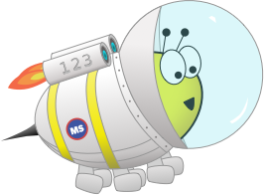
Advent CalenBAR
24th December

Slide 2
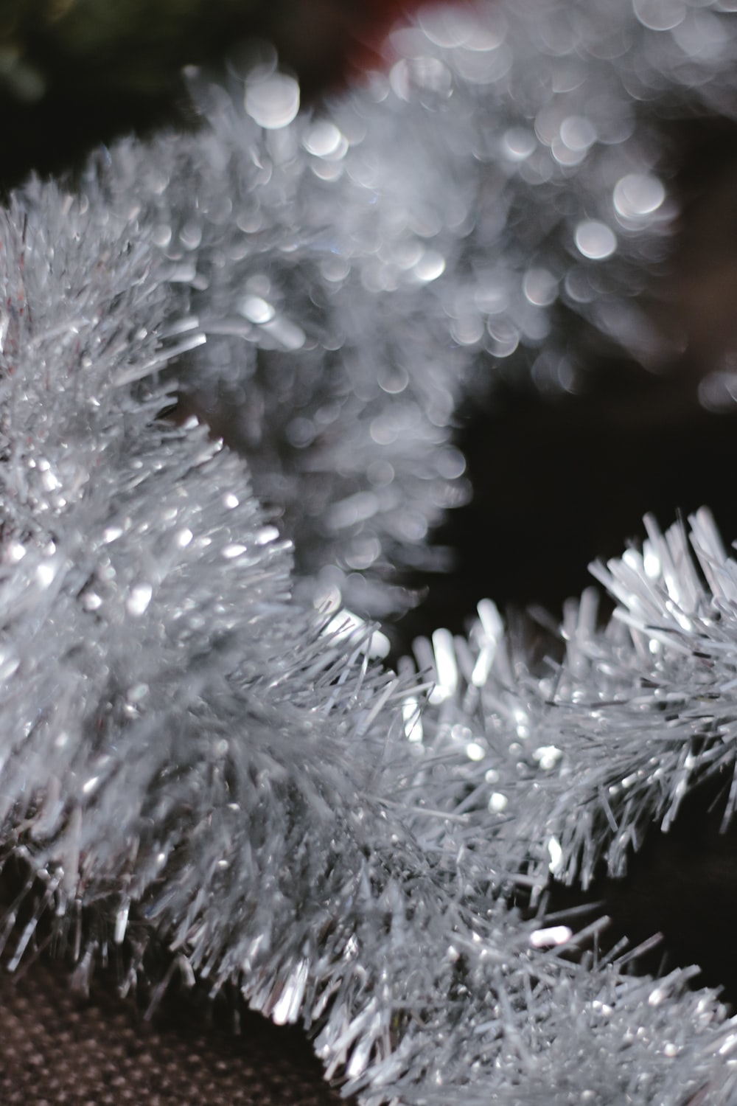
Challenge 1:
Advent CalenBAR | 24th December
Ruth and Ahmed have some lengths of tinsel to put on a Christmas tree.
Ruth’s length is 90cm long and Ahmed’s is 67cm long.
How much shorter is Ahmed’s length of tinsel compared to Ruth’s?
Bar Modelling:
Number Sentences:
© EdShed, 2020-

Slide 3
Challenge 1:
Advent CalenBAR | 24th December
Ruth and Ahmed have some lengths of tinsel to put on a Christmas tree.
Ruth’s length is 90cm long and Ahmed’s is 67cm long.
How much shorter is Ahmed’s length of tinsel compared to Ruth’s?
Bar Modelling:
Number Sentences:
Ruth
90cm
90 – 67 =
23
23cm
?
Ahmed
67cm
23
Ahmed’s length of tinsel is ____cm shorter than Ruth’s.
© EdShed, 2020-

Slide 4
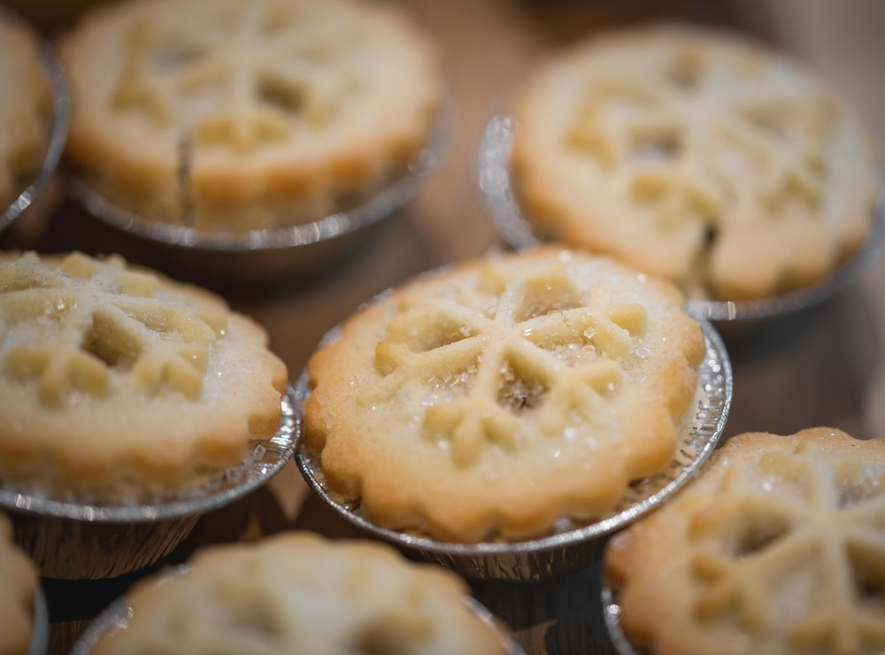
Challenge 2:
Advent CalenBAR | 24th December
Yasmin and Jamal have been baking some mince pies.
Altogether, they have baked 64 mince pies.
The difference between the number of mince pies they have baked is 14 and Yasmin has baked fewer pies than Jamal.
How many mince pies has Jamal baked?
Bar Modelling:
Number Sentences:
© EdShed, 2020-

Slide 5
Challenge 2:
Advent CalenBAR | 24th December
Yasmin and Jamal have been baking some mince pies.
Altogether, they have baked 64 mince pies.
The difference between the number of mince pies they have baked is 14 and Yasmin has baked fewer pies than Jamal.
How many mince pies has Jamal baked?
Bar Modelling:
Number Sentences:
39
?
64 – 14 =
50
Jamal
25
50 ÷ 2 =
25
50
64
14
25 + 14 =
39
Yasmin
25
Check: 39 + 25 =
64
39
Jamal has baked ____ mince pies.
© EdShed, 2020-

Slide 6
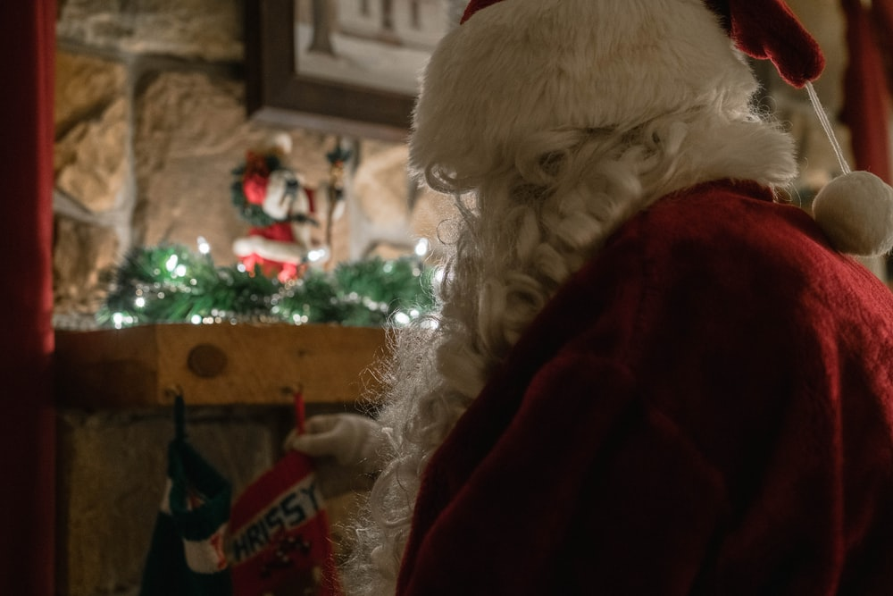
Challenge 3:
Advent CalenBAR | 24th December
There are different coloured presents in Santa’s workshop.
There are 30 more blue presents than red presents.
The number of green presents is a quarter of the number of red presents.
There are 570 presents in total.
How many red presents are there?
Bar Modelling:
Number Sentences:
© EdShed, 2020-

Slide 7
Challenge 3:
Advent CalenBAR | 24th December
There are different coloured presents in Santa’s workshop.
There are 30 more blue presents than red presents.
The number of green presents is a quarter of the number of red presents.
There are 570 presents in total.
How many red presents are there?
Bar Modelling:
Number Sentences:
570 – 30 =
540
blue
60
60
60
60
30
540 ÷ 9 =
60
30
540
red
60
60
60
60
570
60 x 4 =
240
?
240
green
60
240
There are ____ red presents.
© EdShed, 2020-

Slide 8
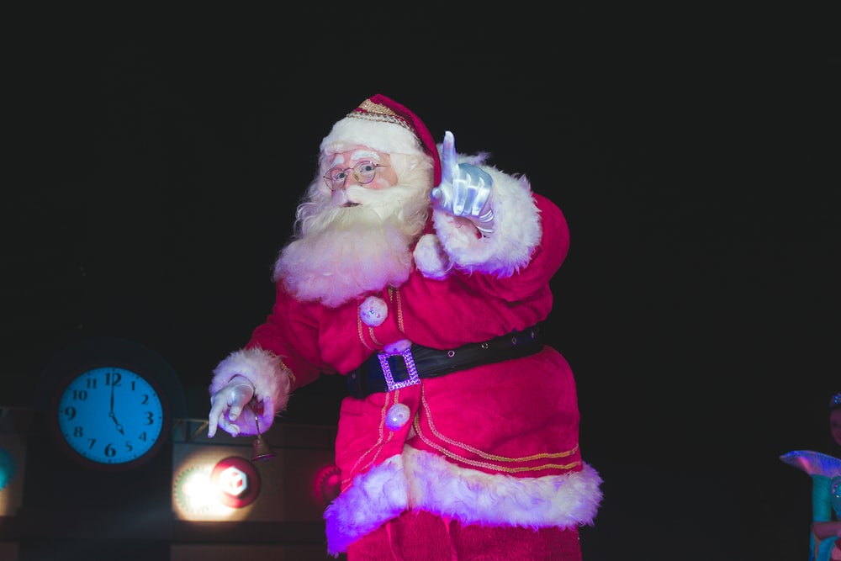
Challenge 4:
Advent CalenBAR | 24th December
Santa was running late!
He made some presents on the 22nd of December, but had to increase the number of presents he made on the 23rd of December by a quarter to keep up.
He made 615 presents on the 23rd of December. How many did he make on the 22nd of December?
Bar Modelling:
Number Sentences:
© EdShed, 2020-

Slide 9
Challenge 4:
Advent CalenBAR | 24th December
Santa was running late!
He made some presents on the 22nd of December, but had to increase the number of presents he made on the 23rd of December by a quarter to keep up.
He made 615 presents on the 23rd of December. How many did he make on the 22nd of December?
Bar Modelling:
Number Sentences:
615
615 ÷ 5 =
123
123 x 4 =
492
123
123
123
123
123
Check: 492 + 123 =
615
492
?
492
Santa made ____ presents on the 22nd of December.
© EdShed, 2020-

