Slide 1




Festive Problems
23rd December

Slide 2

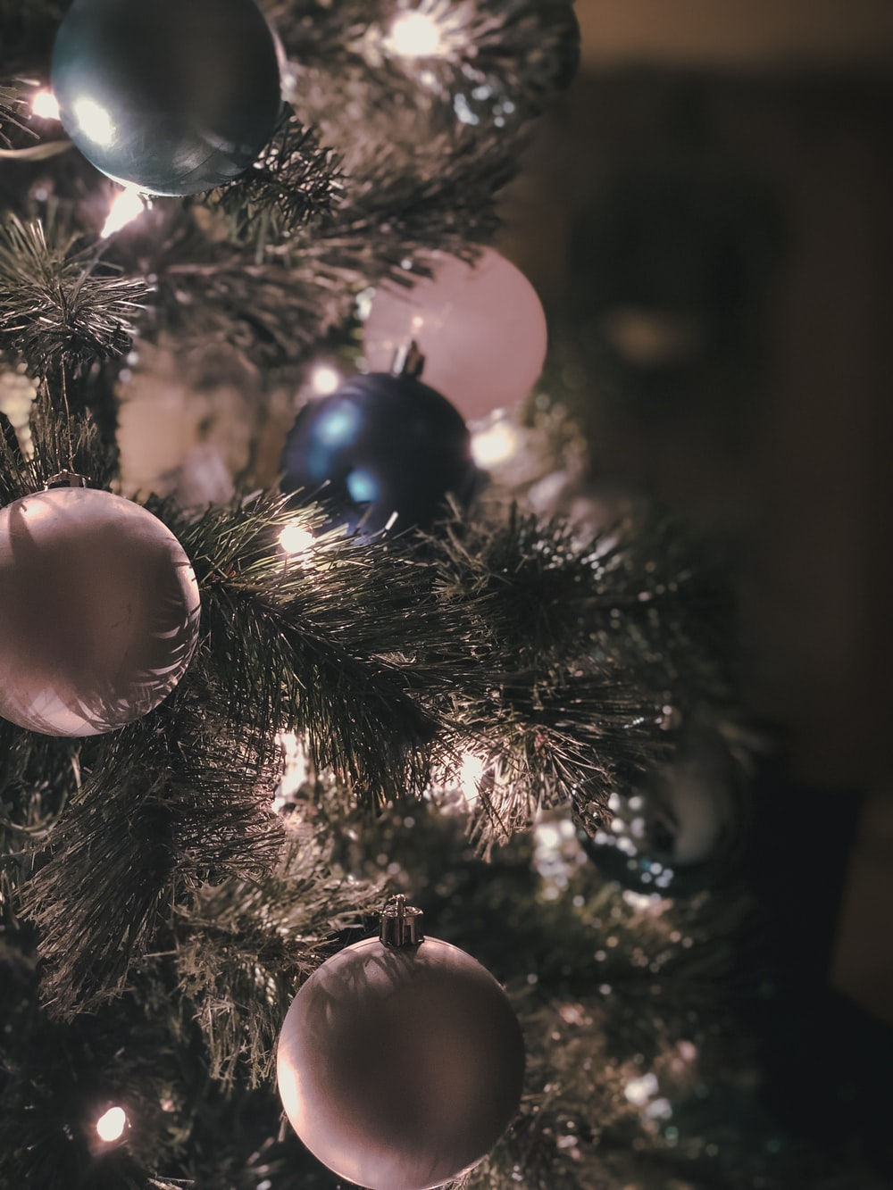
Challenge 1:
Festive Problems | 23rd December
Chen has 4 baubles to put on his Christmas tree.
Ruth has 5 times as many baubles as Chen.
How many baubles do Chen and Ruth have altogether?
Bar Modelling:
Number Sentences:
© EdShed, 2020-

Slide 3
Challenge 1:
Festive Problems | 23rd December
Chen has 4 baubles to put on his Christmas tree.
Ruth has 5 times as many baubles as Chen.
How many baubles do Chen and Ruth have altogether?
Bar Modelling:
Number Sentences:
Chen
4
4 x 5 =
20
24
20 + 4 =
24
Ruth
4
4
4
4
4
20
24
Chen and Ruth have ____ baubles altogether.
© EdShed, 2020-

Slide 4



Challenge 2:
Festive Problems | 23rd December
Ahmed buys some toys for his cousins for Christmas.
He spends $5.00 in total.
How much does the red toy ship cost?
$1.99
$1.45
Bar Modelling:
Number Sentences:
© EdShed, 2020-

Slide 5
Challenge 2:
Festive Problems | 23rd December
Ahmed buys some toys for his cousins for Christmas.
He spends $5.00 in total.
How much does the red toy ship cost?
$1.99
$1.45
Bar Modelling:
Number Sentences:
$5.00
$1.45 + $1.99 =
$3.44
$1.45
$1.99
?
$1.56
$5.00 - $3.44 =
$1.56
helicopter
plane
ship
1.56
The red toy ship costs $____.
© EdShed, 2020-

Slide 6
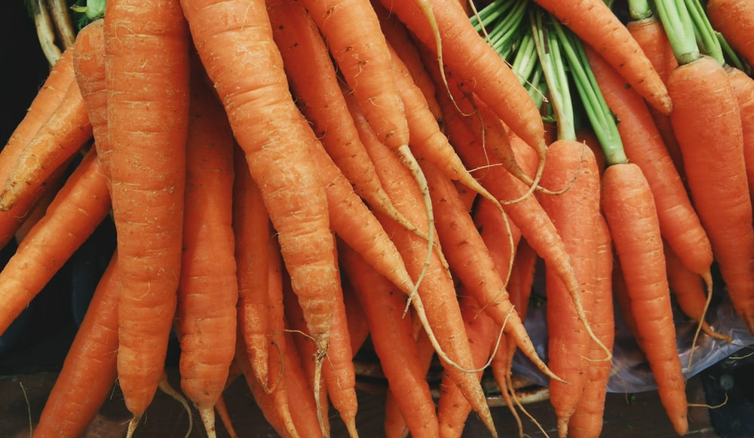
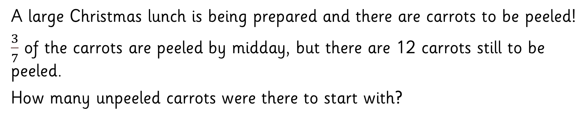
Challenge 3:
Festive Problems | 23rd December
A large Christmas lunch is being prepared and there are carrots to be peeled!
$\frac{3}{7}$ of the carrots are peeled by midday, but there are 12 carrots still to be peeled.
How many unpeeled carrots were there to start with?
Bar Modelling:
Number Sentences:
© EdShed, 2020-

Slide 7
Challenge 3:
Festive Problems | 23rd December
A large Christmas lunch is being prepared and there are carrots to be peeled!
$\frac{3}{7}$ of the carrots are peeled by midday, but there are 12 carrots still to be peeled.
How many unpeeled carrots were there to start with?
Bar Modelling:
Number Sentences:
peeled carrots
12
12 ÷ 4 =
3
3 x 7 =
21
3
3
3
3
3
3
3
21
?
21
There were ____ unpeeled carrots to start with.
© EdShed, 2020-

Slide 8

Challenge 4:
Festive Problems | 23rd December
In a Christmas sale, there is 20% off the price of Christmas jumpers.
Yasmin buys a Christmas jumper costing $24 in the sale.
How much did the jumper cost before the sale?
Bar Modelling:
Number Sentences:
© EdShed, 2020-

Slide 9
Challenge 4:
Festive Problems | 23rd December
In a Christmas sale, there is 20% off the price of Christmas jumpers.
Yasmin buys a Christmas jumper costing $24 in the sale.
How much did the jumper cost before the sale?
Bar Modelling:
Number Sentences:
$24
24 ÷ 8 =
3
3
3
3
3 x 10 =
30
10%
10%
10%
3
3
3
3
3
10%
3
10%
10%
10%
10%
10%
10%
3
$30
?
30
The jumper cost $____ before the sale.
© EdShed, 2020-

