Slide 1
Advent CalenBAR
23rd December

Slide 2
Challenge 1:
Advent CalenBAR | 23rd December
Chen has 4 baubles to put on his Christmas tree.
Ruth has 5 times as many baubles as Chen.
How many baubles do Chen and Ruth have altogether?
Bar Modelling:
Number Sentences:
© EdShed, 2020-

Slide 3
Challenge 1:
Advent CalenBAR | 23rd December
Chen has 4 baubles to put on his Christmas tree.
Ruth has 5 times as many baubles as Chen.
How many baubles do Chen and Ruth have altogether?
Bar Modelling:
Number Sentences:
Chen
4
4 x 5 =
20
24
20 + 4 =
24
Ruth
4
4
4
4
4
20
24
Chen and Ruth have ____ baubles altogether.
© EdShed, 2020-

Slide 4
Challenge 2:
Advent CalenBAR | 23rd December
Ahmed buys some toys for his cousins for Christmas.
He spends £5.00 in total.
How much does the red toy ship cost?
£1.99
£1.45
Bar Modelling:
Number Sentences:
© EdShed, 2020-

Slide 5
Challenge 2:
Advent CalenBAR | 23rd December
Ahmed buys some toys for his cousins for Christmas.
He spends £5.00 in total.
How much does the red toy ship cost?
£1.99
£1.45
Bar Modelling:
Number Sentences:
£5.00
£1.45 + £1.99 =
£3.44
£1.45
£1.99
?
£1.56
£5.00 - £3.44 =
£1.56
helicopter
plane
ship
1.56
The red toy ship costs £____.
© EdShed, 2020-

Slide 6
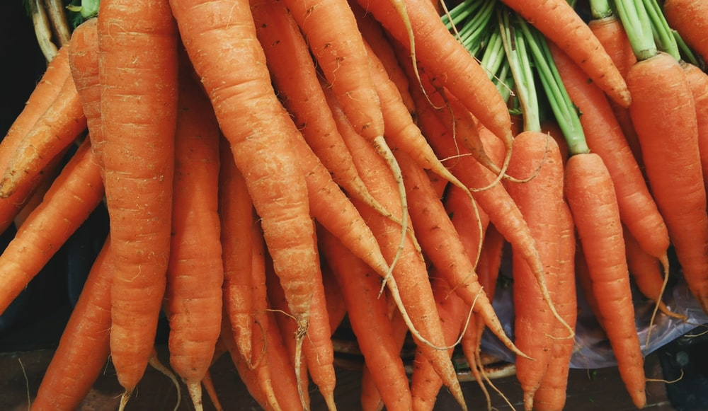
Challenge 3:
Advent CalenBAR | 23rd December
A large Christmas lunch is being prepared and there are carrots to be peeled!
$\frac{3}{7}$ of the carrots are peeled by midday, but there are 12 carrots still to be peeled.
How many unpeeled carrots were there to start with?
Bar Modelling:
Number Sentences:
© EdShed, 2020-

Slide 7
Challenge 3:
Advent CalenBAR | 23rd December
A large Christmas lunch is being prepared and there are carrots to be peeled!
$\frac{3}{7}$ of the carrots are peeled by midday, but there are 12 carrots still to be peeled.
How many unpeeled carrots were there to start with?
Bar Modelling:
Number Sentences:
peeled carrots
12
12 ÷ 4 =
3
3 x 7 =
21
3
3
3
3
3
3
3
21
?
21
There were ____ unpeeled carrots to start with.
© EdShed, 2020-

Slide 8
Challenge 4:
Advent CalenBAR | 23rd December
In a Christmas sale, there is 20% off the price of Christmas jumpers.
Yasmin buys a Christmas jumper costing £24 in the sale.
How much did the jumper cost before the sale?
Bar Modelling:
Number Sentences:
© EdShed, 2020-

Slide 9
Challenge 4:
Advent CalenBAR | 23rd December
In a Christmas sale, there is 20% off the price of Christmas jumpers.
Yasmin buys a Christmas jumper costing £24 in the sale.
How much did the jumper cost before the sale?
Bar Modelling:
Number Sentences:
£24
24 ÷ 8 =
3
3
3
3
3 x 10 =
30
10%
10%
10%
3
3
3
3
3
10%
3
10%
10%
10%
10%
10%
10%
3
£30
?
30
The jumper cost £____ before the sale.
© EdShed, 2020-

