Slide 1
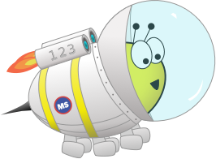
Advent CalenBAR
22nd December

Slide 2
Challenge 1:
Advent CalenBAR | 22nd December
Eve has 62 red and 37 green strips of paper to make a Christmas paper chain.
She uses 39 red strips and 16 green strips to make the paper chain.
How many more red strips than green strips does she have left?
Bar Modelling:
Number Sentences:
© EdShed, 2020-

Slide 3
Challenge 1:
Advent CalenBAR | 22nd December
Eve has 62 red and 37 green strips of paper to make a Christmas paper chain.
She uses 39 red strips and 16 green strips to make the paper chain.
How many more red strips than green strips does she have left?
Bar Modelling:
Number Sentences:
62 – 39 =
23
62
red
23
37 – 16 =
21
23 – 21 =
2
37
green
21
2
Eve has ____ more red strips than green strips left.
© EdShed, 2020-

Slide 4
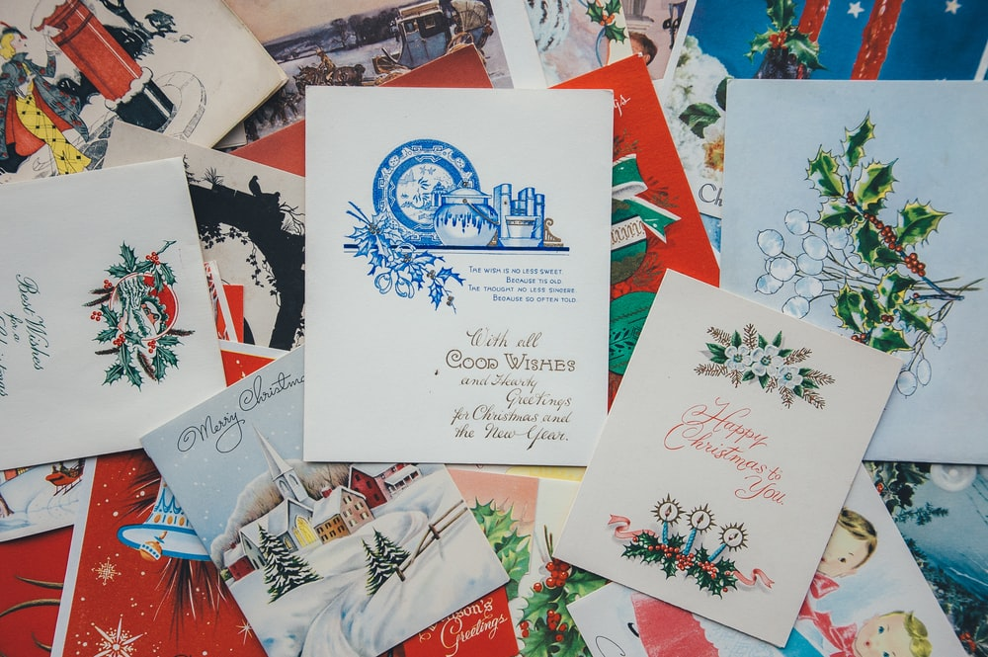
Challenge 2:
Advent CalenBAR | 22nd December
There are 36 Christmas cards in a box.
Another box contains three-quarters of the cards in the first box.
How many Christmas cards are there altogether in the two boxes?
Bar Modelling:
Number Sentences:
© EdShed, 2020-

Slide 5
Challenge 2:
Advent CalenBAR | 22nd December
There are 36 Christmas cards in a box.
Another box contains three-quarters of the cards in the first box.
How many Christmas cards are there altogether in the two boxes?
Bar Modelling:
Number Sentences:
36
36 ÷ 4 =
9
Box 1
9
9
9
9
9 x 3 =
27
Box 2
36 + 27 =
63
27
63
There are ____ cards altogether in the two boxes.
© EdShed, 2020-

Slide 6
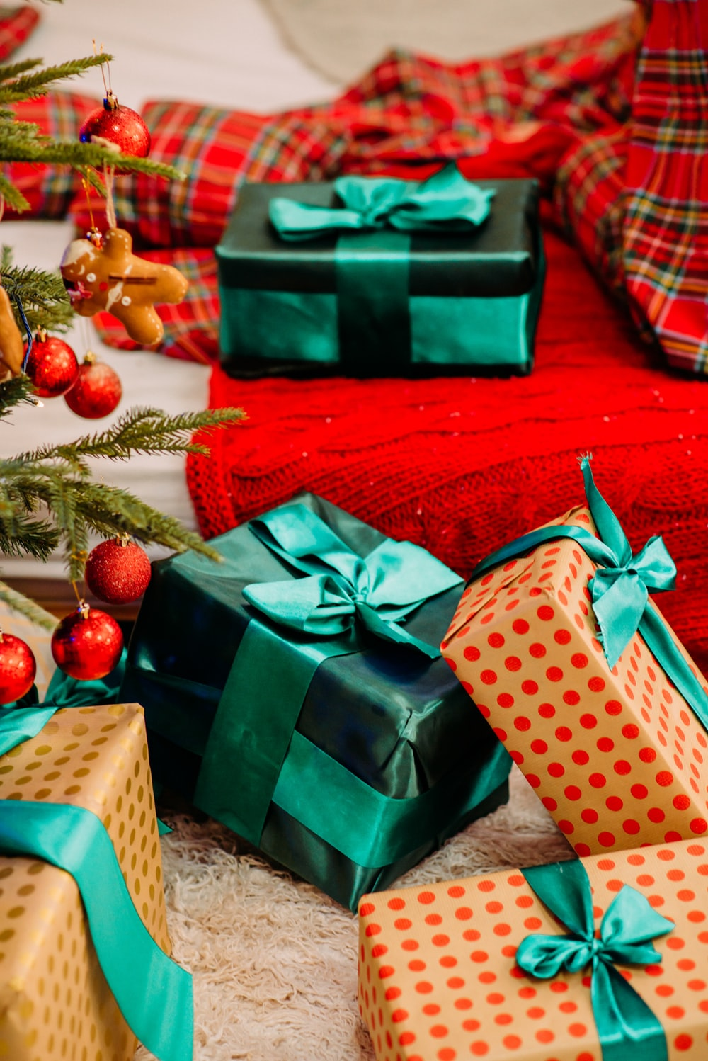
Challenge 3:
Advent CalenBAR | 22nd December
Jamal, Yasmin and Ruth have been saving money to buy presents.
Jamal and Yasmin have a total of £110; Yasmin and Ruth have a total of £160.
Ruth has 3 times as much money as Yasmin.
How much money does Jamal have?
Bar Modelling:
Number Sentences:
© EdShed, 2020-

Slide 7
Challenge 3:
Advent CalenBAR | 22nd December
Jamal, Yasmin and Ruth have been saving money to buy presents.
Jamal and Yasmin have a total of £110; Yasmin and Ruth have a total of £160.
Ruth has 3 times as much money as Yasmin.
How much money does Jamal have?
Bar Modelling:
Number Sentences:
£160 ÷ 4 =
£40
?
Jamal
£70
£110
£110 - £40 =
£70
Yasmin
£40
£160
Ruth
£40
£40
£40
70
Jamal has £____.
© EdShed, 2020-

Slide 8
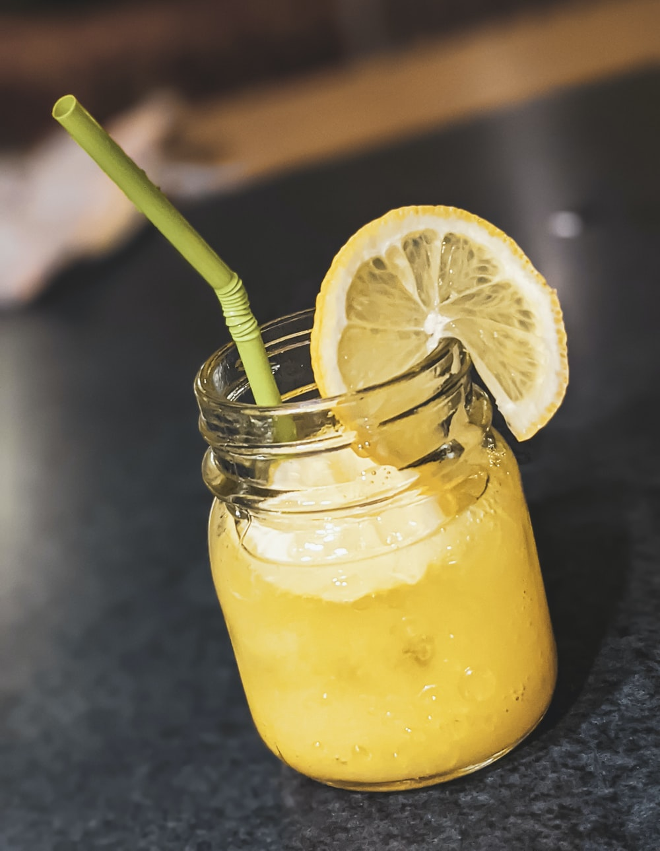
Challenge 4:
Advent CalenBAR | 22nd December
James and his sister each like to leave out some lemonade for Santa to drink. They have 0.5l of lemonade in a bottle.
James’ sister pours 170ml into a glass; James pours some into a glass, too. 20% of the lemonade in the bottle is left.
How much lemonade did James pour into his glass?
Bar Modelling:
Number Sentences:
© EdShed, 2020-

Slide 9
Challenge 4:
Advent CalenBAR | 22nd December
James and his sister each like to leave out some lemonade for Santa to drink. They have 0.5l of lemonade in a bottle.
James’ sister pours 170ml into a glass; James pours some into a glass, too. 20% of the lemonade in the bottle is left.
How much lemonade did James pour into his glass?
Bar Modelling:
500ml
Number Sentences:
20% of 500ml =
100ml
?
170ml
230ml
100ml
170ml + 100ml =
270ml
James’ sister’s glass
James’ glass
20%
500ml - 270ml =
230ml
230
James poured ____ml into his glass.
© EdShed, 2020-

