Slide 1
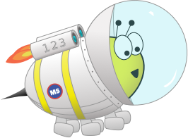
Festive Problems
21st December

Slide 2
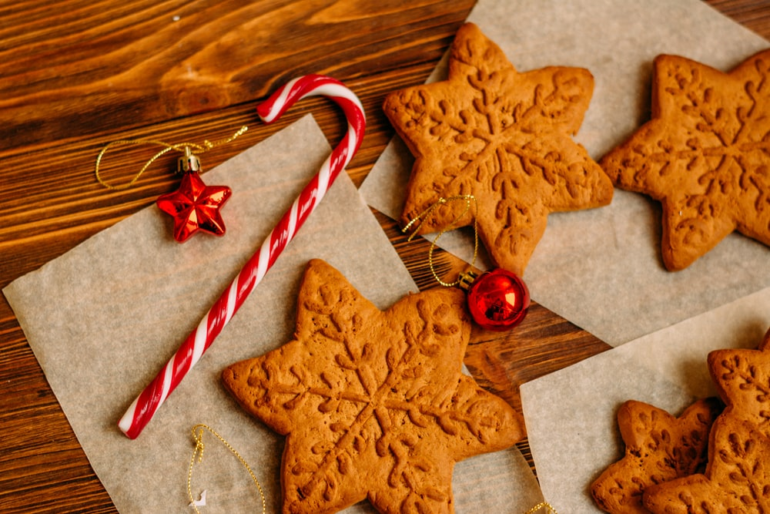
Challenge 1:
Festive Problems | 21st December
Yasmin is baking gingerbread biscuits.
She can bake six biscuits in 15 minutes.
How many can she bake in one hour (60 minutes)?
Bar Modelling:
Number Sentences:
© EdShed, 2020-

Slide 3
Challenge 1:
Festive Problems | 21st December
Yasmin is baking gingerbread biscuits.
She can bake six biscuits in 15 minutes.
How many can she bake in one hour (60 minutes)?
Bar Modelling:
Number Sentences:
Number of biscuits baked
60 ÷ 15 =
4
6
6
6
6
6 x 4 =
24
60 minutes
24
Yasmin can bake ____ biscuits in one hour.
© EdShed, 2020-

Slide 4
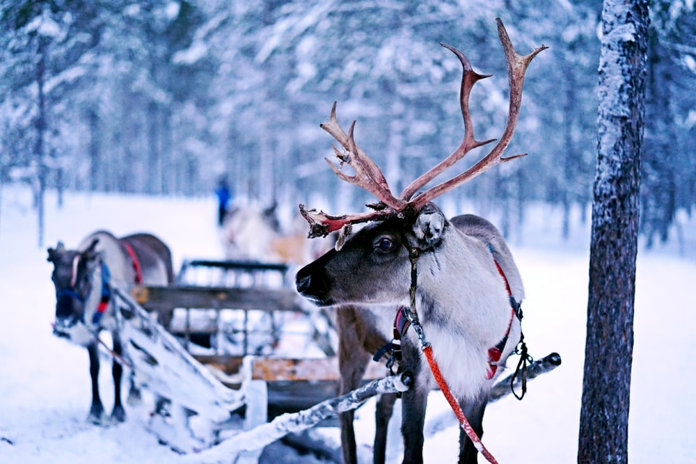
Challenge 2:
Festive Problems | 21st December
Santa is giving carrots to his reindeer.
He accidentally gives Prancer six times as many carrots as Cupid, so he decides to give Cupid some of Prancer’s carrots. They now have the same amount of carrots.
What fraction of Prancer’s carrots did Santa give Cupid?
Bar Modelling:
Number Sentences:
© EdShed, 2020-

Slide 5
Challenge 2:
Festive Problems | 21st December
Santa is giving carrots to his reindeer.
He accidentally gives Prancer six times as many carrots as Cupid, so he decides to give Cupid some of Prancer’s carrots. They now have the same amount of carrots.
What fraction of Prancer’s carrots did Santa give Cupid?
Bar Modelling:
Number Sentences:
Sometimes bar models speak louder than sentences! ☺
Cupid
Prancer
$$\frac{5}{12}$$
$$\frac{5}{12}$$
Cupid is given ____ of Prancer’s carrots.
© EdShed, 2020-

Slide 6
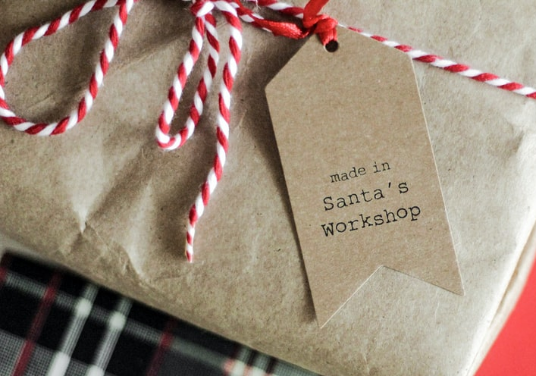
Challenge 3:
Festive Problems | 21st December
Yesterday, Santa made six small identical presents and seven large identical presents. The total weight of the presents was 54kg.
Each large present weighed 6kg.
How much did each small present weigh?
Bar Modelling:
Number Sentences:
© EdShed, 2020-

Slide 7
Challenge 3:
Festive Problems | 21st December
Yesterday, Santa made six small identical presents and seven large identical presents. The total weight of the presents was 54kg.
Each large present weighed 6kg.
How much did each small present weigh?
Bar Modelling:
42kg
Number Sentences:
6kg x 7 =
42kg
large
6
6
6
6
6
6
6
54kg
54kg – 42kg =
12kg
small
2
2
2
2
2
2
12kg ÷ 6 =
2kg
12kg
2
Each small present weighed ____kg.
© EdShed, 2020-

Slide 8
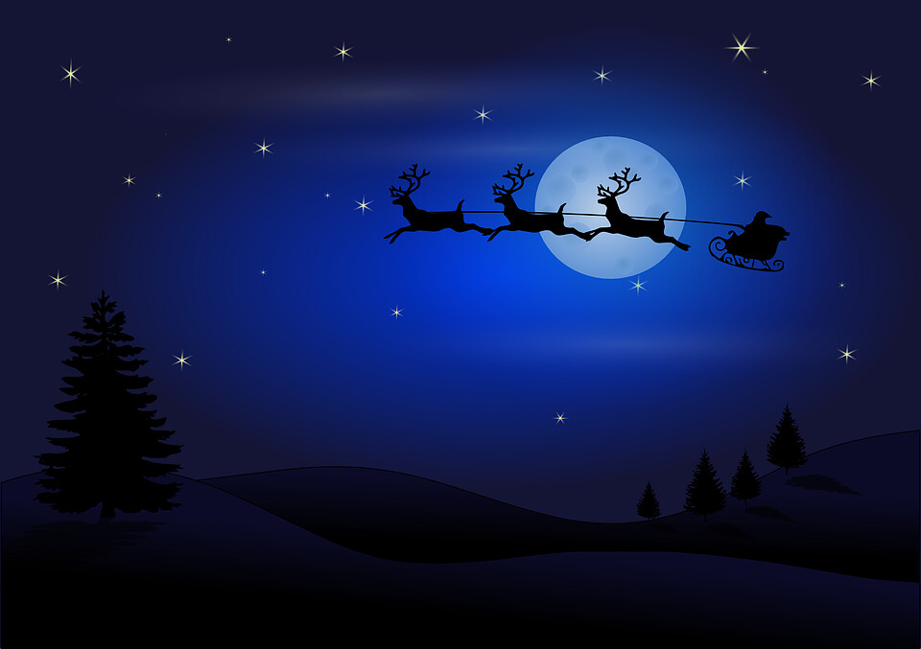
Challenge 4:
Festive Problems | 21st December
Santa’s reindeer have been practising pulling the sleigh ready for Christmas.
Over four days, they have travelled 648km; each day, they travelled 14km further than the previous day.
How far did they travel on the third day?
Bar Modelling:
Number Sentences:
© EdShed, 2020-

Slide 9
Challenge 4:
Festive Problems | 21st December
Santa’s reindeer have been practising pulling the sleigh ready for Christmas.
Over four days, they have travelled 648km; each day, they travelled 14km further than the previous day.
How far did they travel on the third day?
Bar Modelling:
Number Sentences:
14
14 x 6 =
84
day 1
141
648 – 84 =
564
14
day 2
141
14
564
564 ÷ 4 =
141
648km
14
141 + 14 + 14 =
169
day 3
141
14
14
day 4
141
14
14
14
169
The reindeer travelled ____km on the third day.
© EdShed, 2020-

