Slide 1
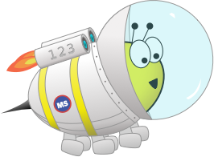
Advent CalenBAR
20th December

Slide 2
Challenge 1:
Advent CalenBAR | 20th December
Eve and Jamal have been given some money to buy presents.
Eve has £24. She spends £7 on a present and, as a result, has £5 less than Jamal.
How much money does Jamal have?
Bar Modelling:
Number Sentences:
© EdShed, 2020-

Slide 3
Challenge 1:
Advent CalenBAR | 20th December
Eve and Jamal have been given some money to buy presents.
Eve has £24. She spends £7 on a present and, as a result, has £5 less than Jamal.
How much money does Jamal have?
Bar Modelling:
£24
Number Sentences:
£24 - £7 =
£17
Eve
£17
£7
£5
£17 + £5 =
£22
Jamal
£22
£22
Jamal has ____.
© EdShed, 2020-

Slide 4
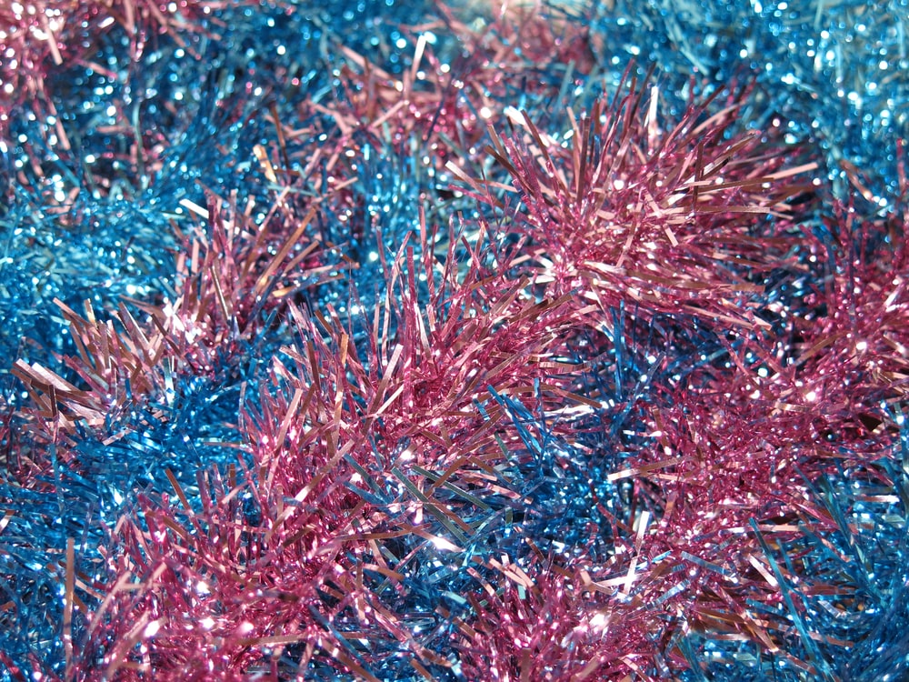
Challenge 2:
Advent CalenBAR | 20th December
A Christmas tree bauble costs half the price of a length of tinsel.
The total cost of both items is 126p.
How much does the length of tinsel cost?
Bar Modelling:
Number Sentences:
© EdShed, 2020-

Slide 5
Challenge 2:
Advent CalenBAR | 20th December
A Christmas tree bauble costs half the price of a length of tinsel.
The total cost of both items is 126p.
How much does the length of tinsel cost?
Bar Modelling:
Number Sentences:
126p ÷ 3 =
42p
bauble
42p
126p
42p x 2 =
84p
tinsel
42p
42p
84p
The length of tinsel costs ____.
© EdShed, 2020-

Slide 6
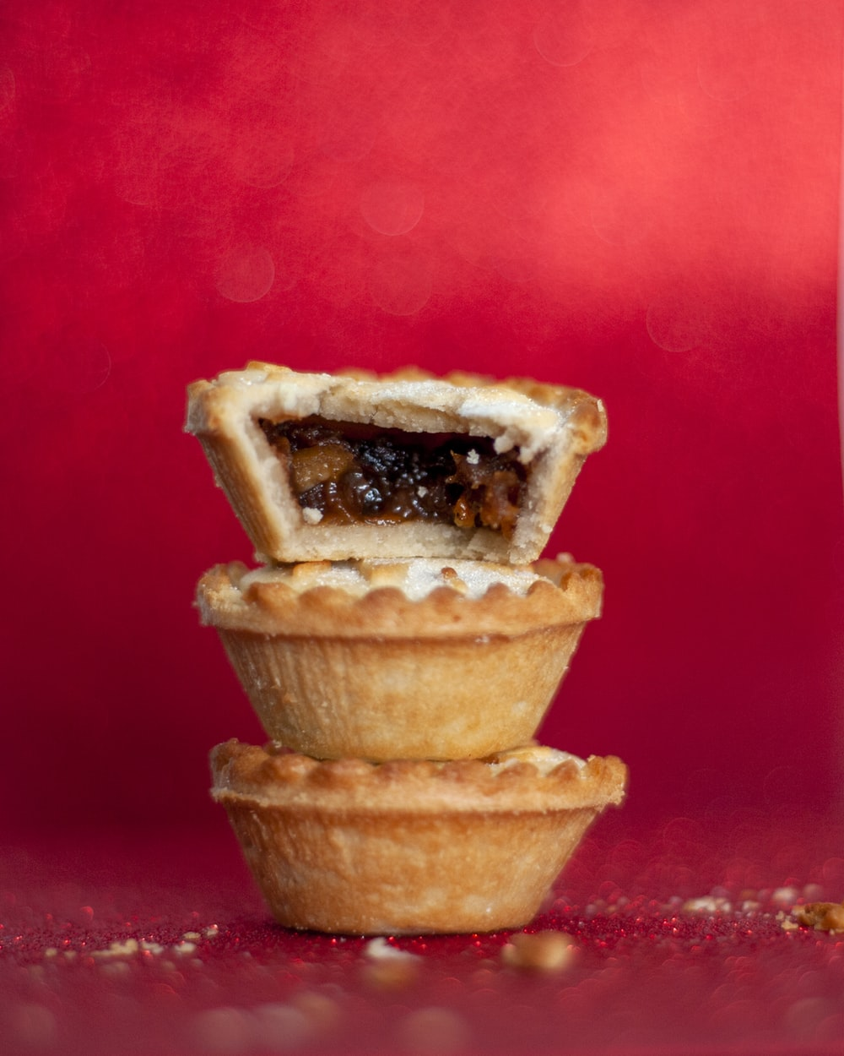
Challenge 3:
Advent CalenBAR | 20th December
Ruth, James and Ahmed are having Christmas parties and have bought some mince pies together.
Ruth takes one-third of the pies and James takes one-ninth. Ahmed has the rest.
Ruth has 4 more pies than James.
How many pies does Ahmed have?
Bar Modelling:
Number Sentences:
© EdShed, 2020-

Slide 7
Challenge 3:
Advent CalenBAR | 20th December
Ruth, James and Ahmed are having Christmas parties and have bought some mince pies together.
Ruth takes one-third of the pies and James takes one-ninth. Ahmed has the rest.
Ruth has 4 more pies than James.
How many pies does Ahmed have?
Bar Modelling:
Number Sentences:
Ruth’s share is worth two blocks more than James’ share.
mince pies
2
2
2
2
2
2
2
2
2
4 ÷ 2 =
2
5 x 2 =
10
Ruth
Ahmed
James
10
Ahmed has ____ mince pies.
© EdShed, 2020-

Slide 8
Challenge 4:
Advent CalenBAR | 20th December
A box contains 9 presents.
The mass of the box and presents is 2,450g.
4 presents are taken out of the box and the mass of the box and presents is now 2,418g.
What is the mass of the box?
Bar Modelling:
Number Sentences:
© EdShed, 2020-

Slide 9
Challenge 4:
Advent CalenBAR | 20th December
A box contains 9 presents.
The mass of the box and presents is 2,450g.
4 presents are taken out of the box and the mass of the box and presents is now 2,418g.
What is the mass of the box?
Bar Modelling:
72g
Number Sentences:
2,450g – 2,418g =
32g
box
8
8
8
8
8
8
8
8
8
32g ÷ 4 =
8g
8g x 9 =
72g
presents taken out
2,450g – 72g =
2,378g
2,378
The box weighs ______g.
© EdShed, 2020-

