Slide 1
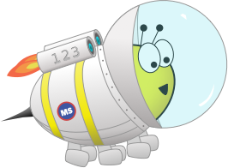
Advent CalenBAR
19th December

Slide 2
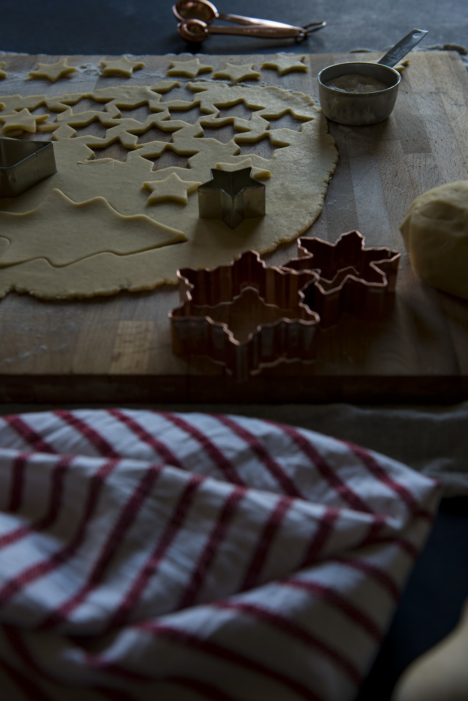
Challenge 1:
Advent CalenBAR | 19th December
James has baked some biscuits. He has 18 altogether.
He decides to give 3 to each of his 4 friends.
How many does he keep for himself?
Bar Modelling:
Number Sentences:
© EdShed, 2020-

Slide 3
Challenge 1:
Advent CalenBAR | 19th December
James has baked some biscuits. He has 18 altogether.
He decides to give 3 to each of his 4 friends.
How many does he keep for himself?
Bar Modelling:
Number Sentences:
3 x 4 =
12
18
3
3
3
3
18 – 12 =
6
6
6
James has kept ____ biscuits for himself.
© EdShed, 2020-

Slide 4
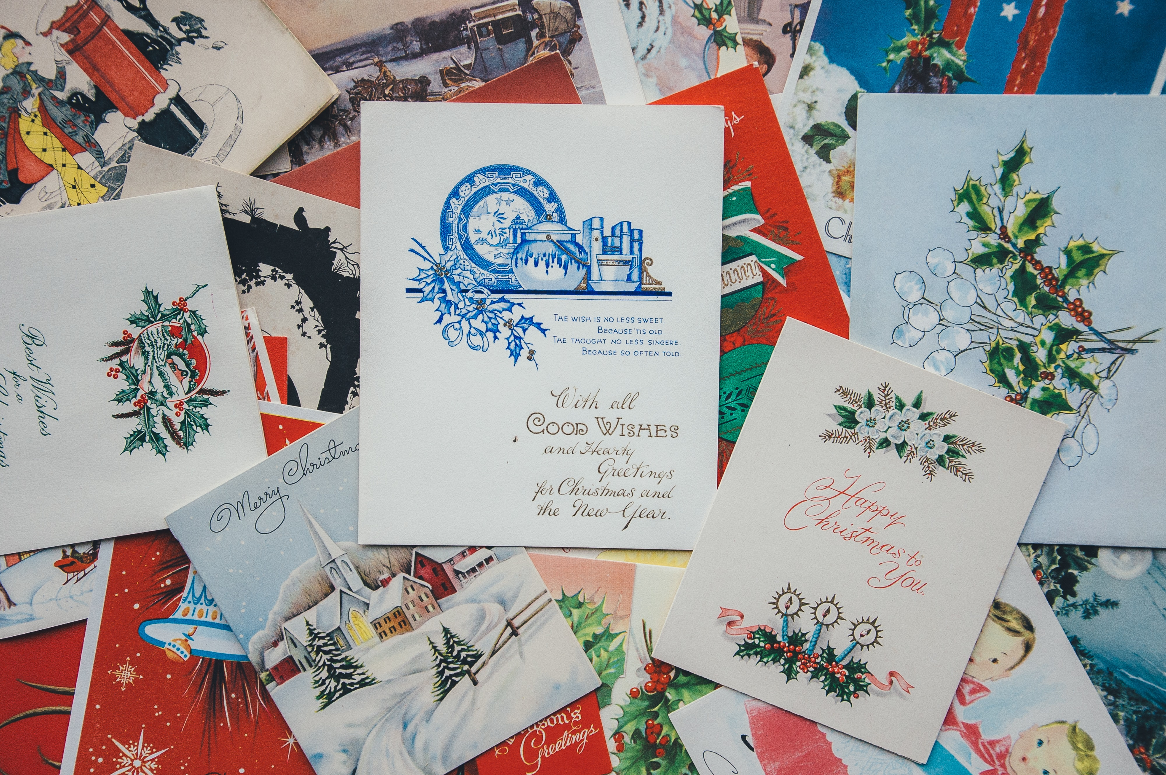
Challenge 2:
Advent CalenBAR | 19th December
On Monday, Eve received 12 Christmas cards. That same day, Jamal received 7 more cards than Eve and Ruth was given 8 fewer cards than Eve.
How many cards did the children receive altogether?
Bar Modelling:
Number Sentences:
© EdShed, 2020-

Slide 5
Challenge 2:
Advent CalenBAR | 19th December
On Monday, Eve received 12 Christmas cards. That same day, Jamal received 7 more cards than Eve and Ruth was given 8 fewer cards than Eve.
How many cards did the children receive altogether?
Bar Modelling:
Number Sentences:
Eve
12
12 – 8 =
4
Jamal
12
7
12 + 12 =
24
7 + 4 =
11
Ruth
4
8
24 + 11 =
35
35
The children had ____ cards altogether.
© EdShed, 2020-

Slide 6
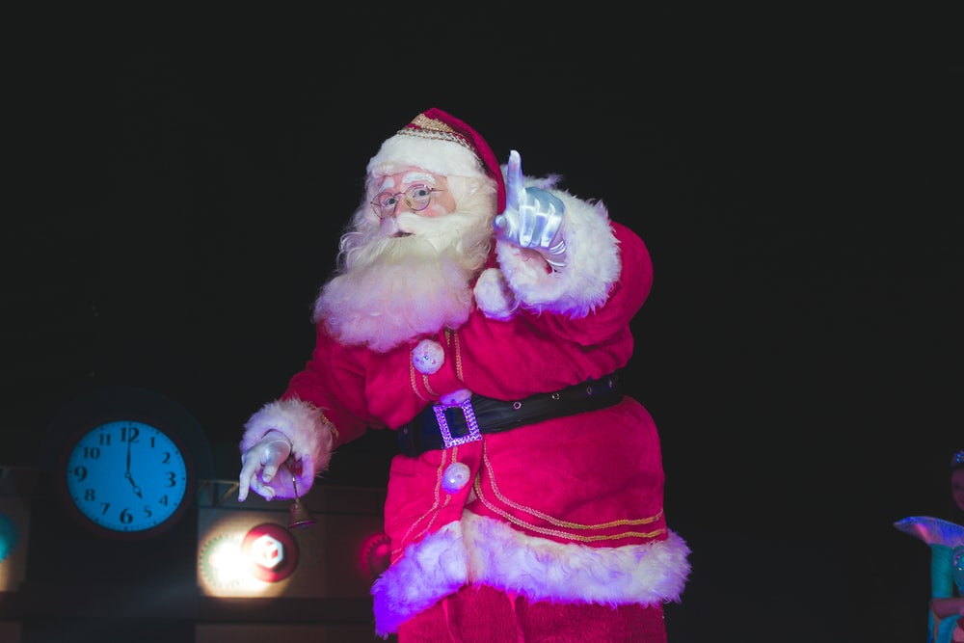
Challenge 3:
Advent CalenBAR | 19th December
Santa fills a sack with carrots and weighs it. Its mass is 640g.
He then takes an identical sack and fills it with presents. Its mass is 920g.
The carrots weigh half as much as the presents.
How much does each sack weigh?
Bar Modelling:
Number Sentences:
© EdShed, 2020-

Slide 7
Challenge 3:
Advent CalenBAR | 19th December
Santa fills a sack with carrots and weighs it. Its mass is 640g.
He then takes an identical sack and fills it with presents. Its mass is 920g.
The carrots weigh half as much as the presents.
How much does each sack weigh?
Bar Modelling:
Number Sentences:
carrots
360g
280g
920g – 640g =
280g
280g
640g
360g
640g – 280g =
presents
360g
920g
360
Each sack weighs ____g.
© EdShed, 2020-

Slide 8
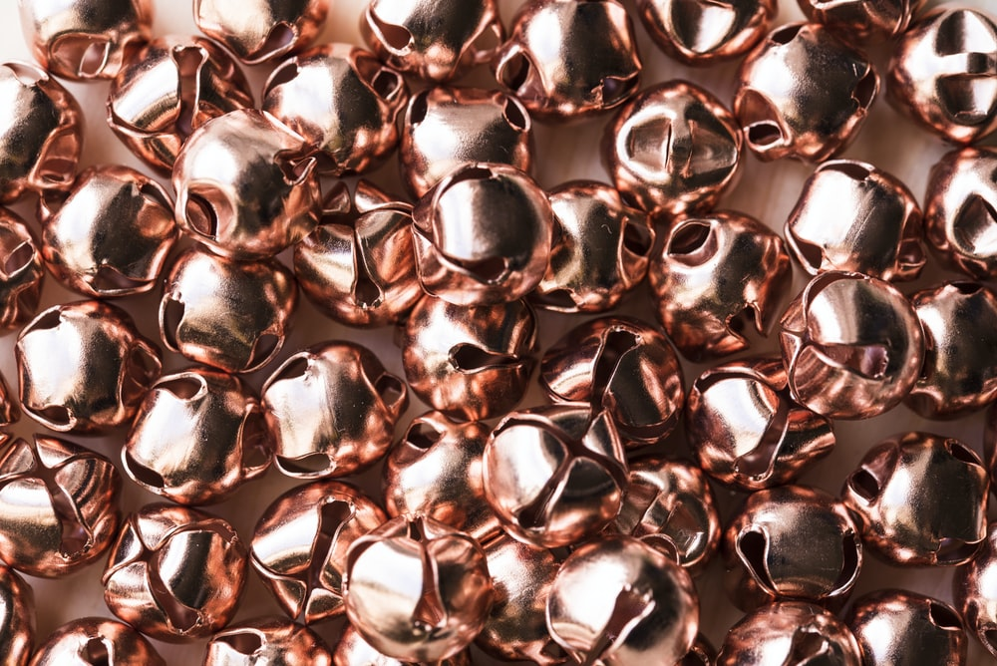
Challenge 4:
Advent CalenBAR | 19th December
Chen has 5 bags of sweets and 4 individual sweets to give to his class. Yasmin has 2 bags of sweets and 22 individual sweets to share out.
They both have the same number of sweets to give out.
How many sweets does each child give?
Bar Modelling:
Number Sentences:
© EdShed, 2020-

Slide 9
Challenge 4:
Advent CalenBAR | 19th December
Chen has 5 bags of sweets and 4 individual sweets to give to his class. Yasmin has 2 bags of sweets and 22 individual sweets to share out.
They both have the same number of sweets to give out.
How many sweets does each child give?
18
Bar Modelling:
Number Sentences:
6
6
6
6
6
22 – 4 =
18
Chen
4
18 ÷ 3 =
6
Yasmin
18
22
4
(6 x 5) + 4 =
34
22
34
Each child gives____ sweets.
© EdShed, 2020-

