Slide 1




Festive Problems
18th December

Slide 2


Challenge 1:
Festive Problems | 18th December
A small Christmas tree weighs half as much as a large tree.
The total mass of a small and large Christmas tree is 33kg.
What is the mass of a large Christmas tree?
S
L
Bar Modelling:
Number Sentences:
© EdShed, 2020-

Slide 3
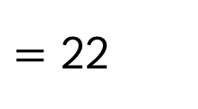

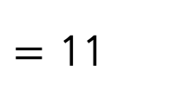

Challenge 1:
Festive Problems | 18th December
A small Christmas tree weighs half as much as a large tree.
The total mass of a small and large Christmas tree is 33kg.
What is the mass of a large Christmas tree?
S
L
Bar Modelling:
Number Sentences:
33 $÷$ 3
$=$ 11
33kg
22kg
small
11kg
11kg
11kg
large
large
large
2 $×$ 11
$=$ 22
22
The mass of a large Christmas tree is ____kg.
© EdShed, 2020-

Slide 4
Challenge 2:
Festive Problems | 18th December
Ahmed, Chen and Yasmin are sharing some satsumas.
Ahmed has a quarter of the satsumas, Chen has one twelfth of the satsumas and Yasmin has the rest of the satsumas. Ahmed has 18 more satsumas than Chen.
How many satsumas does Yasmin have?
Bar Modelling:
Number Sentences:
© EdShed, 2020-

Slide 5
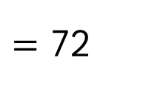
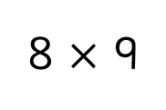
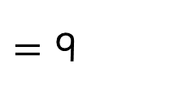

Challenge 2:
Festive Problems | 18th December
Ahmed, Chen and Yasmin are sharing some satsumas.
Ahmed has a quarter of the satsumas, Chen has one twelfth of the satsumas and Yasmin has the rest of the satsumas. Ahmed has 18 more satsumas than Chen.
How many satsumas does Yasmin have?
Bar Modelling:
Number Sentences:
total number of satsumas
18 $÷$ 2
$=$ 9
9
9
9
9
9
9
9
9
9
9
9
9
8 $×$ 9
$=$ 72
Ahmed
Chen
Yasmin
Yasmin has ____ satsumas.
© EdShed, 2020-

Slide 6
Challenge 3:
Festive Problems | 18th December
Ruth and Jamal are buying gingerbread.
Ruth has 160 gingerbread and Jamal has 64 gingerbread.
Ruth gives Jamal some of her gingerbread.
Jamal now has 14 more gingerbread than Ruth.
How many gingerbread did Ruth give to Jamal?
Bar Modelling:
Number Sentences:
© EdShed, 2020-

Slide 7
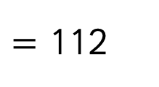

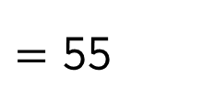
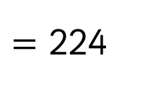


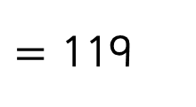

Challenge 3:
Festive Problems | 18th December
Ruth and Jamal are buying gingerbread.
Ruth has 160 gingerbread and Jamal has 64 gingerbread.
Ruth gives Jamal some of her gingerbread.
Jamal now has 14 more gingerbread than Ruth.
How many gingerbread did Ruth give to Jamal?
Bar Modelling:
Number Sentences:
160 $+$ 64
$=$ 224
?
224
224 $÷$ 2
$=$ 112
160
64
224
112 $+$ 7
$=$ 119
?
112
?
112
119 $−$ 64
$=$ 55
55
Ruth gave Jamal ____ gingerbread.
© EdShed, 2020-

Slide 8


Challenge 4:
Festive Problems | 18th December
Santa has 240 toy boats and planes to give as gifts.
He gives away 87 of the boats and 20% of the planes.
He now has the same amount of boats and planes.
How many planes did he have to give as gifts originally?
Bar Modelling:
Number Sentences:
© EdShed, 2020-

Slide 9

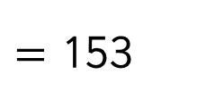

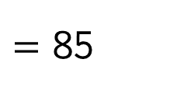

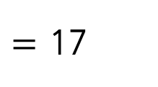
Challenge 4:
Festive Problems | 18th December
Santa has 240 toy boats and planes to give as gifts.
He gives away 87 of the boats and 20% of the planes.
He now has the same amount of boats and planes.
How many planes did he have to give as gifts originally?
Bar Modelling:
Number Sentences:
240 $−$ 87
$=$ 153
17
17
17
17
boats
?
?
?
?
87
153 $÷$ 9
$=$ 17
240
153
5 $×$ 17
$=$ 85
17
17
17
17
17
planes
?
?
?
?
?
85
?
85
Santa had ____ toy planes to give away originally.
© EdShed, 2020-

