Slide 1




Advent CalenBAR
17th December

Slide 2

Challenge 1:
Advent CalenBAR | 17th December
Jamal and Ahmed have the same amount of chocolate sauce.
Jamal has 19L. If he pours 6L on to some cakes, he will have 8L less than Ahmed.
How much chocolate sauce has Ahmed made?
Bar Modelling:
Number Sentences:
© EdShed, 2020-

Slide 3
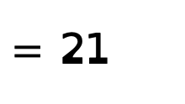
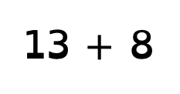
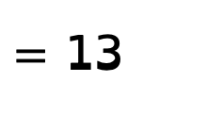
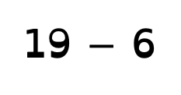
Challenge 1:
Advent CalenBAR | 17th December
Jamal and Ahmed have the same amount of chocolate sauce.
Jamal has 19L. If he pours 6L on to some cakes, he will have 8L less than Ahmed.
How much chocolate sauce has Ahmed made?
Bar Modelling:
Number Sentences:
19 $−$ 6
$=$ 13
19L
6L
13L
?
13 $+$ 8
$=$ 21
?
21L
13L
8L
21
Ahmed has made ____L of chocolate sauce.
© EdShed, 2020-

Slide 4
Challenge 2:
Advent CalenBAR | 17th December
Chen has made a Christmas cake.
He gives half of the cake to his brother.
His sister eats a fifth of the cake.
What fraction of the cake is left?
Bar Modelling:
Number Sentences:
© EdShed, 2020-

Slide 5
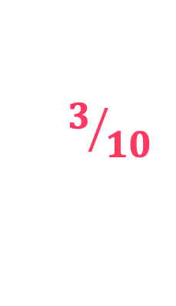
Challenge 2:
Advent CalenBAR | 17th December
Chen has made a Christmas cake.
He gives half of the cake to his brother.
His sister eats a fifth of the cake.
What fraction of the cake is left?
Bar Modelling:
Number Sentences:
Christmas cake
Sometimes bar models speak lounder than sentences! ☺
brother
sister
$$3/{10}$$
Chen has ____ of his Christmas cake left.
© EdShed, 2020-

Slide 6
Challenge 3:
Advent CalenBAR | 17th December
Santa has three sacks of cool for the naughty listers.
Put together, he has a total mass of 195kg of coal.
The first sack has a mass of 92kg.
The second sack is half as heavy as the first sack.
What is the mass of Santa’s third sack of coal?
Bar Modelling:
Number Sentences:
© EdShed, 2020-

Slide 7
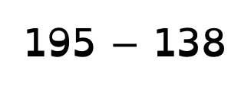

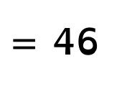

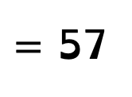
Challenge 3:
Advent CalenBAR | 17th December
Santa has three sacks of cool for the naughty listers.
Put together, he has a total mass of 195kg of coal.
The first sack has a mass of 92kg.
The second sack is half as heavy as the first sack.
What is the mass of Santa’s third sack of coal?
Bar Modelling:
Number Sentences:
92 $÷$ 2
$=$ 46
92kg
1st sack
46kg
46kg
92 + 46
$=$ 138
2nd sack
46kg
195
3rd sack
57kg
195 $−$ 138
$=$ 57
57
The third sack of coal has a mass of _____kg.
© EdShed, 2020-

Slide 8
Challenge 4:
Advent CalenBAR | 17th December
A bag of gingerbread weighs two fifths as much as a box of mince pies. 3 bags of gingerbread and 2 boxes of mince pies weigh 6.88kg.
How much would 1 bag of gingerbread and 1 box of mince pies weigh?
Bar Modelling:
Number Sentences:
© EdShed, 2020-

Slide 9
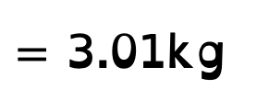

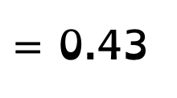

Challenge 4:
Advent CalenBAR | 17th December
A bag of gingerbread weighs two fifths as much as a box of mince pies. 3 bags of gingerbread and 2 boxes of mince pies weigh 6.88kg.
How much would 1 bag of gingerbread and 1 box of mince pies weigh?
Bar Modelling:
Number Sentences:
6.88 $÷$ 16
$=$ 0.43
mince pies
0.43
0.43
0.43
0.43
0.43
3.01kg
?
gingerbread
0.43
0.43
7 $×$ 0.43
$=$ 3.01kg
mince pies
0.43
0.43
0.43
0.43
0.43
0.43
0.43
0.43
0.43
0.43
6.88kg
gingerbread
0.43
0.43
0.43
0.43
0.43
0.43
3.01
1 bag of gingerbread and 1 box of mince pies weigh ______kg.
© EdShed, 2020-

