Slide 1




Advent CalenBAR
15th December

Slide 2
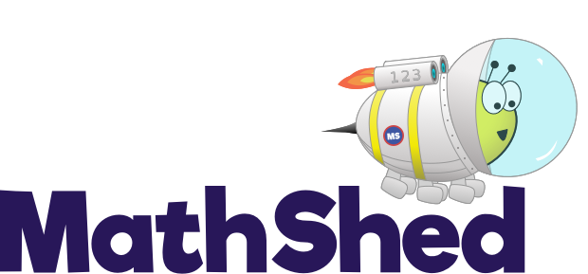
Challenge 1:
Advent CalenBAR | 15th December
Santa has some hats.
¼ of his hats are shown below.
How many hats does Santa have in total?
Bar Modelling:
Number Sentences:
© EdShed, 2020-

Slide 3

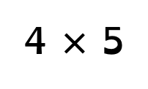
Challenge 1:
Advent CalenBAR | 15th December
Santa has some hats.
¼ of his hats are shown below.
How many hats does Santa have in total?
Bar Modelling:
Number Sentences:
4 $×$ 5
$=$ 20
20
?
5
5
5
5
?
?
?
?
20
Santa has ____ hats in total.
© EdShed, 2020-

Slide 4
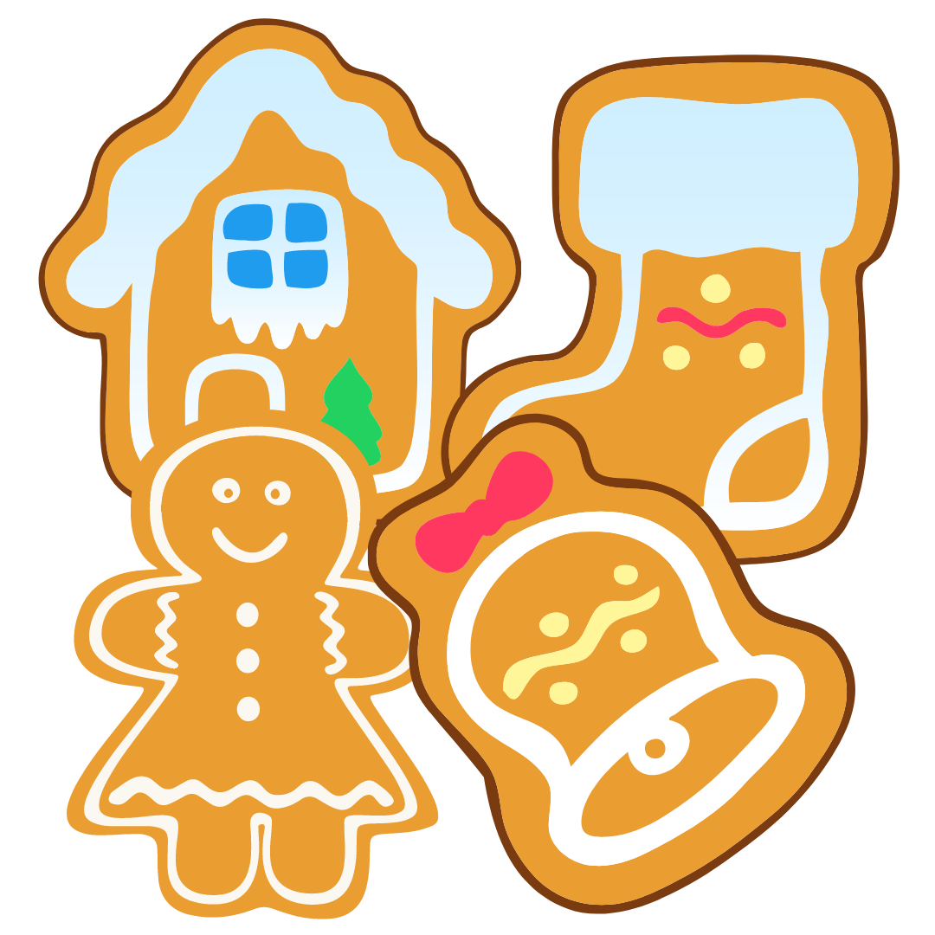
Challenge 2:
Advent CalenBAR | 15th December
Jamal has made triple the number of gingerbread as Ruth.
Jamal has made 64 more gingerbread than Ruth.
How many gingerbread has Ruth made?
Bar Modelling:
Number Sentences:
© EdShed, 2020-

Slide 5
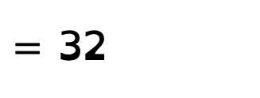
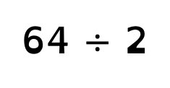
Challenge 2:
Advent CalenBAR | 15th December
Jamal has made triple the number of gingerbread as Ruth.
Jamal has made 64 more gingerbread than Ruth.
How many gingerbread has Ruth made?
Bar Modelling:
Number Sentences:
64 $÷$ 2
$=$ 32
64
?
Ruth
32
Jamal
?
32
?
32
?
32
32
Ruth has made ____ gingerbread.
© EdShed, 2020-

Slide 6

Challenge 3:
Advent CalenBAR | 15th December
Rudolph has stored 40kg more carrots than Dancer this year.
Dancer eats a third of her carrots.
Rudolph now has twice as many carrots as Dancer.
How many kg of carrots did Dancer eat?
Bar Modelling:
Number Sentences:
© EdShed, 2020-

Slide 7
Challenge 3:
Advent CalenBAR | 15th December
Rudolph has stored 40kg more carrots than Dancer this year.
Dancer eats a third of her carrots.
Rudolph now has twice as many carrots as Dancer.
How many kg of carrots did Dancer eat?
Bar Modelling:
Number Sentences:
40kg
40kg
40kg
40kg
Sometimes bar models speak lounder than sentences! ☺
Rudolph
40kg
40kg
40kg
40kg
Dancer
40
Dancer ate ____kg of carrots.
© EdShed, 2020-

Slide 8
Challenge 4:
Advent CalenBAR | 15th December
Chen and Yasmin have made 400L of custard combined.
Chen has put four tenths of his custard into jars.
Yasmin has used 40L making custard tarts.
They have the same amount of custard left.
How much custard did Yasmin make originally?
Bar Modelling:
Number Sentences:
© EdShed, 2020-

Slide 9
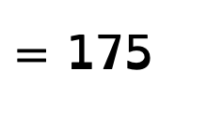

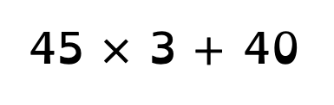
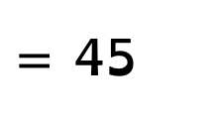

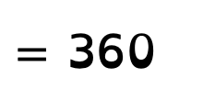
Challenge 4:
Advent CalenBAR | 15th December
Chen and Yasmin have made 400L of custard combined.
Chen has put four tenths of his custard into jars.
Yasmin has used 40L making custard tarts.
They have the same amount of custard left.
How much custard did Yasmin make originally?
Bar Modelling:
Number Sentences:
400 $−$ 40
$=$ 360
45L
45L
45L
45L
45L
Chen
360 $÷$ 8
$=$ 45
400
360
45L
45L
45L
40L
Yasmin
45 $×$ 3 $+$ 40
$=$ 175
?
175
175
Yasmin made _____L of custard at the start.
© EdShed, 2020-

