Slide 1




Advent CalenBAR
14th December

Slide 2

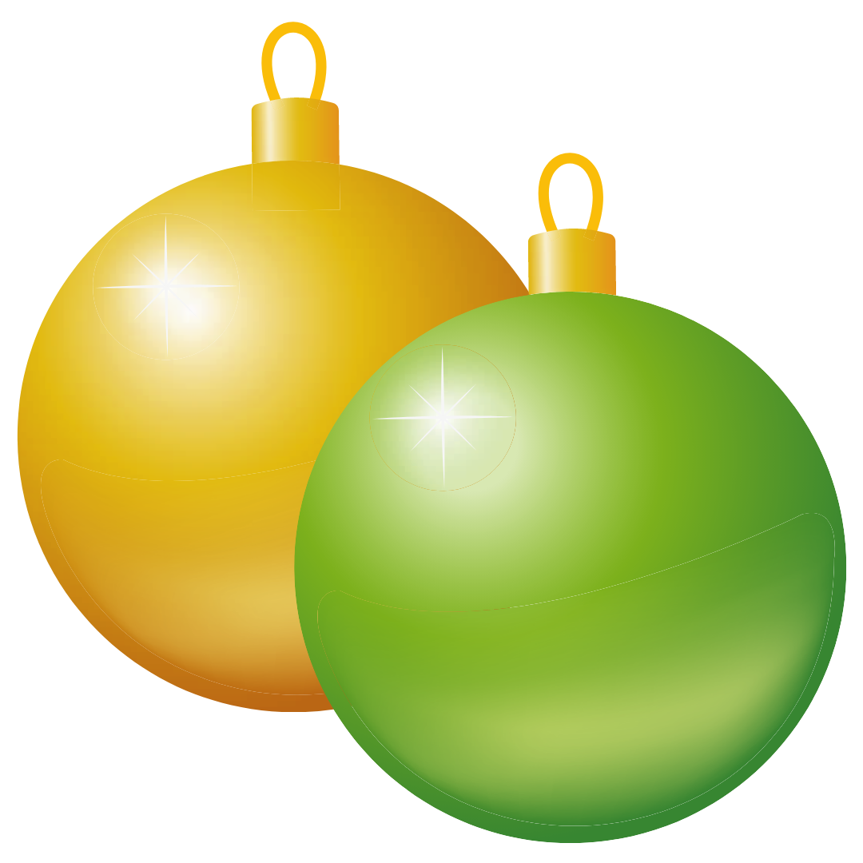
Challenge 1:
Advent CalenBAR | 14th December
Yasmin has 16 baubles.
She gives 2 each to five of her friends.
How many baubles does she have left?
Bar Modelling:
Number Sentences:
© EdShed, 2020-

Slide 3
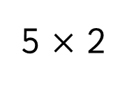
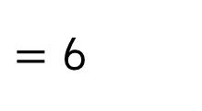

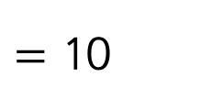
Challenge 1:
Advent CalenBAR | 14th December
Yasmin has 16 baubles.
She gives 2 each to five of her friends.
How many baubles does she have left?
Bar Modelling:
Number Sentences:
5 $×$ 2
$=$ 10
16
2
2
?
2
2
2
6
16 $−$ 10
$=$ 6
10
?
6
Yasmin has ____ baubles left.
© EdShed, 2020-

Slide 4

Challenge 2:
Advent CalenBAR | 14th December
Jamal has been making Christmas cards. He gives 14 to his swimming friends and 17 to his dance friends.
He then makes 10 more cards. He now has 32 cards.
How many Christmas cards has he made in total?
Bar Modelling:
Number Sentences:
© EdShed, 2020-

Slide 5
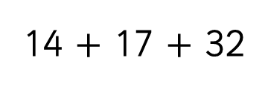
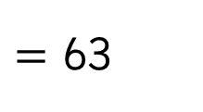
Challenge 2:
Advent CalenBAR | 14th December
Jamal has been making Christmas cards. He gives 14 to his swimming friends and 17 to his dance friends.
He then makes 10 more cards. He now has 32 cards.
How many Christmas cards has he made in total?
Bar Modelling:
Number Sentences:
14 $+$ 17 $+$ 32
$=$ 63
63
?
14
17
32
10
swim
dance
has now
63
Jamal has made ____ Christmas cards in total.
© EdShed, 2020-

Slide 6

Challenge 3:
Advent CalenBAR | 14th December
A gift box is filled with gingerbread and has a mass of 540g.
It is emptied and refilled with candy canes to a mass of 390g. The gingerbread weigh double the candy canes’ mass.
What is the gift box’s mass?
Bar Modelling:
Number Sentences:
© EdShed, 2020-

Slide 7
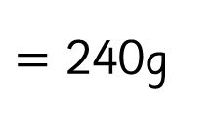
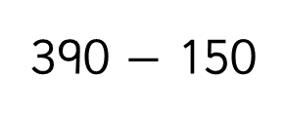
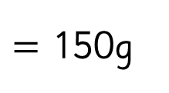
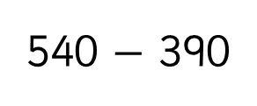
Challenge 3:
Advent CalenBAR | 14th December
A gift box is filled with gingerbread and has a mass of 540g.
It is emptied and refilled with candy canes to a mass of 390g. The gingerbread weigh double the candy canes’ mass.
What is the gift box’s mass?
Bar Modelling:
Number Sentences:
540 $−$ 390
$=$ 150g
gingerbread
+ box
540g
?
240g
150g
150g
390 $−$ 150
$=$ 240g
150
390g
?
candy canes
+ box
?
240g
150g
240
The gift box has a mass of _____g.
© EdShed, 2020-

Slide 8

Challenge 4:
Advent CalenBAR | 14th December
Three buckets contain the same amount of glitter.
25% of the glitter is poured from Bucket A to Bucket C.
A quarter of the glitter is poured from Bucket B to Bucket C.
There is 450g more glitter in Bucket C than Bucket A.
What mass of glitter was in each bucket originally?
Bar Modelling:
Number Sentences:
© EdShed, 2020-

Slide 9
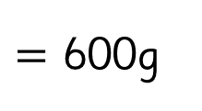

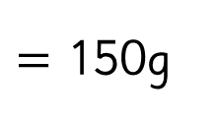

Challenge 4:
Advent CalenBAR | 14th December
Three buckets contain the same amount of glitter.
25% of the glitter is poured from Bucket A to Bucket C.
A quarter of the glitter is poured from Bucket B to Bucket C.
There is 450g more glitter in Bucket C than Bucket A.
What mass of glitter was in each bucket originally?
Bar Modelling:
Number Sentences:
600g
?
450 $÷$ 3
$=$ 150g
Bucket A
150
150
150
150
4 $×$ 150
$=$ 600g
Bucket B
Bucket C
450g
600
There was _____g of glitter in each bucket originally.
© EdShed, 2020-

