Slide 1
Advent CalenBAR
12th December

Slide 2
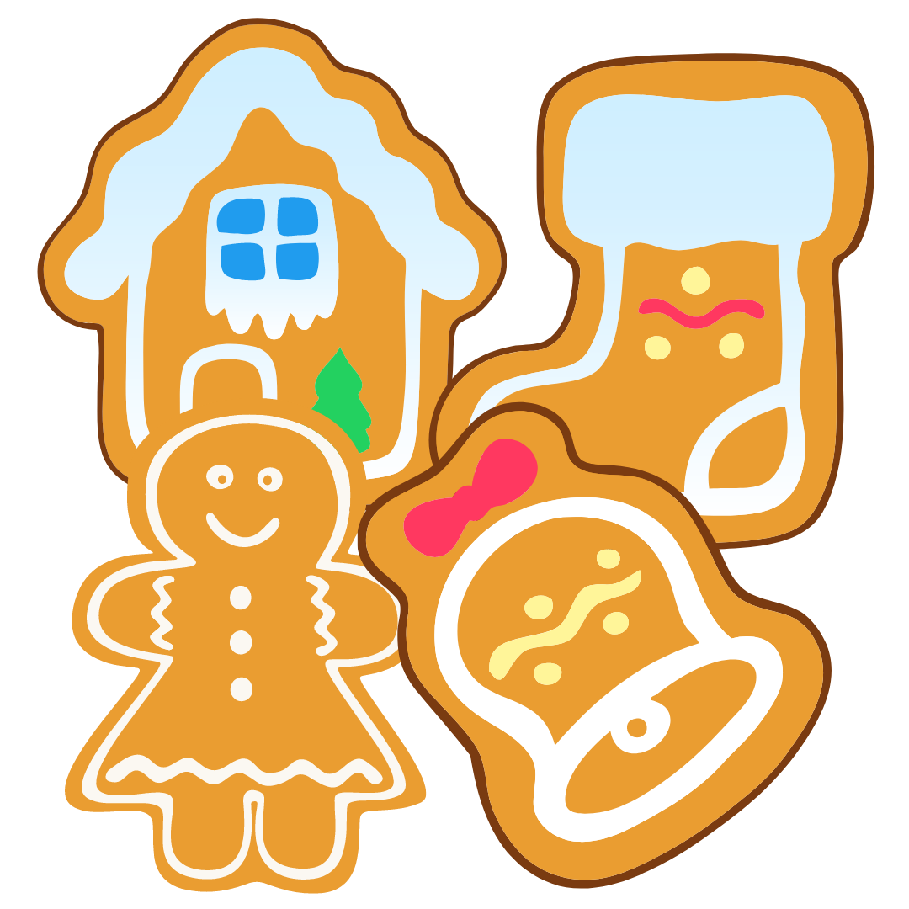
Challenge 1:
Advent CalenBAR | 12th December
There are five bags of four gingerbread.
Ruth and Jamal share them equally.
How many gingerbread does each person get?
Bar Modelling:
Number Sentences:
© EdShed, 2020-

Slide 3
Challenge 1:
Advent CalenBAR | 12th December
There are five bags of four gingerbread.
Ruth and Jamal share them equally.
How many gingerbread does each person get?
Bar Modelling:
Number Sentences:
5 $×$ 4
$=$ 20
?
20
4
4
4
4
4
20 $÷$ 2
$=$ 10
20
10
?
10
?
10
Each person gets ____ gingerbread.
© EdShed, 2020-

Slide 4
Challenge 2:
Advent CalenBAR | 12th December
Two sacks contain the same number of presents.
A quarter of the presents are moved from Sack 1 to 2.
Sack 2 now holds 80 presents.
Originally, how many presents were in Sack 1?
1
2
Bar Modelling:
Number Sentences:
© EdShed, 2020-

Slide 5
Challenge 2:
Advent CalenBAR | 12th December
Two sacks contain the same number of presents.
A quarter of the presents are moved from Sack 1 to 2.
Sack 2 now holds 80 presents.
Originally, how many presents were in Sack 1?
1
2
Bar Modelling:
Number Sentences:
80 $÷$ 5
$=$ 16
Sack 2 now: 80 presents
?
?
?
?
?
16
16
16
16
16
4 $×$ 16
$=$ 64
Sack 1: ? presents
Sack 1: 64 presents
?
?
?
?
16
16
16
16
64
There were ____ presents in Sack 1 at the start.
© EdShed, 2020-

Slide 6
Challenge 3:
Advent CalenBAR | 12th December
Ahmed, Ruth and Yasmin have some walnuts.
Ahmed and Ruth have 195 walnuts each. Yasmin has 111 walnuts. Ahmed and Ruth give her the same number of walnuts each. They all have the same number of walnuts each now.
How many walnuts did Ahmed give to Yasmin?
Bar Modelling:
Number Sentences:
© EdShed, 2020-

Slide 7
Challenge 3:
Advent CalenBAR | 12th December
Ahmed, Ruth and Yasmin have some walnuts.
Ahmed and Ruth have 195 walnuts each. Yasmin has 111 walnuts. Ahmed and Ruth give her the same number of walnuts each. They all have the same number of walnuts each now.
How many walnuts did Ahmed give to Yasmin?
Bar Modelling:
Number Sentences:
195 $+$ 195 $+$ 111
$=$ 501
501
?
195
195
111
501 $÷$ 3
$=$ 167
501
?
?
?
167
167
167
195 $−$ 167
$=$ 28
195
167
28
?
28
Ahmed gave Yasmin ____ walnuts.
© EdShed, 2020-

Slide 8
Challenge 4:
Advent CalenBAR | 12th December
At the Times Square Fayre in New York City, one hot chocolate and one candy cane cost $5.30.
3 hot chocolates and 4 candy canes cost $17.
How much does a hot chocolate cost?
Bar Modelling:
Number Sentences:
© EdShed, 2020-

Slide 9
Challenge 4:
Advent CalenBAR | 12th December
At the Times Square Fayre in New York City, one hot chocolate and one candy cane cost $5.30.
3 hot chocolates and 4 candy canes cost $17.
How much does a hot chocolate cost?
Bar Modelling:
Number Sentences:
3 $×$ $5.30
$=$ $15.90
candy
1.10
$5.30
$5.30
$15.90
$17 $−$ $15.90
$=$ $1.10
hot choc
$4.20
$5.30 $−$ $1.10
$=$ $4.20
candy
1.10
$17
hot choc
4.20
A hot chocolate costs $______.
© EdShed, 2020-

