Slide 1
Advent CalenBAR
11th December

Slide 2
Challenge 1:
Advent CalenBAR | 11th December
A regular turkey weighs 7kg.
Two regular turkeys and one small turkey weigh 20kg.
How much does the small turkey weigh?
Bar Modelling:
Number Sentences:
© EdShed, 2020-

Slide 3
Challenge 1:
Advent CalenBAR | 11th December
A regular turkey weighs 7kg.
Two regular turkeys and one small turkey weigh 20kg.
How much does the small turkey weigh?
Bar Modelling:
Number Sentences:
2 $×$ 7
$=$ 14
20kg
20 $−$ 14
$=$ 6
6kg
7kg
7kg
?kg
14kg
small turkey
6
A small turkey weighs ____kg.
© EdShed, 2020-

Slide 4
Challenge 2:
Advent CalenBAR | 11th December
Two boxes contain the same number of baubles.
Half of the baubles from Box 1 are moved to Box 2.
There are now 84 baubles in Box 2.
How many baubles were in Box 1 originally?
1
2
Bar Modelling:
Number Sentences:
© EdShed, 2020-

Slide 5
Challenge 2:
Advent CalenBAR | 11th December
Two boxes contain the same number of baubles.
Half of the baubles from Box 1 are moved to Box 2.
There are now 84 baubles in Box 2.
How many baubles were in Box 1 originally?
1
2
Bar Modelling:
56
Number Sentences:
?
84 $÷$ 3
$=$ 28
Box 1
28
28
2 $×$ 28
$=$ 56
Box 2
28
28
28
84
56
Originally, there were ____ baubles in Box 1.
© EdShed, 2020-

Slide 6
Challenge 3:
Advent CalenBAR | 11th December
Rudolph flies the same distance each hour.
He flies 284 miles in four hours.
How far would Rudolph fly in seven hours?
Bar Modelling:
Number Sentences:
© EdShed, 2020-

Slide 7
Challenge 3:
Advent CalenBAR | 11th December
Rudolph flies the same distance each hour.
He flies 284 miles in four hours.
How far would Rudolph fly in seven hours?
Bar Modelling:
Number Sentences:
284 $÷$ 4
$=$ 71
497 miles
? miles
71 $×$ 7
$=$ 497
71 miles
71 miles
71 miles
71 miles
71 miles
71 miles
71 miles
hour 1
hour 2
hour 3
hour 4
hour 5
hour 6
hour 7
284 miles
497
Rudolph would fly _____ miles in seven hours.
© EdShed, 2020-

Slide 8
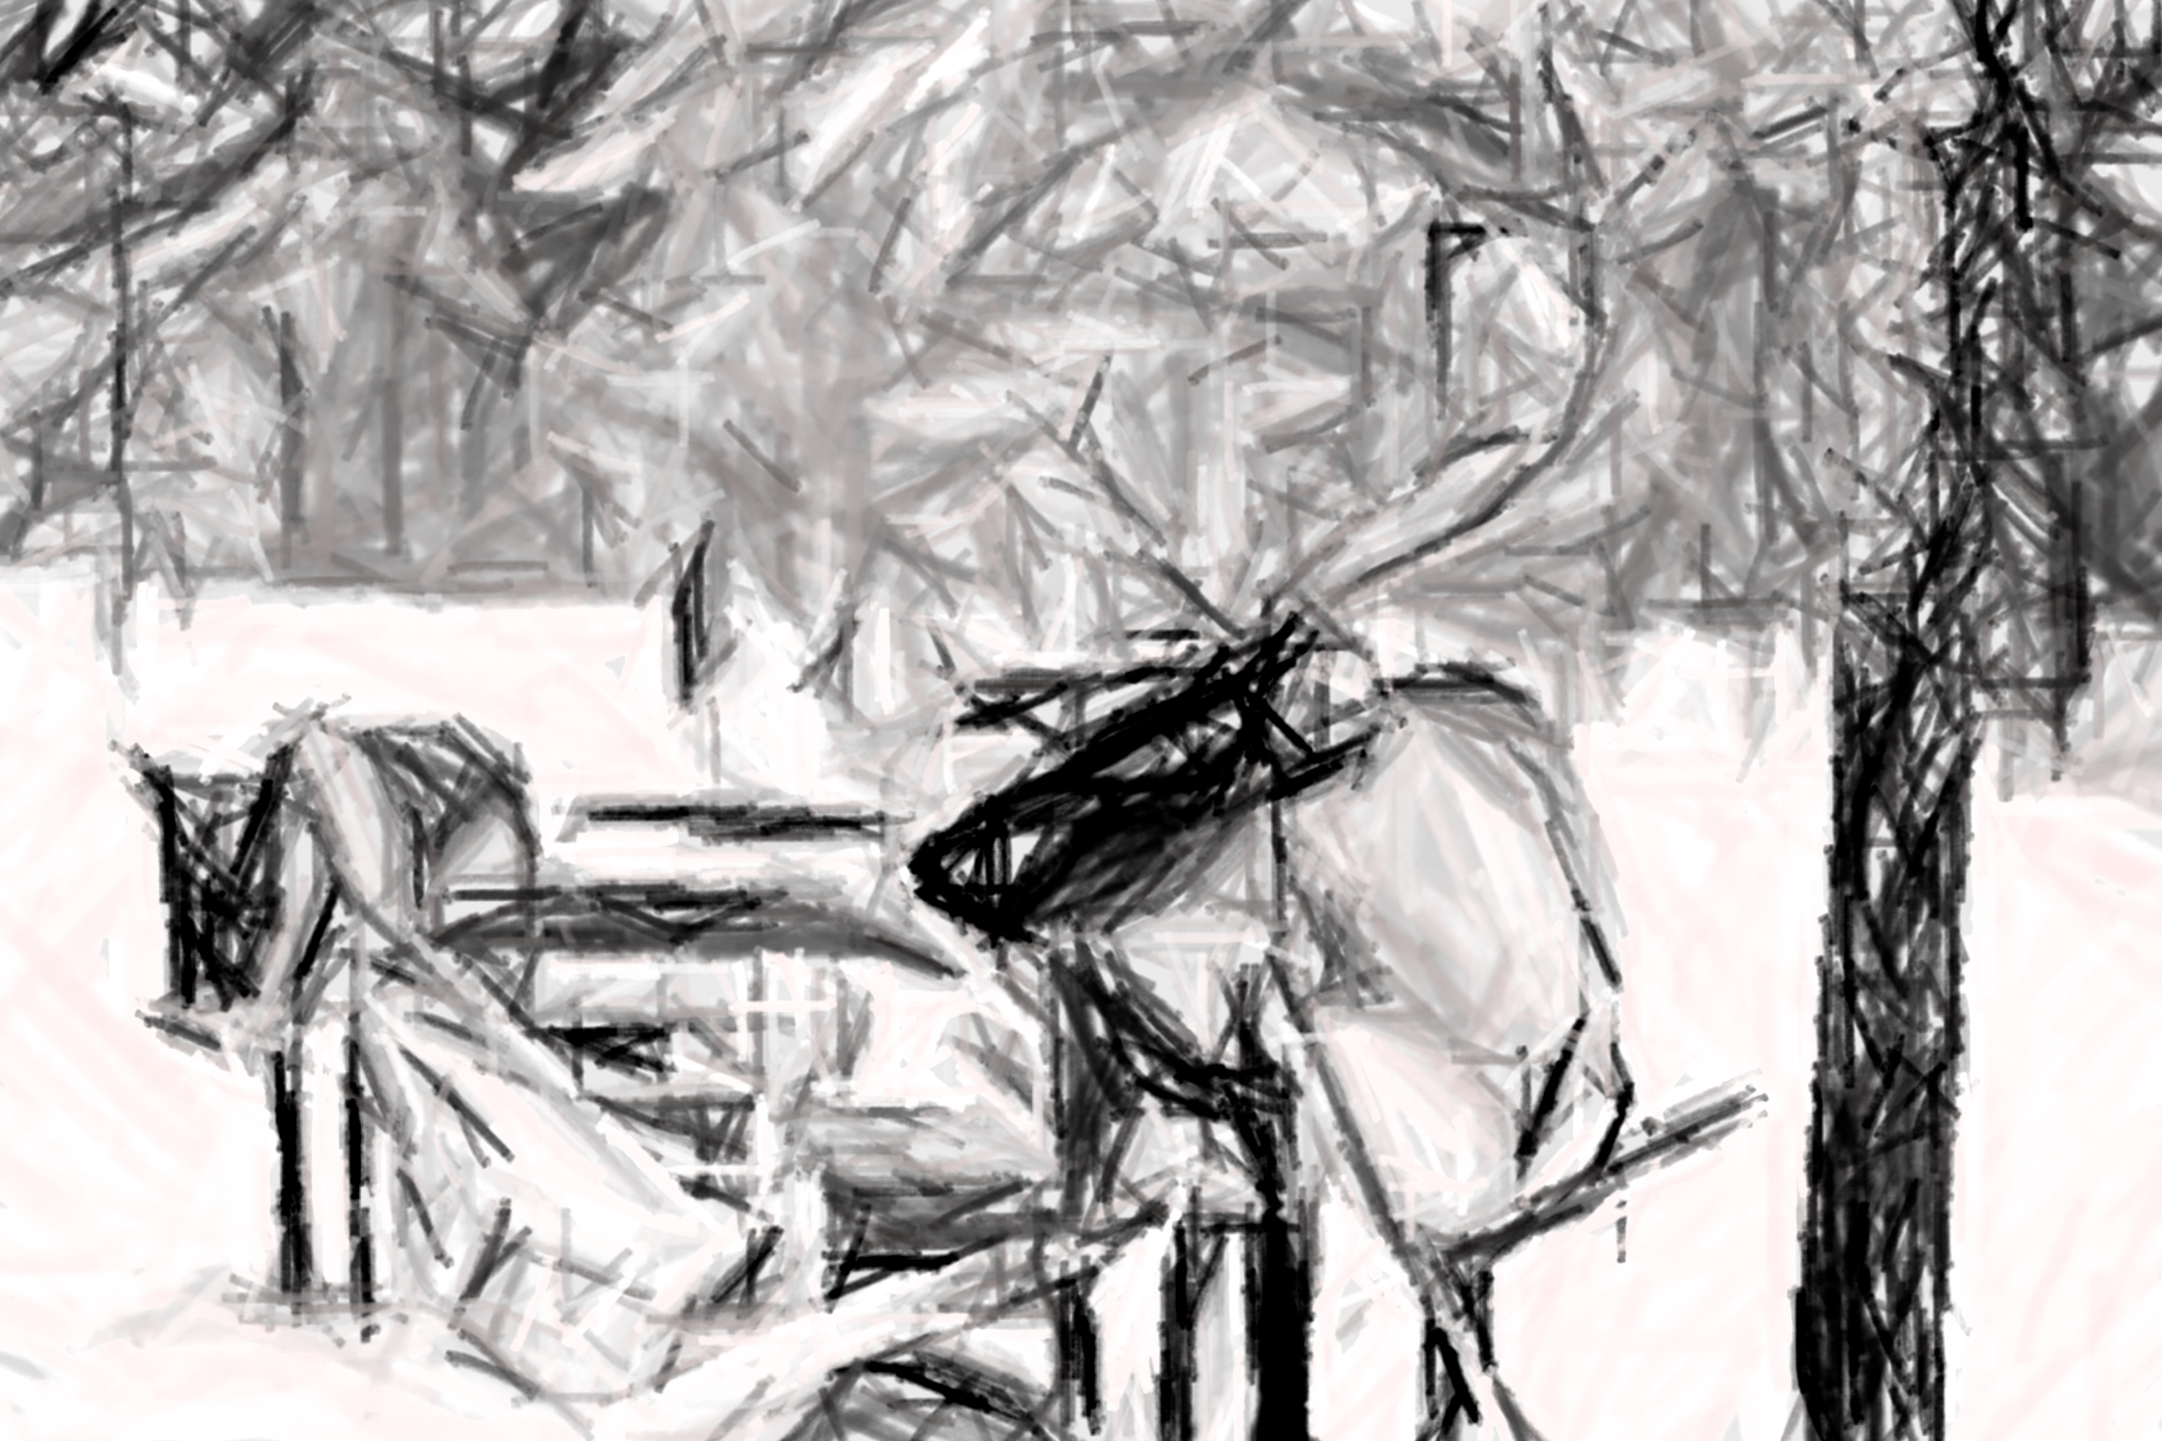
Challenge 4:
Advent CalenBAR | 11th December
Vixen is 3 years older than Rudolph.
Dancer’s age is the sum of Vixen and Rudolph’s ages.
Comet’s age is the sum of Vixen and Dancer’s ages.
The four reindeer have a combined age of 186 years.
How old is Dancer?
Bar Modelling:
Number Sentences:
© EdShed, 2020-

Slide 9
Challenge 4:
Advent CalenBAR | 11th December
Vixen is 3 years older than Rudolph.
Dancer’s age is the sum of Vixen and Rudolph’s ages.
Comet’s age is the sum of Vixen and Dancer’s ages.
The four reindeer have a combined age of 186 years.
How old is Dancer?
Bar Modelling:
Number Sentences:
R
29
215 $−$ 4 $×$ 3
$=$ 203
V
29
3
203
61
?
215
203 $÷$ 7
$=$ 29
D
29
29
3
2 $×$ 29 $+$ 3
$=$ 61
C
29
3
29
29
3
61
Dancer is _____ years old.
© EdShed, 2020-

