Slide 1




Festive Problems
9th December

Slide 2

Challenge 1:
Festive Problems | 9th December
A bakery is mixing milk and cream to make custard.
They use 6L of cream.
They make 19L of milk and cream mixture in total.
How much milk did they use to make their custard?
Bar Modelling:
Number Sentences:
© EdShed, 2020-

Slide 3

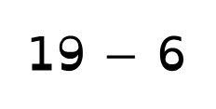
Challenge 1:
Festive Problems | 9th December
A bakery is mixing milk and cream to make custard.
They use 6L of cream.
They make 19L of milk and cream mixture in total.
How much milk did they use to make their custard?
Bar Modelling:
Number Sentences:
19L
19 $−$ 6
$=$ 13
6L
13L
?
13
The bakery has used ____L of milk to make their custard.
© EdShed, 2020-

Slide 4
Challenge 2:
Festive Problems | 9th December
Rudolph flew 120 miles between his first and second test flights.
He flew half as long in the first flight than the second flight.
How far did Rudolph fly in his second test flight?
Bar Modelling:
Number Sentences:
© EdShed, 2020-

Slide 5

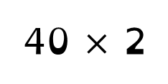


Challenge 2:
Festive Problems | 9th December
Rudolph flew 120 miles between his first and second test flights.
He flew half as long in the first flight than the second flight.
How far did Rudolph fly in his second test flight?
Bar Modelling:
Number Sentences:
120 $÷$ 3
$=$ 40
120 miles
40 miles
40 $×$ 2
$=$ 80
40 miles
40 miles
?
?
?
1st
2nd
80
Rudolph flew ____ miles in his second test flight.
© EdShed, 2020-

Slide 6
Challenge 3:
Festive Problems | 9th December
Yasmin has four times as many candy canes as Ruth.
Jamal has 45 more candy canes than Ruth.
They have 225 candy canes in total.
How many candy canes does Jamal have?
Bar Modelling:
Number Sentences:
© EdShed, 2020-

Slide 7

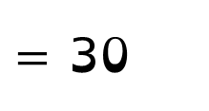

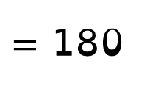

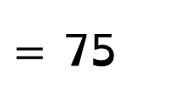
Challenge 3:
Festive Problems | 9th December
Yasmin has four times as many candy canes as Ruth.
Jamal has 45 more candy canes than Ruth.
They have 225 candy canes in total.
How many candy canes does Jamal have?
Bar Modelling:
Number Sentences:
Ruth
30
225 $−$ 45
$=$ 180
180 $÷$ 6
$=$ 30
Yasmin
30
30
30
30
225
?
75
45 $+$ 30
$=$ 75
Jamal
30
45
75
Jamal has ____ candy canes.
© EdShed, 2020-

Slide 8
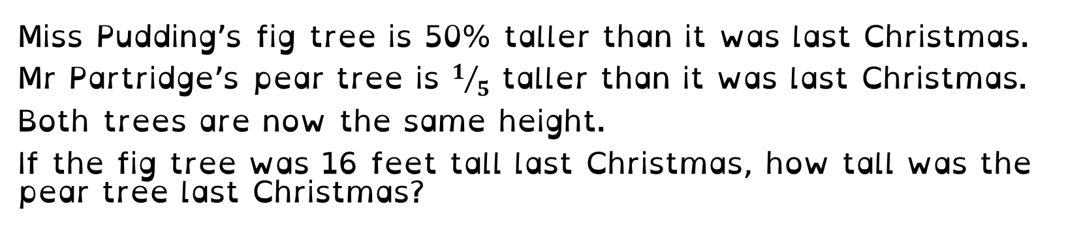
Challenge 4:
Festive Problems | 9th December
Miss Pudding’s fig tree is 50% taller than it was last Christmas.
Mr Partridge’s pear tree is $1/5$ taller than it was last Christmas.
Both trees are now the same height.
If the fig tree was 16 feet tall last Christmas, how tall was the pear tree last Christmas?
Bar Modelling:
Number Sentences:
© EdShed, 2020-

Slide 9




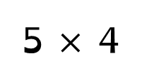



Challenge 4:
Festive Problems | 9th December
Miss Pudding’s fig tree is 50% taller than it was last Christmas.
Mr Partridge’s pear tree is $1/5$ taller than it was last Christmas.
Both trees are now the same height.
If the fig tree was 16 feet tall last Christmas, how tall was the pear tree last Christmas?
Bar Modelling:
Number Sentences:
this Christmas
last Christmas
16 $÷$ 2
$=$ 8
16
8
fig
24
16 $+$ 8
$=$ 24
last Christmas
24 $÷$ 6
$=$ 4
20
5 $×$ 4
$=$ 20
?
?
?
?
?
?
pear
4
4
4
4
4
4
20
Mr Partridge’s pear tree was ____ft tall last Christmas.
© EdShed, 2020-

