Slide 1




Festive Problems
3rd December

Slide 2

Challenge 1:
Festive Problems | 3rd December
Santa can put 20kg of presents in each box.
He has put the following items into a box already.
What weight of presents could still go in the box?
8 kg
5 kg
Bar Modelling:
Number Sentences:
© EdShed, 2020-

Slide 3





Challenge 1:
Festive Problems | 3rd December
Santa can put 20kg of presents in each box.
He has put the following items into a box already.
What weight of presents could still go in the box?
8 kg
5 kg
Bar Modelling:
Number Sentences:
8 $+$ 5
$=$ 13
7
8
5
?
20 $−$ 13
$=$ 7kg
20kg
7
___kg of presents could still go in the box.
© EdShed, 2020-

Slide 4
Challenge 2:
Festive Problems | 3rd December
Combined, Eve and Chen have 35 baubles.
Eve has four times as many baubles as Chen.
How many baubles does each person have?
Bar Modelling:
Number Sentences:
© EdShed, 2020-

Slide 5

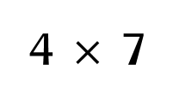

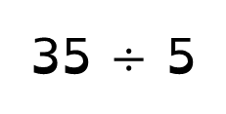
Challenge 2:
Festive Problems | 3rd December
Combined, Eve and Chen have 35 baubles.
Eve has four times as many baubles as Chen.
How many baubles does each person have?
Bar Modelling:
Number Sentences:
Chen
7
35 $÷$ 5
$=$ 7
35
4 $×$ 7
$=$ 28
Eve
7
7
7
7
28
7
28
Chen has ___ baubles. Eve has ___ baubles.
© EdShed, 2020-

Slide 6
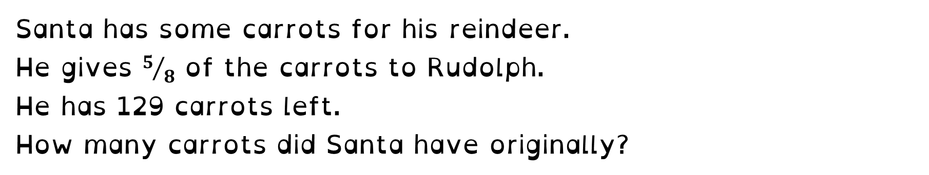
Challenge 3:
Festive Problems | 3rd December
Santa has some carrots for his reindeer.
He gives $5/8$ of the carrots to Rudolph.
He has 129 carrots left.
How many carrots did Santa have originally?
Bar Modelling:
Number Sentences:
© EdShed, 2020-

Slide 7
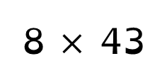



Challenge 3:
Festive Problems | 3rd December
Santa has some carrots for his reindeer.
He gives $5/8$ of the carrots to Rudolph.
He has 129 carrots left.
How many carrots did Santa have originally?
Bar Modelling:
Number Sentences:
129 leftover
129 $÷$ 3
$=$ 43
8 $×$ 43
$=$ 344
43 | 43 | 43 | 43 | 43 | 43 | 43 | 43
Rudolph
344
344
Originally, Santa had _____ carrots.
© EdShed, 2020-

Slide 8
Challenge 4:
Festive Problems | 3rd December
Jamal buys 2 candy canes and 3 gingerbread.
He spends $11.50 in total.
A gingerbread costs $1.05 more than a candy cane.
How much does a gingerbread cost?
Bar Modelling:
Number Sentences:
© EdShed, 2020-

Slide 9


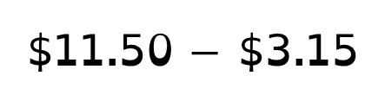
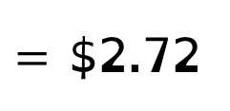
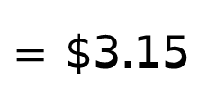
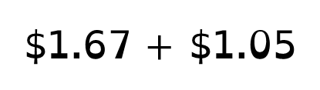


Challenge 4:
Festive Problems | 3rd December
Jamal buys 2 candy canes and 3 gingerbread.
He spends $11.50 in total.
A gingerbread costs $1.05 more than a candy cane.
How much does a gingerbread cost?
Bar Modelling:
Number Sentences:
$1.67
$1.67
3 $×$ $1.05
$=$ $3.15
candy cane
$11.50 $−$ $3.15
$=$ $8.35
$11.50
$1.67
$1.05
$1.67
$1.05
$1.67
$1.05
$8.35
$8.35 $÷$ 5
$=$ $1.67
gingerbread
$2.72
$1.67 $+$ $1.05
$=$ $2.72
?
2.72
A gingerbread costs $______.
© EdShed, 2020-

