Slide 1




Advent CalenBAR
7th December

Slide 2

Challenge 1:
Advent CalenBAR | 7th December
Two snowmen are each wearing scarves.
The orange scarf is 14cm long.
The purple scarf is half as long as the orange scarf.
How long are the scarves combined?
Bar Modelling:
Number Sentences:
© EdShed, 2020-

Slide 3
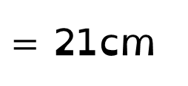
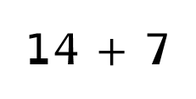

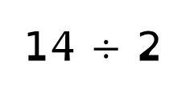
Challenge 1:
Advent CalenBAR | 7th December
Two snowmen are each wearing scarves.
The orange scarf is 14cm long.
The purple scarf is half as long as the orange scarf.
How long are the scarves combined?
Bar Modelling:
Number Sentences:
orange
14 $÷$ 2
$=$ 7cm
14cm
?
21cm
purple
14 $+$ 7
$=$ 21cm
7cm
21
Together, the scarves are ____cm long.
© EdShed, 2020-

Slide 4
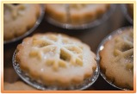
Challenge 2:
Advent CalenBAR | 7th December
Ruth gives away 100 mince pies on Saturday and Sunday.
She gives away 73 on Saturday.
How many more mince pies did Ruth give away on Saturday than on Sunday?
Bar Modelling:
Number Sentences:
© EdShed, 2020-

Slide 5

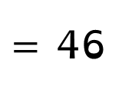

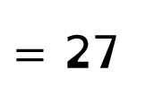
Challenge 2:
Advent CalenBAR | 7th December
Ruth gives away 100 mince pies on Saturday and Sunday.
She gives away 73 on Saturday.
How many more mince pies did Ruth give away on Saturday than on Sunday?
Bar Modelling:
Number Sentences:
Saturday
100$−$ 73
$=$ 27
73
100
46
?
73$−$ 27
$=$ 46
Sunday
27
46
Ruth gave away ____ more mince pies away on Saturday.
© EdShed, 2020-

Slide 6
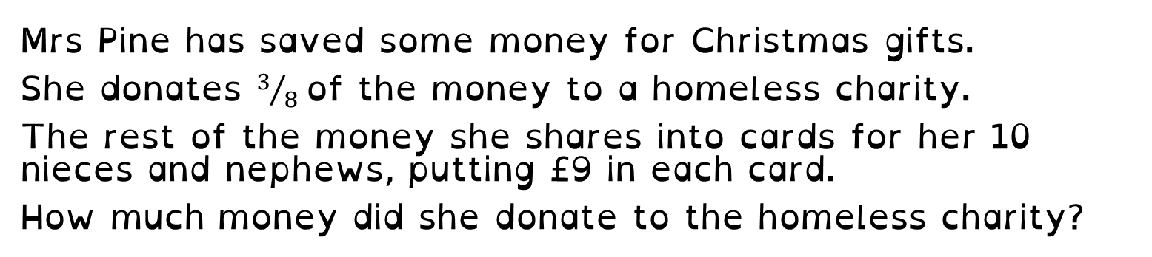
Challenge 3:
Advent CalenBAR | 7th December
Mrs Pine has saved some money for Christmas gifts.
She donates $3/8$of the money to a homeless charity.
The rest of the money she shares into cards for her 10 nieces and nephews, putting £9 in each card.
How much money did she donate to the homeless charity?
Bar Modelling:
Number Sentences:
© EdShed, 2020-

Slide 7
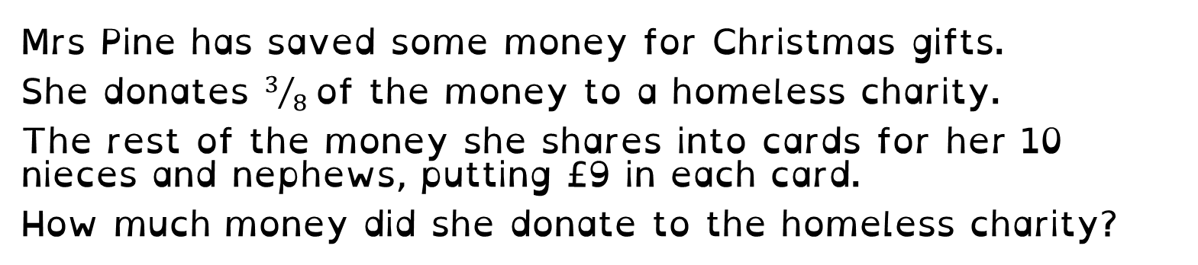
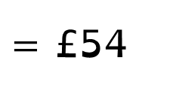
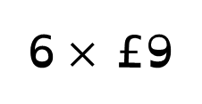
Challenge 3:
Advent CalenBAR | 7th December
Mrs Pine has saved some money for Christmas gifts.
She donates $3/8$of the money to a homeless charity.
The rest of the money she shares into cards for her 10 nieces and nephews, putting £9 in each card.
How much money did she donate to the homeless charity?
Bar Modelling:
Number Sentences:
donation
£9
6$×$ £9
$=$ £54
nephews and nieces
54
Mrs Pine donated £____ to the homeless charity.
© EdShed, 2020-

Slide 8

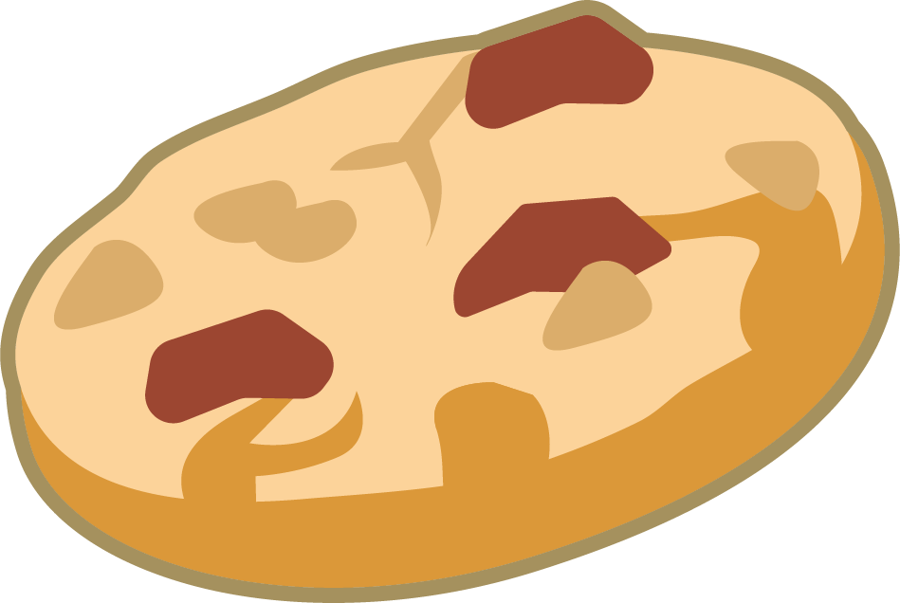

Challenge 4:
Advent CalenBAR | 7th December
A cookie costs half as much as a mug of hot chocolate.
Mrs Kringle buys 3 gingerbread and 2 mugs of hot chocolate.
She pays £12.25 altogether.
How much does a mug of hot chocolate cost?
Bar Modelling:
Number Sentences:
© EdShed, 2020-

Slide 9


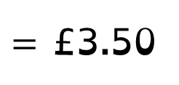

Challenge 4:
Advent CalenBAR | 7th December
A cookie costs half as much as a mug of hot chocolate.
Mrs Kringle buys 3 gingerbread and 2 mugs of hot chocolate.
She pays £12.25 altogether.
How much does a mug of hot chocolate cost?
Bar Modelling:
Number Sentences:
£3.50
£12.25 $÷$ 7
$=$ £1.75
?
hot choc
£1.75
£1.75
£1.75
£1.75
2$×$ £1.75
$=$ £3.50
gingerbread
£12.25
£1.75
£1.75
£1.75
3.50
A mug of hot chocolate costs £_____.
© EdShed, 2020-

