Slide 1
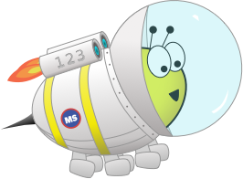
Festive Problems
6th December

Slide 2
Challenge 1:
Festive Problems | 6th December
Jamal receives 19 presents for Christmas altogether.
Ruth receives 12 presents for Christmas in total.
How many more presents did Jamal receive than Ruth?
Bar Modelling:
Number Sentences:
© EdShed, 2020-

Slide 3
Challenge 1:
Festive Problems | 6th December
Jamal receives 19 presents for Christmas altogether.
Ruth receives 12 presents for Christmas in total.
How many more presents did Jamal receive than Ruth?
Bar Modelling:
Number Sentences:
19$−$ 12
$=$ 7
Jamal
19
7
Ruth
?
12
7
Jamal received ___ more presents than Ruth.
© EdShed, 2020-

Slide 4
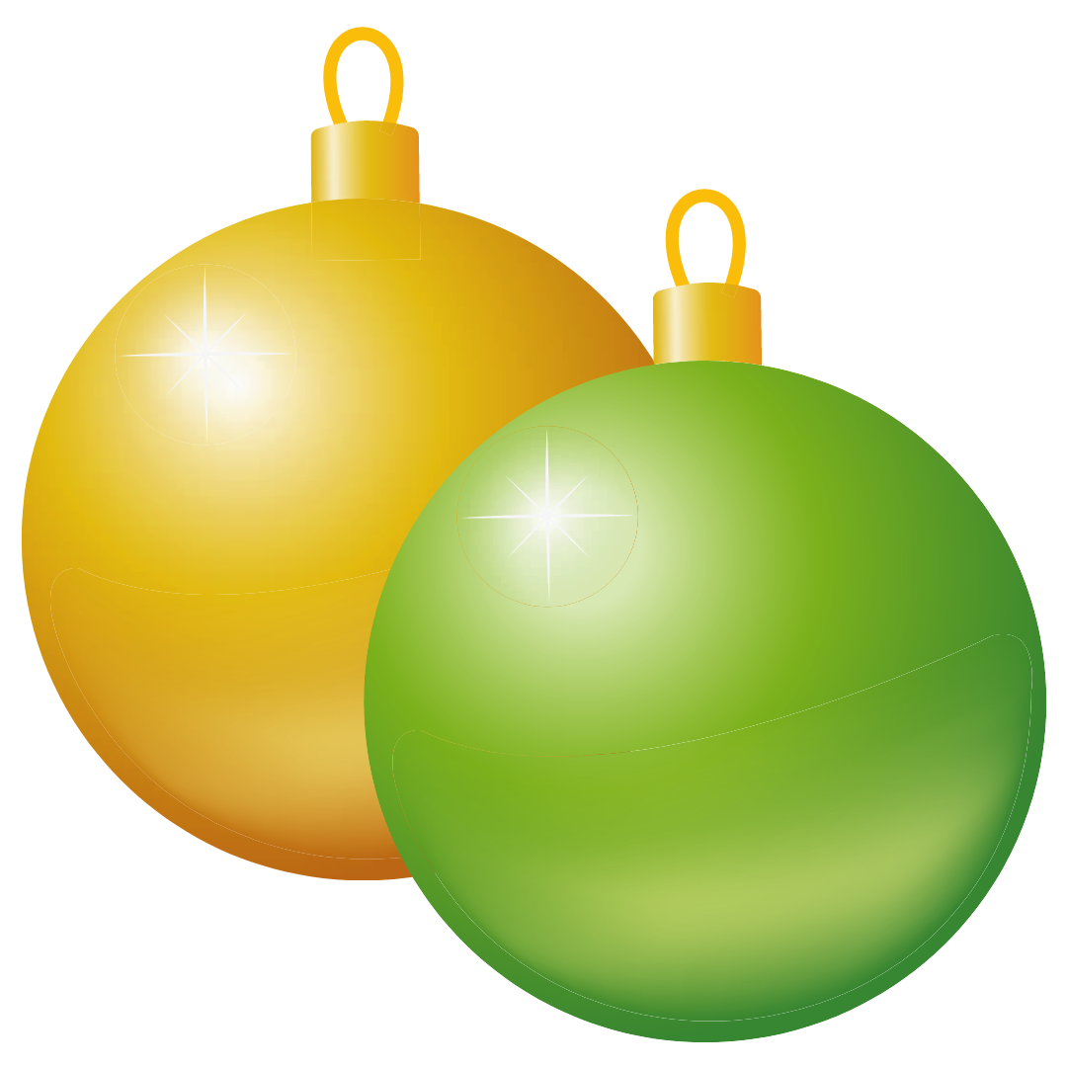
Challenge 2:
Festive Problems | 6th December
Yasmin has five boxes of baubles.
Each box contains six baubles.
Yasmin gives 11 baubles to Ruth.
How many baubles does Yasmin have left?
Bar Modelling:
Number Sentences:
© EdShed, 2020-

Slide 5
Challenge 2:
Festive Problems | 6th December
Yasmin has five boxes of baubles.
Each box contains six baubles.
Yasmin gives 11 baubles to Ruth.
How many baubles does Yasmin have left?
Bar Modelling:
30
Number Sentences:
5$×$ 6
$=$ 30
6
6
6
6
6
11
30$−$ 11
$=$ 19
19
?
19
Yasmin has ___ baubles left.
© EdShed, 2020-

Slide 6
Challenge 3:
Festive Problems | 6th December
These two gift boxes contain chocolates.
The larger box contains 4 times as many chocolates.
The difference between the two boxes is 78 chocolates.
How many chocolates are there in both boxes combined?
Bar Modelling:
Number Sentences:
© EdShed, 2020-

Slide 7
Challenge 3:
Festive Problems | 6th December
These two gift boxes contain chocolates.
The larger box contains 4 times as many chocolates.
The difference between the two boxes is 78 chocolates.
How many chocolates are there in both boxes combined?
Bar Modelling:
Number Sentences:
78 $÷$ 3
$=$ 26
?
26
?
26
?
26
?
large
26
130
5$×$ 26
$=$ 130
?
78
?
small
26
130
Both boxes combined contain ____ chocolates.
© EdShed, 2020-

Slide 8
Challenge 4:
Festive Problems | 6th December
Three stockings contain some sweet treats.
The 2nd stocking contains $4/5$ the number of treats as the 1st. The 3rd stocking contains half as many as the 2nd stocking. There are 66 more treats in the 1st than the 3rd stocking.
How many treats are in the 2nd stocking?
Bar Modelling:
Number Sentences:
© EdShed, 2020-

Slide 9
Challenge 4:
Festive Problems | 6th December
Three stockings contain some sweet treats.
The 2nd stocking contains $4/5$ the number of treats as the 1st. The 3rd stocking contains half as many as the 2nd stocking. There are 66 more treats in the 1st than the 3rd stocking.
How many treats are in the 2nd stocking?
Bar Modelling:
Number Sentences:
22
22
22
22
22
66 $÷$ 3
$=$ 22
1st
2nd
22
22
22
22
22 $×$ 4
$=$ 88
66
3rd
22
22
88
The 2nd stocking has ____ sweet treats inside.
© EdShed, 2020-

