Slide 1




Festive Problems
1st December

Slide 2

Challenge 1:
Festive Problems | 1st December
Eve has 20 baubles.
7 of them are gold.
The rest are green.
How many more green than gold baubles does she have?
Bar Modelling:
Number Sentences:
© EdShed, 2020-

Slide 3


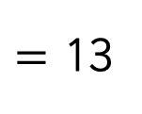

Challenge 1:
Festive Problems | 1st December
Eve has 20 baubles.
7 of them are gold.
The rest are green.
How many more green than gold baubles does she have?
Bar Modelling:
Number Sentences:
20 $−$ 7
$=$ 13
?
7
6
gold
13 $−$ 7
$=$ 6
20
green
13
6
There are __ more green baubles than gold baubles.
© EdShed, 2020-

Slide 4

Challenge 2:
Festive Problems | 1st December
A large Christmas tree weighs 13kg.
A small Christmas tree weighs 7kg less.
How much do a small and large Christmas tree weigh combined?
L
S
Bar Modelling:
Number Sentences:
© EdShed, 2020-

Slide 5
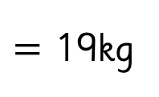

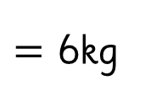

Challenge 2:
Festive Problems | 1st December
A large Christmas tree weighs 13kg.
A small Christmas tree weighs 7kg less.
How much do a small and large Christmas tree weigh combined?
L
S
Bar Modelling:
Number Sentences:
13 $−$ 7
$=$ 6kg
large
13kg
13 $+$ 6
$=$ 19kg
?
19
7kg
6kg
small
19
A small and large Christmas tree weigh ____kg combined.
© EdShed, 2020-

Slide 6
Challenge 3:
Festive Problems | 1st December
A bakery baked 87 more gingerbread on Friday than Thursday.
They baked 36 more gingerbread on Saturday than Friday.
They baked 129 gingerbread on Friday.
How many gingerbread did they bake in total on Thursday, Friday and Saturday?
Bar Modelling:
Number Sentences:
© EdShed, 2020-

Slide 7
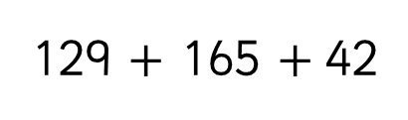
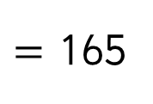

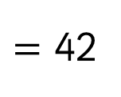

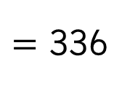
Challenge 3:
Festive Problems | 1st December
A bakery baked 87 more gingerbread on Friday than Thursday.
They baked 36 more gingerbread on Saturday than Friday.
They baked 129 gingerbread on Friday.
How many gingerbread did they bake in total on Thursday, Friday and Saturday?
Bar Modelling:
Number Sentences:
129 $−$ 87
$=$ 42
87
42
Thursday
Friday
129
?
129 $+$ 36
$=$ 165
336
129
36
Saturday
129 $+$ 165 $+$42
$=$ 336
165
336
The bakery baked a total of ______ gingerbread.
© EdShed, 2020-

Slide 8
Challenge 4:
Festive Problems | 1st December
I have three pieces of paper to wrap gifts.
Put together, I have a total area of 160cm² of paper.
The first piece has an area of 78cm².
The second piece is half as big as the first piece.
What is the area of the third piece of gift wrapping paper?
Bar Modelling:
Number Sentences:
© EdShed, 2020-

Slide 9
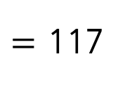
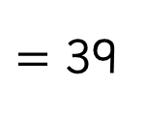

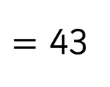
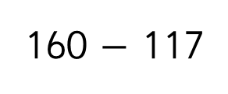
Challenge 4:
Festive Problems | 1st December
I have three pieces of paper to wrap gifts.
Put together, I have a total area of 160cm² of paper.
The first piece has an area of 78cm².
The second piece is half as big as the first piece.
What is the area of the third piece of gift wrapping paper?
Bar Modelling:
Number Sentences:
78 $÷$ 2
$=$ 39
78cm²
1st piece
39cm²
39cm²
78 + 39
$=$ 117
2nd piece
39cm²
160
3rd piece
43cm²
160 $−$ 117
$=$ 43
43
The third piece of paper has an area of _____cm².
© EdShed, 2020-

