Slide 1




Advent CalenBAR
10th December

Slide 2

Challenge 1:
Advent CalenBAR | 10th December
Jamal has a box of candy canes.
He eats six of them.
There are now eight candy canes in the box.
How many candy canes did Jamal have originally?
Bar Modelling:
Number Sentences:
© EdShed, 2020-

Slide 3
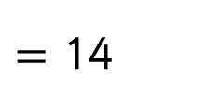
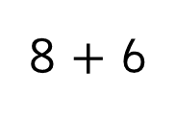
Challenge 1:
Advent CalenBAR | 10th December
Jamal has a box of candy canes.
He eats six of them.
There are now eight candy canes in the box.
How many candy canes did Jamal have originally?
Bar Modelling:
Number Sentences:
8 $+$ 6
$=$ 14
?
14
eats: 6
still in the box: 8
14
There were ____ candy canes in Jamal’s box originally.
© EdShed, 2020-

Slide 4


Challenge 2:
Advent CalenBAR | 10th December
James buys a box with 45 baubles in it.
He hangs 12 of them on his tree.
He packs the rest of the baubles evenly into 3 boxes.
How many baubles go into each of the boxes?
Bar Modelling:
Number Sentences:
© EdShed, 2020-

Slide 5
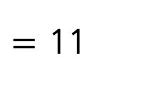

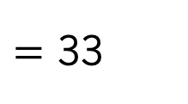

Challenge 2:
Advent CalenBAR | 10th December
James buys a box with 45 baubles in it.
He hangs 12 of them on his tree.
He packs the rest of the baubles evenly into 3 boxes.
How many baubles go into each of the boxes?
Bar Modelling:
Number Sentences:
45
45 $−$ 12
$=$ 33
hangs: 12
packs into boxes: 33
packs into boxes: ?
33 $÷$ 3
$=$ 11
33
Box 1: 11
Box 1: ?
Box 2: 11
Box 2: ?
Box 3: 11
Box 3: ?
11
James packs ____ baubles into each box.
© EdShed, 2020-

Slide 6

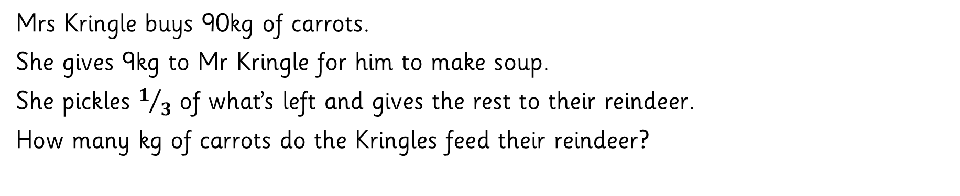
Challenge 3:
Advent CalenBAR | 10th December
Mrs Kringle buys 90kg of carrots.
She gives 9kg to Mr Kringle for him to make soup.
She pickles $1/3$ of what’s left and gives the rest to their reindeer.
How many kg of carrots do the Kringles feed their reindeer?
Bar Modelling:
Number Sentences:
© EdShed, 2020-

Slide 7
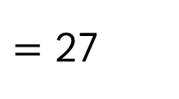

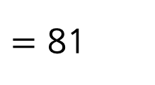

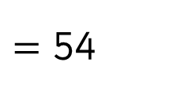

Challenge 3:
Advent CalenBAR | 10th December
Mrs Kringle buys 90kg of carrots.
She gives 9kg to Mr Kringle for him to make soup.
She pickles $1/3$ of what’s left and gives the rest to their reindeer.
How many kg of carrots do the Kringles feed their reindeer?
Bar Modelling:
Number Sentences:
90kg
90 $−$ 9
$=$ 81
9kg
after soup: 81kg
81 $÷$ 3
$=$ 27
81kg
pickles ?
$=$ 54
pickles: 27kg
for reindeer: 54kg
for reindeer ?kg
27 $×$ 2
54
The Kringles gave ____kg of carrots to their reindeer.
© EdShed, 2020-

Slide 8
Challenge 4:
Advent CalenBAR | 10th December
Jamal has 4 boxes of gingerbread and 5 single gingerbread.
Ruth has 1 box of gingerbread and 26 single gingerbread.
They have the same number of gingerbread.
How many gingerbread do they have combined?
Bar Modelling:
Number Sentences:
© EdShed, 2020-

Slide 9
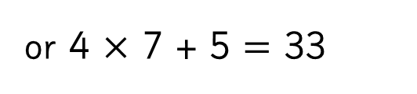

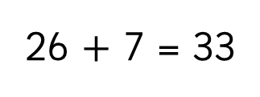
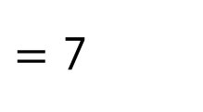

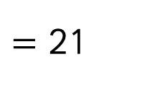
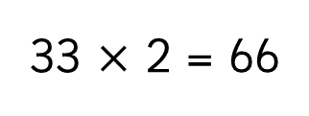
Challenge 4:
Advent CalenBAR | 10th December
Jamal has 4 boxes of gingerbread and 5 single gingerbread.
Ruth has 1 box of gingerbread and 26 single gingerbread.
They have the same number of gingerbread.
How many gingerbread do they have combined?
Bar Modelling:
Number Sentences:
26 $−$ 5
$=$ 21
Box 3
Jamal
Box 1
7
5
7
Box 4
Box 2
7
7
21 $÷$ 3
$=$ 7
?
21
66
?
26 $+$ 7 = 33
or 4 $×$ 7 + 5 $=$ 33
Ruth
Box 1
26
7
33 $×$ 2 = 66
66
In total, Ruth and Jamal have ____ gingerbread.
© EdShed, 2020-

