Slide 1
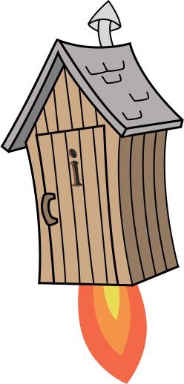
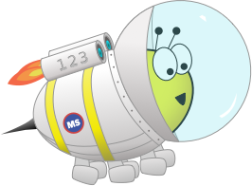
Advent CalenBAR
4th December

Slide 2
Challenge 1:
Advent CalenBAR | 4th December
Yasmin has three boxes of presents.
Two boxes contain four presents.
The final box contains five presents.
How many presents does she have in total?
Bar Modelling:
Number Sentences:
© EdShed, 2020-

Slide 3
Challenge 1:
Advent CalenBAR | 4th December
Yasmin has three boxes of presents.
Two boxes contain four presents.
The final box contains five presents.
How many presents does she have in total?
Bar Modelling:
Number Sentences:
4 $+$ 4 $+$ 5
$=$ 13
4
4
5
13
?
13
Yasmin ___ has presents in total.
© EdShed, 2020-

Slide 4
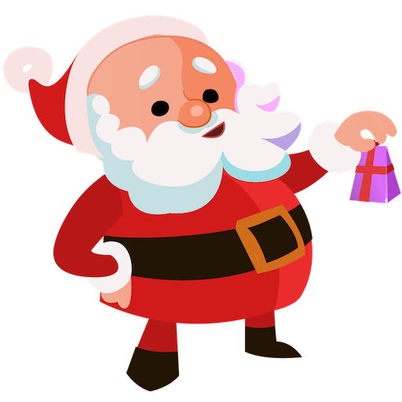
Challenge 2:
Advent CalenBAR | 4th December
There are 50 people waiting to see Santa.
There are 22 adults waiting for Santa.
How many more children than adults are waiting for Santa?
Bar Modelling:
Number Sentences:
© EdShed, 2020-

Slide 5
Challenge 2:
Advent CalenBAR | 4th December
There are 50 people waiting to see Santa.
There are 22 adults waiting for Santa.
How many more children than adults are waiting for Santa?
Bar Modelling:
Number Sentences:
?
50 $−$ 22
$=$ 28
6
adults
22
28 $−$ 22
$=$ 6
50
children
28
6
There are ___ more children than adults waiting for Santa.
© EdShed, 2020-

Slide 6
Challenge 3:
Advent CalenBAR | 4th December
Santa has three sacks of lichen (reindeer food).
Sack 2 has 7kg less than Sack 1. Sack 1 contains 30kg of lichen.
Sack 3 contains 9kg more than Sack 2.
How much lichen is in Sack 3?
Bar Modelling:
Number Sentences:
© EdShed, 2020-

Slide 7
Challenge 3:
Advent CalenBAR | 4th December
Santa has three sacks of lichen (reindeer food).
Sack 2 has 7kg less than Sack 1. Sack 1 contains 30kg of lichen.
Sack 3 contains 9kg more than Sack 2.
How much lichen is in Sack 3?
Bar Modelling:
Number Sentences:
30 $−$ 7
$=$ 23
Sack 1
30kg
9kg
23 $+$ 9
$=$ 32
Sack 2
23kg
Sack 3
32kg
32
There are ___kg of lichen in Sack 3.
© EdShed, 2020-

Slide 8
Challenge 4:
Advent CalenBAR | 4th December
A bakery has two boxes of gingerbread. The first box has 1.4kg of gingerbread. The second has 930g. Some gingerbread are moved from the first box to the second.
How much gingerbread needs to be moved so the two boxes are equal?
Bar Modelling:
Number Sentences:
© EdShed, 2020-

Slide 9
Challenge 4:
Advent CalenBAR | 4th December
A bakery has two boxes of gingerbread. The first box has 1.4kg of gingerbread. The second has 930g. Some gingerbread are moved from the first box to the second.
How much gingerbread needs to be moved so the two boxes are equal?
Bar Modelling:
1,400g
Number Sentences:
1.4kg
$=$ 1,400g
1.4kg
1st Box
1,165kg
1,400 $−$ 930
$=$ 470g
470
?
930g
235g
470 $÷$ 2
$=$ 235g
2nd Box
235
_____g of gingerbread needs to be moved across.
© EdShed, 2020-

