Slide 1
Dulce Et Decorum Est
Stage 6
Unit Focus: Narrative Poetry
Text Focus: Narrative
Notes:
You may wish to show the children a picture of a salamander before beginning and the area the story takes place on a map.

Slide 2
Today we are learning to…
identify new words when you read and discuss their meaning in context
explain and justify using evidence from the text

Slide 3
Before reading…
What can you see? What do you wonder? What can you infer?

Slide 4
Before reading…
Spend some time listening to ‘We’ll Meet Again’ by Vera Lynn. How does this make you feel? Why do you think it was a popular song during the second world war?

Slide 5
Task 1: Read ‘Dulce Et Decorum Est’ in pairs
While you are reading, you may wish to:
Underline and identify any new, unknown words
Underline references to the senses in different colours
Challenge:
If you finish early, describe the story in three words and explain your word choice to a partner.
Notes:
You may wish to read this first and have the children follow along and then read on their own.

Slide 6
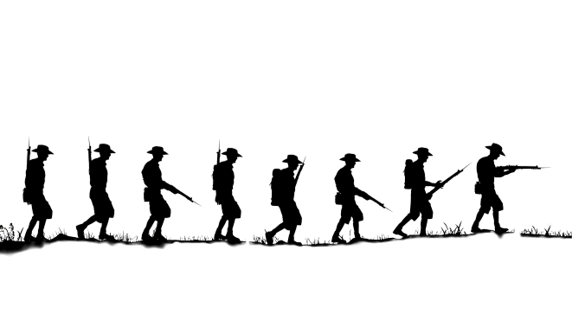
Task 1: Read ‘Dulce Et Decorum Est’ in pairs Read this extract from the story. How can you show the soldier’s feelings through your expression?
“Gas! Gas!”
The shout every soldier feared. Screaming voices pierced our addled minds, and suddenly each man stood upright and scrambled with numb fingers for their masks.
Notes:
How can we show the soldier’s feelings through our expression?

Slide 7
Task 2: Vocabulary Check Complete this table to show your understanding of these words
Word | Have you heard the word before? | What do you think it means? | Synonyms | Antonyms
addled
barren
flounder
Notes:
Children could use a scale to indicate if they have heard the word before – 1 indicating no, I’ve never heard it before and 5 indicating yes, I know this word well.

Slide 8
Task 3: Vocabulary Check Have a class discussion around these words and phrases!
Sometimes, I wish people could hear the blood bubbling in his lungs each time the cart jolted on the rutted field or the incurable sores that erupted on his tongue…
I assure you that if you saw those things, or heard those noises, you wouldn’t be so zealous in your cries for glory.
Notes:
What does ‘erupted’ suggest about the sores?

Slide 9
Task 4: Explain and justify
Complete the table below with one piece of evidence from the story to support each statement.
Statement | Evidence
The soldiers are tired.
The narrator is plagued by bad dreams.
The narrator is no longer sure about the honour and glory of war.
Notes:
If finished early, children could give a partner a statement and challenge them to find evidence.

Slide 10
Task 4: Your turn
Spend some time preparing your answer. Use evidence from the story.
Remember to:
Complete the table with at least one piece of evidence for each statement

Slide 11
Task 5: Let’s look at these answers! How did you do?
Statement | Evidence
The soldiers are tired. | Any words or phrases which refer to soldiers being tired and exhausted. For example: ‘trudged’, ‘bent double like old beggars’, marching while half-asleep’, ‘eyes dropping and jaw hanging open’, ‘limped on’, ‘drunk with fatigue’. They are struggling to walk, exhaustion has taken over them.

Slide 12
Task 5: Let’s look at these answers! How did you do?
Statement | Evidence
The narrator is plagued by bad dreams. | The dreams are described as being ‘the worst’ part of war. Rather than comforting the narrator they ‘smother’ them and make them feel anxious and fearful, The dreams themselves are horrible – dying soldiers are described in a nightmarish manner. The narrator wishes that others could understand how terrifying war is.
Notes:
Are there any other pieces of evidence that support this decision?

Slide 13
Task 5: Let’s look at these answers! How did you do?
Statement | Evidence
The narrator is no longer sure about the honour and glory of war. | Refer to evidence in the last paragraph. The narrator says that if you knew how terrifying war was and the horrible consequences of it, you wouldn’t be so eager to glorify war and tell children that it is the ‘sweet and fitting thing’ to die for your country – this is a lie. Young men who have been through war and suffered would agree with the narrator.

Slide 14
Task 6: Class discussion
How does the narrator feel about war? How do you think they want us to feel about war?
Use evidence from the story to support your opinion.
Notes:
Against glorifying war, describes the horror and fear, pointless deaths etc. Encourage chn to justify and explain.

Slide 15
Task 7: Class discussion
How did this story make you feel? Why?
Do you think the writer successfully conveys the horror of war? Do you have any favourite phrases or words that stand out for you?
Use evidence from the story to support your opinion.

Slide 16
You have reached the end of the lesson!
Spend some time reading and exploring the poem which this story is based on, Dulce Et Decorum Est by Wilfred Owen.
How did this poem make you feel? What did you like/dislike about it? Does it remind you of anything? Is there anything that confuses you?
Notes:
Encourage children to justify and explain.

