Slide 1
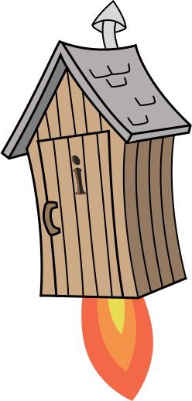
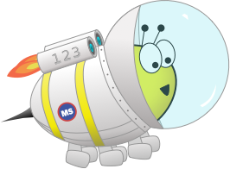
Quiz: QBOCXGN
Stage 6
Term 3 - Block 3 - Properties of Shape
Lesson 1 - To be able to measure with a protractor
3
Block 3 – Properties of Shape
1

Slide 2
To be able to measure with a protractor
Success criteria:
I can line up a protractor accurately and identify the correct scale to use, giving a correct measurement
I can explain my reasoning when lining up a protractor accurately and identify the correct scale to use, giving a correct measurement

Slide 3
To be able to measure with a protractor
Starter:
Revise the following angle terminology.
acute angle
(less than 90º)
right angle
(exactly 90º)
obtuse angle
(more than 90º, less than 180º)
straight line / half turn
(exactly 180º)
reflex angle
(between 180º and 360º)
full turn
(exactly 360º)

Slide 4
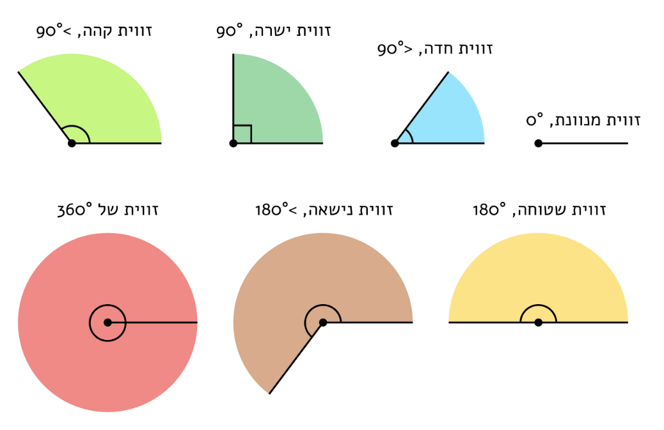
To be able to measure with a protractor
Starter:
Copy and translate the worksheet into your books.

Slide 5
To be able to measure with a protractor
Starter:
Copy and translate the worksheet into your books.
acute angle
(less than 90º)
obtuse angle
(between 90º
and 180º)
right angle
(exactly 90º)
straight line / half turn
(exactly 180º)
full turn
(exactly 360º)
reflex angle
(between 180º
and 360º)

Slide 6
To be able to measure with a protractor
Talking Time:
Look at the angle, then complete the sentences below:
C
A
B
It is a/an _______ angle. It has a measurement of ___º.

Slide 7
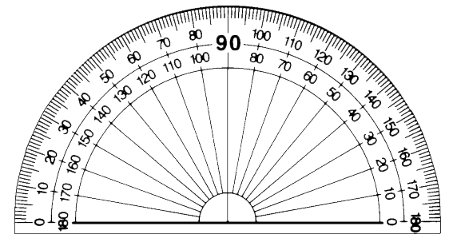
To be able to measure with a protractor
Talking Time:
Look at the angle, then complete the sentences below:
C
A
B
It is a/an _______ angle. It has a measurement of ___º.

Slide 8
To be able to measure with a protractor
Talking Time:
Look at the angle, then complete the sentences below:
C
A
B
It is a/an right angle. It has a measurement of 90º.
X

Slide 9
To be able to measure with a protractor
Talking Time:
Look at the angle, then complete the sentences below:
C
A
B
It is a/an _______ angle. It has a measurement of ___º.

Slide 10
To be able to measure with a protractor
Talking Time:
Look at the angle, then complete the sentences below:
C
A
B
It is a/an _______ angle. It has a measurement of ___º.

Slide 11
To be able to measure with a protractor
Talking Time:
Look at the angle, then complete the sentences below:
C
A
B
It is a/an acute angle. It has a measurement of 50º.
X

Slide 12
To be able to measure with a protractor
Talking Time:
Look at the angle, then complete the sentences below:
C
A
B
It is a/an _______ angle. It has a measurement of ___º.

Slide 13
To be able to measure with a protractor
Talking Time:
Look at the angle, then complete the sentences below:
C
A
B
It is a/an _______ angle. It has a measurement of ___º.

Slide 14
To be able to measure with a protractor
Talking Time:
Look at the angle, then complete the sentences below:
C
A
B
It is a/an obtuse angle. It has a measurement of 120º.
X

Slide 15
To be able to measure with a protractor
Talking Time:
Look at the angle, then complete the sentences below:
C
A
B
It is a/an _______ angle. It has a measurement of ___º.

Slide 16
To be able to measure with a protractor
Talking Time:
Look at the angle, then complete the sentences below:
C
A
B
It is a/an _______ angle. It has a measurement of ___º.

Slide 17
To be able to measure with a protractor
Talking Time:
Look at the angle, then complete the sentences below:
C
A
B
It is a/an acute angle. It has a measurement of 75º.
X

Slide 18
To be able to measure with a protractor
Talking Time:
Look at the angle, then complete the sentences below:
C
B
A
It is a/an _______ angle. It has a measurement of ___º.

Slide 19
To be able to measure with a protractor
Talking Time:
Look at the angle, then complete the sentences below:
C
B
A
It is a/an _______ angle. It has a measurement of ___º.

Slide 20
To be able to measure with a protractor
Talking Time:
Look at the angle, then complete the sentences below:
C
B
A
It is a/an obtuse angle. It has a measurement of 105º.
X

Slide 21
To be able to measure with a protractor
Draw angles and swap with a partner to measure them.
Activity 1:
Look at the angle, then complete the sentences below:
C
B
A
It is a/an _______ angle. It has a measurement of ___º.

Slide 22
To be able to measure with a protractor
Draw angles and swap with a partner to measure them.
Activity 1:
Look at the angle, then complete the sentences below:
C
B
A
It is a/an _______ angle. It has a measurement of ___º.

Slide 23
To be able to measure with a protractor
Teacher / peer assessment
Activity 1:
Look at the angle, then complete the sentences below:
C
B
A
It is a/an acute angle. It has a measurement of 45º.
X

Slide 24
To be able to measure with a protractor
Talking Time
Look at the angle, then complete the sentences below:
A
C
B
It is a/an _______ angle. It has a measurement of ___º.

Slide 25
To be able to measure with a protractor
Talking Time:
Look at the angle, then complete the sentences below:
A
C
B
It is a/an _______ angle. It has a measurement of ___º.

Slide 26
To be able to measure with a protractor
Talking Time:
Look at the angle, then complete the sentences below:
A
C
B
It is a/an acute angle. It has a measurement of 70º.
X

Slide 27
To be able to measure with a protractor
Talking Time:
Look at the angle, then complete the sentences below:
A
C
B
It is a/an _______ angle. It has a measurement of ___º.

Slide 28
To be able to measure with a protractor
Talking Time:
Look at the angle, then complete the sentences below:
A
C
B
It is a/an _______ angle. It has a measurement of ___º.

Slide 29
To be able to measure with a protractor
Talking Time:
Look at the angle, then complete the sentences below:
A
C
B
It is a/an obtuse angle. It has a measurement of 100º.
X

Slide 30
To be able to measure with a protractor
Talking Time:
Look at the angle, then complete the sentences below:
A
C
B
It is a/an _______ angle. It has a measurement of ___º.

Slide 31
To be able to measure with a protractor
Talking Time:
Look at the angle, then complete the sentences below:
A
C
B
It is a/an _______ angle. It has a measurement of ___º.

Slide 32
To be able to measure with a protractor
Talking Time:
Look at the angle, then complete the sentences below:
A
C
B
It is a/an obtuse angle. It has a measurement of 125º.
X

Slide 33
To be able to measure with a protractor
Talking Time:
Look at the angle, then complete the sentences below:
C
A
B
It is a/an _______ angle. It has a measurement of ___º.

Slide 34
To be able to measure with a protractor
Talking Time:
Look at the angle, then complete the sentences below:
C
A
B
It is a/an _______ angle. It has a measurement of ___º.

Slide 35
To be able to measure with a protractor
Talking Time:
Look at the angle, then complete the sentences below:
C
A
B
It is a/an obtuse angle. It has a measurement of 145º.
X

Slide 36
To be able to measure with a protractor
Talking Time:
Look at the angle, then complete the sentences below:
C
A
B
It is a/an _______ angle. It has a measurement of ___º.

Slide 37
To be able to measure with a protractor
Talking Time:
Look at the angle, then complete the sentences below:
C
A
B
It is a/an _______ angle. It has a measurement of ___º.

Slide 38
To be able to measure with a protractor
Talking Time:
Look at the angle, then complete the sentences below:
C
A
B
It is a/an acute angle. It has a measurement of 75º.
X

Slide 39
To be able to measure with a protractor
Draw angles and swap with a partner to measure them.
Activity 2:
Look at the angle, then complete the sentences below:
C
A
B
It is a/an _______ angle. It has a measurement of ___º.

Slide 40
To be able to measure with a protractor
Draw angles and swap with a partner to measure them.
Activity 2:
Look at the angle, then complete the sentences below:
C
A
B
It is a/an _______ angle. It has a measurement of ___º.

Slide 41
To be able to measure with a protractor
Teacher / peer assessment
Activity 2:
Look at the angle, then complete the sentences below:
C
A
B
It is a/an obtuse angle. It has a measurement of 115º.
X

Slide 42
To be able to measure with a protractor
Talking Time:
Look at the angle, then complete the sentences below:
C
A
B
It is a/an _______ angle. It has a measurement of ___º.

Slide 43
To be able to measure with a protractor
Talking Time:
Look at the angle, then complete the sentences below:
C
A
B
It is a/an _______ angle. It has a measurement of ___º.

Slide 44
To be able to measure with a protractor
Talking Time:
Look at the angle, then complete the sentences below:
C
A
B
It is a/an reflex angle. It has a measurement of 250º.
X

Slide 45
To be able to measure with a protractor
Talking Time:
Look at the angle, then complete the sentences below:
C
A
B
It is a/an _______ angle. It has a measurement of ___º.

Slide 46
To be able to measure with a protractor
Talking Time:
Look at the angle, then complete the sentences below:
C
A
B
It is a/an _______ angle. It has a measurement of ___º.

Slide 47
To be able to measure with a protractor
Talking Time:
Look at the angle, then complete the sentences below:
C
A
B
It is a/an reflex angle. It has a measurement of 285º.
X

Slide 48
To be able to measure with a protractor
Draw angles and swap with a partner to measure them.
Activity 3:
Look at the angle, then complete the sentences below:
A
c
B
It is a/an _______ angle. It has a measurement of ___º.

Slide 49
To be able to measure with a protractor
Draw angles and swap with a partner to measure them.
Activity 3:
Look at the angle, then complete the sentences below:
A
c
B
It is a/an _______ angle. It has a measurement of ___º.

Slide 50
To be able to measure with a protractor
Teacher / peer assessment
Activity 3:
Look at the angle, then complete the sentences below:
A
c
B
It is a/an reflex angle. It has a measurement of 325º.
X

Slide 51
To be able to measure with a protractor
Activity 4:
Draw an irregular quadrilateral, like the one shown below.
Measure all four of the angles. What is the sum of the four angles?
Explain your answer.
A
B
C
D

Slide 52
To be able to measure with a protractor
Activity 4:
Draw an irregular quadrilateral, like the one shown below.
The sum of the four angles must be 360º.
Teacher / peer assessment
A
B
C
D

Slide 53
To be able to measure with a protractor
Activity 5:
What are the values of each of the angles below?
Explain your answer.
Y
X
Z

Slide 54
To be able to measure with a protractor
Activity 5:
What are the values of each of the angles below?
X = 35º; Y = 55º; Z = 90º
Y
X
Z

Slide 55
To be able to measure with a protractor
Evaluation:
What has Astrobee done wrong?
Explain your answer.
C
The angle above measures 110º.
A
B

Slide 56
To be able to measure with a protractor
Evaluation:
Astrobee has measured using the incorrect scale. Astrobee could subtract this measurement from 360º or measure from the other scale, getting a measurement of 70º and add this to 180º to arrive at the correct answer, 250º.
C
The angle above measures 110º.
A
B

Slide 57
To be able to measure with a protractor
Success criteria:
I can line up a protractor accurately and identify the correct scale to use, giving a correct measurement
I can explain my reasoning when lining up a protractor accurately and identify the correct scale to use, giving a correct measurement

