Slide 1




Quiz: QOCRBWA
Stage 6
Term 2 - Block 2 - Percentages - Lesson 1
To be able to convert fractions to percentages
2
Block 2 – Percentages
2

Slide 2
To be able to convert fractions to percentages
Success criteria:
I can apply my knowledge that ’percent’ means out of one hundred to convert fractions to percentages
I can explain my reasoning when applying my knowledge that ’percent’ means out of one hundred to convert fractions to percentages

Slide 3
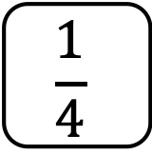
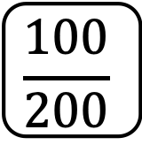
To be able to convert fractions to percentages
Starter:
Which one doesn’t belong?
Explain your answer.
$$\frac{1}{4}$$
50%
$$\frac{100}{200}$$
0.5

Slide 4
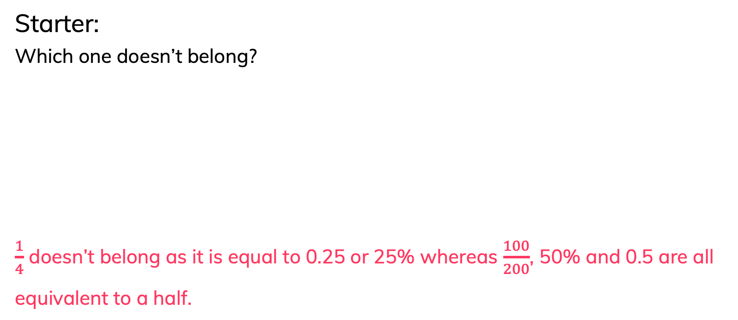
To be able to convert fractions to percentages
Starter:
Which one doesn’t belong?
$\frac{1}{4}$ doesn’t belong as it is equal to 0.25 or 25% whereas $\frac{100}{200}$, 50% and 0.5 are all equivalent to a half.
$$\frac{1}{4}$$
50%
$$\frac{100}{200}$$
0.5

Slide 5
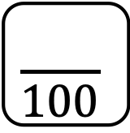
To be able to convert fractions to percentages
Talking Time:
Convert the shaded area into a fraction over 100, then into a percentage.
$$\frac{21}{100}$$
21%
=

Slide 6
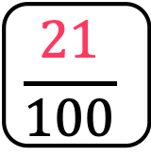
To be able to convert fractions to percentages
Talking Time:
Convert the shaded area into a fraction over 100, then into a percentage.
$$\frac{21}{100}$$
21%
=

Slide 7
To be able to convert fractions to percentages
Talking Time:
Convert the shaded area into a fraction over 100, then into a percentage.
$$\frac{21}{100}$$
21%
=

Slide 8
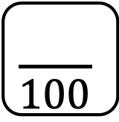
To be able to convert fractions to percentages
Talking Time:
Convert the shaded area into a fraction over 100, then into a percentage.
$$\frac{55}{100}$$
55%
=

Slide 9
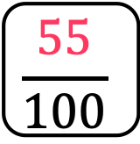
To be able to convert fractions to percentages
Talking Time:
Convert the shaded area into a fraction over 100, then into a percentage.
$$\frac{55}{100}$$
55%
=

Slide 10
To be able to convert fractions to percentages
Talking Time:
Convert the shaded area into a fraction over 100, then into a percentage.
$$\frac{55}{100}$$
55%
=

Slide 11
To be able to convert fractions to percentages
Talking Time:
Convert the shaded area into a fraction over 100, then into a percentage.
$$\frac{43}{100}$$
43%
=

Slide 12
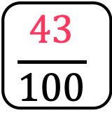
To be able to convert fractions to percentages
Talking Time:
Convert the shaded area into a fraction over 100, then into a percentage.
$$\frac{43}{100}$$
43%
=

Slide 13
To be able to convert fractions to percentages
Talking Time:
Convert the shaded area into a fraction over 100, then into a percentage.
$$\frac{43}{100}$$
43%
=

Slide 14
To be able to convert fractions to percentages
Talking Time:
Convert the shaded area into a fraction over 100, then into a percentage.
$$\frac{10}{100}$$
10%
=

Slide 15
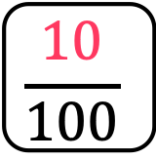
To be able to convert fractions to percentages
Talking Time:
Convert the shaded area into a fraction over 100, then into a percentage.
$$\frac{10}{100}$$
10%
=

Slide 16
To be able to convert fractions to percentages
Talking Time:
Convert the shaded area into a fraction over 100, then into a percentage.
$$\frac{10}{100}$$
10%
=

Slide 17
To be able to convert fractions to percentages
Talking Time:
Convert the shaded area into a fraction over 100, then into a percentage.
$$\frac{77}{100}$$
77%
=

Slide 18
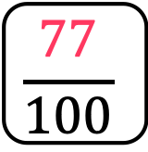
To be able to convert fractions to percentages
Talking Time:
Convert the shaded area into a fraction over 100, then into a percentage.
$$\frac{77}{100}$$
77%
=

Slide 19
To be able to convert fractions to percentages
Talking Time:
Convert the shaded area into a fraction over 100, then into a percentage.
$$\frac{77}{100}$$
77%
=

Slide 20
To be able to convert fractions to percentages
Talking Time:
Convert the shaded area into a fraction over 100, then into a percentage.
$$\frac{54}{100}$$
54%
=

Slide 21
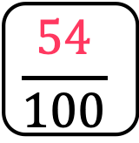
To be able to convert fractions to percentages
Talking Time:
Convert the shaded area into a fraction over 100, then into a percentage.
$$\frac{54}{100}$$
54%
=

Slide 22
To be able to convert fractions to percentages
Talking Time:
Convert the shaded area into a fraction over 100, then into a percentage.
$$\frac{54}{100}$$
54%
=

Slide 23
To be able to convert fractions to percentages
Talking Time:
Convert the shaded area into a fraction over 100, then into a percentage.
$$\frac{63}{100}$$
63%
=

Slide 24
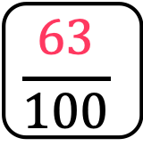
To be able to convert fractions to percentages
Talking Time:
Convert the shaded area into a fraction over 100, then into a percentage.
$$\frac{63}{100}$$
63%
=

Slide 25
To be able to convert fractions to percentages
Talking Time:
Convert the shaded area into a fraction over 100, then into a percentage.
$$\frac{63}{100}$$
63%
=

Slide 26
To be able to convert fractions to percentages
Talking Time:
Convert the shaded area into a fraction over 100, then into a percentage.
$$\frac{80}{100}$$
80%
=

Slide 27
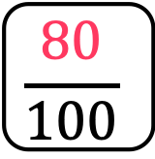
To be able to convert fractions to percentages
Talking Time:
Convert the shaded area into a fraction over 100, then into a percentage.
$$\frac{80}{100}$$
80%
=

Slide 28
To be able to convert fractions to percentages
Talking Time:
Convert the shaded area into a fraction over 100, then into a percentage.
$$\frac{80}{100}$$
80%
=

Slide 29
To be able to convert fractions to percentages
Talking Time:
Convert the shaded area into a fraction over 100, then into a percentage.
$$\frac{67}{100}$$
67%
=

Slide 30
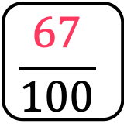
To be able to convert fractions to percentages
Talking Time:
Convert the shaded area into a fraction over 100, then into a percentage.
$$\frac{67}{100}$$
67%
=

Slide 31
To be able to convert fractions to percentages
Talking Time:
Convert the shaded area into a fraction over 100, then into a percentage.
$$\frac{67}{100}$$
67%
=

Slide 32
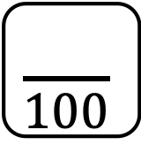
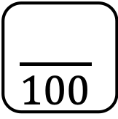
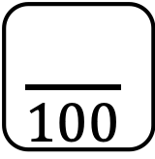
To be able to convert fractions to percentages
Activity 1:
Convert the shaded area into a fraction over 100, then into a percentage.
$$\frac{20}{100}$$
20%
$$\frac{81}{100}$$
81%
=
=
$$\frac{35}{100}$$
35%
$$\frac{79}{100}$$
79%
=
=

Slide 33
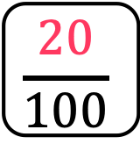
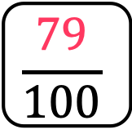
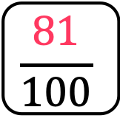

To be able to convert fractions to percentages
Activity 1:
Convert the shaded area into a fraction over 100, then into a percentage.
$$\frac{20}{100}$$
20%
$$\frac{81}{100}$$
81%
=
=
$$\frac{35}{100}$$
35%
$$\frac{79}{100}$$
79%
=
=

Slide 34
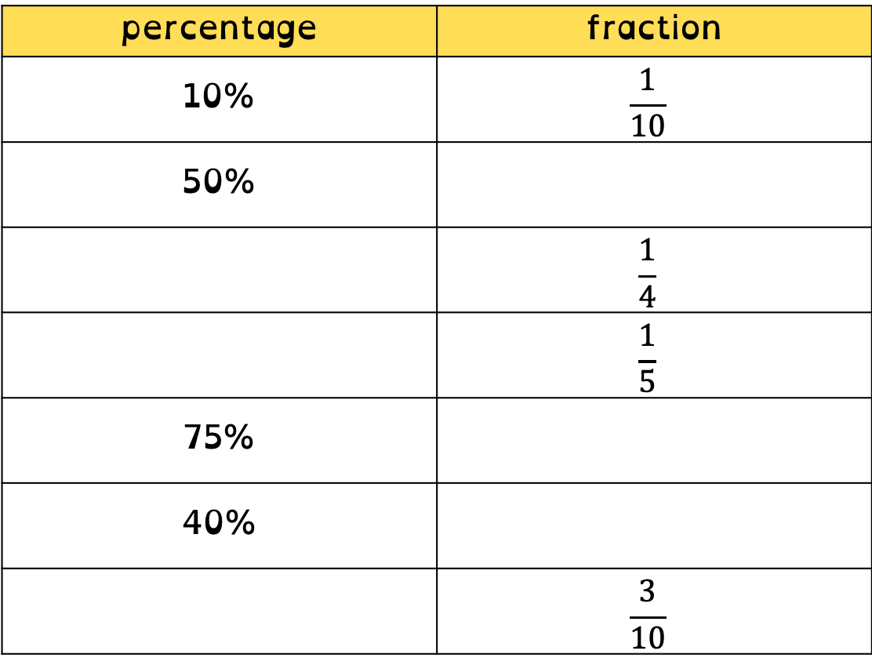
To be able to convert fractions to percentages
percentage | fraction
10% | $$\frac{1}{10}$$
50% | $$\frac{1}{2}$$
25% | $$\frac{1}{4}$$
20% | $$\frac{1}{5}$$
75% | $$\frac{3}{4}$$
40% | $$\frac{2}{5}$$
30% | $$\frac{3}{10}$$
Activity 2:
Complete the table, writing
fractions in their simplest forms:

Slide 35
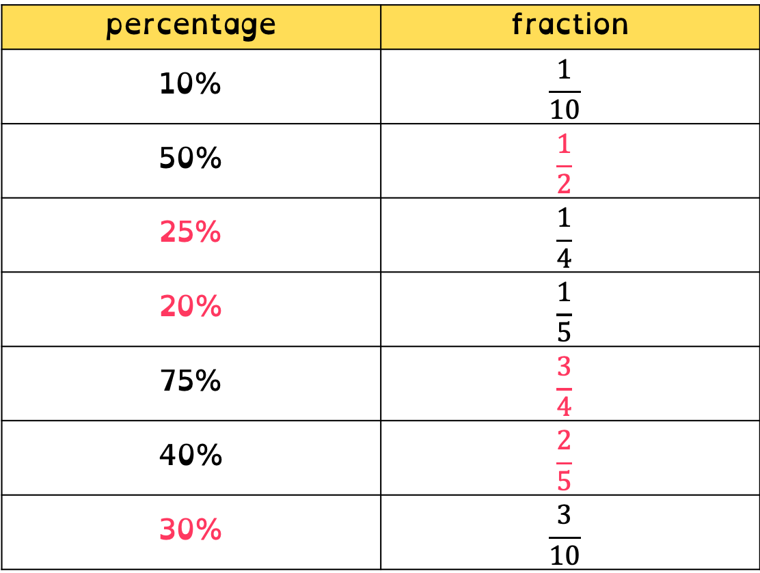
To be able to convert fractions to percentages
percentage | fraction
10% | $$\frac{1}{10}$$
50% | $$\frac{1}{2}$$
25% | $$\frac{1}{4}$$
20% | $$\frac{1}{5}$$
75% | $$\frac{3}{4}$$
40% | $$\frac{2}{5}$$
30% | $$\frac{3}{10}$$
Activity 2:
Complete the table, writing
fractions in their simplest forms:

Slide 36
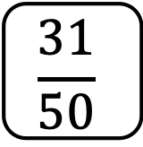
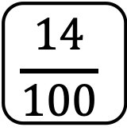
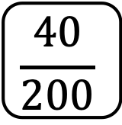
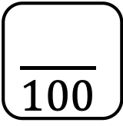
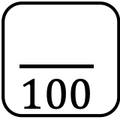

To be able to convert fractions to percentages
Talking Time:
Fill in the blanks below.
$$\frac{14}{100}$$
14%
$$\frac{47}{100}$$
47%
=
=
$$\frac{40}{200}$$
$$\frac{20}{100}$$
20%
$$\frac{31}{50}$$
$$\frac{62}{100}$$
62%
=
=
=
=

Slide 37
To be able to convert fractions to percentages
Talking Time:
Fill in the blanks below.
$$\frac{14}{100}$$
14%
$$\frac{47}{100}$$
47%
=
=
$$\frac{40}{200}$$
$$\frac{20}{100}$$
20%
$$\frac{31}{50}$$
$$\frac{62}{100}$$
62%
=
=
=
=

Slide 38
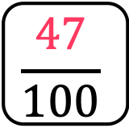
To be able to convert fractions to percentages
Talking Time:
Fill in the blanks below.
$$\frac{14}{100}$$
14%
$$\frac{47}{100}$$
47%
=
=
$$\frac{40}{200}$$
$$\frac{20}{100}$$
20%
$$\frac{31}{50}$$
$$\frac{62}{100}$$
62%
=
=
=
=

Slide 39

To be able to convert fractions to percentages
Talking Time:
Fill in the blanks below.
$$\frac{14}{100}$$
14%
$$\frac{47}{100}$$
47%
=
=
$$\frac{40}{200}$$
$$\frac{20}{100}$$
20%
$$\frac{31}{50}$$
$$\frac{62}{100}$$
62%
=
=
=
=

Slide 40

To be able to convert fractions to percentages
Talking Time:
Fill in the blanks below.
$$\frac{14}{100}$$
14%
$$\frac{47}{100}$$
47%
=
=
$$\frac{40}{200}$$
$$\frac{20}{100}$$
20%
$$\frac{31}{50}$$
$$\frac{62}{100}$$
62%
=
=
=
=

Slide 41
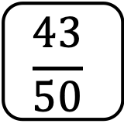
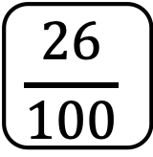
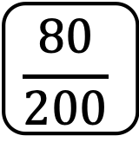

To be able to convert fractions to percentages
Activity 3:
Fill in the blanks below.
$$\frac{26}{100}$$
26%
$$\frac{59}{100}$$
59%
=
=
$$\frac{80}{200}$$
$$\frac{40}{100}$$
40%
$$\frac{43}{50}$$
$$\frac{86}{100}$$
86%
=
=
=
=

Slide 42
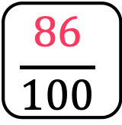
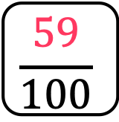
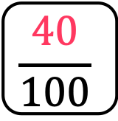
To be able to convert fractions to percentages
Activity 3:
Fill in the blanks below.
$$\frac{26}{100}$$
26%
$$\frac{59}{100}$$
59%
=
=
$$\frac{80}{200}$$
$$\frac{40}{100}$$
40%
$$\frac{43}{50}$$
$$\frac{86}{100}$$
86%
=
=
=
=

Slide 43
To be able to convert fractions to percentages
Activity 4:
Solve the word problems below.
Ruth and Jamal are comparing how much battery life their phones have.
Ruth’s phone has 55% battery life remaining; Jamal’s phone is half charged.
Whose phone has more battery life?
James and Yasmin took part in a spelling competition.
James got three quarters of the spellings correct; Yasmin got 75% correct.
James says, “I got more spellings correct.”
Do you agree?
Explain your answer.

Slide 44
To be able to convert fractions to percentages
Activity 4:
Solve the word problems below.
Ruth and Jamal are comparing how much battery life their phones have.
Ruth’s phone has 55% battery life remaining; Jamal’s phone is half charged.
Whose phone has more battery life?
Ruth’s phone has more battery life as 55% is more than half (or 50%).
James and Yasmin took part in a spelling competition.
James got three quarters of the spellings correct; Yasmin got 75% correct.
James says, “I got more spellings correct.”
Do you agree?
Explain your answer.

Slide 45
To be able to convert fractions to percentages
Activity 4:
Solve the word problems below.
Ruth and Jamal are comparing how much battery life their phones have.
Ruth’s phone has 55% battery life remaining; Jamal’s phone is half charged.
Whose phone has more battery life?
Ruth’s phone has more battery life as 55% is more than half (or 50%).
James and Yasmin took part in a spelling competition.
James got three quarters of the spellings correct; Yasmin got 75% correct.
James says, “I got more spellings correct.”
Three quarters is 75% as a percentage. So Yasmin and James got the same score, meaning James is incorrect.

Slide 46
To be able to convert fractions to percentages
Activity 5:
Look at the diagram.
Ahmed says, “12% of the diagram is green.”
Chen says, “24% of the diagram is green.”
Who do you agree with?
Explain your answer.

Slide 47
To be able to convert fractions to percentages
Activity 5:
Look at the diagram.
Ahmed says, “12% of the diagram is green.”
Chen says, “24% of the diagram is green.”
I agree with Chen as there are a total of 50 small squares in the diagram and 12 are green, as each small square is worth 2%, it means 24% of the diagram is green.

Slide 48
To be able to convert fractions to percentages
Evaluation:
Is Astrobee’s statement always, sometimes or never true?
Explain your answer.
If one fraction has a greater numerator than another fraction, it will be greater as a percentage.

Slide 49

To be able to convert fractions to percentages
Evaluation:
Astrobee’s statement is only sometimes true. For example, $\frac{63}{100}$ is greater as a percentage than $\frac{1}{10}$ as 63% > 10%; however, $\frac{4}{5}$ is greater than $\frac{77}{100}$ as 80% > 77%.
If one fraction has a greater numerator than another fraction, it will be greater as a percentage.

Slide 50
To be able to convert fractions to percentages
Success criteria:
I can apply my knowledge that ’percent’ means out of one hundred to convert fractions to percentages
I can explain my reasoning when applying my knowledge that ’percent’ means out of one hundred to convert fractions to percentages

