Slide 1
Quiz: QCRQEVT
Stage 4 Term 2 - Block 1 - Multiplication and Division
Lesson 4: To be able to divide by 100
Autumn
Block 4 – Multiplication and Division
4

Slide 2
To be able to divide by 100
Success criteria:
I can use concrete, pictorial and abstract representations to show that making something one hundred times smaller is the same as dividing by 100
I can explain my reasoning when using concrete, pictorial and abstract representations to show that making something one hundred times smaller is the same as dividing by 100

Slide 3
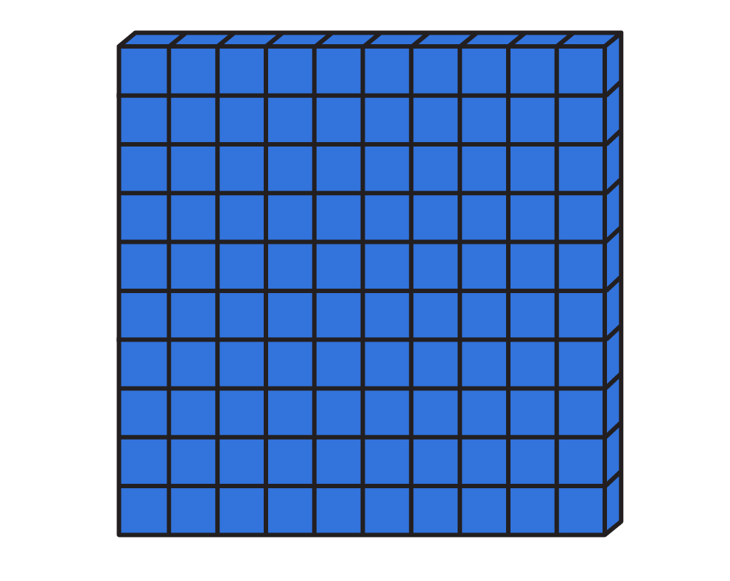
To be able to divide by 100
Starter:
What’s the same? What’s different?
Explain your answer.

Slide 4
To be able to divide by 100
Starter:
What’s the same? What’s different?
Both representations have starting amounts of 300; however, the Base 10 has been divided by 100 to 3, whereas the counters have been divided by 10 to 30.

Slide 5
To be able to divide by 100
Talking Time:
Use counters to calculate: 500 ÷ 10 = ___ and then 500 ÷ 100 = ___
hundreds | tens | ones

Slide 6
To be able to divide by 100
Talking Time:
Use counters to calculate: 500 ÷ 10 = ___ and then 500 ÷ 100 = ___
hundreds | tens | ones

Slide 7
To be able to divide by 100
Talking Time:
Use counters to calculate: 500 ÷ 10 = 50 and then 500 ÷ 100 = ___
hundreds | tens | ones

Slide 8
To be able to divide by 100
Talking Time:
Use counters to calculate: 500 ÷ 10 = 50 and then 500 ÷ 100 = 5
hundreds | tens | ones

Slide 9
To be able to divide by 100
Talking Time:
Use counters to calculate: 300 ÷ 10 = ___ and then 300 ÷ 100 = ___
hundreds | tens | ones

Slide 10
To be able to divide by 100
Talking Time:
Use counters to calculate: 300 ÷ 10 = ___ and then 300 ÷ 100 = ___
hundreds | tens | ones

Slide 11
To be able to divide by 100
Talking Time:
Use counters to calculate: 300 ÷ 10 = 30 and then 300 ÷ 100 = ___
hundreds | tens | ones

Slide 12
To be able to divide by 100
Talking Time:
Use counters to calculate: 300 ÷ 10 = 30 and then 300 ÷ 100 = 3
hundreds | tens | ones

Slide 13
To be able to divide by 100
Talking Time:
Use counters to calculate: 400 ÷ 10 = ___ and then 400 ÷ 100 = ___
hundreds | tens | ones

Slide 14
To be able to divide by 100
Talking Time:
Use counters to calculate: 400 ÷ 10 = ___ and then 400 ÷ 100 = ___
hundreds | tens | ones

Slide 15
To be able to divide by 100
Talking Time:
Use counters to calculate: 400 ÷ 10 = 40 and then 400 ÷ 100 = ___
hundreds | tens | ones

Slide 16
To be able to divide by 100
Talking Time:
Use counters to calculate: 400 ÷ 10 = 40 and then 400 ÷ 100 = 4
hundreds | tens | ones

Slide 17
To be able to divide by 100
Talking Time:
What knowledge can we use to solve the calculation below?
thousands | hundreds | tens | ones
 | 2 | 0 | 0
200 ÷ 100 = 2
How do we divide by 100?

Slide 18
To be able to divide by 100
Talking Time:
What knowledge can we use to solve the calculation below?
thousands | hundreds | tens | ones
 | 2 | 0 | 0
 |  |  | 2
200 ÷ 100 = 2
We slide the digits right by two places!

Slide 19
To be able to divide by 100
Talking Time:
What knowledge can we use to solve the calculation below?
thousands | hundreds | tens | ones
 | 7 | 0 | 0
700 ÷ 100 = 2
How do we divide by 100?

Slide 20
To be able to divide by 100
Talking Time:
What knowledge can we use to solve the calculation below?
thousands | hundreds | tens | ones
 | 7 | 0 | 0
 |  |  | 7
700 ÷ 100 = 7
We slide the digits right by two places!

Slide 21
To be able to divide by 100
Talking Time:
What knowledge can we use to solve the calculation below?
thousands | hundreds | tens | ones
 | 9 | 0 | 0
900 ÷ 100 = 2
How do we divide by 100?

Slide 22
To be able to divide by 100
Talking Time:
What knowledge can we use to solve the calculation below?
thousands | hundreds | tens | ones
 | 9 | 0 | 0
 |  |  | 9
900 ÷ 100 = 9
We slide the digits right by two places!

Slide 23
To be able to divide by 100
Talking Time:
What knowledge can we use to solve the calculation below?
thousands | hundreds | tens | ones
3 | 9 | 0 | 0
3,900 ÷ 10 = 390
How do we divide by 10?

Slide 24
To be able to divide by 100
Talking Time:
What knowledge can we use to solve the calculation below?
thousands | hundreds | tens | ones
3 | 9 | 0 | 0
 | 3 | 9 | 0
3,900 ÷ 10 = 390
We slide the digits right by one place!

Slide 25
To be able to divide by 100
Talking Time:
What knowledge can we use to solve the calculation below?
thousands | hundreds | tens | ones
3 | 9 | 0 | 0
3,900 ÷ 100 = 39
How do we divide by 100?

Slide 26
To be able to divide by 100
Talking Time:
What knowledge can we use to solve the calculation below?
thousands | hundreds | tens | ones
3 | 9 | 0 | 0
 |  | 3 | 9
3,900 ÷ 100 = 39
We slide the digits right by two places!

Slide 27
To be able to divide by 100
Talking Time:
What knowledge can we use to solve the calculation below?
thousands | hundreds | tens | ones
6 | 5 | 0 | 0
6,500 ÷ 100 = 39
How do we divide by 100?

Slide 28
To be able to divide by 100
Talking Time:
What knowledge can we use to solve the calculation below?
thousands | hundreds | tens | ones
6 | 5 | 0 | 0
 |  | 6 | 5
6,500 ÷ 100 = 65
We slide the digits right by two places!

Slide 29
To be able to divide by 100
Talking Time:
What knowledge can we use to solve the calculation below?
thousands | hundreds | tens | ones
6 | 5 | 0 | 0
6,500 ÷ 10 = 390
How do we divide by 10?

Slide 30
To be able to divide by 100
Talking Time:
What knowledge can we use to solve the calculation below?
thousands | hundreds | tens | ones
6 | 5 | 0 | 0
 | 6 | 5 | 0
6,500 ÷ 10 = 650
We slide the digits right by one place!

Slide 31
To be able to divide by 100
Talking Time:
What knowledge can we use to solve the calculation below?
thousands | hundreds | tens | ones
4 | 4 | 0 | 0
4,400 ÷ 10 = 390
How do we divide by 10?

Slide 32
To be able to divide by 100
Talking Time:
What knowledge can we use to solve the calculation below?
thousands | hundreds | tens | ones
4 | 4 | 0 | 0
 | 4 | 4 | 0
4,400 ÷ 10 = 440
We slide the digits right by one place!

Slide 33
To be able to divide by 100
Talking Time:
What knowledge can we use to solve the calculation below?
thousands | hundreds | tens | ones
4 | 4 | 0 | 0
4,400 ÷ 100 = 39
How do we divide by 100?

Slide 34
To be able to divide by 100
Talking Time:
What knowledge can we use to solve the calculation below?
thousands | hundreds | tens | ones
4 | 4 | 0 | 0
 |  | 4 | 4
4,400 ÷ 100 = 44
We slide the digits right by two places!

Slide 35
To be able to divide by 100
Talking Time:
Match each calculation with the correct result.
3,600 ÷ 100
36
36 x 10
3,600 ÷ 10
360
360 ÷ 10

Slide 36
To be able to divide by 100
Talking Time:
Match each calculation with the correct result.
3,600 ÷ 100
36
36 x 10
3,600 ÷ 10
360
360 ÷ 10

Slide 37
To be able to divide by 100
Talking Time:
Match each calculation with the correct result.
3,600 ÷ 100
36
36 x 10
3,600 ÷ 10
360
360 ÷ 10

Slide 38
To be able to divide by 100
Talking Time:
Match each calculation with the correct result.
3,600 ÷ 100
36
36 x 10
3,600 ÷ 10
360
360 ÷ 10

Slide 39
To be able to divide by 100
Talking Time:
Match each calculation with the correct result.
3,600 ÷ 100
36
36 x 10
3,600 ÷ 10
360
360 ÷ 10

Slide 40
To be able to divide by 100
Activity 1:
Match each calculation with the correct result.
5,400 ÷ 100
540
54 x 10
5,400 ÷ 10
54
540 ÷ 10

Slide 41
To be able to divide by 100
Activity 1:
Match each calculation with the correct result.
5,400 ÷ 100
540
54 x 10
5,400 ÷ 10
54
540 ÷ 10

Slide 42
To be able to divide by 100
Talking Time:
Use the comparison symbols (<, > or =) to complete the following statements:
530 ÷ 10
5,300 ÷ 100
5,300 ÷ 10
53 x 100
350 ÷ 10
3,500 ÷ 10
530 ÷ 10
3,500 ÷ 100

Slide 43
To be able to divide by 100
Talking Time:
Use the comparison symbols (<, > or =) to complete the following statements:
530 ÷ 10
=
5,300 ÷ 100
5,300 ÷ 10
53 x 100
350 ÷ 10
3,500 ÷ 10
530 ÷ 10
3,500 ÷ 100

Slide 44
To be able to divide by 100
Talking Time:
Use the comparison symbols (<, > or =) to complete the following statements:
530 ÷ 10
=
5,300 ÷ 100
5,300 ÷ 10
<
53 x 100
350 ÷ 10
3,500 ÷ 10
530 ÷ 10
3,500 ÷ 100

Slide 45
To be able to divide by 100
Talking Time:
Use the comparison symbols (<, > or =) to complete the following statements:
530 ÷ 10
=
5,300 ÷ 100
5,300 ÷ 10
<
53 x 100
350 ÷ 10
<
3,500 ÷ 10
530 ÷ 10
3,500 ÷ 100

Slide 46
To be able to divide by 100
Talking Time:
Use the comparison symbols (<, > or =) to complete the following statements:
530 ÷ 10
=
5,300 ÷ 100
5,300 ÷ 10
<
53 x 100
350 ÷ 10
<
3,500 ÷ 10
530 ÷ 10
>
3,500 ÷ 100

Slide 47
To be able to divide by 100
Activity 2:
Use the comparison symbols (<, > or =) to complete the following statements:
4,700 ÷ 10
4,700 ÷ 100
47 x 100
4,700 ÷ 10
740 ÷ 10
7,400 ÷ 100
740 ÷ 10
4,700 ÷ 10

Slide 48
To be able to divide by 100
Activity 2:
Use the comparison symbols (<, > or =) to complete the following statements:
4,700 ÷ 10
>
4,700 ÷ 100
47 x 100
>
4,700 ÷ 10
740 ÷ 10
=
7,400 ÷ 100
740 ÷ 10
<
4,700 ÷ 10

Slide 49
To be able to divide by 100
Activity 3:
Fill in the blank spaces to complete the statements below:
5,300 ÷ 100
=
__ x 10
84 x 10
=
8,_00 ÷ 10
746 x 10
=
7,_60
8,300 ÷ 100
=
_3

Slide 50
To be able to divide by 100
Activity 3:
Fill in the blank spaces to complete the statements below:
5,300 ÷ 100
=
53 x 10
84 x 10
=
8,400 ÷ 10
746 x 10
=
7,460
8,300 ÷ 100
=
83

Slide 51
To be able to divide by 100
Activity 4:
Jamal and Ruth are both dividing numbers by ten and one hundred.
To begin with they start with the same dividend, a four-digit number.
Ruth says, “My quotient has 0 ones, 3 tens and 7 hundreds.”
Jamal says, ”My quotient has 3 ones and 7 tens.”
What number did they both have as their dividend?
Who has divided by ten and who has divided by one hundred? Explain your answer.

Slide 52
To be able to divide by 100
Activity 4:
Jamal and Ruth are both dividing numbers by 10 and 100.
To begin with they start with the same dividend, a four-digit number.
Ruth says, “My quotient has 0 ones, 3 tens and 7 hundreds.”
Jamal says, ”My quotient has 3 ones and 7 tens.”
They both had the number 7,300 as their dividend.
Ruth has divided by ten as 7,300 ÷ 10 = 730 (seven hundreds and three tens) and Jamal has divided by one hundred as 7,300 ÷ 10 = 73 (seven tens and three ones)

Slide 53
To be able to divide by 100
Evaluation:
Is Astrobee’s statement always, sometimes or never true?
Explain your answer.
If you divide a number by 10 it has a greater quotient than any number divided by 100.

Slide 54
To be able to divide by 100
Evaluation:
Astrobee’s statement is only sometimes true. For example, if I divide 5,400 by 10, the quotient (540) is greater than if I divided 4,500 by 100 (with a quotient of 45); however, if I divided 320 by 10 (it has a quotient of 32), then divided 5,600 by 100, I receive a greater quotient of 56.
If you divide a number by 10 it has a greater quotient than any number divided by 100.

Slide 55
To be able to divide by 100
Success criteria:
I can use concrete, pictorial and abstract representations to show that making something one hundred times smaller is the same as dividing by 100
I can explain my reasoning when using concrete, pictorial and abstract representations to show that making something one hundred times smaller is the same as dividing by 100

