Slide 1




Quiz: QQPIMIX
Stage 4
Term 2 - Block 1 - Multiplication and Division - Lesson 1 - To be able to multiply by 10
2
Block 1 – Multiplication and Division
1

Slide 2
To be able to multiply by 10
Success criteria:
I can use concrete, pictorial and abstract representations to show that making something ten times greater is the same as multiplying by 10
I can explain my reasoning when using concrete, pictorial and abstract representations to show that making something ten times greater is the same as multiplying by 10

Slide 3

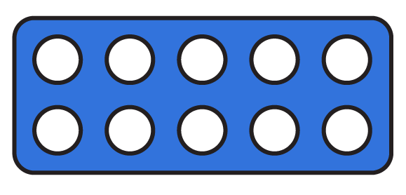
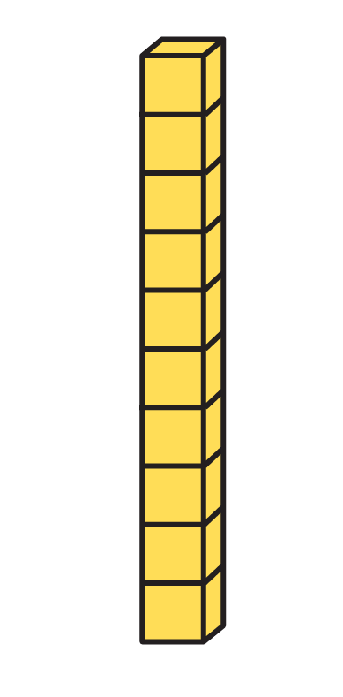
To be able to multiply by 10
Starter:
Which one doesn’t belong?
Explain your answer.

Slide 4
To be able to multiply by 10
Starter:
Which one doesn’t belong?
The place value counters don’t belong as they represent 50, whereas the Numicon Shape, straw bundles and Base Ten pieces all represent 40.

Slide 5
To be able to multiply by 10
Talking Time:
If Yasmin has one straw and Jamal has ten times as many, how many straws does Jamal have?
Explain your answer.

Slide 6
To be able to multiply by 10
Talking Time:
If Yasmin has one straw and Jamal has ten times as many, how many straws does Jamal have?
Jamal has ten straws, as ten is ten times greater than one.

Slide 7
To be able to multiply by 10
Talking Time:
If James has two beads and Yasmin has ten times as many, how many beads does Yasmin have?
Explain your answer.

Slide 8
To be able to multiply by 10
Talking Time:
If James has two beads and Yasmin has ten times as many, how many beads does Yasmin have?
Yasmin has twenty beads, as twenty is ten times greater than two.

Slide 9

To be able to multiply by 10
Talking Time:
If Chen has five cubes and Ruth has ten times as many, how many cubes does Ruth have?
Explain your answer.

Slide 10

To be able to multiply by 10
Talking Time:
If Chen has five cubes and Ruth has ten times as many, how many cubes does Ruth have?
Ruth has fifty cubes, as fifty is ten times greater than five.

Slide 11
To be able to multiply by 10
Talking Time:
Use Base Ten pieces to calculate: 7 x 10 =
tens | ones

Slide 12
To be able to multiply by 10
Talking Time:
Use Base Ten pieces to calculate: 7 x 10 = 70
tens | ones

Slide 13
To be able to multiply by 10
Talking Time:
Use straws to calculate: 10 x 4 =
tens | ones

Slide 14
To be able to multiply by 10
Talking Time:
Use straws to calculate: 10 x 4 = 40
tens | ones

Slide 15
To be able to multiply by 10
Talking Time:
Use place value coins to calculate: 6 x 10 =
tens | ones

Slide 16
To be able to multiply by 10
Talking Time:
Use place value coins to calculate: 6 x 10 = 60
tens | ones

Slide 17
To be able to multiply by 10
Talking Time:
Use a number bead string to calculate: 10 x 2 =
tens | ones

Slide 18
To be able to multiply by 10
Talking Time:
Use a number bead string to calculate: 10 x 2 = 20
tens | ones

Slide 19
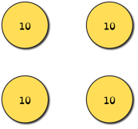
To be able to multiply by 10
Activity 1:
Use a variety of mathematical equipment to help you calculate…
3 x 10 =
10 x 5 =
4 x 10 =
10 x 7 =
10 x 9 =
8 x 10 =
6 x 10 =

Slide 20
To be able to multiply by 10
Activity 1:
Use a variety of mathematics equipment to help you calculate…
Example:
3 x 10 = 30
10 x 5 = 50
4 x 10 = 40
10 x 7 = 70
10 x 9 = 90
8 x 10 = 80
6 x 10 = 60

Slide 21
To be able to multiply by 10
Talking Time:
Match the number story to the relevant bar model.
Six hens lay ten eggs each
10 | 10 | 10 | 10
Four friends buy ten cookies each
5 | 5 | 5 | 5 | 5 | 5 | 5 | 5 | 5 | 5
Ten cats each catch seven mice
10 | 10 | 10 | 10 | 10 | 10
Ten dogs each round up five sheep
7 | 7 | 7 | 7 | 7 | 7 | 7 | 7 | 7 | 7

Slide 22
To be able to multiply by 10
Talking Time:
Match the number story to the relevant bar model.
Six hens lay ten eggs each
10 | 10 | 10 | 10
Four friends buy ten cookies each
5 | 5 | 5 | 5 | 5 | 5 | 5 | 5 | 5 | 5
Ten cats each catch seven mice
10 | 10 | 10 | 10 | 10 | 10
Ten dogs each round up five sheep
7 | 7 | 7 | 7 | 7 | 7 | 7 | 7 | 7 | 7

Slide 23
To be able to multiply by 10
Talking Time:
Match the number story to the relevant bar model.
Six hens lay ten eggs each
10 | 10 | 10 | 10
Four friends buy ten cookies each
5 | 5 | 5 | 5 | 5 | 5 | 5 | 5 | 5 | 5
Ten cats each catch seven mice
10 | 10 | 10 | 10 | 10 | 10
Ten dogs each round up five sheep
7 | 7 | 7 | 7 | 7 | 7 | 7 | 7 | 7 | 7

Slide 24
To be able to multiply by 10
Talking Time:
Match the number story to the relevant bar model.
Six hens lay ten eggs each
10 | 10 | 10 | 10
Four friends buy ten cookies each
5 | 5 | 5 | 5 | 5 | 5 | 5 | 5 | 5 | 5
Ten cats each catch seven mice
10 | 10 | 10 | 10 | 10 | 10
Ten dogs each round up five sheep
7 | 7 | 7 | 7 | 7 | 7 | 7 | 7 | 7 | 7

Slide 25
To be able to multiply by 10
Talking Time:
Match the number story to the relevant bar model.
Six hens lay ten eggs each
10 | 10 | 10 | 10
Four friends buy ten cookies each
5 | 5 | 5 | 5 | 5 | 5 | 5 | 5 | 5 | 5
Ten cats each catch seven mice
10 | 10 | 10 | 10 | 10 | 10
Ten dogs each round up five sheep
7 | 7 | 7 | 7 | 7 | 7 | 7 | 7 | 7 | 7

Slide 26
To be able to multiply by 10
Activity 2:
Match the number story to the relevant bar model.
Seven friends pick ten apples each
10 | 10 | 10 | 10 | 10
Ten falcons each catch eight mice
4 | 4 | 4 | 4 | 4 | 4 | 4 | 4 | 4 | 4
Five policemen each catch ten burglars
10 | 10 | 10 | 10 | 10 | 10 | 10
Ten cowboys each round up four cows
8 | 8 | 8 | 8 | 8 | 8 | 8 | 8 | 8 | 8

Slide 27
To be able to multiply by 10
Activity 2:
Match the number story to the relevant bar model.
Seven friends pick ten apples each
10 | 10 | 10 | 10 | 10
Ten falcons each catch eight mice
4 | 4 | 4 | 4 | 4 | 4 | 4 | 4 | 4 | 4
Five policemen each catch ten burglars
10 | 10 | 10 | 10 | 10 | 10 | 10
Ten cowboys each round up four cows
8 | 8 | 8 | 8 | 8 | 8 | 8 | 8 | 8 | 8

Slide 28


To be able to multiply by 10
tens | ones
Talking Time:
Complete the statements below.
Each of the rows has _ tens and _ ones.
So, each row has a total of __.
There are __ rows in total.
The calculation represented is:
__ x __ = __ or __ x __ = __

Slide 29
To be able to multiply by 10
tens | ones
Talking Time:
Complete the statements below.
Each of the rows has 1 tens and 2 ones.
So, each row has a total of 12.
There are 10 rows in total.
The calculation represented is:
12 x 10 = 120 or 10 x 12 = 120

Slide 30
To be able to multiply by 10
tens | ones
Talking Time:
Complete the statements below.
Each of the rows has _ tens and _ ones.
So, each row has a total of __.
There are __ rows in total.
The calculation represented is:
__ x __ = __ or __ x __ = __

Slide 31
To be able to multiply by 10
tens | ones
Talking Time:
Complete the statements below.
Each of the rows has 2 tens and 3 ones.
So, each row has a total of 23.
There are 10 rows in total.
The calculation represented is:
23 x 10 = 230 or 10 x 23 = 230

Slide 32
To be able to multiply by 10
tens | ones
Activity 3:
Complete the statements below.
Each of the rows has _ tens and _ ones.
So, each row has a total of __.
There are __ rows in total.
The calculation represented is:
__ x __ = __ or __ x __ = __

Slide 33
To be able to multiply by 10
tens | ones
Activity 3:
Complete the statements below.
Each of the rows has 4 tens and 5 ones.
So, each row has a total of 45.
There are 10 rows in total.
The calculation represented is:
45 x 10 = 450 or 10 x 45 = 450

Slide 34
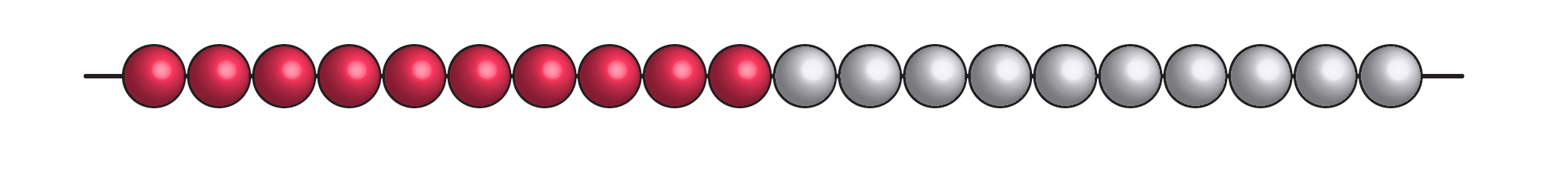
To be able to multiply by 10
Talking Time:
What knowledge can we use to solve the calculation below?
2 x ? = 20

Slide 35
To be able to multiply by 10
Talking Time:
What knowledge can we use to solve the calculation below?
2 x 10 = 20

Slide 36
To be able to multiply by 10
Talking Time:
What knowledge can we use to solve the calculation below?
10 x ? = 40

Slide 37
To be able to multiply by 10
Talking Time:
What knowledge can we use to solve the calculation below?
10 x 4 = 40

Slide 38

To be able to multiply by 10
Talking Time:
What knowledge can we use to solve the calculation below?
80 = 10 x ?

Slide 39
To be able to multiply by 10
Talking Time:
What knowledge can we use to solve the calculation below?
80 = 10 x 8

Slide 40
To be able to multiply by 10
Talking Time:
What knowledge can we use to solve the calculation below?
hundreds | tens | ones
 |  | 7
7 x 10 =
How do we multiply by 10?

Slide 41
To be able to multiply by 10
Talking Time:
What knowledge can we use to solve the calculation below?
hundreds | tens | ones
 |  | 7
 | 7 | 0
7 x 10 = 70
We slide the digits left by one place!

Slide 42
To be able to multiply by 10
Talking Time:
What knowledge can we use to solve the calculation below?
hundreds | tens | ones
 |  | 5
5 x 10 =
How do we multiply by 10?

Slide 43
To be able to multiply by 10
Talking Time:
What knowledge can we use to solve the calculation below?
hundreds | tens | ones
 |  | 5
 | 5 | 0
5 x 10 = 50
We slide the digits left by one place!

Slide 44
To be able to multiply by 10
Talking Time:
What knowledge can we use to solve the calculation below?
hundreds | tens | ones
 | 1 | 0
10 x 10 =
How do we multiply by 10?

Slide 45
To be able to multiply by 10
Talking Time:
What knowledge can we use to solve the calculation below?
hundreds | tens | ones
 | 1 | 0
1 | 0 | 0
10 x 10 = 100
We slide the digits left by one place!

Slide 46
To be able to multiply by 10
Talking Time:
What knowledge can we use to solve the calculation below?
hundreds | tens | ones
 | 1 | 4
14 x 10 =
How do we multiply by 10?

Slide 47
To be able to multiply by 10
Talking Time:
What knowledge can we use to solve the calculation below?
hundreds | tens | ones
 | 1 | 4
1 | 4 | 0
14 x 10 = 140
We slide the digits left by one place!

Slide 48
To be able to multiply by 10
Talking Time:
What knowledge can we use to solve the calculation below?
hundreds | tens | ones
 | 1 | 9
10 x 19 =
How do we multiply by 10?

Slide 49
To be able to multiply by 10
Talking Time:
What knowledge can we use to solve the calculation below?
hundreds | tens | ones
 | 1 | 9
1 | 9 | 0
10 x 19 = 190
We slide the digits left by one place!

Slide 50
To be able to multiply by 10
Talking Time:
What knowledge can we use to solve the calculation below?
hundreds | tens | ones
 | 1 | 7
17 x 10 =
How do we multiply by 10?

Slide 51
To be able to multiply by 10
Talking Time:
What knowledge can we use to solve the calculation below?
hundreds | tens | ones
 | 1 | 7
1 | 7 | 0
17 x 10 = 170
We slide the digits left by one place!

Slide 52
To be able to multiply by 10
Talking Time:
What knowledge can we use to solve the calculation below?
hundreds | tens | ones
 | 3 | 5
10 x 35 =
How do we multiply by 10?

Slide 53
To be able to multiply by 10
Talking Time:
What knowledge can we use to solve the calculation below?
hundreds | tens | ones
 | 3 | 5
3 | 5 | 0
10 x 35 = 350
We slide the digits left by one place!

Slide 54
To be able to multiply by 10
Talking Time:
What knowledge can we use to solve the calculation below?
hundreds | tens | ones
 | 7 | 4
74 x 10 =
How do we multiply by 10?

Slide 55
To be able to multiply by 10
Talking Time:
What knowledge can we use to solve the calculation below?
hundreds | tens | ones
 | 7 | 4
7 | 4 | 0
74 x 10 = 740
We slide the digits left by one place!

Slide 56
To be able to multiply by 10
Activity 4:
Is the following statement always, sometimes or never true?
When using a place value chart to multiply by 10,
you move the digits one place to the right.
Explain your answer.

Slide 57
To be able to multiply by 10
Activity 4:
Is the following statement always, sometimes or never true?
When using a place value chart to multiply by 10,
you move the digits one place to the right.
The statement above is never true – when using a place value chart to multiply by 10, you move the digits one place to the left as the number is becoming ten times greater.

Slide 58
To be able to multiply by 10
Activity 5:
Ruth has multiplied a two-digit number by 10 and has received a result between 640 and 740 (not including 640 and 740).
What possible calculations might she have performed?
Explain your answer.

Slide 59
To be able to multiply by 10
Activity 5:
Ruth has multiplied a two-digit number by 10 and has received a result between 640 and 740 (not including 640 and 740).
Ruth may have performed the following calculations:
65 x 10; 66 x 10; 67 x 10; 68 x 10; 69 x 10; 70 x 10; 71 x 10; 72 x 10; 73 x 10
(or 10 x 65; 10 x 66; 10 x 67; 10 x 68; 10 x 69; 10 x 70; 10 x 71; 10 x 72; 10 x 73).
Any two-digit number less than 65 will receive a result lower than the range; any two-digit number greater 73 will receive a result greater than the range.

Slide 60
To be able to multiply by 10
Evaluation:
Do you agree with Astrobee’s result?
Explain your answer.
I have used a place value chart to multiply 53 by 10. The answer is 503.

Slide 61
To be able to multiply by 10
Evaluation:
Astrobee has placed the 0 place holder in the tens place rather than moving both of the digits 5 and 3 across by one place and placing the 0 place holder in the ones place. Astrobee is incorrect, 53 x 10 = 530.
I have used a place value chart to multiply 53 by 10. The answer is 503.

Slide 62
To be able to multiply by 10
Success criteria:
I can use concrete, pictorial and abstract representations to show that making something ten times greater is the same as multiplying by 10
I can explain my reasoning when using concrete, pictorial and abstract representations to show that making something ten times greater is the same as multiplying by 10

