Slide 1
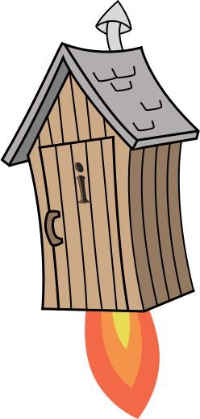
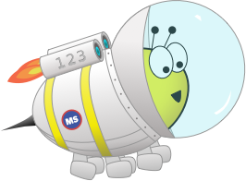
Quiz: QQPIMIX
Stage 4
Term 1 - Block 3 - Length and Perimeter - Lesson 1
To be able to convert between metres and kilometres
1
Block 3 – Length and Perimeter
1

Slide 2
To be able to convert between metres and kilometres
Success criteria:
I can multiply and divide by 1,000 to convert between metres and kilometres, also adding and subtracting 4-digit numbers to find distances, as well as using bar models to help me find fractions of distances too
I can explain my reasoning when multiplying and dividing by 1,000 to convert between metres and kilometres, when adding and subtracting 4-digit numbers to find distances, and when using bar models to help me find fractions of distances too

Slide 3
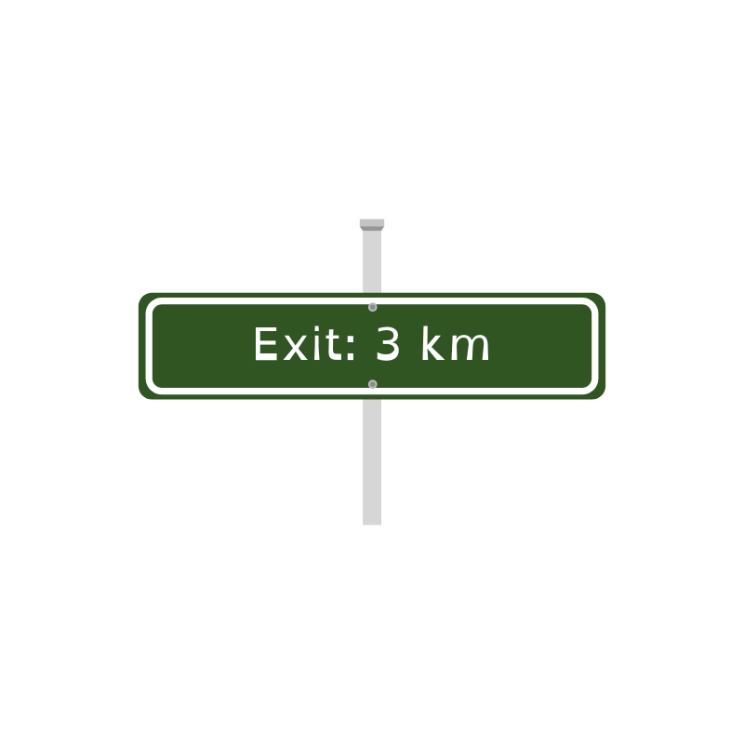
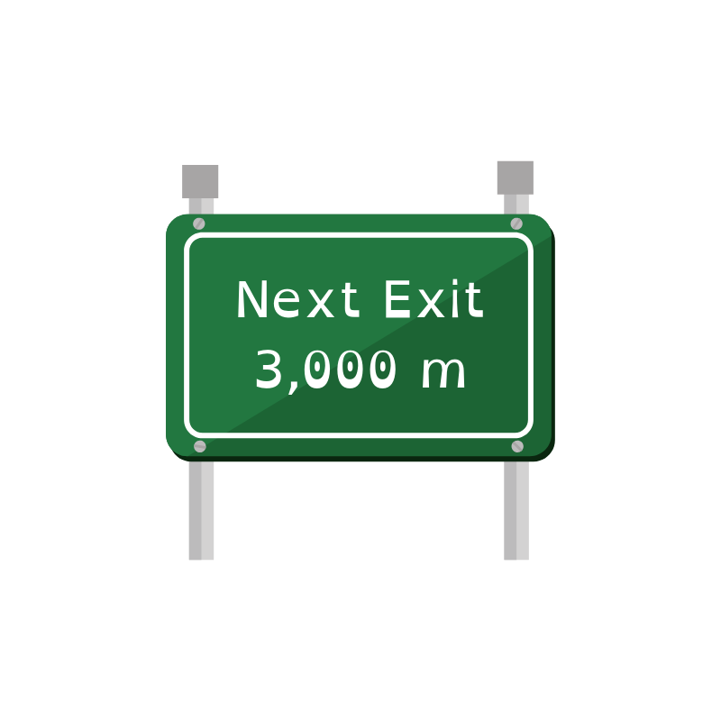
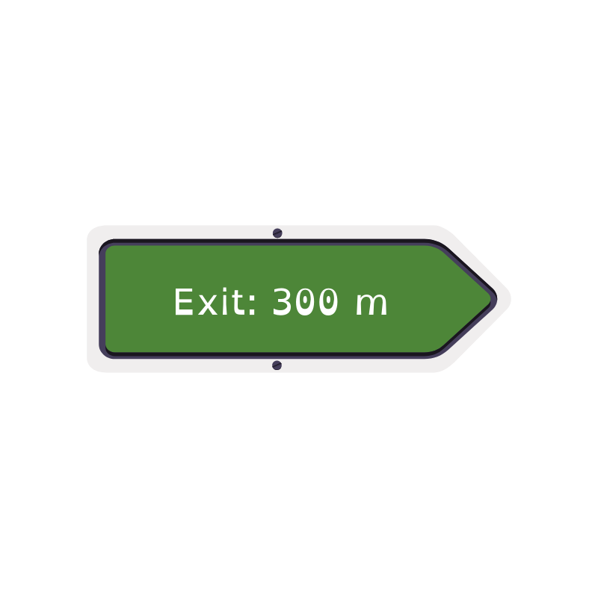
To be able to convert between metres and kilometres
Starter:
Which one doesn’t belong?
Explain your answer.

Slide 4
To be able to convert between metres and kilometres
Starter:
Which one doesn’t belong?
The 300 m sign does not belong as it is less than the other two distances, as 3,000 m and 3 km are the same distance!

Slide 5
To be able to convert between metres and kilometres
Talking Time:
Use the knowledge that the Greek word χίλιοι (kilo) means 1,000 to help you complete the statements below:
1 km = 1,000 m
6 km = 6,000 m
2,000 m = 2 km
2 km + 5 km = 7,000 m
4 km = 4,000 m
500 m = ½ km
2,500 m = 2 ½ km
2,500 m – 1,000 m = 1 ½ km

Slide 6
To be able to convert between metres and kilometres
Talking Time:
Use the knowledge that the Greek word χίλιοι (kilo) means 1,000 to help you complete the statements below:
1 km = 1,000 m
6 km = 6,000 m
2,000 m = 2 km
2 km + 5 km = 7,000 m
4 km = 4,000 m
500 m = ½ km
2,500 m = 2 ½ km
2,500 m – 1,000 m = 1 ½ km

Slide 7
To be able to convert between metres and kilometres
Talking Time:
Use the knowledge that the Greek word χίλιοι (kilo) means 1,000 to help you complete the statements below:
1 km = 1,000 m
6 km = 6,000 m
2,000 m = 2 km
2 km + 5 km = 7,000 m
4 km = 4,000 m
500 m = ½ km
2,500 m = 2 ½ km
2,500 m – 1,000 m = 1 ½ km

Slide 8
To be able to convert between metres and kilometres
Talking Time:
Use the knowledge that the Greek word χίλιοι (kilo) means 1,000 to help you complete the statements below:
1 km = 1,000 m
6 km = 6,000 m
2,000 m = 2 km
2 km + 5 km = 7,000 m
4 km = 4,000 m
500 m = ½ km
2,500 m = 2 ½ km
2,500 m – 1,000 m = 1 ½ km

Slide 9
To be able to convert between metres and kilometres
Talking Time:
Use the knowledge that the Greek word χίλιοι (kilo) means 1,000 to help you complete the statements below:
1 km = 1,000 m
6 km = 6,000 m
2,000 m = 2 km
2 km + 5 km = 7,000 m
4 km = 4,000 m
500 m = ½ km
2,500 m = 2 ½ km
2,500 m – 1,000 m = 1 ½ km

Slide 10
To be able to convert between metres and kilometres
Talking Time:
Use the knowledge that the Greek word χίλιοι (kilo) means 1,000 to help you complete the statements below:
1 km = 1,000 m
6 km = 6,000 m
2,000 m = 2 km
2 km + 5 km = 7,000 m
4 km = 4,000 m
500 m = ½ km
2,500 m = 2 ½ km
2,500 m – 1,000 m = 1 ½ km

Slide 11
To be able to convert between metres and kilometres
Talking Time:
Use the knowledge that the Greek word χίλιοι (kilo) means 1,000 to help you complete the statements below:
1 km = 1,000 m
6 km = 6,000 m
2,000 m = 2 km
2 km + 5 km = 7,000 m
4 km = 4,000 m
500 m = ½ km
2,500 m = 2 ½ km
2,500 m – 1,000 m = 1 ½ km

Slide 12
To be able to convert between metres and kilometres
Talking Time:
Use the knowledge that the Greek word χίλιοι (kilo) means 1,000 to help you complete the statements below:
1 km = 1,000 m
6 km = 6,000 m
2,000 m = 2 km
2 km + 5 km = 7,000 m
4 km = 4,000 m
500 m = ½ km
2,500 m = 2 ½ km
2,500 m – 1,000 m = 1 ½ km

Slide 13
To be able to convert between metres and kilometres
Talking Time:
Use the knowledge that the Greek word χίλιοι (kilo) means 1,000 to help you complete the statements below:
1 km = 1,000 m
6 km = 6,000 m
2,000 m = 2 km
2 km + 5 km = 7,000 m
4 km = 4,000 m
500 m = ½ km
2,500 m = 2 ½ km
2,500 m – 1,000 m = 1 ½ km

Slide 14
To be able to convert between metres and kilometres
Activity 1:
Use the knowledge that the Greek word χίλιοι (kilo) means 1,000 to help you complete the statements below:
2 km = 2,000 m
8 km = 8,000 m
3,000 m = 3 km
6 km + 3 km = 9,000 m
5 km = 5,000 m
750 m = ¾ km
5,500 m = 5 ½ km
7,500 m – 3,000 m = 4 ½ km

Slide 15
To be able to convert between metres and kilometres
Activity 1:
Use the knowledge that the Greek word χίλιοι (kilo) means 1,000 to help you complete the statements below:
2 km = 2,000 m
8 km = 8,000 m
3,000 m = 3 km
6 km + 3 km = 9,000 m
5 km = 5,000 m
750 m = ¾ km
5,500 m = 5 ½ km
7,500 m – 3,000 m = 4 ½ km

Slide 16
To be able to convert between metres and kilometres
Talking Time:
Complete the bar models below.
km
800 m | 1,200 m
4 km
2,700 m | m
3 km
m | 2,730 m
km
3,740 m | 1,260 m

Slide 17
To be able to convert between metres and kilometres
Talking Time:
Complete the bar models below.
2 km
800 m | 1,200 m
4 km
2,700 m | m
3 km
m | 2,730 m
km
3,740 m | 1,260 m

Slide 18
To be able to convert between metres and kilometres
Talking Time:
Complete the bar models below.
2 km
800 m | 1,200 m
4 km
2,700 m | m
3 km
270 m | 2,730 m
km
3,740 m | 1,260 m

Slide 19
To be able to convert between metres and kilometres
Talking Time:
Complete the bar models below.
2 km
800 m | 1,200 m
4 km
2,700 m | 1,300 m
3 km
270 m | 2,730 m
km
3,740 m | 1,260 m

Slide 20
To be able to convert between metres and kilometres
Talking Time:
Complete the bar models below.
2 km
800 m | 1,200 m
4 km
2,700 m | 1,300 m
3 km
270 m | 2,730 m
5 km
3,740 m | 1,260 m

Slide 21
To be able to convert between metres and kilometres
Activity 2:
Complete the bar models below.
km
700 m | 2,300 m
5 km
3,100 m | m
4 km
m | 3,620 m
km
4,590 m | 1,410 m

Slide 22
To be able to convert between metres and kilometres
Activity 2:
Complete the bar models below.
3 km
700 m | 2,300 m
5 km
3,100 m | 1,900 m
4 km
380 m | 3,620 m
6 km
4,590 m | 1,410 m

Slide 23
To be able to convert between metres and kilometres
Talking Time:
Use the comparison symbols (<, > or =) to complete the following statements.
1,000 m
1 km
3,000 m
2 km
4 km
5,500 m
3,200 m
3 ½ km

Slide 24
To be able to convert between metres and kilometres
Talking Time:
Use the comparison symbols (<, > or =) to complete the following statements.
=
1,000 m
1 km
3,000 m
2 km
4 km
5,500 m
3,200 m
3 ½ km

Slide 25
To be able to convert between metres and kilometres
Talking Time:
Use the comparison symbols (<, > or =) to complete the following statements.
=
1,000 m
1 km
>
3,000 m
2 km
4 km
5,500 m
3,200 m
3 ½ km

Slide 26
To be able to convert between metres and kilometres
Talking Time:
Use the comparison symbols (<, > or =) to complete the following statements.
=
1,000 m
1 km
>
3,000 m
2 km
<
4 km
5,500 m
3,200 m
3 ½ km

Slide 27
To be able to convert between metres and kilometres
Talking Time:
Use the comparison symbols (<, > or =) to complete the following statements.
=
1,000 m
1 km
>
3,000 m
2 km
<
4 km
5,500 m
<
3,200 m
3 ½ km

Slide 28
To be able to convert between metres and kilometres
Activity 3:
Use the comparison symbols (<, > or =) to complete the following statements.
1,000 m
1 ½ km
4,000 m
3 km
6 km
6,600 m
250 m
¼ km

Slide 29
To be able to convert between metres and kilometres
Activity 3:
Use the comparison symbols (<, > or =) to complete the following statements.
<
1,000 m
1 ½ km
>
4,000 m
3 km
<
6 km
6,600 m
=
250 m
¼ km

Slide 30
To be able to convert between metres and kilometres
Activity 4:
Ruth and Jamal cycle 30 kilometres for a charity fundraiser.
Ruth cycles twice as many kilometres as Jamal.
How far did Jamal cycle?
Ruth and Jamal raised $1 for every 250 m they cycled.
How much money did they each raise for charity?

Slide 31
To be able to convert between metres and kilometres
Activity 4:
Ruth and Jamal cycle 30 kilometres for a charity fundraiser.
Ruth cycled 20 km – there are four lots of 250 m within each 1 km, so they raised $4 per km. In total Ruth raised $80.
Jamal cycled 10 km, which at $4 per 1 km, means he raised $40 for charity.
30 km
10 km | 10 km | 10 km
Ruth
Jamal

Slide 32
To be able to convert between metres and kilometres
Activity 5:
Complete the table below so that each row and column has a total of 3 km.
1,400 m |  | ¾ km
½ km | 1,500 m | 1 km
1,100 m |  | 1,250 m

Slide 33
To be able to convert between metres and kilometres
Activity 5:
Complete the table below so that each row and column has a total of 3 km.
1,400 m |  | ¾ km
½ km | 1,500 m | 1 km
1,100 m |  | 1,250 m

Slide 34
To be able to convert between metres and kilometres
Evaluation:
Do you agree?
Explain your answer.
If it is 5 km between a lavender field and my nest and I have flown 1 ¾ km already, I only have another 3 km left to arrive home.

Slide 35
To be able to convert between metres and kilometres
Evaluation:
I do not agree – 3 km more than 1 ¾ km is 4 ¾ km or 4,750 m, which is less than 5 km (or 5,000 m). Astrobee would still need to fly another ¼ km or 250 m to get back to the nest after flying another 3 km.
If it is 5 km between a lavender field and my nest and I have flown 1 ¾ km already, I only have another 3 km left to arrive home.

Slide 36
To be able to convert between metres and kilometres
Success criteria:
I can multiply and divide by 1,000 to convert between metres and kilometres, also adding and subtracting 4-digit numbers to find distances, as well as using bar models to help me find fractions of distances too
I can explain my reasoning when multiplying and dividing by 1,000 to convert between metres and kilometres, when adding and subtracting 4-digit numbers to find distances, and when using bar models to help me find fractions of distances too

