Slide 1




Quiz: QULBOCI
Stage 2
Term 2 - Block 4 - Fractions - Lesson 1
To be able to make equal parts
2
Fractions
1

Slide 2
To be able to make equal parts
Success criteria:
I can use mathematical equipment and pictorial representations to explore making equal and unequal parts from a whole amount
I can explain my reasoning when using mathematical equipment and pictorial representations to explore making equal and unequal parts from a whole amount

Slide 3
To be able to make equal parts
Starter:
Which one does not belong?
Explain your answer.

Slide 4
To be able to make equal parts
Starter:
Which one does not belong?
The blue and red representation does not belong as the blue area is greater than the red area. Whereas, the other diagrams are split equally in to halves.

Slide 5
To be able to make equal parts
Activity 1:
How many different ways can you find of shading the shape below in halves?

Slide 6
To be able to make equal parts
Activity 1:
How many different ways can you find of shading the shape below in halves?

Slide 7
To be able to make equal parts
Activity 1:
How many different ways can you find of shading the shape below in halves?

Slide 8
To be able to make equal parts
Activity 1:
How many different ways can you find of shading the shape below in halves?

Slide 9
To be able to make equal parts
Activity 1:
How many different ways can you find of shading the shape below in halves?

Slide 10
To be able to make equal parts
Activity 1:
How many different ways can you find of shading the shape below in halves?
Did you find the same ways?
Did you find different ways?

Slide 11





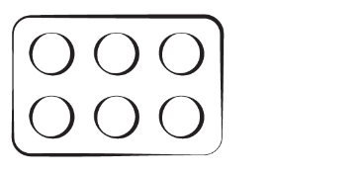
To be able to make equal parts
Talking Time:
Which one doesn’t belong?
Explain your answer.

Slide 12
To be able to make equal parts
Talking Time:
Which one doesn’t belong?
The counters do not belong as they not split in equal parts. There are more pink counters than green counters. The other representations are all split equally.

Slide 13
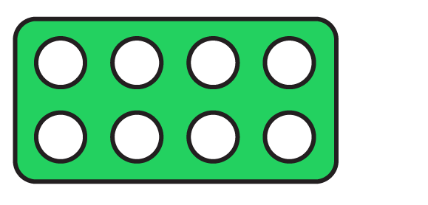

To be able to make equal parts
Talking Time:
Which one doesn’t belong?
Explain your answer.

Slide 14
To be able to make equal parts
Talking Time:
Which one doesn’t belong?
The multilink cubes do not belong as they are the only representation that is split equally. The area diagram is more purple than white, there are more pink counters than green counters and the green Numicon shape is greater than the blue shape.

Slide 15



To be able to make equal parts
Activity 2:
Which one doesn’t belong?
Explain your answer.

Slide 16
To be able to make equal parts
Activity 2:
Which one doesn’t belong?
The area model diagram does not belong as there are an equal number of white and red squares. Whereas the other representations are split unequally.

Slide 17

To be able to make equal parts
Talking Time:
Shade the counters below so they are split equally.
Can you think of more than one way to shade in the counters above?
Explain your answer.

Slide 18

To be able to make equal parts
Talking Time:
Shade the counters below so they are split equally.
Can you think of more than one way to shade in the counters above?
Explain your answer.

Slide 19
To be able to make equal parts
Talking Time:
Shade the counters below so they are split equally.
Can you think of more than one way to shade in the counters above?
Explain your answer.

Slide 20

To be able to make equal parts
Talking Time:
Shade the counters below so they are split equally.
Can you think of more than one way to shade in the counters above?
Explain your answer.

Slide 21
To be able to make equal parts
Talking Time:
Shade the counters below so they are split equally.
Six can be split into one group of six, two groups of three, three groups of two or six groups of one.

Slide 22
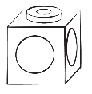
To be able to make equal parts
Talking Time:
Shade the cubes below so they are split equally.
Can you think of more than one way to shade in the cubes above?
Explain your answer.

Slide 23

To be able to make equal parts
Talking Time:
Shade the cubes below so they are split equally.
Can you think of more than one way to shade in the cubes above?
Explain your answer.

Slide 24

To be able to make equal parts
Talking Time:
Shade the cubes below so they are split equally.
Can you think of more than one way to shade in the cubes above?
Explain your answer.

Slide 25
To be able to make equal parts
Talking Time:
Shade the cubes below so they are split equally.
Can you think of more than one way to shade in the cubes above?
Explain your answer.

Slide 26



To be able to make equal parts
Talking Time:
Shade the cubes below so they are split equally.
Eight can be split into one group of eight, two groups of four, four groups of two or eight groups of one.

Slide 27
To be able to make equal parts
Activity 3:
Shade the cubes below so they are split equally.
Can you think of more than one way to shade in the cubes above?
Explain your answer.

Slide 28
To be able to make equal parts
Activity 3:
Shade the cubes below so they are split equally.
Twelve can be split into one group of twelve, two groups of six, three groups of four, four groups of three, six groups of two or twelve groups of one.
Notes:
Children should use cubes or sketch cubes of different shades to demonstrate their understanding.

Slide 29

To be able to make equal parts
Activity 4:
How many different ways can you split the counters equally below?
Explain your answer.

Slide 30


To be able to make equal parts
Activity 4:
How many different ways can you split the counters equally below?
Sixteen can be split into one group of sixteen, two groups of eight, four groups of four, eight groups of two or sixteen groups of one.

Slide 31
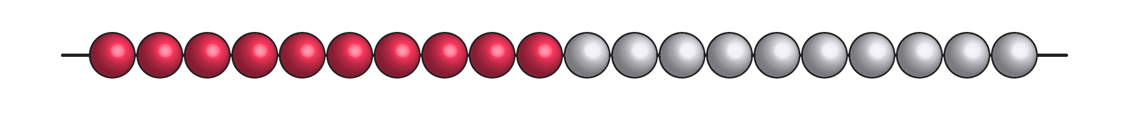
To be able to make equal parts
Activity 5:
How many different ways can you split the beads equally below?
Explain your answer.

Slide 32
To be able to make equal parts
Activity 5:
How many different ways can you split the beads equally below?
Twenty can be kept as one equal group of twenty, split into two groups of ten, four groups of five, five groups of four, ten groups of two, or twenty groups of one.

Slide 33
To be able to make equal parts
Evaluation:
Do you agree?
Explain your answer.
One of the shapes shown has not been shared equally.

Slide 34
To be able to make equal parts
Evaluation:
No, I do not agree.
All of the shapes have been split equally in different ways.
One of the shapes shown has not been shared equally.

Slide 35
To be able to make equal parts
Success criteria:
I can use mathematical equipment and pictorial representations to explore making equal and unequal parts from a whole amount
I can explain my reasoning when using mathematical equipment and pictorial representations to explore making equal and unequal parts from a whole amount

