Slide 1




Year 4
Term 4 - Block 3 - Converting Units
Lesson 1 - To be able to convert between g and kg and m and km
4
Block 3 – Converting Units
1

Slide 2
To be able to convert between g and kg and m and km
Success criteria:
I can apply my place value, multiplication and division knowledge when converting between g and kg and m and km
I can explain my reasoning when applying my place value, multiplication and division knowledge when converting between g and kg and m and km

Slide 3
To be able to convert between g and kg and m and km
Starter:
Complete the bar models provided.
What’s the same? What’s different?
Explain your answer.
1,000 g | 1,000 g | 1,000 g | 1,000 g
1 kg | 1 kg
1,000 m | 1,000 m | 1,000 m | 1,000 m
1 km | 1 km

Slide 4
To be able to convert between g and kg and m and km
Starter:
Complete the bar models provided.
What’s the same? What’s different?
Explain your answer.
1,000 g | 1,000 g | 1,000 g | 1,000 g
1 kg | 1 kg | 1 kg | 1 kg
1,000 m | 1,000 m | 1,000 m | 1,000 m
1 km | 1 km | 1 km | 1 km
4 kg
4 km

Slide 5
To be able to convert between g and kg and m and km
Starter:
Complete the bar models provided.
Both bar models show four lots of 1,000 smaller units being converted to four kilo units, making totals of four kilo units each. One is g and kg; the other is m and km.
1,000 g | 1,000 g | 1,000 g | 1,000 g
1 kg | 1 kg | 1 kg | 1 kg
1,000 m | 1,000 m | 1,000 m | 1,000 m
1 km | 1 km | 1 km | 1 km
4 kg
4 km

Slide 6
To be able to convert between g and kg and m and km
Talking Time:
Complete the bar models provided.
1,000 m | 1,000 m
1 km | 1 km
1 kg | 1 kg | 1 kg
1,000 g | 1,000 g | 1,000 g
2 km = ______ m
3 kg = ______ g

Slide 7
To be able to convert between g and kg and m and km
Talking Time:
Complete the bar models provided.
1,000 m | 1,000 m
1 km | 1 km
1 kg | 1 kg | 1 kg
1,000 g | 1,000 g | 1,000 g
2 km = 2,000 m
2 km = ______ m
3 kg = 3,000 g
3 kg = ______ g

Slide 8
To be able to convert between g and kg and m and km
Activity 1:
Complete the bar models provided.
1,000 m | 1,000 m | 1,000 m
1 km | 1 km | 1 km
1 kg | 1 kg | 1 kg | 1 kg | 1 kg
1,000 g | 1,000 g | 1,000 g | 1,000 g | 1,000 g
3 km = ______ m
5 kg = ______ g

Slide 9
To be able to convert between g and kg and m and km
Activity 1:
Complete the bar models provided.
1,000 m | 1,000 m | 1,000 m
1 km | 1 km | 1 km
1 kg | 1 kg | 1 kg | 1 kg | 1 kg
1,000 g | 1,000 g | 1,000 g | 1,000 g | 1,000 g
3 km = ______ m
3 km = 3,000 m
5 kg = ______ g
5 kg = 5,000 g

Slide 10
To be able to convert between g and kg and m and km
Talking Time:
Use the scale provided to help you convert between g and kg.
___ kg
___ kg
4 kg
___ kg
___ kg
19.5 kg
kg
g
500 g
1,000 g
_____ g
6,500 g
12,000 g
_____ g

Slide 11
To be able to convert between g and kg and m and km
Talking Time:
Use the scale provided to help you convert between g and kg.
___ kg
0.5 kg
___ kg
1 kg
4 kg
___ kg
6.5 kg
___ kg
12 kg
19.5 kg
kg
g
500 g
1,000 g
_____ g
4,000 g
6,500 g
12,000 g
_____ g
19,500 g

Slide 12
To be able to convert between g and kg and m and km
Activity 2:
Use the scale provided to help you convert between m and km.
___ km
___ km
2 km
___ km
___ km
21.5 km
km
m
250 m
1,000 m
_____ m
7,500 m
18,000 m
_____ m

Slide 13
To be able to convert between g and kg and m and km
Activity 2:
Use the scale provided to help you convert between m and km.
___ km
¼ km
1 km
___ km
2 km
___ km
7.5 km
___ km
21.5 km
18 km
21.5 km
km
m
250 m
1,000 m
_____ m
2,000 m
7,500 m
18,000 m
_____ m
21,500 m

Slide 14
To be able to convert between g and kg and m and km
Talking Time:
Complete the conversions below.
___ km = 12,000 m
11.5 km = ______ m
___ kg = 12,000 g
______ g = 31.4 kg
21,000 m = ___ km
___ km = 100 m
21,500 g = ___ kg
______ g = 10 kg

Slide 15
To be able to convert between g and kg and m and km
Talking Time:
Complete the conversions below.
___ km = 12,000 m
12 km = 12,000 m
11.5 km = ______ m
11.5 km = 11,500 m
___ kg = 12,000 g
12 kg = 12,000 g
______ g = 31.4 kg
31,400 g = 31.4 kg
21,000 m = ___ km
21,000 m = 21 km
___ km = 100 m
0.1 km = 100 m
21,500 g = ___ kg
21,500 g = 21.5 kg
______ g = 10 kg
10,000 g = 10 kg

Slide 16
To be able to convert between g and kg and m and km
Activity 3:
Complete the conversions below.
___ km = 16,000 m
14.5 km = ______ m
___ kg = 16,000 g
______ g = 62.3 kg
23,000 m = ___ km
___ km = 300 m
23,500 g = ___ kg
______ g = 100 kg

Slide 17
To be able to convert between g and kg and m and km
Activity 3:
Complete the conversions below.
___ km = 16,000 m
16 km = 16,000 m
14.5 km = ______ m
14.5 km = 14,500 m
___ kg = 16,000 g
16 kg = 16,000 g
______ g = 62.3 kg
62,300 g = 62.3 kg
23,000 m = ___ km
23,000 m = 23 km
___ km = 300 m
0.3 km = 300 m
23,500 g = ___ kg
23,500 g = 23.5 kg
______ g = 100 kg
100,000 g = 100 kg

Slide 18
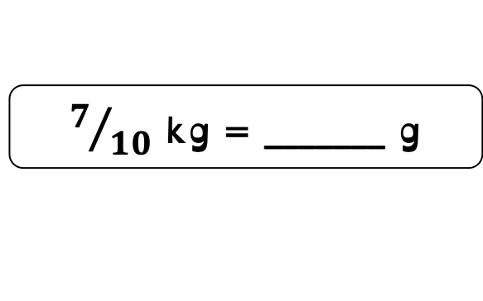
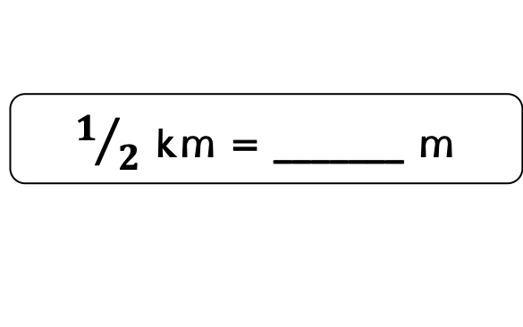
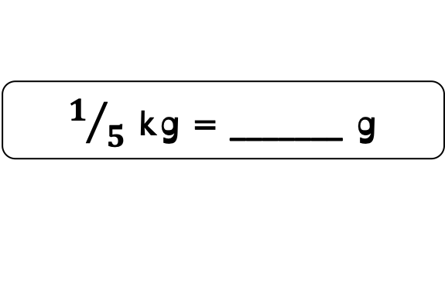
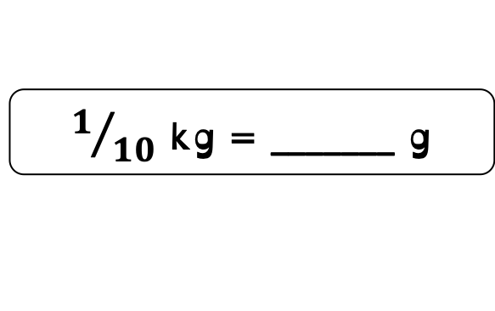
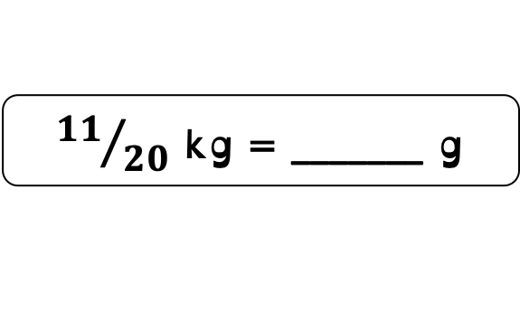

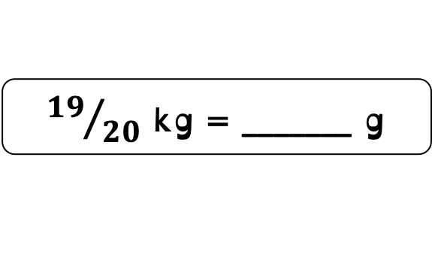

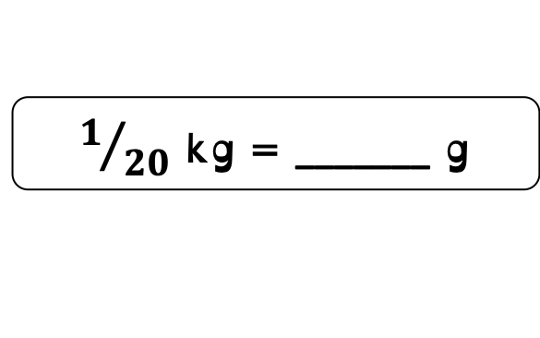
To be able to convert between g and kg and m and km
Activity 4:
Complete the conversions below.
$1/2$ km = _______ m
$1/{10}$ kg = _______ g
$1/{20}$ kg = _______ g
$1/4$ km = _______ m
$1/5$ kg = _______ g
${19}/{20}$ kg = _______ g
$3/4$ km = _______ m
$7/{10}$ kg = _______ g
${11}/{20}$ kg = _______ g

Slide 19
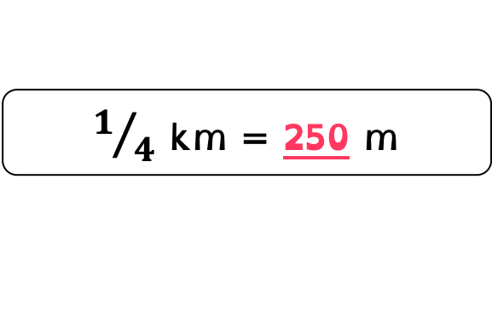
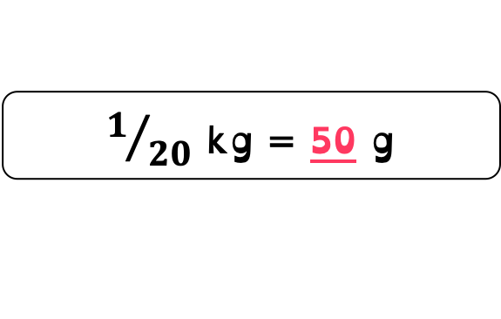
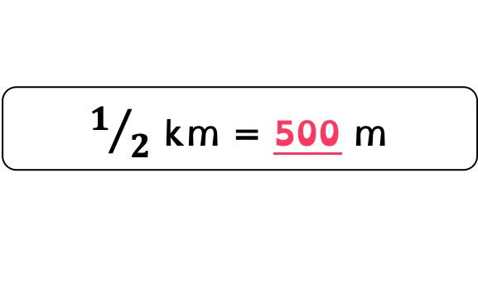
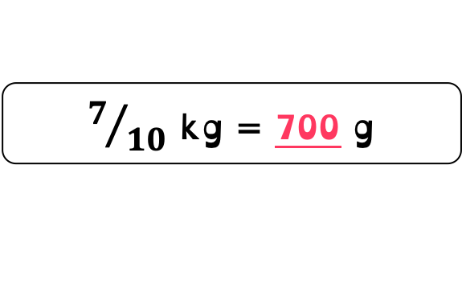
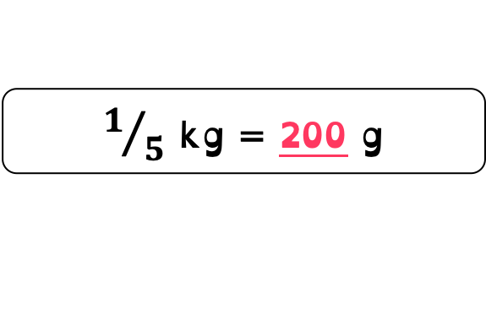
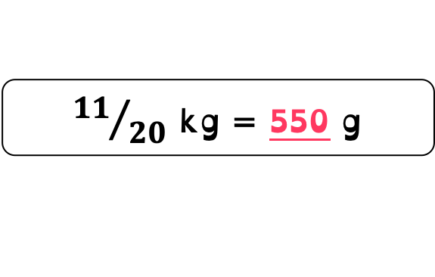
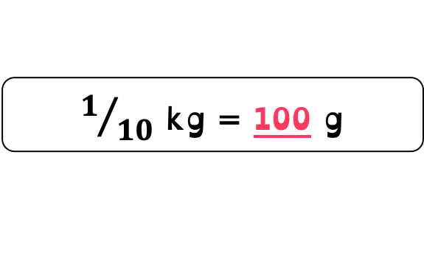
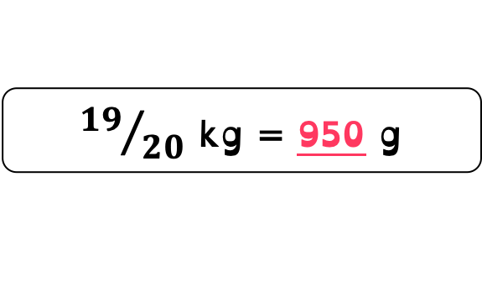
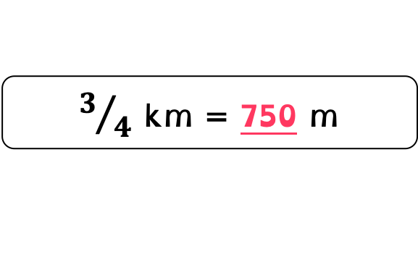
To be able to convert between g and kg and m and km
Activity 4:
Complete the conversions below.
$1/2$ km = _______ m
$1/2$ km = 500 m
$1/{10}$ kg = _______ g
$1/{10}$ kg = 100 g
$1/{20}$ kg = _______ g
$1/{20}$ kg = 50 g
$1/4$ km = _______ m
$1/4$ km = 250 m
$1/5$ kg = _______ g
$1/5$ kg = 200 g
${19}/{20}$ kg = _______ g
${19}/{20}$ kg = 950 g
$3/4$ km = _______ m
$3/4$ km = 750 m
$7/{10}$ kg = _______ g
$7/{10}$ kg = 700 g
${11}/{20}$ kg = _______ g
${11}/{20}$ kg = 550 g

Slide 20

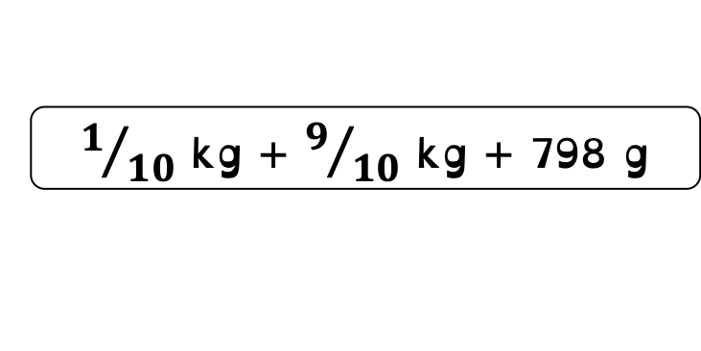
To be able to convert between g and kg and m and km
Talking Time:
Use the comparison symbols <, > and = to complete the statements below.
0.5 kg
700 g
2.7 km
2,700 m
5,000 m + 2 km
4.5 km + 1,500 m
$1/{10}$ kg + $9/{10}$ kg + 798 g
897 g + 1 kg

Slide 21
To be able to convert between g and kg and m and km
Talking Time:
Use the comparison symbols <, > and = to complete the statements below.
0.5 kg
<
700 g
2.7 km
=
2,700 m
5,000 m + 2 km
>
4.5 km + 1,500 m
$1/{10}$ kg + $9/{10}$ kg + 798 g
<
897 g + 1 kg

Slide 22
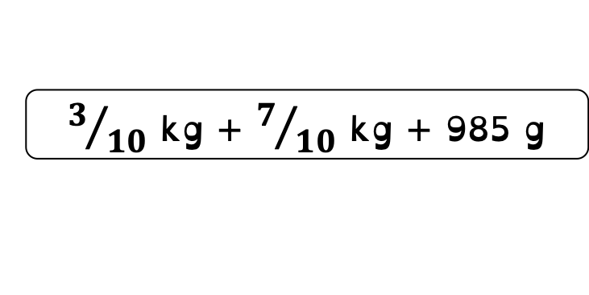
To be able to convert between g and kg and m and km
Activity 5:
Use the comparison symbols <, > and = to complete the statements below.
0.25 kg
200 g
3.9 km
4,200 m
6,000 m + 3 km
5.5 km + 3,500 m
$3/{10}$ kg + $7/{10}$ kg + 985 g
958 g + 1 kg

Slide 23
To be able to convert between g and kg and m and km
Activity 5:
Use the comparison symbols <, > and = to complete the statements below.
0.25 kg
>
200 g
3.9 km
<
4,200 m
6,000 m + 3 km
=
5.5 km + 3,500 m
$3/{10}$ kg + $7/{10}$ kg + 985 g
>
958 g + 1 kg

Slide 24
To be able to convert between g and kg and m and km
Activity 6:
Solve the word problems below.
A lap of a running track is 400 m.
How far would Ahmed have run if he ran eight laps?
Give your answer as a km measurement.
A sack of potatoes weighs 700 g.
How much do eight sacks of potatoes weigh?
Give your answer as a kg measurement.

Slide 25
To be able to convert between g and kg and m and km
Activity 6:
Solve the word problems below.
A lap of a running track is 400 m.
How far would Ahmed have run if he ran eight laps?
Ahmed would have run 3.2 km.
A sack of potatoes weighs 700 g.
How much do eight sacks of potatoes weigh?
Give your answer as a kg measurement.

Slide 26
To be able to convert between g and kg and m and km
Activity 6:
Solve the word problems below.
A lap of a running track is 400 m.
How far would Ahmed have run if he ran eight laps?
Ahmed would have run 3.2 km.
A sack of potatoes weighs 700 g.
How much do eight sacks of potatoes weigh?
Eight sacks of potatoes have a mass of 5.6 kg.

Slide 27


To be able to convert between g and kg and m and km
Activity 7:
Ruth buys 4.7 kg of coffee and 1,750 g of sugar.
She pays with a $20 note.
How much change does she receive?
Explain your answer.
34 c per 100 g
$1.36 per kg

Slide 28
To be able to convert between g and kg and m and km
Activity 7:
Ruth buys 4.7 kg of coffee and 1,750 g of sugar.
She pays with a $20 note.
She will receive $1.64 change.
47 x 34 c = 1,598 c = $15.98
1.75 x $1.36 = $2.38
$15.98 + $2.38 = $18.36
$20.00 – $18.36 = $1.64
34 c per 100 g
$1.36 per kg

Slide 29
To be able to convert between g and kg and m and km
Activity 8:
Yasmin manages to weigh out and bag up the first 200 g bag of coffee beans in 28 seconds.
If she continues to bag up the beans at the same rate, how long will it take her to weight out and bag up 5 kg of coffee beans.
Explain your answer, giving your answer as a measurement in minutes and seconds.

Slide 30
To be able to convert between g and kg and m and km
Activity 8:
Yasmin manages to weigh out and bag up the first 200 g bag of coffee beans in 28 seconds.
If she continues to bag up the beans at the same rate, how long will it take her to weight out and bag up 5 kg of coffee beans.
It will take Yasmin 11 minutes and 40 seconds to bag up all 5 kg of coffee beans.
1 kg = 140 seconds as 5 x 200 g = 1,000g and 28 seconds x 5 = 140 seconds.
So, 5 kg will take 700 seconds (or 11 minutes and 40 seconds), as 140 x 5 = 700.

Slide 31
To be able to convert between g and kg and m and km
Evaluation:
Do you agree?
Explain your answer.
The only way to convert between 6 kg and equivalent grams is to use a bar model.

Slide 32
To be able to convert between g and kg and m and km
Evaluation:
Although it is a good way to convert between kg and g, using a bar model is not the only way, you could use a double number line or place value knowledge and multiplication / division too in the abstract form (even a place value, counters or Gattegno chart could be used).
The only way to convert between 6 kg and equivalent grams is to use a bar model.

Slide 33
To be able to convert between g and kg and m and km
Success criteria:
I can apply my place value, multiplication and division knowledge when converting between g and kg and m and km
I can explain my reasoning when applying my place value, multiplication and division knowledge when converting between g and kg and m and km

