Slide 1




Year 3
Term 3 - Block 1 - Decimals - Lesson 1
To be able to identify tenths and hundredths using a hundred square
3
Block 1 – Decimals
1

Slide 2
To be able to identify tenths and hundredths using a hundred square
Success criteria:
I can use a hundred square to identify tenths and hundredths
I can explain my reasoning when using a hundred square to identify tenths and hundredths

Slide 3
To be able to identify tenths and hundredths using a hundred square
Starter:
Which one doesn’t belong?
Explain your answer.

Slide 4
To be able to identify tenths and hundredths using a hundred square
Starter:
Which one doesn’t belong?
The purple hundred square doesn’t belong, as a single-digit amount of squares are shaded in. Whereas the other hundred squares have two-digit multiples of 10 shaded in: orange (50), green (30) and yellow (20).

Slide 5

To be able to identify tenths and hundredths using a hundred square
Activity 1:
Fill the blanks within the sentences below.
Each small square represents __ out of ___.
Each small square represents $\frac{1}{100}$
Each column represents __ out of ___.
Each column represents $\frac{10}{100}$

Slide 6

To be able to identify tenths and hundredths using a hundred square
Activity 1:
Fill the blanks within the sentences below.
Each small square represents 1 out of 100.
Each small square represents $\frac{1}{100}$.
Each column represents 10 out of 100.
Each column represents $\frac{10}{100}$.

Slide 7


To be able to identify tenths and hundredths using a hundred square
Talking Time:
Express the representation below as a fraction over 10 and a fraction over 100.
$$\frac{2}{10}$$
$$\frac{20}{100}$$

Slide 8


To be able to identify tenths and hundredths using a hundred square
Talking Time:
Express the representation below as a fraction over 10 and a fraction over 100.
$$\frac{2}{10}$$
$$\frac{20}{100}$$

Slide 9


To be able to identify tenths and hundredths using a hundred square
Talking Time:
Express the representation below as a fraction over 10 and a fraction over 100.
$$\frac{5}{10}$$
$$\frac{50}{100}$$

Slide 10


To be able to identify tenths and hundredths using a hundred square
Talking Time:
Express the representation below as a fraction over 10 and a fraction over 100.
$$\frac{5}{10}$$
$$\frac{50}{100}$$

Slide 11
To be able to identify tenths and hundredths using a hundred square
Talking Time:
Express the representation below as a fraction over 10 and a fraction over 100.
$$\frac{3}{10}$$
$$\frac{30}{100}$$

Slide 12


To be able to identify tenths and hundredths using a hundred square
Talking Time:
Express the representation below as a fraction over 10 and a fraction over 100.
$$\frac{3}{10}$$
$$\frac{30}{100}$$

Slide 13

To be able to identify tenths and hundredths using a hundred square
Talking Time:
Express the representation below as a fraction over 10 and a fraction over 100.
$$\frac{7}{10}$$
$$\frac{70}{100}$$

Slide 14


To be able to identify tenths and hundredths using a hundred square
Talking Time:
Express the representation below as a fraction over 10 and a fraction over 100.
$$\frac{7}{10}$$
$$\frac{70}{100}$$

Slide 15

To be able to identify tenths and hundredths using a hundred square
Talking Time:
Express the representation below as a fraction over 10 and a fraction over 100.
$$\frac{4}{10}$$
$$\frac{40}{100}$$

Slide 16


To be able to identify tenths and hundredths using a hundred square
Talking Time:
Express the representation below as a fraction over 10 and a fraction over 100.
$$\frac{4}{10}$$
$$\frac{40}{100}$$

Slide 17
To be able to identify tenths and hundredths using a hundred square
Talking Time:
Express the representation below as a fraction over 10 and a fraction over 100.
$$\frac{9}{10}$$
$$\frac{90}{100}$$

Slide 18


To be able to identify tenths and hundredths using a hundred square
Talking Time:
Express the representation below as a fraction over 10 and a fraction over 100.
$$\frac{9}{10}$$
$$\frac{90}{100}$$

Slide 19
To be able to identify tenths and hundredths using a hundred square
Talking Time:
Express the representation below as a fraction over 10 and a fraction over 100.
$$\frac{8}{10}$$
$$\frac{80}{100}$$

Slide 20


To be able to identify tenths and hundredths using a hundred square
Talking Time:
Express the representation below as a fraction over 10 and a fraction over 100.
$$\frac{8}{10}$$
$$\frac{80}{100}$$

Slide 21
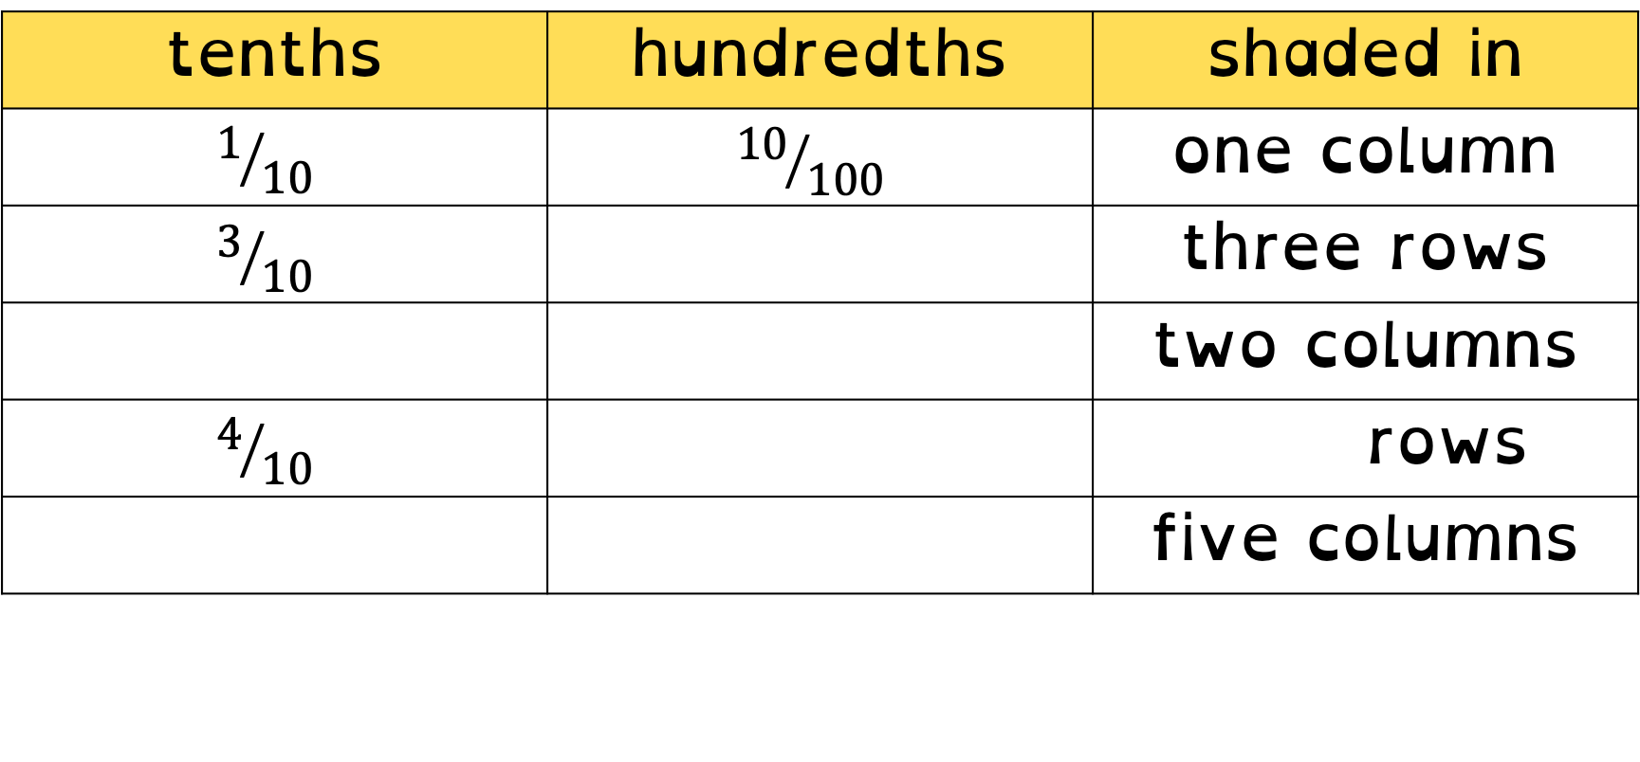
To be able to identify tenths and hundredths using a hundred square
Talking Time:
Complete the table below.
tenths | hundredths | shaded in
$$1/{10}$$ | $${10}/{100}$$ | one column
$$3/{10}$$ | $${30}/{100}$$ | three rows
$$2/{10}$$ | $${20}/{100}$$ | two columns
$$4/{10}$$ | $${40}/{100}$$ | four rows
$$5/{10}$$ | $${50}/{100}$$ | five columns

Slide 22
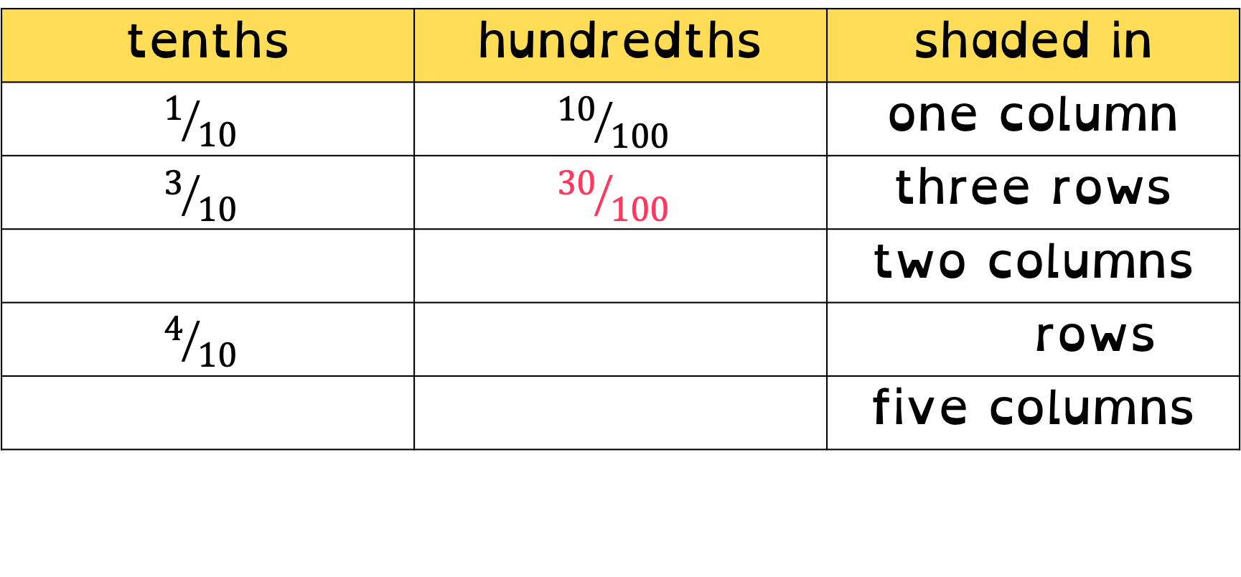
To be able to identify tenths and hundredths using a hundred square
Talking Time:
Complete the table below.
tenths | hundredths | shaded in
$$1/{10}$$ | $${10}/{100}$$ | one column
$$3/{10}$$ | $${30}/{100}$$ | three rows
$$2/{10}$$ | $${20}/{100}$$ | two columns
$$4/{10}$$ | $${40}/{100}$$ | four rows
$$5/{10}$$ | $${50}/{100}$$ | five columns

Slide 23
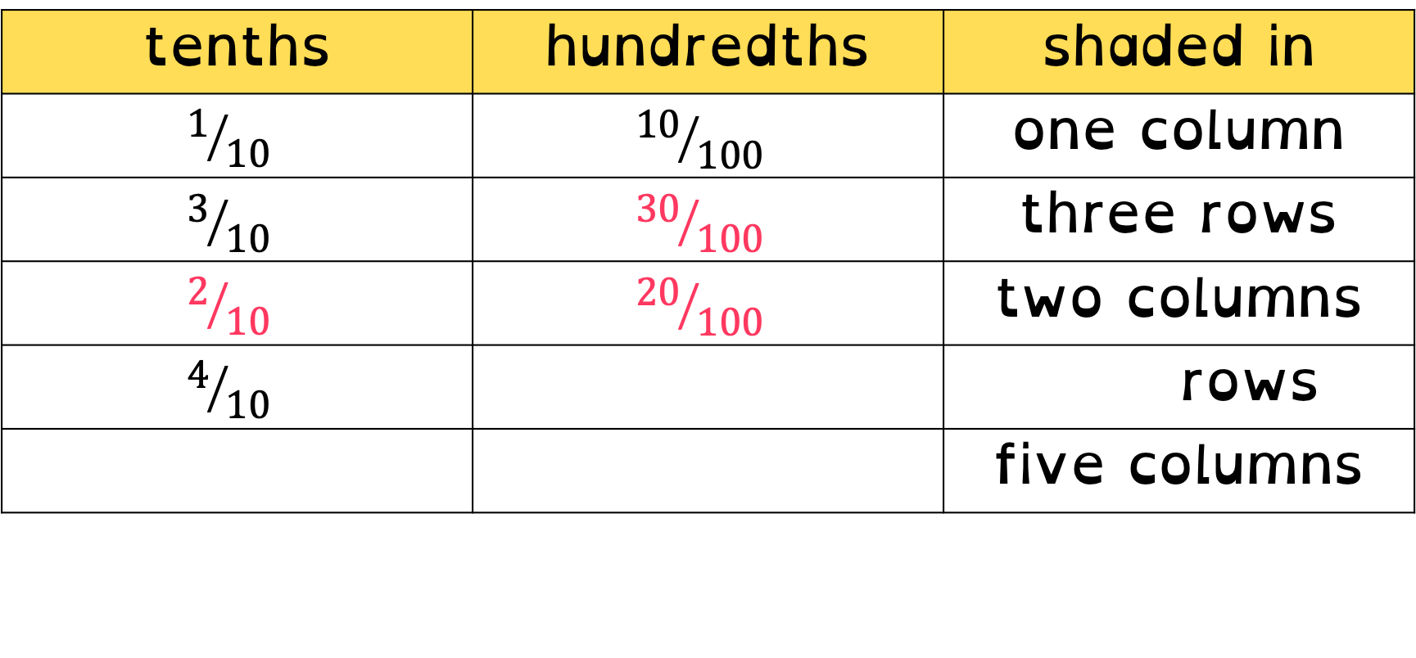
To be able to identify tenths and hundredths using a hundred square
Talking Time:
Complete the table below.
tenths | hundredths | shaded in
$$1/{10}$$ | $${10}/{100}$$ | one column
$$3/{10}$$ | $${30}/{100}$$ | three rows
$$2/{10}$$ | $${20}/{100}$$ | two columns
$$4/{10}$$ | $${40}/{100}$$ | four rows
$$5/{10}$$ | $${50}/{100}$$ | five columns

Slide 24
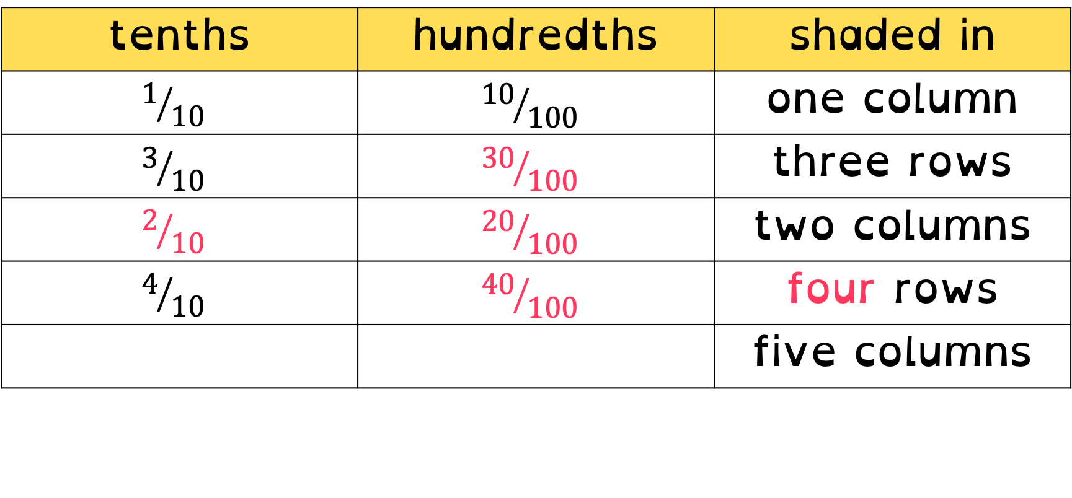
To be able to identify tenths and hundredths using a hundred square
Talking Time:
Complete the table below.
tenths | hundredths | shaded in
$$1/{10}$$ | $${10}/{100}$$ | one column
$$3/{10}$$ | $${30}/{100}$$ | three rows
$$2/{10}$$ | $${20}/{100}$$ | two columns
$$4/{10}$$ | $${40}/{100}$$ | four rows
$$5/{10}$$ | $${50}/{100}$$ | five columns

Slide 25
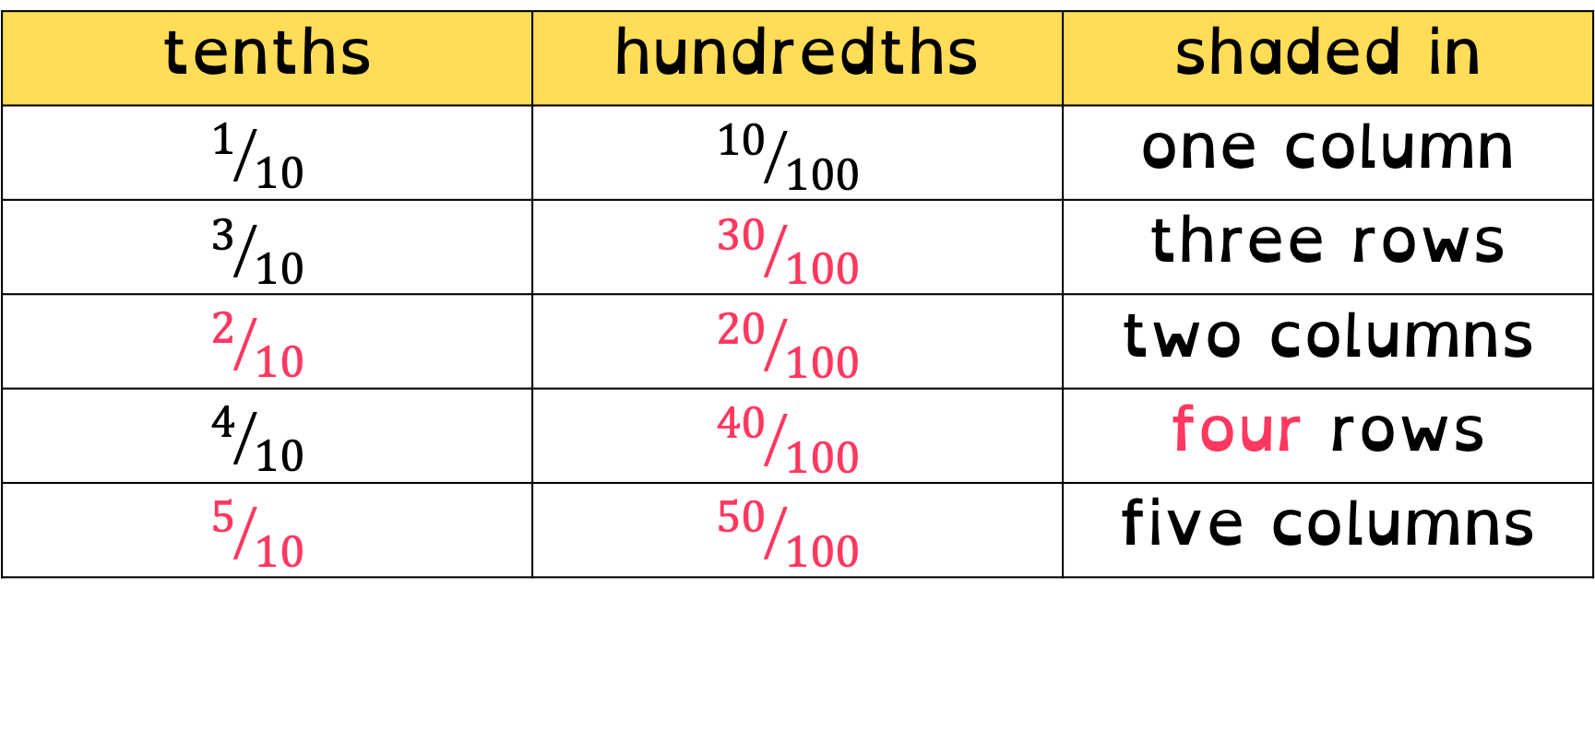
To be able to identify tenths and hundredths using a hundred square
Talking Time:
Complete the table below.
tenths | hundredths | shaded in
$$1/{10}$$ | $${10}/{100}$$ | one column
$$3/{10}$$ | $${30}/{100}$$ | three rows
$$2/{10}$$ | $${20}/{100}$$ | two columns
$$4/{10}$$ | $${40}/{100}$$ | four rows
$$5/{10}$$ | $${50}/{100}$$ | five columns

Slide 26
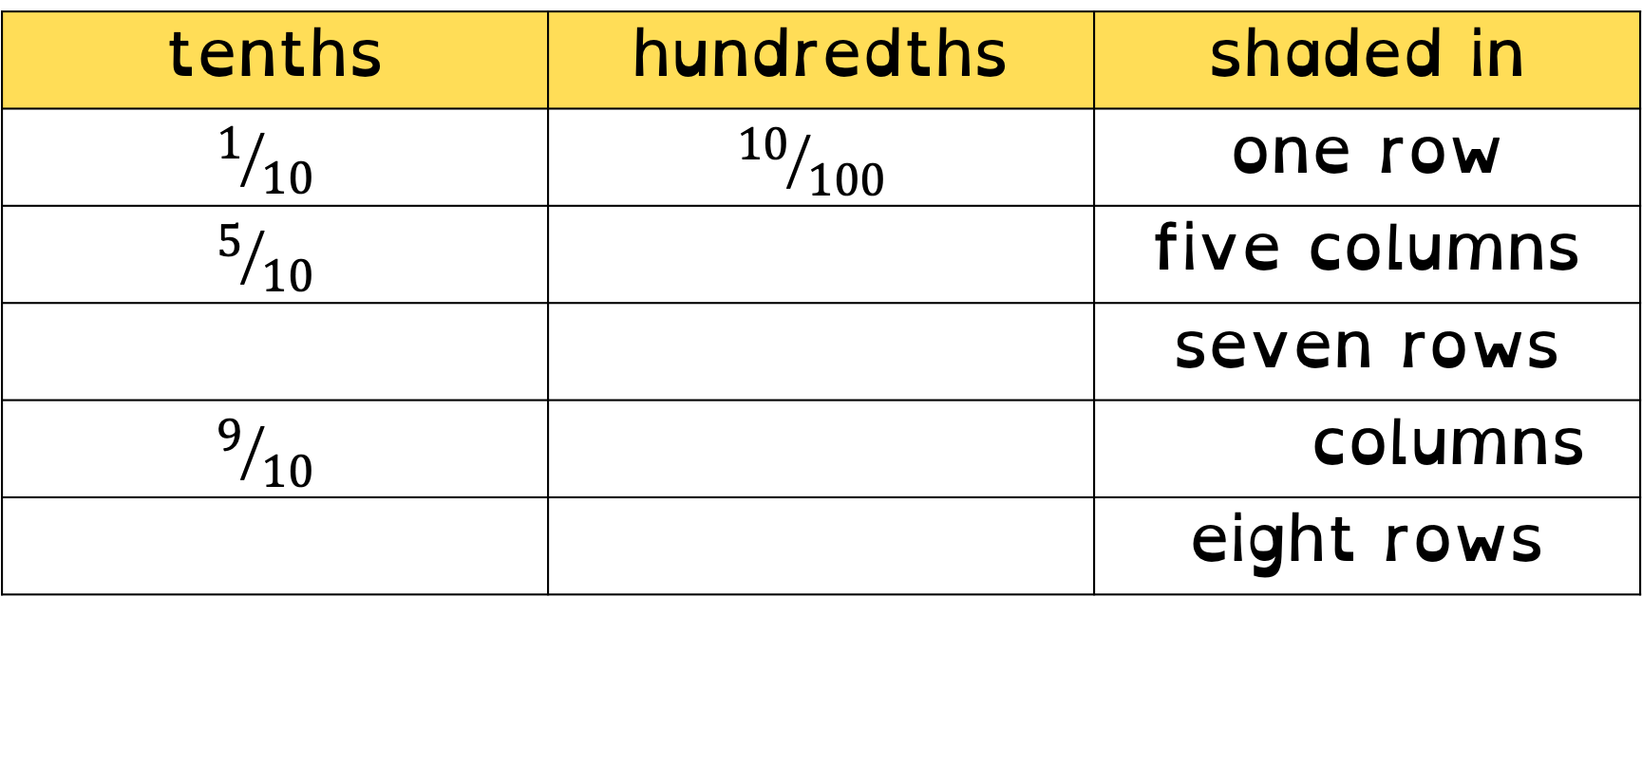
To be able to identify tenths and hundredths using a hundred square
Activity 2:
Complete the table below.
tenths | hundredths | shaded in
$$1/{10}$$ | $${10}/{100}$$ | one row
$$5/{10}$$ | $${50}/{100}$$ | five columns
$$7/{10}$$ | $${70}/{100}$$ | seven rows
$$9/{10}$$ | $${90}/{100}$$ | nine columns
$$8/{10}$$ | $${80}/{100}$$ | eight rows

Slide 27
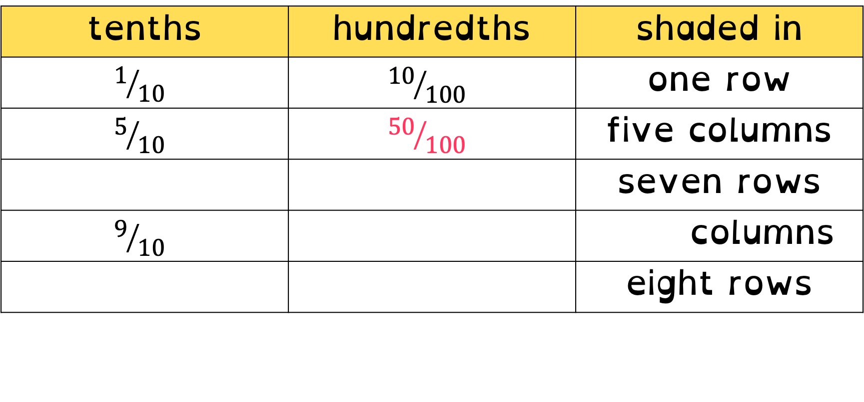
To be able to identify tenths and hundredths using a hundred square
Activity 2:
Complete the table below.
tenths | hundredths | shaded in
$$1/{10}$$ | $${10}/{100}$$ | one row
$$5/{10}$$ | $${50}/{100}$$ | five columns
$$7/{10}$$ | $${70}/{100}$$ | seven rows
$$9/{10}$$ | $${90}/{100}$$ | nine columns
$$8/{10}$$ | $${80}/{100}$$ | eight rows

Slide 28
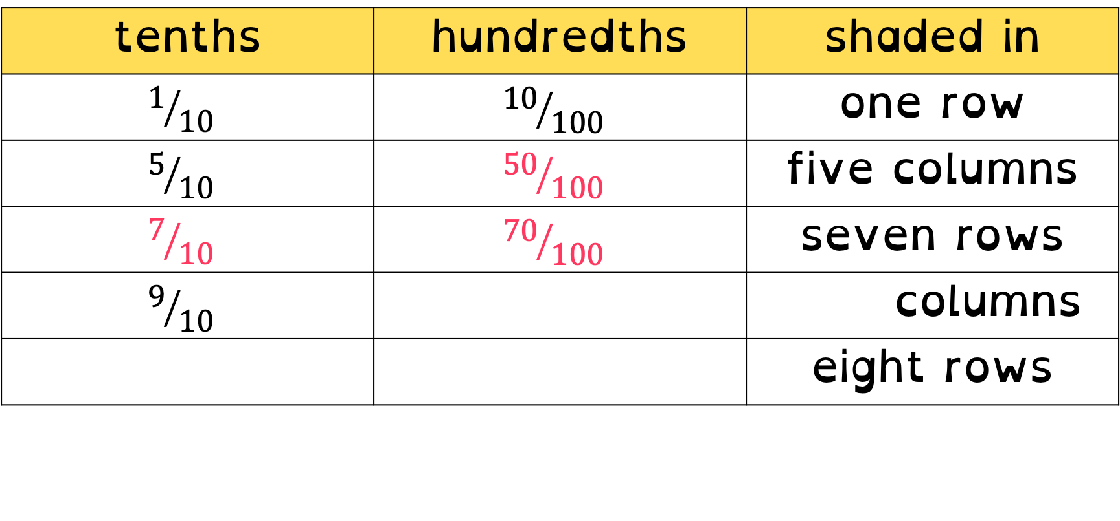
To be able to identify tenths and hundredths using a hundred square
Activity 2:
Complete the table below.
tenths | hundredths | shaded in
$$1/{10}$$ | $${10}/{100}$$ | one row
$$5/{10}$$ | $${50}/{100}$$ | five columns
$$7/{10}$$ | $${70}/{100}$$ | seven rows
$$9/{10}$$ | $${90}/{100}$$ | nine columns
$$8/{10}$$ | $${80}/{100}$$ | eight rows

Slide 29
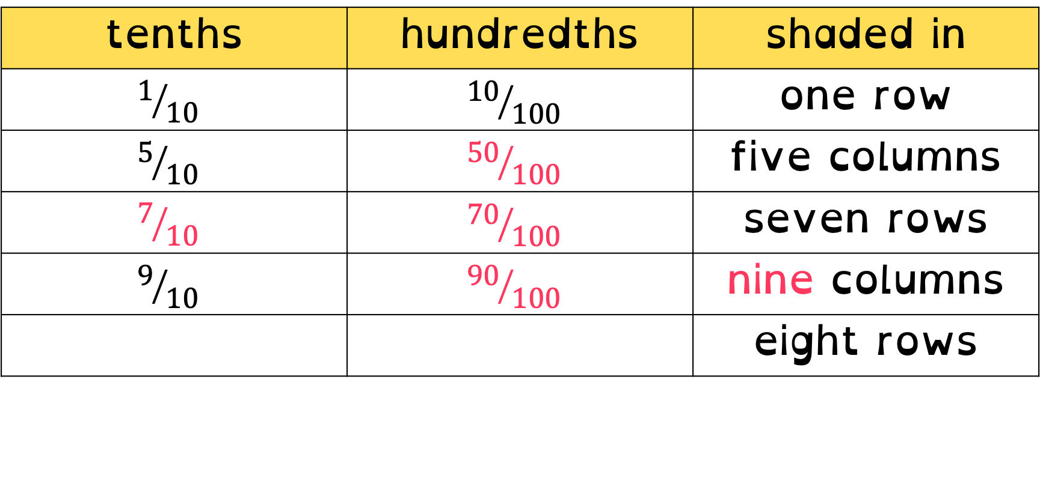
To be able to identify tenths and hundredths using a hundred square
Activity 2:
Complete the table below.
tenths | hundredths | shaded in
$$1/{10}$$ | $${10}/{100}$$ | one row
$$5/{10}$$ | $${50}/{100}$$ | five columns
$$7/{10}$$ | $${70}/{100}$$ | seven rows
$$9/{10}$$ | $${90}/{100}$$ | nine columns
$$8/{10}$$ | $${80}/{100}$$ | eight rows

Slide 30
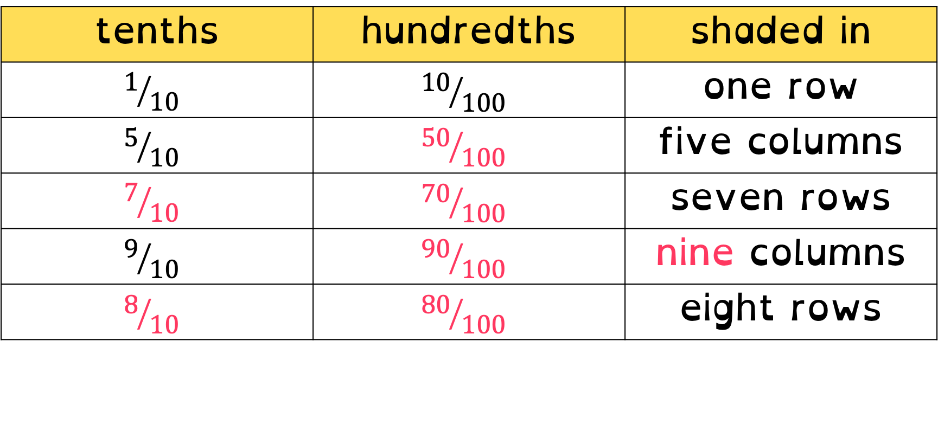
To be able to identify tenths and hundredths using a hundred square
Activity 2:
Complete the table below.
tenths | hundredths | shaded in
$$1/{10}$$ | $${10}/{100}$$ | one row
$$5/{10}$$ | $${50}/{100}$$ | five columns
$$7/{10}$$ | $${70}/{100}$$ | seven rows
$$9/{10}$$ | $${90}/{100}$$ | nine columns
$$8/{10}$$ | $${80}/{100}$$ | eight rows

Slide 31



To be able to identify tenths and hundredths using a hundred square
Talking Time:
Use the part-whole model to partition 47 hundredths into tenths and hundredths.
$$\frac{47}{100}$$
$$\frac{4}{10}$$
$$\frac{7}{100}$$

Slide 32


To be able to identify tenths and hundredths using a hundred square
Talking Time:
Use the part-whole model to partition 47 hundredths into tenths and hundredths.
$$\frac{47}{100}$$
$$\frac{4}{10}$$
$$\frac{7}{100}$$

Slide 33



To be able to identify tenths and hundredths using a hundred square
Talking Time:
Use the part-whole model to partition 35 hundredths into tenths and hundredths.
$$\frac{35}{100}$$
$$\frac{3}{10}$$
$$\frac{5}{100}$$

Slide 34


To be able to identify tenths and hundredths using a hundred square
Talking Time:
Use the part-whole model to partition 35 hundredths into tenths and hundredths.
$$\frac{35}{100}$$
$$\frac{3}{10}$$
$$\frac{5}{100}$$

Slide 35



To be able to identify tenths and hundredths using a hundred square
Talking Time:
Use the part-whole model to partition 74 hundredths into tenths and hundredths.
$$\frac{74}{100}$$
$$\frac{7}{10}$$
$$\frac{4}{100}$$

Slide 36


To be able to identify tenths and hundredths using a hundred square
Talking Time:
Use the part-whole model to partition 74 hundredths into tenths and hundredths.
$$\frac{74}{100}$$
$$\frac{7}{10}$$
$$\frac{4}{100}$$

Slide 37



To be able to identify tenths and hundredths using a hundred square
Talking Time:
Use the part-whole model to partition 83 hundredths into tenths and hundredths.
$$\frac{83}{100}$$
$$\frac{8}{10}$$
$$\frac{3}{100}$$

Slide 38


To be able to identify tenths and hundredths using a hundred square
Talking Time:
Use the part-whole model to partition 83 hundredths into tenths and hundredths.
$$\frac{83}{100}$$
$$\frac{8}{10}$$
$$\frac{3}{100}$$

Slide 39

To be able to identify tenths and hundredths using a hundred square
Talking Time:
Use the part-whole model to partition 91 hundredths into tenths and hundredths.
$$\frac{91}{100}$$

Slide 40


To be able to identify tenths and hundredths using a hundred square
Talking Time:
Use the part-whole model to partition 91 hundredths into tenths and hundredths.
$$\frac{91}{100}$$
$$\frac{9}{10}$$
$$\frac{1}{100}$$

Slide 41


To be able to identify tenths and hundredths using a hundred square
Talking Time:
Use the part-whole model to partition 80 hundredths into tenths and hundredths.
$$\frac{80}{100}$$
$$\frac{8}{10}$$
$$\frac{0}{100}$$

Slide 42

To be able to identify tenths and hundredths using a hundred square
Talking Time:
Use the part-whole model to partition 80 hundredths into tenths and hundredths.
$$\frac{80}{100}$$
$$\frac{8}{10}$$
$$\frac{0}{100}$$

Slide 43

To be able to identify tenths and hundredths using a hundred square
Talking Time:
Use the part-whole model to partition 30 hundredths into tenths and hundredths.
$$\frac{30}{100}$$
$$\frac{8}{10}$$
$$\frac{3}{100}$$

Slide 44
To be able to identify tenths and hundredths using a hundred square
Talking Time:
Use the part-whole model to partition 30 hundredths into tenths and hundredths.
$$\frac{30}{100}$$
$$\frac{3}{10}$$
$$\frac{0}{100}$$

Slide 45



To be able to identify tenths and hundredths using a hundred square
Talking Time:
Use the part-whole model to partition 29 hundredths into tenths and hundredths.
$$\frac{29}{100}$$
$$\frac{2}{10}$$
$$\frac{9}{100}$$

Slide 46


To be able to identify tenths and hundredths using a hundred square
Talking Time:
Use the part-whole model to partition 29 hundredths into tenths and hundredths.
$$\frac{29}{100}$$
$$\frac{2}{10}$$
$$\frac{9}{100}$$

Slide 47



To be able to identify tenths and hundredths using a hundred square
Talking Time:
Use the part-whole model to partition 72 hundredths into tenths and hundredths.
$$\frac{72}{100}$$
$$\frac{7}{10}$$
$$\frac{2}{100}$$

Slide 48


To be able to identify tenths and hundredths using a hundred square
Talking Time:
Use the part-whole model to partition 72 hundredths into tenths and hundredths.
$$\frac{72}{100}$$
$$\frac{7}{10}$$
$$\frac{2}{100}$$

Slide 49



To be able to identify tenths and hundredths using a hundred square
Talking Time:
Use the part-whole model to partition 40 hundredths into tenths and hundredths.
$$\frac{40}{100}$$
$$\frac{4}{10}$$
$$\frac{0}{100}$$

Slide 50


To be able to identify tenths and hundredths using a hundred square
Talking Time:
Use the part-whole model to partition 40 hundredths into tenths and hundredths.
$$\frac{40}{100}$$
$$\frac{4}{10}$$
$$\frac{0}{100}$$

Slide 51







To be able to identify tenths and hundredths using a hundred square
Activity 3:
Complete the part-whole models below.
$$\frac{19}{100}$$
$$\frac{90}{100}$$
$$\frac{33}{100}$$
$$\frac{1}{10}$$
$$\frac{9}{100}$$
$$\frac{9}{10}$$
$$\frac{0}{100}$$
$$\frac{3}{10}$$
$$\frac{3}{100}$$

Slide 52





To be able to identify tenths and hundredths using a hundred square
Activity 3:
Complete the part-whole models below.
$$\frac{19}{100}$$
$$\frac{90}{100}$$
$$\frac{33}{100}$$
$$\frac{1}{10}$$
$$\frac{9}{100}$$
$$\frac{9}{10}$$
$$\frac{0}{100}$$
$$\frac{3}{10}$$
$$\frac{3}{100}$$

Slide 53









To be able to identify tenths and hundredths using a hundred square
Activity 4:
Cross out the incorrect part-whole model below. What’s gone wrong?
$$\frac{57}{100}$$
$$\frac{57}{100}$$
$$\frac{57}{100}$$
$$\frac{5}{10}$$
$$\frac{7}{100}$$
$$\frac{7}{10}$$
$$\frac{5}{100}$$
$$\frac{50}{100}$$
$$\frac{7}{100}$$

Slide 54



To be able to identify tenths and hundredths using a hundred square
Activity 4:
The tenths digit has been put over 100 and vice versa.
$$\frac{57}{100}$$
$$\frac{57}{100}$$
$$\frac{57}{100}$$
$$\frac{5}{10}$$
$$\frac{7}{100}$$
$$\frac{7}{10}$$
$$\frac{5}{100}$$
$$\frac{50}{100}$$
$$\frac{7}{100}$$

Slide 55
To be able to identify tenths and hundredths using a hundred square
Activity 5:
Jamal says, “Three tenths is equivalent to thirty hundredths.”
Ruth says, “Three hundredths is equal to three tenths.”
Who is correct? Who is incorrect?
Explain your answer.

Slide 56
To be able to identify tenths and hundredths using a hundred square
Activity 5:
Jamal says, “Three tenths is equivalent to thirty hundredths.”
Ruth says, “Three hundredths is equal to three tenths.”
Jamal is correct, three tenths is equivalent to thirty hundredths as it would be three columns/rows in a hundred square, with each row/column equal to ten hundredths.

Slide 57
To be able to identify tenths and hundredths using a hundred square
Evaluation:
Do you agree with Astrobee?
Provide examples to explain your answer.
In a hundred square, a row is worth more than a column.

Slide 58

To be able to identify tenths and hundredths using a hundred square
Evaluation:
No, I do not agree. A row and a column are worth the same. For example, eight rows are equal to ${80}/{100}$ eight columns are equal to ${80}/{100}$.
In a hundred square, a row is worth more than a column.

Slide 59
To be able to identify tenths and hundredths using a hundred square
Success criteria:
I can use a hundred square to identify tenths and hundredths
I can explain my reasoning when using a hundred square to identify tenths and hundredths

