Slide 1




Year 2
Term 4 - Block 3: Money
Lesson 1: To be able to identify notes and coins
4
Block 3 – Money
1

Slide 2
To be able to identify notes and coins
Success criteria:
I can use my knowledge of the value of notes and coins to identify and represent amounts of money in different ways
I can explain my reasoning when using my knowledge of the value of notes and coins to identify and represent amounts of money in different ways

Slide 3
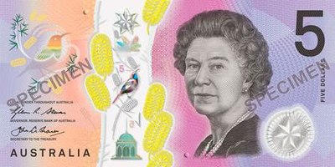
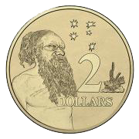
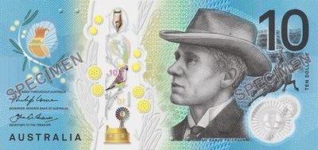
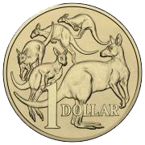
To be able to identify notes and coins
Starter:
Which one doesn’t belong?
Explain your answer.
A
B
C
D

Slide 4
To be able to identify notes and coins
Starter:
Which one doesn’t belong?
C doesn’t belong as it has a total of $11. Whereas the other representations all have a total of $10, as $5 + $2 + $2 + $1 = $10, 1 x $10 = $10 and 5 x $2 = $10.
A
B
C
D

Slide 5
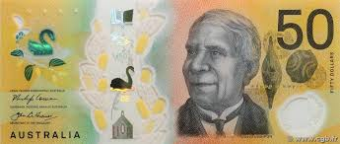
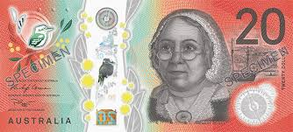
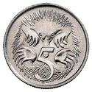
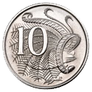
To be able to identify notes and coins
Talking Time:
Match the words to the correct amount.
ten cents
fifty dollars
thirty cents
forty dollars

Slide 6
To be able to identify notes and coins
Talking Time:
Match the words to the correct amount.
ten cents
fifty dollars
thirty cents
forty dollars

Slide 7
To be able to identify notes and coins
Talking Time:
Match the words to the correct amount.
ten cents
fifty dollars
thirty cents
forty dollars

Slide 8
To be able to identify notes and coins
Talking Time:
Match the words to the correct amount.
ten cents
fifty dollars
thirty cents
forty dollars

Slide 9
To be able to identify notes and coins
Talking Time:
Match the words to the correct amount.
ten cents
fifty dollars
thirty cents
forty dollars

Slide 10
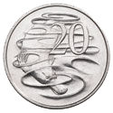
To be able to identify notes and coins
Talking Time:
Match the words to the correct amount.
ten dollars
twenty cents
thirty dollars
twenty-five cents

Slide 11
To be able to identify notes and coins
Talking Time:
Match the words to the correct amount.
ten dollars
twenty cents
thirty dollars
twenty-five cents

Slide 12
To be able to identify notes and coins
Talking Time:
Match the words to the correct amount.
ten dollars
twenty cents
thirty dollars
twenty-five cents

Slide 13
To be able to identify notes and coins
Talking Time:
Match the words to the correct amount.
ten dollars
twenty cents
thirty dollars
twenty-five cents

Slide 14
To be able to identify notes and coins
Talking Time:
Match the words to the correct amount.
ten dollars
twenty cents
thirty dollars
twenty-five cents

Slide 15
To be able to identify notes and coins
Activity 1:
Match the words to the correct amount.
fifteen cents
fifteen dollars
fifty dollars
fifty-five cents

Slide 16
To be able to identify notes and coins
Activity 1:
Match the words to the correct amount.
fifteen cents
fifteen dollars
fifty dollars
fifty-five cents

Slide 17
To be able to identify notes and coins
Activity 1:
Match the words to the correct amount.
fifteen cents
fifteen dollars
fifty dollars
fifty-five cents

Slide 18
To be able to identify notes and coins
Activity 1:
Match the words to the correct amount.
fifteen cents
fifteen dollars
fifty dollars
fifty-five cents

Slide 19
To be able to identify notes and coins
Activity 1:
Match the words to the correct amount.
fifteen cents
fifteen dollars
fifty dollars
fifty-five cents

Slide 20
To be able to identify notes and coins
Talking Time:
How much money is in the piggy bank?
The piggy bank contains
$__ and __¢.

Slide 21
To be able to identify notes and coins
Talking Time:
How much money is in the piggy bank?
The piggy bank contains
$15 and 35¢.

Slide 22
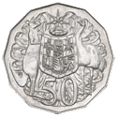
To be able to identify notes and coins
Talking Time:
How much money is in the piggy bank?
The piggy bank contains
$__ and __¢.

Slide 23
To be able to identify notes and coins
Talking Time:
How much money is in the piggy bank?
The piggy bank contains
$35 and 70¢.

Slide 24
To be able to identify notes and coins
Talking Time:
How much money is in the piggy bank?
The piggy bank contains
$__ and __¢.

Slide 25
To be able to identify notes and coins
Talking Time:
How much money is in the piggy bank?
The piggy bank contains
$75 and 95¢.

Slide 26
To be able to identify notes and coins
Activity 2:
How much money is in the piggy bank?
The piggy bank contains
$__ and __¢.

Slide 27
To be able to identify notes and coins
Activity 2:
How much money is in the piggy bank?
The piggy bank contains
$83 and 55¢.

Slide 28

To be able to identify notes and coins
Talking Time:
Use the comparison symbols (<, > or =) to complete the following statements:

Slide 29
To be able to identify notes and coins
Talking Time:
Use the comparison symbols (<, > or =) to complete the following statements:
>

Slide 30
To be able to identify notes and coins
Talking Time:
Use the comparison symbols (<, > or =) to complete the following statements:
>
<

Slide 31
To be able to identify notes and coins
Talking Time:
Use the comparison symbols (<, > or =) to complete the following statements:
>
<
<

Slide 32
To be able to identify notes and coins
Talking Time:
Use the comparison symbols (<, > or =) to complete the following statements:
>
<
<
=

Slide 33
To be able to identify notes and coins
Talking Time:
Use the comparison symbols (<, > or =) to complete the following statements:

Slide 34
To be able to identify notes and coins
Talking Time:
Use the comparison symbols (<, > or =) to complete the following statements:
<

Slide 35
To be able to identify notes and coins
Talking Time:
Use the comparison symbols (<, > or =) to complete the following statements:
<
>

Slide 36
To be able to identify notes and coins
Talking Time:
Use the comparison symbols (<, > or =) to complete the following statements:
<
>
=

Slide 37
To be able to identify notes and coins
Talking Time:
Use the comparison symbols (<, > or =) to complete the following statements:
<
>
=
>

Slide 38
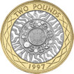
To be able to identify notes and coins
Activity 3:
Use the comparison symbols (<, > or =) to complete the following statements:

Slide 39
To be able to identify notes and coins
Activity 3:
Use the comparison symbols (<, > or =) to complete the following statements:
>

Slide 40
To be able to identify notes and coins
Activity 3:
Use the comparison symbols (<, > or =) to complete the following statements:
>
=

Slide 41
To be able to identify notes and coins
Activity 3:
Use the comparison symbols (<, > or =) to complete the following statements:
>
=
>

Slide 42
To be able to identify notes and coins
Activity 3:
Use the comparison symbols (<, > or =) to complete the following statements:
>
=
>
<

Slide 43
To be able to identify notes and coins
Talking Time:
Jamal has three different bank notes in his piggy bank.
What is the greatest amount of money he could have in his piggy bank?
What is the least amount of money he could have in his piggy bank?
Explain your answers.

Slide 44
To be able to identify notes and coins
Talking Time:
Jamal has three different bank notes in his piggy bank.
What is the greatest amount of money he could have in his piggy bank?
He could have $170 as $100 + $50 + $20 = $170
What is the least amount of money he could have in his piggy bank?
A

Slide 45
To be able to identify notes and coins
Talking Time:
Jamal has three different bank notes in his piggy bank.
What is the greatest amount of money he could have in his piggy bank?
He could have $170 as $100 + $50 + $20 = $170
What is the least amount of money he could have in his piggy bank?
He could have $35 as $20 + $10 + $5 = $35
A
B

Slide 46
To be able to identify notes and coins
Activity 4:
Ruth has five of the same bank notes in her piggy bank.
What is the greatest amount of money she could have in her piggy bank?
What is the least amount of money she could have in her piggy bank?
Explain your answers.

Slide 47
To be able to identify notes and coins
Activity 4:
Ruth has five of the same bank notes in her piggy bank.
What is the greatest amount of money she could have in her piggy bank?
She could have $500 as 5 x $100 = $500
What is the least amount of money she could have in her piggy bank?
She could have $25 as 5 x $5 = $25
A
B

Slide 48
To be able to identify notes and coins
Activity 5:
James says, “$10 and 10¢ are worth the same.”
Do you agree?
Explain your answer.

Slide 49
To be able to identify notes and coins
Activity 5:
James says, “$10 and 10¢ are worth the same.”
No, I do not agree with James.
$10 is worth ten lots of $1. Whereas there are ten lots of 10¢ in $1.
$10 - $0.10 = $9.90
So, the difference between $10 and 10¢ is $9 and 90¢ or $9.90.

Slide 50
To be able to identify notes and coins
Evaluation:
Is Astrobee’s statement always, sometimes or never true?
Explain your answer.
If I have three bank notes in my wallet and no coins, I have an even-numbered amount of money in my wallet.

Slide 51
To be able to identify notes and coins
Evaluation:
Astrobee’s statement is only sometimes true. For example, if Astrobee had three $20 notes in a wallet, then that would make $60 (an even amount). However, if Astrobee had a $20 note, a $10 note and a $5 note in a wallet, then there would be an odd-numbered amount of money in the wallet ($35).
If I have three bank notes in my wallet and no coins, I have an even-numbered amount of money in my wallet.

Slide 52
To be able to identify notes and coins
Success criteria:
I can use my knowledge of the value of notes and coins to identify and represent amounts of money in different ways
I can explain my reasoning when using my knowledge of the value of notes and coins to identify and represent amounts of money in different ways

