Slide 1
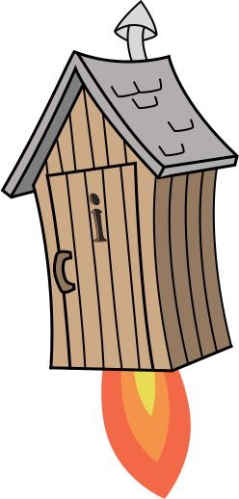
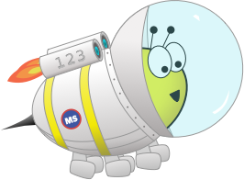
Year 2
Term 3 - Block 2 - Fractions - Lesson 2
To be able to use number lines to identify equivalent fractions
3
Block 2 – Fractions
2

Slide 2
To be able to use number lines to identify equivalent fractions
Success criteria:
I can use Cuisenaire rods, bar models and number lines to identify equivalent fractions
I can explain my reasoning when using Cuisenaire rods, bar models and number lines to identify equivalent fractions

Slide 3
To be able to use number lines to identify equivalent fractions
Starter:
What’s the same? What’s different?
Explain your answer.
0
$$\frac{1}{8}$$
$$\frac{2}{8}$$
$$\frac{3}{8}$$
$$\frac{4}{8}$$
$$\frac{5}{8}$$
$$\frac{6}{8}$$
$$\frac{7}{8}$$
1
0
$$\frac{1}{4}$$
$$\frac{2}{4}$$
$$\frac{3}{4}$$
1

Slide 4
To be able to use number lines to identify equivalent fractions
Starter:
What’s the same? What’s different?
Both fractions that have been selected are equivalent to ¼. Their numerators and denominators are different but they are the same distance along their number lines.
0
$$\frac{1}{8}$$
$$\frac{2}{8}$$
$$\frac{3}{8}$$
$$\frac{4}{8}$$
$$\frac{5}{8}$$
$$\frac{6}{8}$$
$$\frac{7}{8}$$
1
0
$$\frac{1}{4}$$
$$\frac{2}{4}$$
$$\frac{3}{4}$$
1

Slide 5
To be able to use number lines to identify equivalent fractions
Talking Time:
Use the bar models and number lines to identify the equivalent fraction below.
0
1
0
1

Slide 6
To be able to use number lines to identify equivalent fractions
Talking Time:
Use the bar models and number lines to identify the equivalent fraction below.
0
$$\frac{1}{2}$$
1
0
1

Slide 7
To be able to use number lines to identify equivalent fractions
Talking Time:
Use the bar models and number lines to identify the equivalent fraction below.
0
$$\frac{1}{2}$$
1
0
$$\frac{1}{4}$$
$$\frac{2}{4}$$
$$\frac{3}{4}$$
1

Slide 8
To be able to use number lines to identify equivalent fractions
Talking Time:
Use the bar models and number lines to identify the equivalent fraction below.
0
$$\frac{1}{2}$$
1
0
$$\frac{1}{4}$$
$$\frac{2}{4}$$
$$\frac{3}{4}$$
1

Slide 9
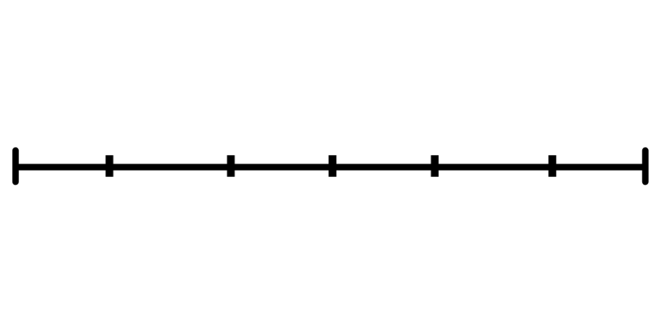
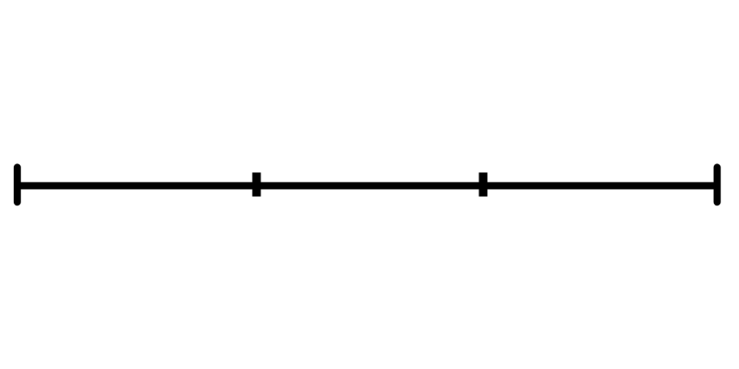
To be able to use number lines to identify equivalent fractions
Activity 1:
Use the bar models and number lines to identify the equivalent fractions below.
0
1
0
1

Slide 10
To be able to use number lines to identify equivalent fractions
Activity 1:
Use the bar models and number lines to identify the equivalent fractions below.
0
$$\frac{1}{6}$$
$$\frac{2}{6}$$
$$\frac{3}{6}$$
$$\frac{4}{6}$$
$$\frac{5}{6}$$
1
0
1

Slide 11
To be able to use number lines to identify equivalent fractions
Activity 1:
Use the bar models and number lines to identify the equivalent fractions below.
0
$$\frac{1}{6}$$
$$\frac{2}{6}$$
$$\frac{3}{6}$$
$$\frac{4}{6}$$
$$\frac{5}{6}$$
1
0
$$\frac{1}{3}$$
$$\frac{2}{3}$$
1

Slide 12
To be able to use number lines to identify equivalent fractions
Activity 1:
Use the bar models and number lines to identify the equivalent fractions below.
0
$$\frac{1}{6}$$
$$\frac{2}{6}$$
$$\frac{3}{6}$$
$$\frac{4}{6}$$
$$\frac{5}{6}$$
1
0
$$\frac{1}{3}$$
$$\frac{2}{3}$$
1

Slide 13
To be able to use number lines to identify equivalent fractions
Talking Time:
Use the area model diagrams and number lines to identify the equivalent fractions below.
$\frac{1}{8}$
$\frac{2}{8}$
$\frac{3}{8}$
$\frac{4}{8}$
$\frac{5}{8}$
$\frac{6}{8}$
$\frac{7}{8}$
1
0

Slide 14
To be able to use number lines to identify equivalent fractions
Talking Time:
Use the area model diagrams and number lines to identify the equivalent fractions below.
$\frac{1}{8}$
$\frac{2}{8}$
$\frac{3}{8}$
$\frac{4}{8}$
$\frac{5}{8}$
$\frac{6}{8}$
$\frac{7}{8}$
1
0
$\frac{1}{4}$

Slide 15
To be able to use number lines to identify equivalent fractions
Talking Time:
Use the area model diagrams and number lines to identify the equivalent fractions below.
$\frac{1}{8}$
$\frac{2}{8}$
$\frac{3}{8}$
$\frac{4}{8}$
$\frac{5}{8}$
$\frac{6}{8}$
$\frac{7}{8}$
1
0
$\frac{1}{4}$
$\frac{2}{4}$

Slide 16
To be able to use number lines to identify equivalent fractions
Talking Time:
Use the area model diagrams and number lines to identify the equivalent fractions below.
$\frac{1}{8}$
$\frac{2}{8}$
$\frac{3}{8}$
$\frac{4}{8}$
$\frac{5}{8}$
$\frac{6}{8}$
$\frac{7}{8}$
1
0
$\frac{1}{4}$
$\frac{1}{2}$

Slide 17
To be able to use number lines to identify equivalent fractions
Talking Time:
Use the area model diagrams and number lines to identify the equivalent fractions below.
$\frac{1}{8}$
$\frac{2}{8}$
$\frac{3}{8}$
$\frac{4}{8}$
$\frac{5}{8}$
$\frac{6}{8}$
$\frac{7}{8}$
1
0
$\frac{1}{4}$
$\frac{2}{4}$
$\frac{3}{4}$

Slide 18
To be able to use number lines to identify equivalent fractions
Talking Time:
Use the area model diagrams and number lines to identify the equivalent fractions below.
$\frac{1}{8}$
$\frac{2}{8}$
$\frac{3}{8}$
$\frac{4}{8}$
$\frac{5}{8}$
$\frac{6}{8}$
$\frac{7}{8}$
1
0
$\frac{1}{4}$
$\frac{1}{2}$
$\frac{3}{4}$

Slide 19
To be able to use number lines to identify equivalent fractions
Activity 2:
Use the area model diagrams and number lines to identify the equivalent fractions below.
$\frac{1}{9}$
$\frac{2}{9}$
$\frac{3}{9}$
$\frac{4}{9}$
$\frac{5}{9}$
$\frac{6}{9}$
$\frac{7}{9}$
$\frac{8}{9}$
1
0

Slide 20
To be able to use number lines to identify equivalent fractions
Activity 2:
Use the area model diagrams and number lines to identify the equivalent fractions below.
$\frac{1}{9}$
$\frac{2}{9}$
$\frac{3}{9}$
$\frac{4}{9}$
$\frac{5}{9}$
$\frac{6}{9}$
$\frac{7}{9}$
$\frac{8}{9}$
1
0
$\frac{1}{3}$

Slide 21
To be able to use number lines to identify equivalent fractions
Activity 2:
Use the area model diagrams and number lines to identify the equivalent fractions below.
$\frac{1}{9}$
$\frac{2}{9}$
$\frac{3}{9}$
$\frac{4}{9}$
$\frac{5}{9}$
$\frac{6}{9}$
$\frac{7}{9}$
$\frac{8}{9}$
1
0
$\frac{1}{3}$
$\frac{2}{3}$

Slide 22
To be able to use number lines to identify equivalent fractions
Talking Time:
Place the equivalent fraction in the correct place on the number line below
$\frac{2}{4}$
$\frac{1}{8}$
$\frac{2}{8}$
$\frac{3}{8}$
$\frac{4}{8}$
$\frac{5}{8}$
$\frac{6}{8}$
$\frac{7}{8}$
1
0

Slide 23
To be able to use number lines to identify equivalent fractions
Talking Time:
Place the equivalent fraction in the correct place on the number line below
$\frac{2}{4}$
$\frac{1}{8}$
$\frac{2}{8}$
$\frac{3}{8}$
$\frac{4}{8}$
$\frac{5}{8}$
$\frac{6}{8}$
$\frac{7}{8}$
1
0

Slide 24
To be able to use number lines to identify equivalent fractions
Talking Time:
Place the equivalent fraction in the correct place on the number line below
$\frac{2}{4}$
$\frac{1}{8}$
$\frac{2}{8}$
$\frac{3}{8}$
$\frac{4}{8}$
$\frac{5}{8}$
$\frac{6}{8}$
$\frac{7}{8}$
1
0

Slide 25
To be able to use number lines to identify equivalent fractions
Talking Time:
Place the equivalent fraction in the correct place on the number line below
$\frac{1}{4}$
$\frac{1}{8}$
$\frac{2}{8}$
$\frac{3}{8}$
$\frac{4}{8}$
$\frac{5}{8}$
$\frac{6}{8}$
$\frac{7}{8}$
1
0

Slide 26
To be able to use number lines to identify equivalent fractions
Talking Time:
Place the equivalent fraction in the correct place on the number line below
$\frac{1}{4}$
$\frac{1}{8}$
$\frac{2}{8}$
$\frac{3}{8}$
$\frac{4}{8}$
$\frac{5}{8}$
$\frac{6}{8}$
$\frac{7}{8}$
1
0

Slide 27
To be able to use number lines to identify equivalent fractions
Talking Time:
Place the equivalent fraction in the correct place on the number line below
$\frac{1}{4}$
$\frac{1}{8}$
$\frac{2}{8}$
$\frac{3}{8}$
$\frac{4}{8}$
$\frac{5}{8}$
$\frac{6}{8}$
$\frac{7}{8}$
1
0

Slide 28
To be able to use number lines to identify equivalent fractions
Talking Time:
Place the equivalent fraction in the correct place on the number line below
$\frac{1}{2}$
$\frac{1}{8}$
$\frac{2}{8}$
$\frac{3}{8}$
$\frac{4}{8}$
$\frac{5}{8}$
$\frac{6}{8}$
$\frac{7}{8}$
1
0

Slide 29
To be able to use number lines to identify equivalent fractions
Talking Time:
Place the equivalent fraction in the correct place on the number line below
$\frac{1}{2}$
$\frac{1}{8}$
$\frac{2}{8}$
$\frac{3}{8}$
$\frac{4}{8}$
$\frac{5}{8}$
$\frac{6}{8}$
$\frac{7}{8}$
1
0

Slide 30
To be able to use number lines to identify equivalent fractions
Talking Time:
Place the equivalent fraction in the correct place on the number line below
$\frac{1}{2}$
$\frac{1}{8}$
$\frac{2}{8}$
$\frac{3}{8}$
$\frac{4}{8}$
$\frac{5}{8}$
$\frac{6}{8}$
$\frac{7}{8}$
1
0

Slide 31
To be able to use number lines to identify equivalent fractions
Talking Time:
Place the equivalent fraction in the correct place on the number line below
$\frac{3}{4}$
$\frac{1}{8}$
$\frac{2}{8}$
$\frac{3}{8}$
$\frac{4}{8}$
$\frac{5}{8}$
$\frac{6}{8}$
$\frac{7}{8}$
1
0

Slide 32
To be able to use number lines to identify equivalent fractions
Talking Time:
Place the equivalent fraction in the correct place on the number line below
$\frac{3}{4}$
$\frac{1}{8}$
$\frac{2}{8}$
$\frac{3}{8}$
$\frac{4}{8}$
$\frac{5}{8}$
$\frac{6}{8}$
$\frac{7}{8}$
1
0

Slide 33
To be able to use number lines to identify equivalent fractions
Talking Time:
Place the equivalent fraction in the correct place on the number line below
$\frac{3}{4}$
$\frac{1}{8}$
$\frac{2}{8}$
$\frac{3}{8}$
$\frac{4}{8}$
$\frac{5}{8}$
$\frac{6}{8}$
$\frac{7}{8}$
1
0

Slide 34
To be able to use number lines to identify equivalent fractions
Activity 3:
Place the equivalent fractions in the correct places on the number line below:
$3/4,2/3,1/4$ and $1/2$.
0
1
$\frac{1}{12}$
$\frac{2}{12}$
$\frac{3}{12}$
$\frac{4}{12}$
$\frac{5}{12}$
$\frac{6}{12}$
$\frac{7}{12}$
$\frac{8}{12}$
$\frac{9}{12}$
$\frac{10}{12}$
$\frac{11}{12}$

Slide 35
To be able to use number lines to identify equivalent fractions
Activity 3:
Place the equivalent fractions in the correct places on the number line below:
$3/4,2/3,1/4$ and $1/2$.
$\frac{3}{4}$
0
1
$\frac{1}{12}$
$\frac{2}{12}$
$\frac{3}{12}$
$\frac{4}{12}$
$\frac{5}{12}$
$\frac{6}{12}$
$\frac{7}{12}$
$\frac{8}{12}$
$\frac{9}{12}$
$\frac{10}{12}$
$\frac{11}{12}$

Slide 36
To be able to use number lines to identify equivalent fractions
Activity 3:
Place the equivalent fractions in the correct places on the number line below:
$3/4,2/3,1/4$ and $1/2$.
$\frac{2}{3}$
$\frac{3}{4}$
0
1
$\frac{1}{12}$
$\frac{2}{12}$
$\frac{3}{12}$
$\frac{4}{12}$
$\frac{5}{12}$
$\frac{6}{12}$
$\frac{7}{12}$
$\frac{8}{12}$
$\frac{9}{12}$
$\frac{10}{12}$
$\frac{11}{12}$

Slide 37
To be able to use number lines to identify equivalent fractions
Activity 3:
Place the equivalent fractions in the correct places on the number line below:
$3/4,2/3,1/4$ and $1/2$.
$\frac{1}{4}$
$\frac{2}{3}$
$\frac{3}{4}$
0
1
$\frac{1}{12}$
$\frac{2}{12}$
$\frac{3}{12}$
$\frac{4}{12}$
$\frac{5}{12}$
$\frac{6}{12}$
$\frac{7}{12}$
$\frac{8}{12}$
$\frac{9}{12}$
$\frac{10}{12}$
$\frac{11}{12}$

Slide 38
To be able to use number lines to identify equivalent fractions
Activity 3:
Place the equivalent fractions in the correct places on the number line below:
$3/4,2/3,1/4$ and $1/2$.
$\frac{1}{4}$
$\frac{1}{2}$
$\frac{2}{3}$
$\frac{3}{4}$
0
1
$\frac{1}{12}$
$\frac{2}{12}$
$\frac{3}{12}$
$\frac{4}{12}$
$\frac{5}{12}$
$\frac{6}{12}$
$\frac{7}{12}$
$\frac{8}{12}$
$\frac{9}{12}$
$\frac{10}{12}$
$\frac{11}{12}$

Slide 39
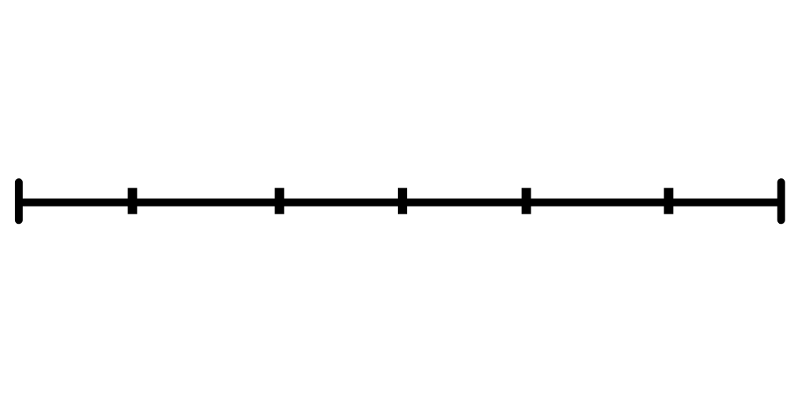
To be able to use number lines to identify equivalent fractions
Activity 4:
Place each person’s fraction on the number line below.
Jamal says, “My fraction is equal to ½ but has the denominator 6.”
Ruth says, “My fraction has the denominator 3, and has the numerator 2.”
Chen says, “My fraction is equivalent to $2/6$ but has a smaller denominator.”
Explain your choices.
0
1

Slide 40
To be able to use number lines to identify equivalent fractions
Activity 4:
Place each person’s fraction on the number line below.
Jamal says, “My fraction is equal to ½ but has the denominator 6.”
Ruth says, “My fraction has the denominator 3, and has the numerator 2.”
Chen says, “My fraction is equivalent to $2/6$ but has a smaller denominator.”
$\frac{1}{3}$
$\frac{3}{6}$
$\frac{2}{3}$
0
$$C$$
$$J$$
$$R$$
1

Slide 41
To be able to use number lines to identify equivalent fractions
Evaluation:
Is Astrobee’s statement always, sometimes or never true.
Draw number lines to help explain your answer.
To find an equivalent fraction, you double the numerator and denominator.

Slide 42
To be able to use number lines to identify equivalent fractions
Evaluation:
Astrobee’s statement is sometimes true. For example, if I wanted to find out the equivalent fraction over 8 to ¼, I could double both digits. However, the other way around I would need to halve each digit… Also, $3/9$ is equivalent to $1/3…$
To find an equivalent fraction, you double the numerator and denominator.

Slide 43
To be able to use number lines to identify equivalent fractions
Success criteria:
I can use Cuisenaire rods, bar models and number lines to identify equivalent fractions
I can explain my reasoning when using Cuisenaire rods, bar models and number lines to identify equivalent fractions

