Slide 1
Foundation Term 4 - Block 3: Money
Lesson 1: To be able to recognise coins
4
Block 3 – Money
1

Slide 2
To be able to recognise coins
Success criteria:
I can recognise coins and be able to give their value, using my place value knowledge to match sets of coins of equal value
I can explain my reasoning when recognising coins and giving their value, and when using my place value knowledge to match sets of coins of equal value

Slide 3
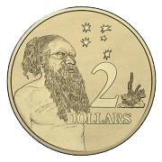
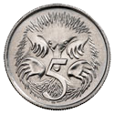
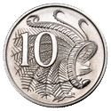
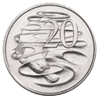
To be able to recognise coins
Starter:
Which one does not belong?
Explain your answer.

Slide 4
To be able to recognise coins
Starter:
Which one does not belong?
The two dollar coin does not belong as it is brass/gold, whereas the other coins are silver. (It also has a single-digit value, while the others have two-digit values.)

Slide 5
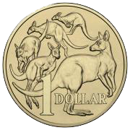
To be able to recognise coins
Talking Time:
Circle the 5¢ coin below.

Slide 6
To be able to recognise coins
Talking Time:
Circle the 5¢ coin below.

Slide 7
To be able to recognise coins
Talking Time:
Circle the $1 coin below.

Slide 8
To be able to recognise coins
Talking Time:
Circle the $1 coin below.

Slide 9
To be able to recognise coins
Talking Time:
Circle the 20¢ coin below.

Slide 10
To be able to recognise coins
Talking Time:
Circle the 20¢ coin below.

Slide 11
To be able to recognise coins
Talking Time:
Circle the 10¢ coin below.

Slide 12
To be able to recognise coins
Talking Time:
Circle the 10¢ coin below.

Slide 13
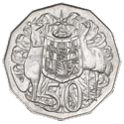
To be able to recognise coins
Talking Time:
Circle the 50¢ coin below.

Slide 14
To be able to recognise coins
Talking Time:
Circle the 50¢ coin below.

Slide 15
To be able to recognise coins
Talking Time:
Circle the 5¢ coin below.

Slide 16
To be able to recognise coins
Talking Time:
Circle the 5¢ coin below.

Slide 17
To be able to recognise coins
Talking Time:
Circle the $2 coin below.

Slide 18
To be able to recognise coins
Talking Time:
Circle the $2 coin below.

Slide 19
To be able to recognise coins
Talking Time:
Circle the 20¢ coin below.

Slide 20
To be able to recognise coins
Talking Time:
Circle the 20¢ coin below.

Slide 21
To be able to recognise coins
Activity 1:
Match each coin to its value.
$1
20¢
50¢
10¢

Slide 22
To be able to recognise coins
Activity 1:
Match each coin to its value.
$1
20¢
50¢
10¢

Slide 23
To be able to recognise coins
Activity 1 (continued):
Match each coin to its value.
5¢
$2
$1
50¢

Slide 24
To be able to recognise coins
Activity 1 (continued):
Match each coin to its value.
5¢
$2
$1
50¢

Slide 25
To be able to recognise coins
Talking Time:
Look at the set of coins, then complete the sentences below.
There are _______ $1 coins.
There are _______ 20¢ coins.
There are _______ 5¢ coins.
There are _______ 50¢ coins.
There are _______ 10¢ coins.
There are _______ $2 coins.

Slide 26
To be able to recognise coins
Talking Time:
Look at the set of coins, then complete the sentences below.
There are _______ $1 coins.
There are three $1 coins.
There are _______ 20¢ coins.
There are four 20¢ coins.
There are _______ 5¢ coins.
There are three 5¢ coins.
There are _______ 50¢ coins.
There are two 50¢ coins.
There are _______ 10¢ coins.
There are five 10¢ coins.
There are _______ $2 coins.
There are four $2 coins.

Slide 27
To be able to recognise coins
Activity 2:
Look at the set of coins, then complete the sentences below.
There are _______ $1 coins.
There are _______ 20¢ coins.
There are _______ 5¢ coins.
There are _______ 50¢ coins.
There are _______ 10¢ coins.
There are _______ $2 coins.

Slide 28
To be able to recognise coins
Activity 2:
Look at the set of coins, then complete the sentences below.
There are _______ $1 coins.
There are four $1 coins.
There are _______ 20¢ coins.
There are five 20¢ coins.
There are _______ 5¢ coins.
There are two 5¢ coins.
There are _______ 50¢ coins.
There are three 50¢ coins.
There are _______ 10¢ coins.
There are four 10¢ coins.
There are _______ $2 coins.
There are two $2 coins.

Slide 29
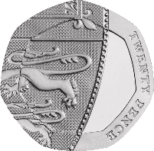
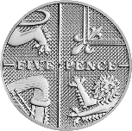
To be able to recognise coins
Talking Time:
Use the comparison symbols <, > and = to compare the coins below.

Slide 30
To be able to recognise coins
Talking Time:
Use the comparison symbols <, > and = to compare the coins below.
>
<
<

Slide 31
To be able to recognise coins
Talking Time:
Use the comparison symbols <, > and = to compare the coins below.

Slide 32
To be able to recognise coins
Talking Time:
Use the comparison symbols <, > and = to compare the coins below.
<
>
<

Slide 33
To be able to recognise coins
Activity 3:
Use the comparison symbols <, > and = to compare the coins below.

Slide 34
To be able to recognise coins
Activity 3:
Use the comparison symbols <, > and = to compare the coins below.
<
<
>

Slide 35
To be able to recognise coins
Activity 4:
Chen says, “I have a silver coin in my hand. It is worth more than 5¢, but less than $1.”
What might his coin be? Is there only one possibility?
Sketch in the box below.

Slide 36
To be able to recognise coins
Activity 4:
Chen says, “I have a silver coin in my hand. It is worth more than 5¢, but less than $1.”
What might his coin be? Is there only one possibility?
Sketch in the box below.

Slide 37
To be able to recognise coins
Evaluation:
Is Astrobee’s statement always, sometimes or never true?
Explain your answer.
A circular coin is worth more than a coin that is not circular in shape.

Slide 38
To be able to recognise coins
Evaluation:
Astrobee’s statement is only sometimes true. For example, 50¢ is worth more than 10¢, but a $2 coin is worth more than a 50¢ coin.
A circular coin is worth more than a coin that is not circular in shape.

Slide 39
To be able to recognise coins
Success criteria:
I can recognise coins and be able to give their value, using my place value knowledge to match sets of coins of equal value
I can explain my reasoning when recognising coins and giving their value, and when using my place value knowledge to match sets of coins of equal value

