Slide 1




Pre-School
Term 4 - Lesson 1 - Number and Place Value
Numbers to 20 - Counting to 20
4
Number and Place Value
1

Slide 2
Counting to 20!
Note to adults:
The activities within this presentation are designed to accompany or act as guidance for concrete tasks for the children to experience using mathematical equipment and other real-world objects in the classroom.
We hope it helps!

Slide 3
Counting to 20!
Around the World to 20!
Split the children into groups.
Each group should sit in a circle.
Start the children off at 1 (or other numbers).
Each person says the next number.
The person that says 20 each round has to leave the circle.
Notes:
You could increase the challenge by counting back and banning zero.

Slide 4



Counting to 20!
Pairs of Hands!
Children, working in pairs, show numbers between 1 and 20 by showing the fingers on their hands combined.
In the example given, the number 17 has been shown by two pairs of hands.

Slide 5


Adding more!
Tower 20!
Ask the children to make towers of different heights between 1 and 20.
When going above 10 the first ten cubes should be one colour and the following cubes should be an alternative colour (as shown).

Slide 6
Counting to 20!
Counting to 20 with a Renekrek!
Use a Rekenrek to explore groups of 5 and 10, use the beads to help count and make amounts between 0 and 20.
Notes:
Challenge children by making mistakes and asking them to call out and correct your mistakes as you count to 20.

Slide 7
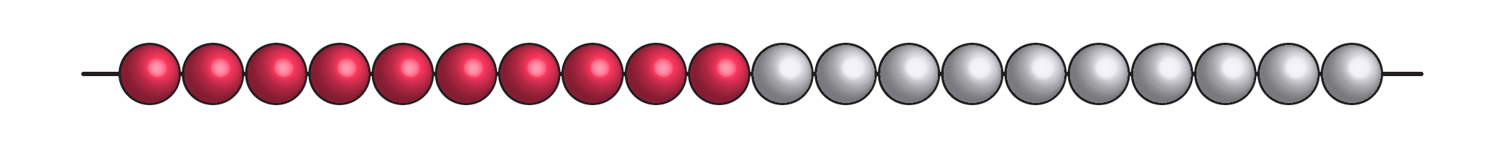
Counting to 20!
Counting to 20 with a Number Bead String!
Use a number bead string to explore groups of 5 and 10, use the beads to help count and make amounts between 0 and 20.
Notes:
Challenge children by making mistakes and asking them to call out and correct your mistakes as you count to 20.

Slide 8
Put the cards in order from smallest to largest…

Slide 9
Number Cards 1-20

Slide 10
Counting to 20!
Identifying numbers up to 20 using ten frames!
Which number is shown below?

Slide 11
Counting to 20!
Identifying numbers up to 20 using ten frames!
Which number is shown below?

Slide 12
Counting to 20!
Identifying numbers up to 20 using ten frames!
Which number is shown below?

Slide 13
Counting to 20!
Identifying numbers up to 20 using ten frames!
Which number is shown below?

Slide 14
Counting to 20!
Identifying numbers up to 20 using ten frames!
Which number is shown below?

Slide 15
Counting to 20!
Identifying numbers up to 20 using ten frames!
Which number is shown below?

Slide 16
Counting to 20!
Identifying numbers up to 20 using ten frames!
Which number is shown below?

Slide 17
Counting to 20!
Identifying numbers up to 20 using ten frames!
Which number is shown below?

Slide 18
Counting to 20!
Identifying numbers up to 20 using ten frames!
Which number is shown below?

Slide 19
Counting to 20!
Identifying numbers up to 20 using ten frames!
Which number is shown below?

Slide 20
Counting to 20!
Identifying numbers up to 20 using ten frames!
Which number is shown below?

Slide 21
Counting to 20!
Identifying numbers up to 20 using ten frames!
Which number is shown below?

Slide 22
Counting to 20!
Identifying numbers up to 20 using ten frames!
Which number is shown below?

Slide 23
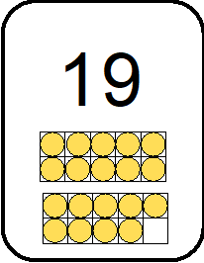
Counting to 20!
Identifying numbers up to 20 using ten frames!
Which number is shown below?

Slide 24
Counting to 20!
Identifying numbers up to 20 using ten frames!
Which number is shown below?

Slide 25
Counting to 20!
Identifying numbers up to 20 using ten frames!
Which number is shown below?

Slide 26
Counting to 20!
Identifying numbers up to 20 using ten frames!
Which number is shown below?

Slide 27
Counting to 20!
Identifying numbers up to 20 using ten frames!
Which number is shown below?

Slide 28
Counting to 20!
Identifying numbers up to 20 using ten frames!
Which number is shown below?

Slide 29
Counting to 20!
Identifying numbers up to 20 using ten frames!
Which number is shown below?

Slide 30
Counting to 20!
Identifying numbers up to 20 using ten frames!
Which number is shown below?

Slide 31
Counting to 20!
Identifying numbers up to 20 using ten frames!
Which number is shown below?

Slide 32

Counting to 20!
Identifying numbers up to 20 using a number bead string!
Which number is shown below?

Slide 33
Counting to 20!
Identifying numbers up to 20 using a number bead string!
Which number is shown below?

Slide 34
Counting to 20!
Identifying numbers up to 20 using a number bead string!
Which number is shown below?

Slide 35
Counting to 20!
Identifying numbers up to 20 using a number bead string!
Which number is shown below?

Slide 36
Counting to 20!
Identifying numbers up to 20 using a number bead string!
Which number is shown below?

Slide 37
Counting to 20!
Identifying numbers up to 20 using a number bead string!
Which number is shown below?

Slide 38
Counting to 20!
Identifying numbers up to 20 using a number bead string!
Which number is shown below?

Slide 39
Counting to 20!
Identifying numbers up to 20 using a number bead string!
Which number is shown below?

Slide 40
Counting to 20!
Identifying numbers up to 20 using a number bead string!
Which number is shown below?

Slide 41
Counting to 20!
Identifying numbers up to 20 using a number bead string!
Which number is shown below?

Slide 42

Counting to 20!
Identifying numbers up to 20 using a number bead string!
Which number is shown below?

Slide 43
Counting to 20!
Identifying numbers up to 20 using a number bead string!
Which number is shown below?

Slide 44
Counting to 20!
Identifying numbers up to 20 using a number bead string!
Which number is shown below?

Slide 45
Counting to 20!
Identifying numbers up to 20 using a number bead string!
Which number is shown below?

Slide 46
Counting to 20!
Identifying numbers up to 20 using a number bead string!
Which number is shown below?

Slide 47
Counting to 20!
Identifying numbers up to 20 using a number bead string!
Which number is shown below?

Slide 48
Counting to 20!
Identifying numbers up to 20 using a number bead string!
Which number is shown below?

Slide 49
Counting to 20!
Identifying numbers up to 20 using a number bead string!
Which number is shown below?

Slide 50
Counting to 20!
Identifying numbers up to 20 using a number bead string!
Which number is shown below?

Slide 51
Counting to 20!
Identifying numbers up to 20 using a number bead string!
Which number is shown below?

Slide 52
Counting to 20!
Identifying numbers up to 20 using a number bead string!
Which number is shown below?

Slide 53
Counting to 20!
Identifying numbers up to 20 using a number bead string!
Which number is shown below?

Slide 54
Counting to 20!
Identifying numbers up to 20 using a number bead string!
Which number is shown below?

Slide 55
Counting to 20!
Identifying numbers up to 20 using a number bead string!
Which number is shown below?

Slide 56
Counting to 20!
Identifying numbers up to 20 using a number bead string!
Which number is shown below?

Slide 57
Counting to 20!
Identifying numbers up to 20 using a number bead string!
Which number is shown below?

Slide 58
Counting to 20!
Identifying numbers up to 20 using a number bead string!
Which number is shown below?

Slide 59
Counting to 20!
Identifying numbers up to 20 using a number bead string!
Which number is shown below?

Slide 60
Counting to 20!
Identifying numbers up to 20 using a number bead string!
Which number is shown below?

Slide 61
Counting to 20!
Identifying numbers up to 20 using a number bead string!
Which number is shown below?

Slide 62
Counting to 20!
Twenty Track!
Children should use the twenty track to represent numbers between 1 and 20.
They should use a variety of mathematical and non-mathematical equipment.
1 | 2 | 3 | 4 | 5 | 6 | 7 | 8 | 9 | 10
11 | 12 | 13 | 14 | 15 | 16 | 17 | 18 | 19 | 20

Slide 63
Counting to 20!
Twenty Track!
Children should use the twenty track to represent numbers between 1 and 20.
They should use a variety of mathematical and non-mathematical equipment.
(For example, fingerprints have been used to show 15 in the twenty track below.)
1 | 2 | 3 | 4 | 5 | 6 | 7 | 8 | 9 | 10
11 | 12 | 13 | 14 | 15 | 16 | 17 | 18 | 19 | 20

Slide 64






Counting to 20!
Twenty Track Race!
Children pull two cards from the deck shown below. (Return used cards to bottom.)
The first one to complete their twenty track wins each round.
If their number is too large, they miss a turn.
1 | 2 | 3 | 4 | 5 | 6 | 7 | 8 | 9 | 10
11 | 12 | 13 | 14 | 15 | 16 | 17 | 18 | 19 | 20

Slide 65
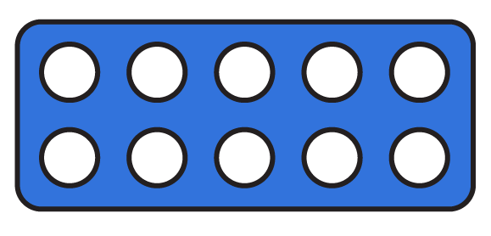

Counting to 20!
One more or one less:
What is one more than the number shown below?

Slide 66
Counting to 20!
One more or one less:
What is one more than the number shown below?

Slide 67
Counting to 20!
One more or one less:
What is one more than the number shown below?

Slide 68
Counting to 20!
One more or one less:
What is one more than the number shown below?

Slide 69
Counting to 20!
One more or one less:
What is one more than the number shown below?

Slide 70
Counting to 20!
One more or one less:
What is one more than the number shown below?

Slide 71
Counting to 20!
One more or one less:
What is one less than the number shown below?

Slide 72
Counting to 20!
One more or one less:
What is one less than the number shown below?

Slide 73
Counting to 20!
One more or one less:
What is one less than the number shown below?

Slide 74
Counting to 20!
One more or one less:
What is one less than the number shown below?

Slide 75
Counting to 20!
One more or one less:
What is one less than the number shown below?

Slide 76
Counting to 20!
One more or one less:
What is one less than the number shown below?

