Slide 1
Quiz: QCLIVUE
Stage 3 Autumn Block 1: Place Value Lesson 1: To be able to count in hundreds up to 1,000
Autumn
Block 1 – Place Value
1

Slide 2
To be able to count in hundreds up to 1,000
Success criteria:
I can use concrete equipment to find out how many hundreds make 1,000
I can explain my reasoning when counting in hundreds up to 1,000

Slide 3
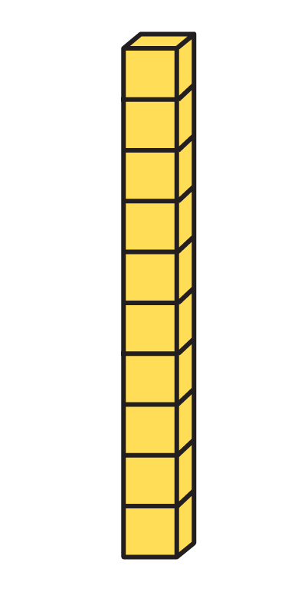
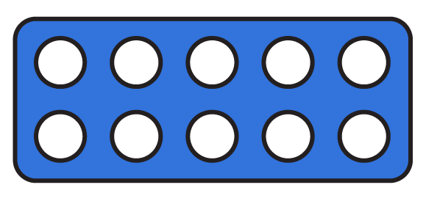
To be able to count in hundreds up to 1,000
Starter:
Which one doesn’t belong?
Explain your answer.

Slide 4
To be able to count in hundreds up to 1,000
Starter:
Which one doesn’t belong?
The number bead string does not belong as it shows 20, whereas the Numicon Shapes, the Base 10 pieces and the place value counters all show 30.

Slide 5
To be able to count in hundreds up to 1,000
Talking Time:
How many orange pieces (ones pieces) do you need to make a blue ten piece?

Slide 6
To be able to count in hundreds up to 1,000
Talking Time:
How many orange pieces (ones pieces) do you need to make a blue ten piece?
You need ten orange ones pieces, to make one blue ten piece.

Slide 7
To be able to count in hundreds up to 1,000
Talking Time:
How many red beads are there between each set of white beads on your number string?
How many white beads are there between each set of red beads on your number string?
How many red and white beads are there in total on your number string?

Slide 8
To be able to count in hundreds up to 1,000
Talking Time:
How many red beads are there between each set of white beads on your number string? There are 10 red beads.
How many white beads are there between each set of red beads on your number string?
How many red and white beads are there in total on your number string?

Slide 9
To be able to count in hundreds up to 1,000
Talking Time:
How many red beads are there between each set of white beads on your number string? There are 10 red beads.
How many white beads are there between each set of red beads on your number string? There are 10 white beads.
How many red and white beads are there in total on your number string?

Slide 10
To be able to count in hundreds up to 1,000
Talking Time:
How many red beads are there between each set of white beads on your number string? There are 10 red beads.
How many white beads are there between each set of red beads on your number string? There are 10 white beads.
How many red and white beads are there in total on your number string?
In total there are 100 beads on a 100 number bead string.

Slide 11
To be able to count in hundreds up to 1,000
Talking Time:
How many red pieces (ones pieces) do you need to make a yellow ten piece?

Slide 12
To be able to count in hundreds up to 1,000
Talking Time:
How many red pieces (ones pieces) do you need to make a yellow ten piece?
You need 10 red ones pieces to make 1 yellow tens piece.

Slide 13
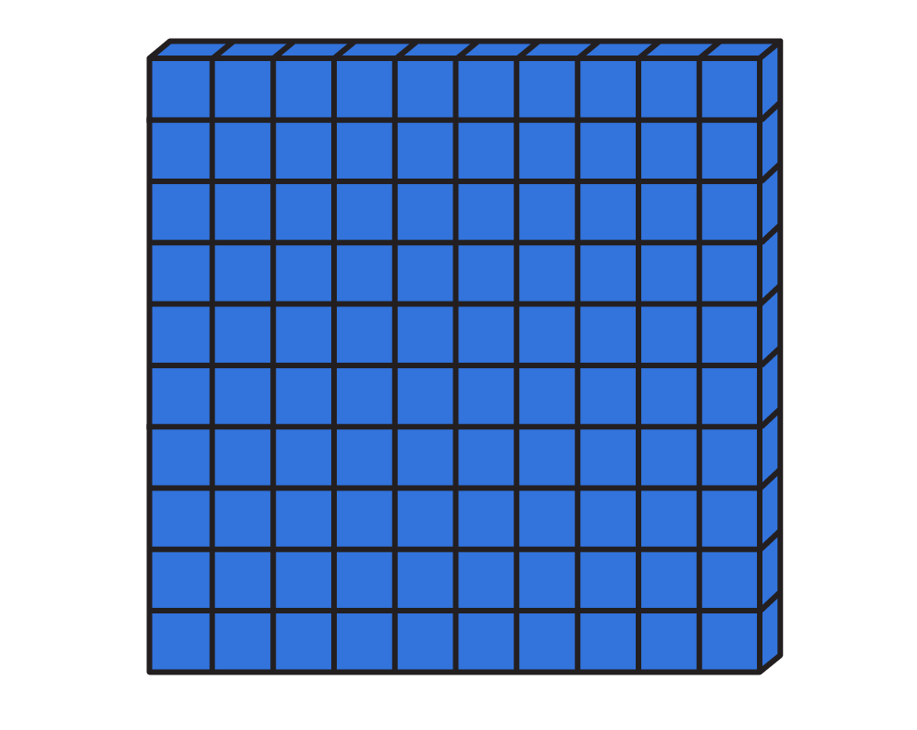
To be able to count in hundreds up to 1,000
Talking Time:
How many yellow tens sticks do you need to make one blue hundred square?

Slide 14
To be able to count in hundreds up to 1,000
Talking Time:
How many yellow tens sticks do you need to make one blue hundred square?
You need 10 yellow tens sticks to make 1 blue hundred square.

Slide 15
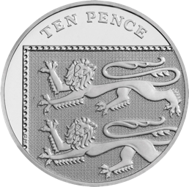
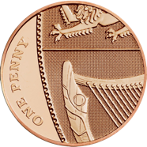
To be able to count in hundreds up to 1,000
Talking Time:
How many pennies would you get for a ten pence piece at a bank?

Slide 16
To be able to count in hundreds up to 1,000
Talking Time:
How many pennies would you get for a ten pence piece at a bank?
You need 10 pennies to receive a ten pence piece at a bank.

Slide 17
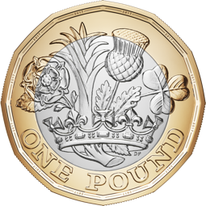
To be able to count in hundreds up to 1,000
Talking Time:
How many ten pence pieces would you need to swap for a £1 coin in the shop?

Slide 18
To be able to count in hundreds up to 1,000
Talking Time:
How many ten pence pieces would you need to swap for a £1 coin in the shop?
You would need 10 ten pence pieces to swap for a £1 coin in the shop.

Slide 19
To be able to count in hundreds up to 1,000
Activity 1:
Complete the following sentences:
Ex. A) There are 2 tens in twenty. Ex. B) To make twenty, you need 2 tens.
There are in forty.
To make , you need 5 tens.
There are in seventy.
If you have 9 tens, you have .
To make a hundred, you need tens.

Slide 20
To be able to count in hundreds up to 1,000
Activity 1:
Complete the following sentences:
Ex. A) There are 2 tens in twenty. Ex. B) To make twenty, you need 2 tens.
There are 4 tens in forty.
To make fifty, you need 5 tens.
There are 7 tens in seventy.
If you have 9 tens, you have ninety.
To make a hundred, you need 10 tens.

Slide 21
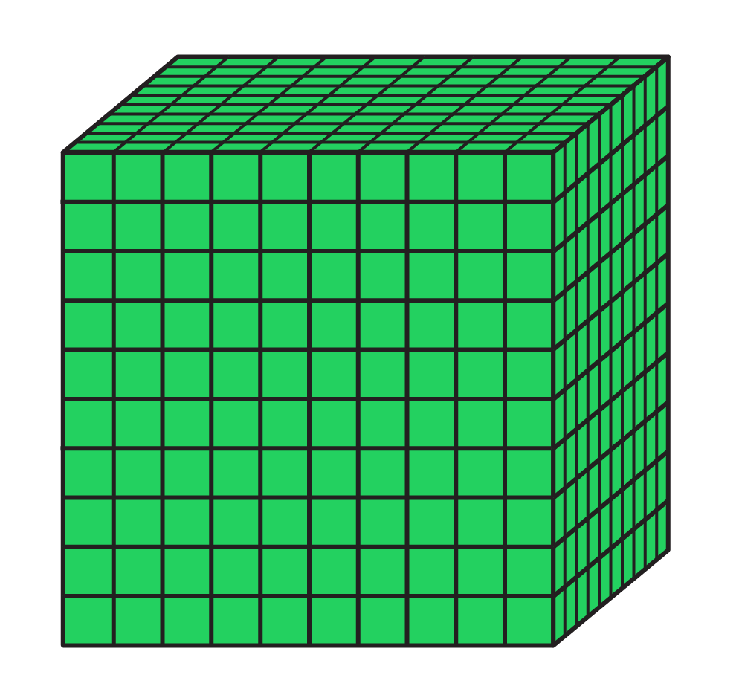
To be able to count in hundreds up to 1,000
Talking Time:
How many hundred squares do you need to make a thousand cube?

Slide 22
To be able to count in hundreds up to 1,000
Talking Time:
Ten hundred squares make a thousand cube.

Slide 23
To be able to count in hundreds up to 1,000
Talking Time:
How many hundreds counters can you trade for a thousand counter?

Slide 24
To be able to count in hundreds up to 1,000
Talking Time:
How many hundreds counters can you trade for a thousand counter?
10 hundreds counters would be required to trade for a thousand counter.

Slide 25
To be able to count in hundreds up to 1,000
Talking Time:
There are 100 bananas in each crate.
How many bananas are there altogether?
In numerals: In total, there are bananas.
In words: There are bananas in total.

Slide 26
To be able to count in hundreds up to 1,000
Talking Time:
There are 100 bananas in each crate.
How many bananas are there altogether?
In numerals: In total, there are 300 bananas.
In words: There are three hundred bananas in total.

Slide 27
To be able to count in hundreds up to 1,000
Activity 2:
There are 100 matches in each match box.
How many matches are there altogether?
In numerals: In total, there are matches.
In words: There are matches in total.

Slide 28
To be able to count in hundreds up to 1,000
Activity 2:
There are 100 matches in each match box.
How many matches are there altogether?
In numerals: In total, there are 500 matches.
In words: There are five hundred matches in total.

Slide 29
To be able to count in hundreds up to 1,000
Talking Time:
Complete the number track.
200
300
600
700

Slide 30
To be able to count in hundreds up to 1,000
Talking Time:
Complete the number track.
100
200
300
400
500
600
700
800

Slide 31
To be able to count in hundreds up to 1,000
Talking Time:
Complete the number track.
800
500
400
200

Slide 32
To be able to count in hundreds up to 1,000
Talking Time:
Complete the number track.
800
700
600
500
400
300
200
100

Slide 33
To be able to count in hundreds up to 1,000
Activity 3:
Complete the number tracks.
400
500
800
900
800
600
300
200

Slide 34
To be able to count in hundreds up to 1,000
Activity 3:
Complete the number tracks.
300
400
500
600
700
800
900
1,000
900
800
700
600
500
400
300
200

Slide 35
To be able to count in hundreds up to 1,000
Talking Time:
Brooke thinks the place value grid below shows the number six hundred.
Do you agree with Brooke? Explain your answer.
hundreds | tens | ones

Slide 36
To be able to count in hundreds up to 1,000
Talking Time:
Brooke thinks the place value grid below shows the number six hundred.
Brooke is correct – there are six 100s counters in the hundreds column. Therefore, the place value grid shows six hundred.
hundreds | tens | ones

Slide 37
To be able to count in hundreds up to 1,000
Activity 4:
Martin says, “The place value grid shows the number 500.”
Do you agree with Martin? Explain your answer.
hundreds | tens | ones
Using the same amount of counters as above in a place value grid, make the smallest number you can!
What other numbers can you make?

Slide 38
To be able to count in hundreds up to 1,000
Activity 4:
Martin says, “The place value grid shows the number 500.”
Martin has confused his place value columns.
Instead, the place value grid shows 5 tens or 50.
hundreds | tens | ones
The smallest possible number would be made by putting all the counters in the ones column to make 5!
Notes:
Children could make 500, 410, 320, 230, 140, 401, 311, 302, 221, 212, 131, 122, 113, 104, 41, 32, 23, 14 or 5 (if they figure any others out, let us know!).

Slide 39
To be able to count in hundreds up to 1,000
Activity 5:
Are the sentences below always true, sometimes true or never true?
When counting in tens, we count in 2-digit numbers.
When counting in hundreds, the digit in the tens column changes.
When counting in tens, the digit in the hundreds column changes.
When counting in hundreds, the digit in the thousands column changes.

Slide 40
To be able to count in hundreds up to 1,000
Activity 5:
Are the sentences below always true, sometimes true or never true?
When counting in tens, we count in 2-digit numbers. Sometimes – if you count in tens below 100 it is true, when you go over 100…
When counting in hundreds, the tens column changes. Never true – the digit in the hundreds (or thousands or above) changes.
When counting in tens, the digit in the hundreds column changes. Sometimes – such as when you count from 190 to 200, the 100s digit changes.
When counting in hundreds, the digit in the thousands column changes. Sometimes – for example. when you count from 2,900 to 3,000 the 1000s digit changes.
Notes:
Second statement becomes sometimes true when children are introduced to negative numbers, e.g. counting back from 260 in hundreds: 260, 160, 60, -40, -140...

Slide 41
To be able to count in hundreds up to 1,000
Evaluation:
Is Astrobee’s statement true or false?
Explain your answer.
When counting back from 1,000 in 100s to 0, each number is an odd number.

Slide 42
To be able to count in hundreds up to 1,000
When counting back from 1,000 in 100s to 0, each number is an odd number.
Evaluation:
Astrobee is incorrect on this occasion. If I count back from 1,000 in 100s, I count 900, 800, 700, 600, 500, 400, 300, 200, 100 and 0. All of the numbers counted end in zero and are therefore even. So, Astrobee is wrong today!

Slide 43
To be able to count in hundreds up to 1,000
Success criteria:
I can use concrete equipment to find out how many hundreds make 1,000
I can explain my reasoning when counting in hundreds up to 1,000

