Slide 1
Quiz: QCMEYWB
Stage 2 Autumn Block 1: Place Value Lesson 1: To be able to count objects to 100
Autumn
Block 1 – Place Value
1

Slide 2
To be able to count objects to 100
Success criteria:
I can count objects to 100 in both numerals and words
I can explain my reasoning when counting objects to 100 in various contexts

Slide 3
To be able to count objects to 100
Starter:
Which one doesn’t belong?

Slide 4
To be able to count objects to 100
Starter:
Which one doesn’t belong?

Slide 5
To be able to count objects to 100
Talking Time:
Count and write the number of boats in the dock.
 | two |  | four | five |  |  | eight |  | ten |  | twelve

Slide 6
To be able to count objects to 100
Talking Time:
Count and write the number of boats in the dock.
one | two |  | four | five |  |  | eight |  | ten |  | twelve

Slide 7
To be able to count objects to 100
Talking Time:
Count and write the number of boats in the dock.
one | two | three | four | five |  |  | eight |  | ten |  | twelve

Slide 8
To be able to count objects to 100
Talking Time:
Count and write the number of boats in the dock.
one | two | three | four | five | six |  | eight |  | ten |  | twelve

Slide 9
To be able to count objects to 100
Talking Time:
Count and write the number of boats in the dock.
one | two | three | four | five | six | seven | eight |  | ten |  | twelve

Slide 10
To be able to count objects to 100
Talking Time:
Count and write the number of boats in the dock.
one | two | three | four | five | six | seven | eight | nine | ten |  | twelve

Slide 11
To be able to count objects to 100
Talking Time:
Count and write the number of boats in the dock.
one | two | three | four | five | six | seven | eight | nine | ten | eleven | twelve

Slide 12
To be able to count objects to 100
Activity 1:
Count and write the number of boats in the dock.
one |  | three | four |  |  | seven |  | nine | ten

Slide 13
To be able to count objects to 100
Activity 1:
Count and write the number of boats in the dock.
one | two | three | four | five | six | seven | eight | nine | ten | eleven | twelve

Slide 14
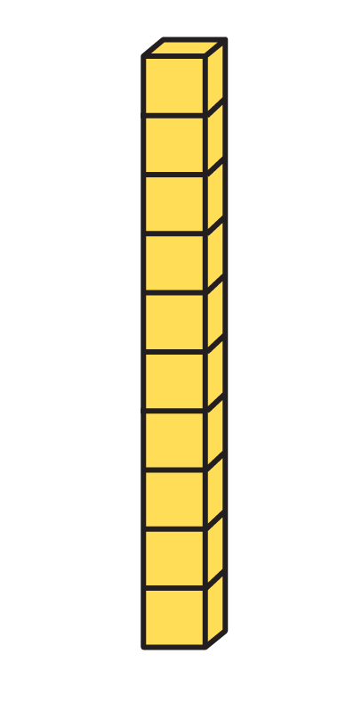
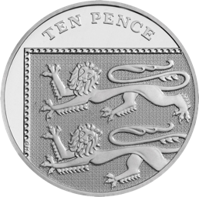
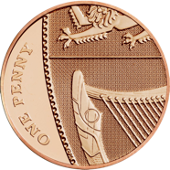
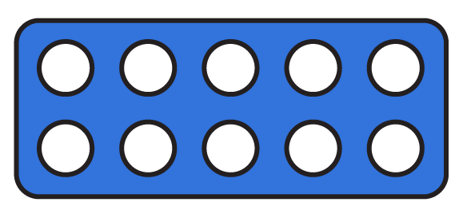
To be able to count objects to 100
Talking Time:
What numbers are shown below?
How can we write each in numerals and words?

Slide 15
To be able to count objects to 100
Talking Time:
What numbers are shown below?
How can we write each in numerals and words?
32
thirty-two
23
twenty-three
22
twenty-two
13
thirteen

Slide 16
To be able to count objects to 100
Activity 2:
What numbers are shown below?
How can we write each in numerals and words?

Slide 17
To be able to count objects to 100
Activity 2:
What numbers are shown below?
How can we write each in numerals and words?
44
forty-four
14
fourteen
12
twelve
24
twenty-four

Slide 18
To be able to count objects to 100
Talking Time:
Match the words to the numerals.
ten
fifteen
twenty
sixty-two
62
20
10
15

Slide 19
To be able to count objects to 100
Talking Time:
Match the words to the numerals.
ten
fifteen
twenty
sixty-two
62
20
10
15

Slide 20
To be able to count objects to 100
Talking Time:
Match the words to the numerals.
ten
fifteen
twenty
sixty-two
62
20
10
15

Slide 21
To be able to count objects to 100
Talking Time:
Match the words to the numerals.
ten
fifteen
twenty
sixty-two
62
20
10
15

Slide 22
To be able to count objects to 100
Talking Time:
Match the words to the numerals.
ten
fifteen
twenty
sixty-two
62
20
10
15

Slide 23
To be able to count objects to 100
Talking Time:
Match the words to the numerals.
five
fifteen
fifty
fifty-one
15
51
5
50

Slide 24
To be able to count objects to 100
Talking Time:
Match the words to the numerals.
five
fifteen
fifty
fifty-one
15
51
5
50

Slide 25
To be able to count objects to 100
Talking Time:
Match the words to the numerals.
five
fifteen
fifty
fifty-one
15
51
5
50

Slide 26
To be able to count objects to 100
Talking Time:
Match the words to the numerals.
five
fifteen
fifty
fifty-one
15
51
5
50

Slide 27
To be able to count objects to 100
Talking Time:
Match the words to the numerals.
five
fifteen
fifty
fifty-one
15
51
5
50

Slide 28
To be able to count objects to 100
Activity 3:
Match the words to the numerals.
seventy
seventy-one
seventeen
seventy-seven
17
70
77
71

Slide 29
To be able to count objects to 100
Activity 3:
Match the words to the numerals.
seventy
seventy-one
seventeen
seventy-seven
17
70
77
71

Slide 30
To be able to count objects to 100
Talking Time:
Do you agree with Astrobee?
Explain your answer.
The Base 10 pieces show the number thirty-five.

Slide 31
To be able to count objects to 100
Talking Time:
Astrobee is correct . There are 3 tens and 5 ones totalling 35 which is written as thirty-five in words.
The Base 10 pieces show the number thirty-five.

Slide 32
To be able to count objects to 100
Activity 4:
Do you agree with Astrobee?
Explain your answer.
The Base 10 pieces show the number seventy-two.

Slide 33
To be able to count objects to 100
Activity 4:
Astrobee is incorrect. There are 2 tens and 7 ones totalling 27. Astrobee has confused the tens and ones pieces. Astrobee should have said twenty-seven.
The base 10 pieces show the number seventy-two.

Slide 34
To be able to count objects to 100
Activity 5:
Each bag contains ten pennies. How many pennies are there in total?
Write your answer in numerals and words.
What strategy did you use? Was it the same strategy as your table partner?
What is the best strategy to use?

Slide 35
To be able to count objects to 100
Activity 5:
Each bag contains ten pennies. How many pennies are there in total?
Write your answer in numerals and words.
There are 36 or thirty-six pennies in total.
The best strategy is to count in 10s to 30, then count up in ones to 6 to make 36.
If you were really fast, you might have noticed there were three bags making 30 and 6 pennies to make 36.

Slide 36
To be able to count objects to 100
Evaluation:
Look at these three sets of objects:
Which is the hardest to count? Explain your answer.

Slide 37
To be able to count objects to 100
Evaluation:
Look at these three sets of objects:
Which is the hardest to count? Explain your answer.
The cubes are hardest to count, because the tens frame and Base 10 pieces show a total of ten each time which means you can start counting from 10!

Slide 38
To be able to count objects to 100
Success criteria:
I can count objects to 100 in both numerals and words
I can explain my reasoning when counting objects to 100 in various contexts

