Slide 1


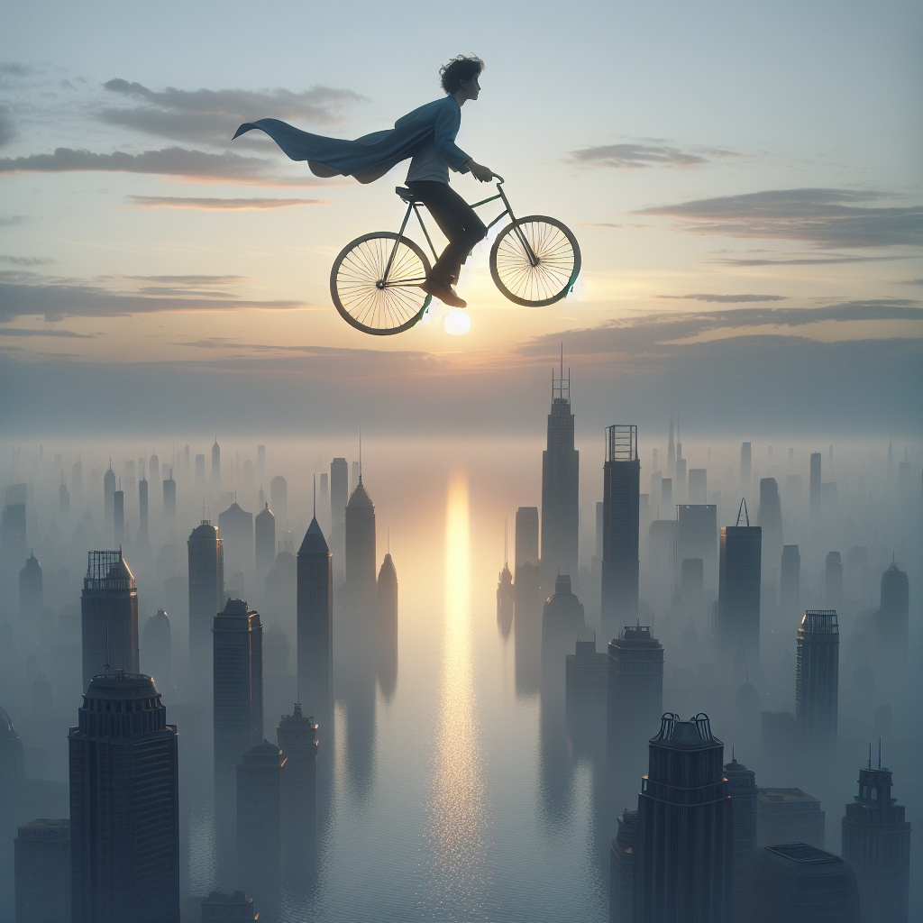

Question Pack
Pedals in the Clouds
Stage 6 – Consolidation Week
Skill (Stage 5)
Brackets, dashes and commas to indicate parenthesis

Slide 2

Question Sheet
Pedals in the Clouds
Shed Success
New vocabulary | Soared — Rising or flying high in the air. It can describe birds, planes, or even emotions. Silhouette — The dark shape of someone or something seen against a lighter background. Billowing — Flowing or moving in waves, like the cape in the wind. Glided — Moving smoothly and effortlessly through the air. Dawn — The first appearance of light in the sky before sunrise; the beginning of the day.
Grammar and Punctuation | Skill Parenthesis provides additional information about the noun or the sentence. The information in the parenthesis acts as an explanation, description, or side note. This information isn't needed for the sentence to make sense, but it gives more detail. You can indicate parenthesis in three different ways: brackets, dashes or commas. The choice between brackets, dashes, and commas depends on style, emphasis, and how you want the sentence to sound. There are some general guidelines: Brackets feel like a side note often used for non-essential information, almost like a whisper. ( ) Dashes create a pause and add drama or surprise. — — Commas blend extra details smoothly into the sentence and offer more flow. , , You can often swap one for another without breaking any grammar rules. It just changes the tone slightly. Writers choose based on what feels best for the sentence. Brackets ( ) = Quiet and separate Use brackets when the extra information is less important or when you want it to feel like a side note. Example: The man rides his bike high in the sky (far above the city) as the sun rises. Dashes — — = More Dramatic! Use dashes when you want the extra information to stand out or create a pause in the sentence. Example: The sky — an astonishing mix of golden light and fading blue — looks magical. Commas , , = Smooth and Natural Use commas when the extra information blends smoothly into the sentence. Example: His cape, billowing in the wind, flew effortlessly behind him.
CEW Spellings | accompany, government, lightning, vehicle, attached

Slide 3




Question Sheet
Pedals in the Clouds
Day One
Structure | The man soared / soar above the city, his silhouette sharp against the waking sun, as the sky was painting/ painted with a golden hue.
Help | Help add parenthesis into this sentence. Make the information about the man’s feelings. The man (feeling________________________________) rode his bike high above the city as the sun awakened, casting golden light below.
Edit | the man soared above the city his cape billowing wildly in the wind as the sky gradually brightened Edit the capital letters and the punctuation at the end of this sentence. After the word ______________there must be A / B / C (Choose one) After the word ______________there must be A / B / C (Choose one)
Develop | Option 1: Write a sentence about the man. Use parenthesis to add a description of the man’s appearance. Use brackets to show the information is more of a side note. Option 2: Only change the parenthesis and keep the main clause. Example: The silhouette of the man on the bike (a startling sight for most ) was accentuated by the morning light. _____________________________________________________________________________ _____________________________________________________________________________
A) an exclamation mark !
B) a full stop .
C) a comma ,

Slide 4
Question Sheet
Pedals in the Clouds
Day Two
Structure | His cape, which flapped / flap wildly in the wind, billowed dramatically — like a superhero in flight — as he sat / sit calmly pedalling on the bike.
Help | Help add parenthesis into this sentence. Make the information about the light. The first light of day, _________________________, painted the city in soft hues of pink and gold.
Edit | the sky a blend of pink and gold began to shift as the man flew through the clouds, his figure a lone silhouette Edit the capital letters and the punctuation at the end of this sentence. After the word ______________there must be A / B / C (Choose one) 3) After the word ______________there must be A / B / C (Choose one)
Develop | Option 1: Write a sentence about the man riding his bike in the sky. Use parenthesis to add a description of what the man looked like above the city . Use brackets to show the information is more of a side note. Option 2: Only change the parenthesis and keep the main clause. Example: The man soared above the city (startling those who saw him) and glided through the air with effortless grace. _____________________________________________________________________________ _____________________________________________________________________________
A) an exclamation mark !
B) a full stop .
C) a dash —

Slide 5
Question Sheet
Pedals in the Clouds
Day Three
Structure | As the sky grew / grow brighter, the city, still asleep beneath him, stood / stand tall, with skyscrapers reaching toward the horizon.
Help | Help add parenthesis into this sentence. Make the information a side note about the air. As the man pedalled higher, the air grew warmer (____________________________________), and the sun slowly rose over the horizon.
Edit | the sun rose slowly casting a warm glow over the city while the man remained calm and peaceful Edit the capital letters and the punctuation at the end of this sentence. After the word _____________there must be A / B / C (Choose one) After the word _____________there must be A / B / C (Choose one)
Develop | Option 1: Write a sentence about the man’s cape. Use parenthesis to add a description of the cape. Use commas to show the information is added in smoothly. Option 2: Only change the parenthesis and keep the main clause. Example: His cape, billowing behind him in the wind, seemed to dance with the rhythm of the morning breeze. __________________________________________________________________________________________________ _____________________________________________________________________________
A) an exclamation mark !
B) an apostrophe ‘
C) a dash —

Slide 6
Question Sheet
Pedals in the Clouds
Day Four
Structure | Below, the buildings stretched / stretch upwards while the man, in perfect serenity, could be seen soared / soaring through the soft clouds.
Help | Help add parenthesis into this sentence. Make the information quite dramatic about the cape. His cape fluttered wildly in the wind — ______________________________________— while the bike soared through the clouds.
Edit | the man pedalled the small, green bicycle it was reminiscent of the colour of his favourite mug through the clouds above the city Edit the capital letters and the punctuation at the end of this sentence. After the word _____________there must be A / B / C (Choose one) 3) After the word _____________there must be A / B / C (Choose one)
Develop | Option 1: Write a sentence about the view of the city from up high. Use parenthesis to add a description of how small he or the city looked. Use dashes to add drama. Option 2: Only change the parenthesis and keep the main sentence. Example: As he soared higher — his body becoming a mere dot against the vastness of the sky — the city’s buildings seemed to disappear, swallowed by the light of dawn breaking. ___________________________________________________________________________ ___________________________________________________________________________
A) an exclamation mark !
B) a bracket ( )
C) an apostrophe ‘

Slide 7
Question Sheet
Pedals in the Clouds
Day Five
Structure | The air grew / grow warmer, as the sun, just beginning to rise, begun / began to illuminate the sky, filling it with soft, glowing colours.
Help | Help add parenthesis into this sentence. Make the information flow smoothly about the man’s thoughts. The man pedalled through the sky,_______________________________, as the city lay still below.
Edit | the cyclist soared through the air his cape fluttering behind him as the morning light began to shine Edit the capital letters and the punctuation at the end of this sentence. After the word _____________there must be A / B / C (Choose one) 3) After the word _____________there must be A / B / C (Choose one)
Develop | Option 1: Write a sentence about the view of the city from up high. Use parenthesis to add a description. Use dashes to add drama. Option 2: Only change the parenthesis and keep the main sentence. Example: The man’s silhouette — his figure almost ethereal against the glowing colours of dawn —created a striking contrast with the dark city below. _____________________________________________________________________________ _____________________________________________________________________________
A) an exclamation mark !
B) a comma ,
C) an apostrophe ‘

Slide 8
Question Sheet
Pedals in the Clouds
Applying Skills (Super Shed Sentences)
Write a sentence describing what the man is doing. Use brackets to add details about the man. | ______________________________________________________________________ ______________________________________________________________________
Describe the cape in the picture. Use dashes to explain how the cape looks or moves in the wind. | ______________________________________________________________________ ______________________________________________________________________
Write a sentence about the city below. Use brackets to give extra details about the buildings or surroundings. | ______________________________________________________________________ ______________________________________________________________________
Write a sentence about the sky and the colours of dawn. Use commas to add a vivid description of the sky or the transition from night to day. | ______________________________________________________________________ ______________________________________________________________________
Write a sentence about how the scene makes you feel. Use dashes to explain the mood or feeling of the picture. | ______________________________________________________________________ ______________________________________________________________________

