Slide 1

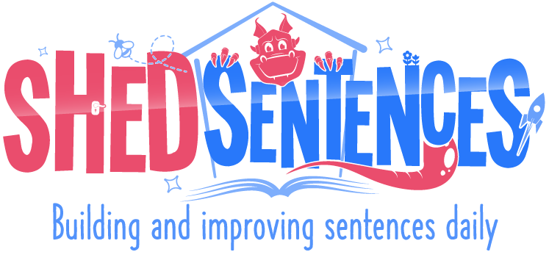
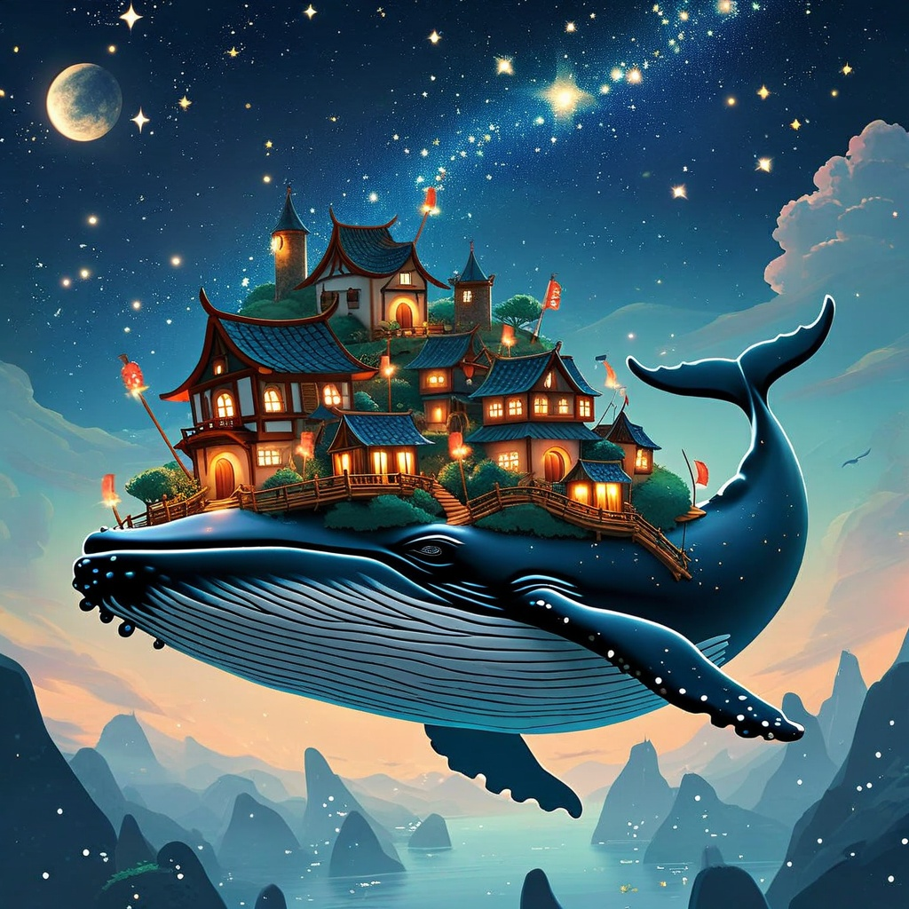

Answer Pack
A Whale of a Home
Stage 4 – Consolidation Week
Skill 1 (Stage 3)
Formation of nouns using a range of prefixes eg. super-, auto-, anti-

Slide 2

Answer Sheet
A Whale of a Home
Weekly Objectives
Picture Analysis | Imagine looking up at the night sky and seeing something magical—a giant whale floating in the air instead of swimming in the sea! The moon and stars shine brightly, lighting up the sky. Beneath the whale, the ocean stretches far and wide, with islands emerging out of the water. But the most amazing thing? There’s a tiny town on the whale’s back! The town is full of wooden houses, and glowing lights twinkle from the windows, making it look warm and welcoming.
Text Level | Write in the correct tense throughout
Word level | Formation of nouns using a range of prefixes e.g. super-. auto-, anti-,
Year 3 / 4 CEW | describe, weight, height, earth, circle
New Vocabulary | Supermoon — A very bright, large full moon that looks bigger than usual in the sky. Autopilot — A system that lets something move by itself without a person controlling it. Superstructure — The part of a building or ship that rises above its main base. Superspeed — Moving very quickly. Superhuman — Having powers or abilities beyond normal people.

Slide 3




Answer Sheet
A Whale of a Home
Day One
Structure | As the whale soared through the night sky, it circled the mountains in an anti- / auto- clockwise motion.
Help Oracy Link — Read Aloud | Help to complete this sentence by filling in the missing prefix. The superstructure on the whale’s back twinkled like fireflies in the night sky.
Edit | The whale floated in the sky. It had many illuminated houses that shone brightly on its back. 1. Edit the capital letters and the punctuation at the end of this sentence. 2. After the word sky there must be A / B / C (Choose one)
Develop Oracy Link — Read Aloud | Write a sentence describing the whale in the sky. Use the word ‘superpower’’ in your sentence. Example: The whale’s superpower was its ability to float effortlessly in the sky—its massive body soaring in a perfect circle above the earth.
A) a full stop
B) a comma ,
C) an apostrophe ‘

Slide 4
Answer Sheet
A Whale of a Home
Day Two
Structure | Below the floating whale, small boats glided smoothly across the sea as though using auto- / anti- pilot.
Help Oracy Link — Read Aloud | Help to complete this sentence by filling in the missing prefix. The antigravity enchantment on the whale made it able to defy the laws of nature.
Edit | The tiny boats sailed beneath the whale. Some of them were moving on their own without powerful engines. 1. Edit the capital letters and the punctuation at the end of this sentence. 2. After the word whale there must be A / B / C (Choose one)
Develop Oracy Link — Read Aloud | Imagine you’re in the town on the whale’s back. Write a sentence using the word ‘antidote’. Example: At night, the town on the back of the flying whale felt like an antidote to the world below—drifting through starlit skies and wrapped in silence.
A) a full stop
B) a comma ,
C) an apostrophe ‘

Slide 5
Answer Sheet
A Whale of a Home
Day Three
Structure | As the super-/ auto- moon rose high above the town on the whale's back, its silvery glow bathed the entire village in a delicate light.
Help Oracy Link — Read Aloud | Help to complete this sentence by filling in the missing prefix. In Whaleback, the superintendent ensured that every building was secure, even as the great creature shifted beneath them.
Edit | The town on the whale’s back had wooden houses. They were illuminated with twinkling lights. 1. Edit the capital letters and the punctuation at the end of this sentence. 2. After the word houses there must be A / B / C (Choose one)
Develop Oracy Link — Read Aloud | Write a sentence about the whale floating above the sea. Use the word ‘autopilot’ to describe how the whale moved. Example: The whale floated above the sea as if on autopilot, its massive weight barely noticeable as it glided smoothly through the night sky.
A) a full stop
B) a comma ,
C) an apostrophe ‘

Slide 6
Answer Sheet
A Whale of a Home
Day Four
Structure | The scene looks almost anti- /super- natural, with the whale glowing softly against the starry sky.
Help Oracy Link — Read Aloud | Help to complete this sentence by filling in the missing prefix. In bustling Whaleback, the streets were lined with strange automobiles which navigated the winding paths amidst the clouds.
Edit | The sky above was filled with stars. The whale moved gently through the air without making a sound. 1. Edit the capital letters and the punctuation at the end of this sentence. 2. After the word stars there must be A / B / C (Choose one)
Develop Oracy Link — Read Aloud | Write a sentence describing the view from the whale’s back. Use the word ‘supernatural’ to describe the way the landscape looks. Example: From the whale's back, the landscape below looked almost supernatural, with the shimmering ocean and glowing islands so vibrant that they seemed impossible to describe.
A) a full stop
B) a comma ,
C) an apostrophe ‘

Slide 7
Answer Sheet
A Whale of a Home
Day Five
Structure | The captain, sitting by the campfire, was writing his auto- /anti- biography, sharing stories of life on the flying whale.
Help Oracy Link — Read Aloud | Help to complete this sentence by filling in the missing prefix. The small cars on the whale’s back moved by autopilot, driving smoothly without anyone steering.
Edit | The people in the town were amazed by the whale's size. They could hardly believe it was real. 1. Edit the capital letters and the punctuation at the end of this sentence. 2. After the word size there must be A / B / C (Choose one)
Develop Oracy Link — Read Aloud | Write a sentence about the sky around the whale. Use the word "antigravity" to describe why the whale floats. Example: The town of Whaleback floated through the velvet night sky, its homes held aloft by antigravity charms older than memory and etched in silver beneath the whale’s fins.
A) a full stop
B) a comma ,
C) an apostrophe ‘

Slide 8
Answer Sheet
A Whale of a Home
Applying Skills (Super Shed Sentences)
Write a sentence about the town on the whale’s back. Use the word ‘supernatural’ to describe the way the houses look at night. | The houses on the whale’s back glowed as though supernatural, casting long shadows across the wooden streets as the night fell.
Imagine flying high above the ocean and mountains. Write a sentence using the word ’certain’ to describe the magical feeling. | As the whale passed over the mountains and oceans, there was a certain magic in the air which whispered down the chimneypots of the sleeping townsfolk.
Describe the sky above the whale’s back. Use the word ’auto’ to explain how the sky changes colour. | As the whale circled higher, the sky above changed as though on autopilot, shifting from soft pinks to oranges and deep blues in an orchestra of colour.
Write a sentence about the town on the whale’s back. Use the word ‘antigravity’. | The town perched on the whale’s back floated effortlessly through the skies, its foundations held firm by ancient antigravity magic.
Imagine looking up at the whale as it floated over the sea. Write a sentence with the word ‘supermoon’. | Under the glow of the supermoon, the majestic whale sailed gracefully through the clouds, its silhouette glowing softly against the luminous backdrop.

