Slide 1


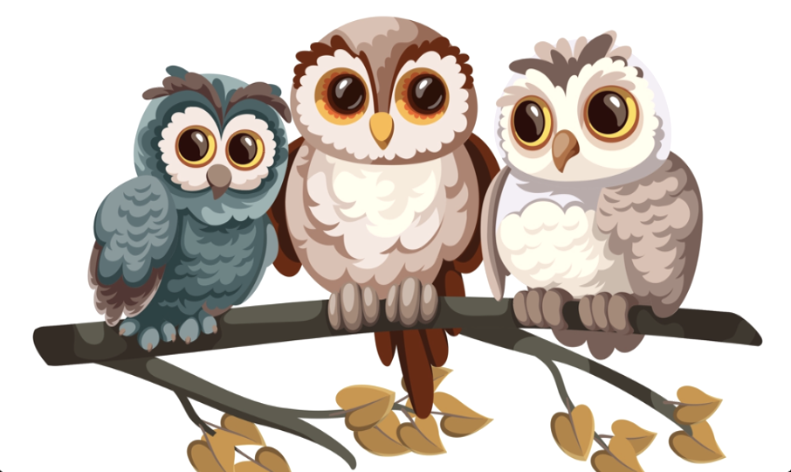

Question Pack
Owl Babies
Stage 1
Skill 1
Beginning to punctuate sentences using a capital letter and a full stop
Skill 2
Using a capital letter for the personal pronoun ‘I’
Link: https://www.literacyshed.com/the-picture-book-shed.html

Slide 2

Question Sheet
Owl Babies
Shed Success
New vocabulary | Owl — A bird with wide eyes. Forest — A large area covered with trees. Waiting — Staying in one place until something happens. Comfort — To make someone feel better, especially when they are upset. Home — The place where you live, or where you feel safe.
Grammar and Punctuation | Skill 1 Capital Letter — Used at the start of a sentence. Full Stop — Used at the end of a sentence. E.g. I miss my mummy . Skill 2 When using the personal pronoun ‘I’, it should always be a capital letter. E.g. I miss my mummy .
CEW Spellings | the, a, I, my, they

Slide 3




Question Sheet
Owl Babies
Day One
Structure | The owls lives / lived in a hole in the trunk of a tree.
Help | Put the words into the correct sentence order — miss / my / I / mummy. _______________________________________________________
Edit | Add the missing capital letter and full stop — sarah is the oldest owl baby
Develop | Use a full stop in a sentence. Example: The owls did not know where their mummy had gone. _______________________________________________________

Slide 4
Question Sheet
Owl Babies
Day Two
Structure | The owls looked / looks out of the hole for their mummy.
Help | Put the words into the correct sentence order — owls / their / The / out / came / baby / of / house. _______________________________________________________
Edit | Add the missing capital letter and full stop — i want my mummy
Develop | Use the personal pronoun ‘I’ in a sentence. Pretend that you are Bill. Example: I wish my mummy would come back. _______________________________________________________

Slide 5
Question Sheet
Owl Babies
Day Three
Structure | The owl babies had / has to be brave.
Help | Put the words into the correct sentence order — sat / and / They / thought. / they _______________________________________________________
Edit | Add the missing capital letter and full stop — sarah thought the other owls should sit on her branch
Develop | Write a sentence about Bill. Example: Bill was the youngest owl. _______________________________________________________

Slide 6
Question Sheet
Owl Babies
Day Four
Structure | The owls waiting / waited for their mummy.
Help | Put the words into the correct sentence order — The / through / mother/ trees. / flying / came / owl / the _______________________________________________________
Edit | Add the missing capital letter and full stop — mother owl swooped and soared through the trees to her babies
Develop | Write a sentence about the mother owl returning. Example: The baby owls were happy when their mummy returned. _______________________________________________________

Slide 7
Question Sheet
Owl Babies
Day Five
Structure | The owls bounced / bounces and dancing / danced when their mummy came back.
Help | Put the words into the correct sentence order — knew / I / come / you / would / back. _______________________________________________________
Edit | Add the missing capital letter and full stop — bill told his mummy that he loved her
Develop | Write a sentence that uses a capital letter, full stop and the personal pronoun ‘I’. Example: I am so happy that my mummy came back. _______________________________________________________

Slide 8
Question Sheet
Owl Babies
Applying Skills (Super Shed Sentences)
Use a capital letter to begin a sentence about an owl of your choice. | ______________________________________________________________
Use a full stop to end a sentence about how the owls felt when they couldn’t find their mummy. | ______________________________________________________________
Use the personal pronoun ‘I’ to write a sentence in the role of Sarah. | ______________________________________________________________
Use a capital letter and full stop to write a sentence about where the mummy owl had been. | ______________________________________________________________

