Slide 1
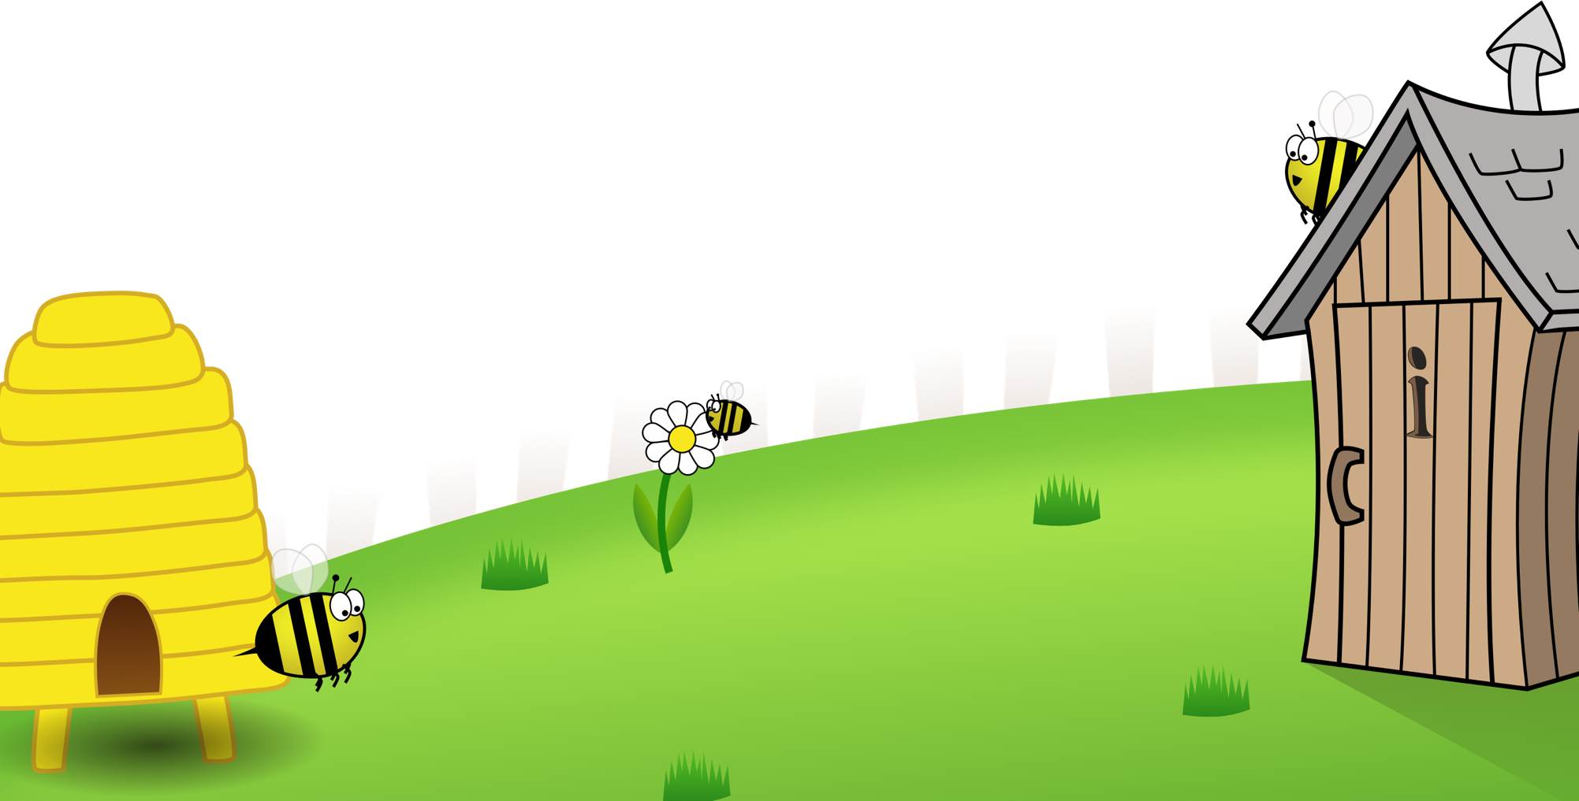
Spelling Curriculum
Sample
All elements of this curriculum are copyright © Education Shed Inc. and may not be redistributed without permission.
4/30/20

Slide 2
Spelling Curriculum
Stage 1
All elements of this curriculum are copyright © Education Shed Inc. and may not be redistributed without permission.

Slide 3
Spelling lists – Stage 1
The /f/, /l/, /s/, /z/ and /k/ sounds are usually spelt as ff, ll, ss, zz and ck if they come straight after a single vowel letter in short words.
The /k/ sound spelled ‘k’ before e, I and y. The /nk/ sound found at the end of words usually comes after a vowel.
The -tch This sound is usually spelled as ‘tch’ when it comes after a single vowel letter.
Some words end with an /e/ sound spelled ‘y’. English words hardly ever end with the letter ‘v’, so if a word ends with a /v/ sound, the letter ‘e’ usually needs to be added after the ‘v’.
Adding s and es to words (plurals) If the ending sounds like /s/ or /z/, it is spelled as –s. If it forms an extra syllable, then it is spelled as –es.
Adding the suffixes – ing and –ed to verbs. If the verb ends in two consonant letters (the same or different), the ending is simply added on.
Adding –er, –est and un- to words.
Words of more than one syllable often have an unstressed syllable in which the vowel sound is unclear. Sometimes words can be joined together to form compound words.
The /ai/ and /oi/ digraphs. These digraphs are virtually never used at the end of words in English.
The ay and oy digraphs. These digraphs are used for those sounds at the ends of words and syllables.
The long vowel sound /a/ spelled with the split digraph a-e
The long vowel sound /e/ spelled with the split digraph e-e.
The long vowel sound /i/ spelled with a split digraph i-e.
The long vowel sound /o/ spelled with the split digraph o_e.
The long vowel /oo/ and /yoo/ sounds spelled as u-e. These sounds are usually found in the middle or at the end of words.
The /ar/ consonant digraph. This digraph may be used at the beginning, middle or end of words.
Long vowel sound /e/ spelled ee. The letters ‘ee’ make a long vowel sound like in the word see. This is a common way of spelling the sound and is found in the middle of words and sometimes at the end.
The long vowel sound /e/ spelled ea. Another common spelling of the sound which is often found in the middle and end of words.
The short vowel sound /e/ spelled ea.
The vowel digraph er. In these words the sound is stressed
The vowel digraph er. In these words the sound is unstressed and found at the end of words.
The digraphs ir and ur. Often found in the middle of words and occasionally at the beginning of words.
The long vowel sound /oo/ as in Zoo. Very few words start or end with /oo/
The short vowel sound ‘oo’ as in foot. *Standard English pronunciation has been used here. In some parts of England the –ook words may have a longer sound.
The ‘oa’ digraph can come at the beginning or in the middle of words but very rarely at the end. The ’oe’ digraph can be sometimes found at the end of words.
The ’ou’ digraph. This digraph can be can be found at the beginning and in the middle of words. The only common English word ending in ‘ou’ is you.
The ‘ow’ digraph. This digraph can make two different sounds like in ‘cow’ or in ‘blow.’
The ‘oo’ and ‘yoo’ sounds can be spelled as u-e, ue and ew. If words end in the /oo/ sound, then it is likely that they will be spelled ew or ue.
The digraph ‘ie’ making the /aɪ / sound as in pie.
The digraph ‘ie’ making the /ee/ sound.
The long vowel sound /i/ spelled ‘igh.’ This is usually found in the middle of words but sometimes at the end of words too.
The /or/ sound. The vowel digraph ‘or’ and trigraph ‘ore.’ It is more likely that when at the end of a word then it will be spelled with an ‘e.’
The /or/ sound spelled with the digraph aw or au. If it is at the end of a word it is more likely to be spelled with an aw and at the beginning of a word with au.
The trigraphs ‘air’ and ‘ear’. These spellings are commonly found in the middle or at the end of words but can sometimes used at the beginning of words too.
The /er/ sound spelled with ’ear’ or ‘are’
Words with ’ph’ or ‘wh’ spellings.

Slide 4
1
1
Words ending with the /f/, /l/, /s/, /z/ or /k/ sound in English almost always have double consonant.

Slide 5
1
Words ending with the /f/, /l/, /s/, /z/ or /k/ sound in English almost always have double consonant.
1
Introduction | Words ending with the /f/, /l/, /s/, /z/ or /k/ sound in English almost always have double consonant. This week’s words are shown in random order. Sound the words out and count the sounds. Ask the children if they can see a pattern with the last sound. Discuss that the /k/ sound is usually written as “ck”.
Main Teaching Activity | Read the sentence for each word and ask children for the word and spelling to reinforce the double-consonant rule.
Independent Activity | Ask the children to choose one of their words to complete the two sentences. Then ask them to choose three more words and write their own sentences. Work in pairs or with support if necessary. Share sentences and spellings with the class.
Spellings
puff
fluff
bell
doll
grass
kiss
buzz
fizz
clock
back

Slide 6
Stage: 1 | Words ending with the /f/, /l/, /s/, /z/ or /k/ sound in English almost always have double consonant. Name:
List: 1
puff
doll
back
clock
grass
kiss
fluff
bell
buzz
fizz

Slide 7
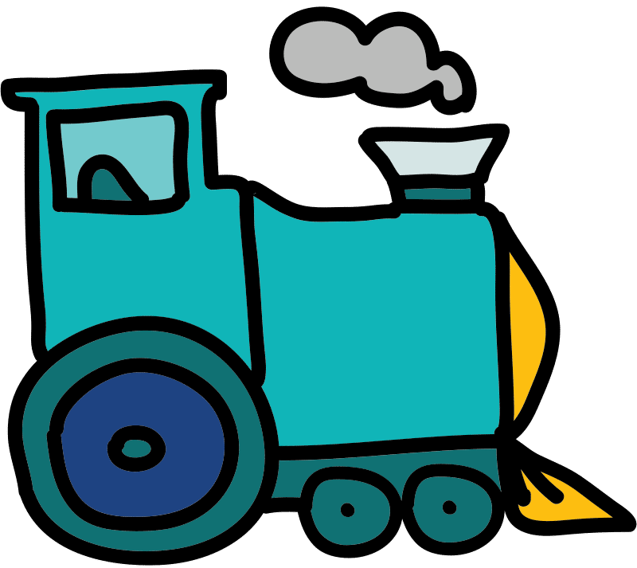
A _______ of smoke came from the train.

Slide 8
A _puff_ of smoke came from the train.
Answer:

Slide 9
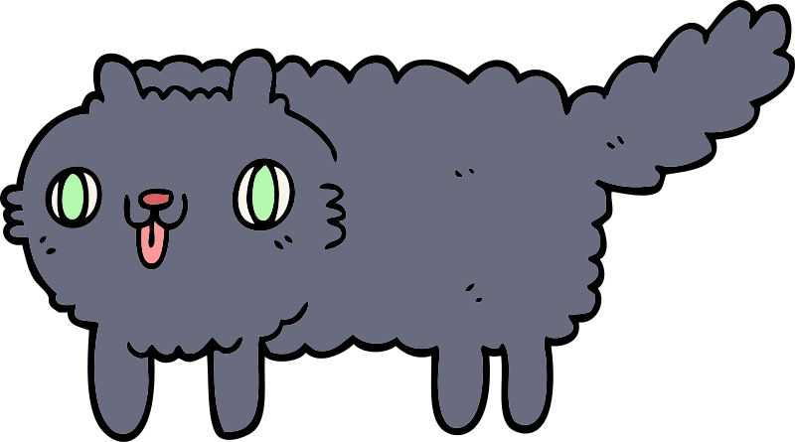
The kitten was covered in _______.

Slide 10
The kitten was covered in _fluff_.
Answer:

Slide 11
The teacher rang the _______.

Slide 12
Answer:
The teacher rang the _bell_.

Slide 13
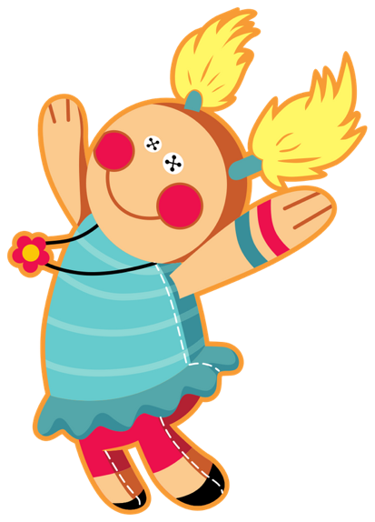
The _______ has a blue dress.

Slide 14
The _doll_ has a blue dress.
Answer:

Slide 15
The _______ on the field is green.

Slide 16
The _grass_ on the field is green.
Answer:

Slide 17
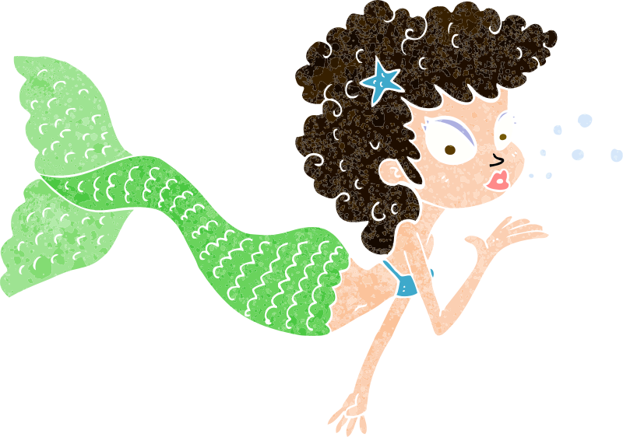
The mermaid blew a _______.

Slide 18
Answer:
The mermaid blew a _kiss_.

Slide 19
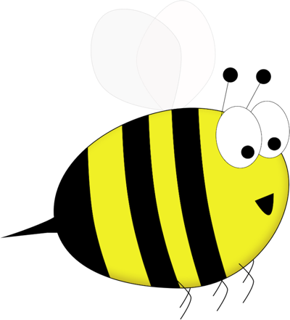
Bumble’s wings _______.

Slide 20
Bumble’s wings _buzz_.
Answer:

Slide 21
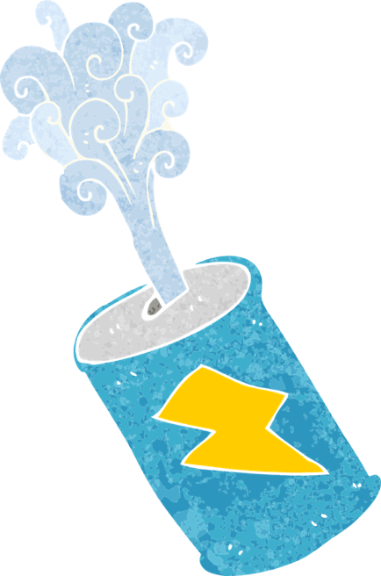
The can was full of _______.

Slide 22
Answer:
The can was full of _fizz_.

Slide 23
You tell the time by using a _______.

Slide 24
You tell the time by using a _clock_.
Answer:

Slide 25
The girl’s hair ran down her _______.

Slide 26
The girl’s hair ran down her _back_.
Answer:

Slide 27
Stage: 1 | Words ending with the /f/, /l/, /s/, /z/ or /k/ sound in English almost always have double consonant.
List: 1
Chose one of your words to complete the two sentences. Try to write three sentences of your own.
Spellings
puff
fluff
bell
doll
grass
kiss
buzz
fizz
clock
back
Your word
Your sentence
The clouds looked like balls of _________ in the sky.
“Can you hear the church _________?” asked mum.

Slide 28
Stage: 1 | Words ending with the /f/, /l/, /s/, /z/ or /k/ sound in English almost always have double consonant. Answers
List: 1
Chose one of your words to complete the two sentences. Try to write three sentences of your own.
Spellings
puff
fluff
bell
doll
grass
kiss
buzz
fizz
clock
back
Your word
Your sentence
The clouds looked like balls of _fluff_ in the sky.
“Can you hear the church _bell_?” asked mum.

Slide 29
Stage: 1 | Words ending with the /f/, /l/, /s/, /z/ or /k/ sound in English almost always have double consonant. Name:
List: 1
Spellings | 1st Attempt | 2nd Attempt | 3rd Attempt | 4th Attempt | 5th Attempt
puff
fluff
bell
doll
grass
kiss
buzz
fizz
clock
back

Slide 30
Stage: 1 | Words ending with the /f/, /l/, /s/, /z/ or /k/ sound in English almost always have double consonant. Name:
List: 1
Spellings
puff
fluff
bell
doll
grass
kiss
buzz
fizz
clock
back
p | u | f | f | q | d | b | e | l | l
a | v | r | f | l | u | f | f | o | p
j | d | o | l | l | n | b | l | k | g
w | v | e | i | s | p | q | j | n | r
f | b | u | z | z | a | c | h | i | a
c | l | o | c | k | g | r | n | o | s
v | g | a | h | y | s | k | i | s | s
a | b | a | c | k | f | b | c | f | m
k | x | l | z | c | f | i | z | z | z
Find and color your spellings which are hiding in this grid.

Slide 31
Stage: 1 | Words ending with the /f/, /l/, /s/, /z/ or /k/ sound in English almost always have double consonant. Answers:
List: 1
Spellings
puff
fluff
bell
doll
grass
kiss
buzz
fizz
clock
back
p | u | f | f | q | d | b | e | l | l
a | v | r | f | l | u | f | f | o | p
j | d | o | l | l | n | b | l | k | g
w | v | e | i | s | p | q | j | n | r
f | b | u | z | z | a | c | h | i | a
c | l | o | c | k | g | r | n | o | s
v | g | a | h | y | s | k | i | s | s
a | b | a | c | k | f | b | c | f | m
k | x | l | z | c | f | i | z | z | z
Find and color your spellings which are hiding in this grid.

Slide 32
1
2
The /k/ sound is spelt as k rather than as c before e, i and y. The /nk/ sound found at the end of words and usually comes after a vowel.

Slide 33
1
The /k/ sound is spelt as k rather than as c before e, i and y. The /nk/ sound found at the end of words and usually comes after a vowel.
2
Introduction | Say some of the words to the children, can they pick up the sound that appears in every word? Ask them to sound out the words and clap when they hear the /k/ sound. Explain the spelling rules: The /k/ sound is spelt as k rather than as c before e, i and y. The /nk/ sound is often found at the end of words and usually comes after a vowel.
Main Teaching Activity | Using the power point slide, discuss the meaning of the spelling list this week. Get children to come out and underline the /k/ or /nk/ sound in each word.
Independent Activity | Get children to work in small groups, one child picks one of the spelling list words and writes the first letter on a mini whiteboard, then passes the board to their left, the next child writes the next letter of the word and so on until the word is complete. The child that writes the final letter checks the spelling is correct and then picks another word from the board to start again.
Spellings
bank
honk
tank
pink
think
kit
skin
frisky
sketch
basket

Slide 34
Circle the /k/ or /nk/ sound in each word. What do the words mean? Can you use them in a sentence?
honk | bank | tank | pink | think
kit | skin | frisky | sketch | basket

Slide 35
Circle the /nk/ sound in each word. What do the words mean? Can you use them in a sentence?
Answers:
honk | bank | tank | pink | think
kit | skin | frisky | sketch | basket

Slide 36
Stage: 1 | The /nk/ sound found at the end of words. This sound usually comes after a vowel. Name:
List: 2
Spellings | 1st Attempt | 2nd Attempt | 3rd Attempt | 4th Attempt | 5th Attempt
bank
honk
tank
pink
think
kit
skin
frisky
sketch
basket

Slide 37
Stage: 1 | The /nk/ sound found at the end of words. This sound usually comes after a vowel. Name:
List: 2
Spellings
bank
honk
tank
pink
think
kit
skin
frisky
sketch
basket
ba__ | ta__ | ho__
fris__y | Add “k” or “nk” to these words and read them out loud. | s__in
thi__ |  | __it
bas__et | pi__ | s__etch

Slide 38
Stage: 1 | The /nk/ sound found at the end of words. This sound usually comes after a vowel. Answers:
List: 2
Spellings
bank
honk
tank
pink
think
kit
skin
frisky
sketch
basket
bank | tank | honk
frisky | Add “k” or “nk” to these words and read them out loud. | skin
think |  | kit
basket | pink | sketch

Slide 39
Spelling Curriculum
Stage 2
All elements of this curriculum are copyright © Education Shed Inc. and may not be redistributed without permission.

Slide 40
Spelling lists – Stage 2
The /j/ sound spelled –dge at the end of words. This spelling is used after the short vowel sounds.
The /j/ sound spelled –ge at the end of words. This spelling comes after all sounds other than the ‘short vowels.’
The /j/ sound spelled with a g.
The /s/ sound spelled c before e, i and y.
The /n/ sound spelled kn and gn at the beginning of words.
Challenge Words
The /r/ sound spelled ’wr’ at the beginning of words.
The /l/ or /ul/ sound spelled ’-le’ at the end of words.
The /l/ or /ul/ sound spelled ‘-el’ at the end of words. This spelling is used after m, n, r, s, v, w and commonly s.
The /l/ or /ul/ sound spelled ‘-al’ at the end of words.
Words ending in ’-il.’
Challenge Words
The long vowel ‘i’ spelled with a y at the end of words.
Adding ‘-es’ to nouns and verbs ending in ‘y.’
Adding ‘-ed’ to words ending in y. The y is changed to an i.
Adding ‘-er’ to words ending in y. The y is changed to an i.
Adding ‘ing’ to words ending in ‘e’ with a consonant before it.
Challenge Words
Adding ‘er’ to words ending in ‘e’ with a consonant before it.
Adding ‘-ing’ to words of one syllable. The last letter is doubled to keep the short vowel sound.
Adding ‘–ed'’ to words of one syllable. The last letter is doubled to keep the short vowel sound.
The ‘or’ sound spelled ’a’ before ll and ll
The short vowel sound ‘o.’
Challenge Words
The /ee/ sound spelled ‘–ey’
Words with the spelling ‘a’ after w and qu.
The /er/ sound spelled with o or ar.
The /z/ sound spelled s.
The suffixes ‘-ment’ and ‘-ness’
The suffixes ‘-ful’ and ‘-less’ If a suffix starts with a consonant letter. It is added straight onto most root words.
These words are homophones or near homophones. They have the same pronunciation but different spellings and/or meanings
These words are homophones or near homophones. They have the same pronunciation but different spellings and/or meanings.
Words ending in ‘-tion.’
Contractions – the apostrophe shows where a letter or letters would be if the words were written in full.
The possessive apostrophe (singular)
Challenge Words

Slide 41
2
1
The /j/ sound spelled –dge at the end of words. This spelling is used after the short vowel sounds

Slide 42
2
The /j/ sound spelled –dge at the end of words. This spelling is used after the short vowel sounds
1
Introduction | The /j/ sound at the end of a word can be spelled using ‘dge’. The rule is that this sound follows a short vowel sound,
Main Teaching Activity | Show children the spelling list and say the words. Can they hear a sound that appears in each word? If they correctly spot the /j/ sound then ask them to speak with a partner for 20 seconds and then write down, on a whiteboard, the letters that they think are creating the sound /j/. Share the answers and discuss the spelling rule. In pairs, can they think of any other words that end with the ‘dge’ spelling?
Independent Activity | Look at the images, can children work out what they are and how to spell them? Remember that each image will have the spelling rule ending!
Spellings
badge
edge
bridge
dodge
fudge
ridge
smudge
judge
wedge
lodge

Slide 43
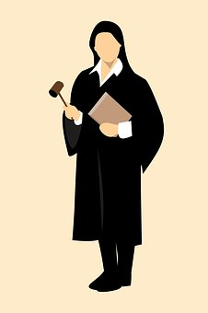
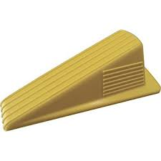
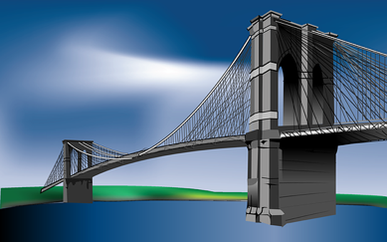
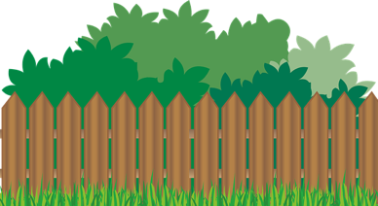
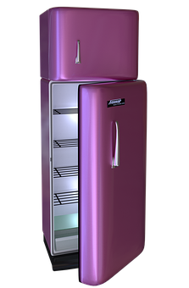
What can you see? Write down what these images are:
j u d _ _
w _ d _ _
_ r _ d _ _
h _ d _ e
l o _ _ _
_ a _ _ e
f r _ _ _ _

Slide 44
What can you see? Write down what these images are:
Answers:
j u d g e
w e d g e
b r i d g e
h e d g e
l o d g e
b a d g e
f r i d g e

Slide 45
Stage: 2 | The /j/ sound spelled –dge at the end of words. Name:
List: 1
Spellings | 1st Attempt | 2nd Attempt | 3rd Attempt | 4th Attempt | 5th Attempt
badge
edge
bridge
dodge
fudge
ridge
smudge
judge
wedge
lodge

Slide 46
Stage: 2 | The /j/ sound spelt –dge at the end of words. Name:
List: 1
Spellings
badge
edge
bridge
dodge
fudge
ridge
smudge
judge
wedge
lodge
a
o
Use your spellings to try and work out which words fit in the boxes.
e
i
Which words have been left out?

Slide 47
Stage: 2 | The /j/ sound spelt –dge at the end of words. Answers:
List: 1
d
b
d
d
d
Spellings
badge
edge
bridge
dodge
fudge
ridge
smudge
judge
wedge
lodge
e
g
e
a
g
e
o
g
e
Use your spellings to try and work out which words fit in the boxes.
b
d
r
i
g
e
d
w
e
g
e
d
d
r
i
g
e
s
m
u
g
e
Which words have been left out?

Slide 48
2
2
The /j/ sound spelt –ge at the end of words. This spelling comes after all sounds other than the short vowels.

Slide 49
2
The /j/ sound spelt –ge at the end of words. This spelling comes after all sounds other than the short vowels.
2
Introduction | Words that end with a /j/ sound that is spelling ‘ge’ have a sound that is not a short vowel.
Main Teaching Activity | Ask children to listen to the words and spot the sound that is the same in each. Use the power point slide to show the spelling list. Ask children to copy the words on their whiteboards and circle the sound that comes before the /j/ sound. Feedback and discuss how this spelling occurs only in words without a short vowel sound.
Independent Activity | Using the spelling list words get children to work in pairs to try and find two new words that they can make from each word. For example: charge – rage – hag orange – range – ran
Spellings
age
huge
change
charge
bulge
village
range
orange
hinge
stage

Slide 50
Stage: 2 | The /j/ sound spelt –ge at the end of words. Name:
List: 2
Spellings | 1st Attempt | 2nd Attempt | 3rd Attempt | 4th Attempt | 5th Attempt
age
huge
change
charge
bulge
village
range
orange
hinge
stage

Slide 51
Stage: 2 | The /j/ sound spelt –ge at the end of words. Name:
List: 2
Spellings
age
huge
change
charge
bulge
village
range
orange
hinge
stage
s | t | a | g | e | t | h | u | g | e
c | h | a | r | g | e | s | p | q | u
h | l | t | r | f | i | o | u | n | d
i | t | y | a | g | e | k | l | l | i
n | z | w | t | c | h | a | n | g | e
g | b | u | l | g | e | r | n | p | t
e | m | v | i | l | l | a | g | e | y
w | l | k | r | a | n | g | e | p | j
o | r | a | n | g | e | r | g | i | k
Can you find your spellings hidden in the word search?

Slide 52
Stage: 2 | The /j/ sound spelt –ge at the end of words. Answers:
List: 2
Spellings
age
huge
change
charge
bulge
village
range
orange
hinge
stage
s | t | a | g | e | t | h | u | g | e
c | h | a | r | g | e | s | p | q | u
h | l | t | r | f | i | o | u | n | d
i | t | y | a | g | e | k | l | l | i
n | z | w | t | c | h | a | n | g | e
g | b | u | l | g | e | r | n | p | t
e | m | v | i | l | l | a | g | e | y
w | l | k | r | a | n | g | e | p | j
o | r | a | n | g | e | r | g | i | k
Can you find your spellings hidden in the word search?

Slide 53
Spelling Curriculum
Stage 3
All elements of this curriculum are copyright © Education Shed Inc. and may not be redistributed without permission.

Slide 54
Spelling lists – Stage 3
The /ow/ and /u/ sounds spelled ‘ou.’
Spelling Rule: The /i/ sound spelled with a ‘y.’
Words with endings that sound like /ze/ as in measure are always spelled with ‘-sure.’
Words with endings that sound like /ch/ is often spelled –’ture’ unless the root word ends in (t)ch.
Challenge words
The prefixes ’re-’, ‘dis-’ and ‘mis’
Adding suffixes beginning with vowel letters to words of more than one syllable
Challenge words
The long vowel /a/ sound
Adding the suffix –ly. Adding the –ly suffix to an adjective turns it into an adverb.
Homophones – words which have the same pronunciation but different meanings and/or spellings.
Challenge Words
The /l/ sound spelled ‘-al’ or ‘-le’ at the end of words.
Adding the suffixes ‘–ly’ and ‘-ally’
Challenge Words
Words ending in ‘-er’ when the root word ends in (t)ch.
Words with the /k/ sound spelled ‘ch’, originating from the Greek language. Words ending with the /g/ sound spelled ‘–gue’, ’ch’ pronounced /sh/ and the /k/ sound spelled ‘–que’, originating from French. Words with the /s/ sound spelled ’sc’, which is Latin in its origin.
Homophones: Words which have the same pronunciation but different meanings and/or spellings.
Challenge Words
Homophones
The prefixes ‘in-’ and ‘il-’ meaning not
The prefixes ‘sub-’ and ‘inter-’
Challenge Words
The suffix ‘-ation’
Adding the suffix ‘-ly’ to form adverbs
The suffix ‘–sion’ pronounced /ʒən/
Challenge Words
Adding the suffix ‘–ion.’ When the root word ends in ’d,’ ‘de’ or ‘se’ then the suffix ’-ion’ needs to be ‘-sion.’
The suffux ‘-ous’
The long /e/ sound spelled with an ‘i’
Challenge Words
The ‘au’ digraoph
The suffix ‘-ion’
The suffix ‘-cian’ used instead of ‘-sion’ when the root word ends in ’c’ or ‘cs’
Adding ‘-ly’ to create adverbs of manner. These adverbs describe how the verb is occurring.
Challenge Words

Slide 55
3
1
The /ow/ and /u/ sound spelled ‘ou’

Slide 56
3
The /ow/ and /u/ sound spelled ‘ou’
Introduction | The digraph ‘ou’ is pronounced as /ow/ or /u/, explain that this sound is most common in the middle of words and sometimes at the start. It is rare at the end of words where the ‘ow’ spelling is usually found (e.g. cow).
Main Teaching Activity | Using the power point slide, discuss the meaning of the spelling list this week. Get children to come out and underline the /ow/ or /u/ sound in each word. Notice that most often the sound comes in the middle of the word.
Independent Activity | Get children to work in small groups, one child picks one of the spelling list words and writes the first letter on a mini whiteboard, then passes the board to their left, the next child writes the next letter of the word and so on until the word is complete. The child that writes the final letter checks the spelling is correct and then picks another word from the board to start again.
Spellings
mouth
around
found
sound
hound
touch
double
country
trouble
young

Slide 57
Discuss the meanings of the words below and then ask children to come out and underline the /ow/or /u/ sound in each word
mouth | around | found | sound | hound
touch | double | country | trouble | young

Slide 58
Answers:
Discuss the meanings of the words below and then ask children to come out and underline the /ow/ sound in each word
mouth | around | found | sound | hound
touch | double | country | trouble | young

Slide 59
Stage: 3 | The /ow/ and /u/ sound spelled ‘ou’ Name:
List: 1
Spellings | 1st Attempt | 2nd Attempt | 3rd Attempt | 4th Attempt | 5th Attempt
mouth
around
found
sound
hound
touch
double
country
trouble
young

Slide 60
Stage: 3 | The /ow/ and /u/ sound spelled ‘ou’ Name:
List: 1
Find and unscramble your spellings in the grids.
Spellings
mouth
around
found
sound
hound
touch
double
country
trouble
young
h | t | m | o | u
n | a | r | o | u | d
u | h | t | c | o
r | t | u | b | e | o | l
d | n | f | o | u
d | e | l | u | o | b
n | c | y | o | t | u | r
o | s | u | n | d
n | u | d | o | h
n | o | g | y | u

Slide 61
Stage: 3 | The /ow/ and /u/ sound spelled ‘ou’ Answers:
List: 1
Find and unscramble your spellings in the grids.
Spellings
mouth
around
found
sound
hound
touch
double
country
trouble
young
h | t | m | o | u
m | o | u | t | h
n | a | r | o | u | d
a | r | o | u | n | d
u | h | t | c | o
t | o | u | c | h
r | t | u | b | e | o | l
t | r | o | u | b | l | e
d | n | f | o | u
f | o | u | n | d
d | e | l | u | o | b
d | o | u | b | l | e
n | c | y | o | t | u | r
c | o | u | n | t | r | y
o | s | u | n | d
s | o | u | n | d
n | u | d | o | h
h | o | u | n | d
n | o | g | y | u
y | o | u | n | g

Slide 62
3
2
Spelling Rule: The /i/ sound spelled with a ‘y.’

Slide 63
3
The /i/ sound spelled with a ‘y’.
2
Introduction | Some words contain an /i/ sound which is written with a /y/ instead on an ‘i’. Very often the ‘y’ is the second letter of the word but not always.
Main Teaching Activity | Using the power point slide, get children to split their whiteboard with a line down the middle. Then they can sort the words on the slide in to words that use an ‘i’ for the /i/ sound and words that use a ‘y’ for it. Discuss the results and look at misconceptions.
Independent Activity | Using the power point slide, ask children to choose five of the words in their spelling list and write a sentence containing the chosen word. For a bonus point they can try and accurately include two of the words in one sentence! Share sentences with the class.
Spellings
gym
myth
Egypt
pyramid
mystery
symbol
synonym
lyrics
system
gymnastics

Slide 64
Sort the spellings in to two boxes. Words with an /i/ sound that are spelled with an ‘i’ and words with an /i/ sound that are spelled with a ‘y’.
him | gym | hippy | pyramid | skim | system
impossible | oxygen | fringe | mystery | lyric | imposter
/i/ spelled with an ‘i’
/i/ spelled with a ‘y’

Slide 65
Sort the spellings in to two boxes. Words with an /i/ sound that are spelled with an ‘i’ and words with an /i/ sound that are spelled with a ‘y’.
Answers:
him | gym | hippy | pyramid | skim | system
impossible | oxygen | fringe | mystery | lyric | imposter
hippy
skim
fringe
pyramid
system
lyric
him
gym
impossible
oxygen
imposter
mystery
/i/ spelled with an ‘i’
/i/ spelled with a ‘y’

Slide 66
Stage: 3 | Spelling rule: The /i/ sound spelled with a ‘y.’ Name:
List: 2
Copy down five of the words in your spelling list and write a sentence containing it.
Spellings
gym
myth
Egypt
pyramid
mystery
symbol
synonym
lyrics
system
gymnastics
Your word
Your sentence

Slide 67
Stage: 3 | Spelling Rule: The /i/ sound spelled with a ‘y.’ Name:
List: 2
Spellings | 1st Attempt | 2nd Attempt | 3rd Attempt | 4th Attempt | 5th Attempt
gym
myth
Egypt
pyramid
mystery
symbol
synonym
lyrics
system
gymnastics

Slide 68
Stage: 3 | The /i/ sound spelled with a ‘y.’ Name:
List: 2
 |  |  | y | r |  |  |  | d |  | g
 |  |  | n
 |  |  |  |  |  |  | s |  |  | t |  | m
 | m |  | s
 | b
 |  |  | i
 |  |  | c
 |  |  |  |  |  |  | y | r
 |  |  |  |  |  |  | m
Spellings
gym
myth
Egypt
pyramid
mystery
symbol
synonym
lyrics
system
gymnastics
Use your spellings, and the letters in the crossword, to work out the missing words.

Slide 69
Stage: 3 | The /i/ sound spelled with a ‘y.’ Answers:
List: 2
 |  |  | g |  |  |  |  |  |  | E
 |  | p | y | r | a | m | i | d |  | g | y | m
 |  |  | m |  |  |  |  |  |  | y
 | s |  | n |  |  |  |  |  |  | p
 | y |  | a |  |  |  | s | y | s | t | e | m
 | m | y | s | t | e | r | y |  |  |  |  | y
 | b |  | t |  |  |  | n |  |  |  |  | t
 | o |  | i |  |  |  | o |  |  |  |  | t
 | l |  | c |  |  |  | n
 |  |  | s |  |  | l | y | r | i | c | s
 |  |  |  |  |  |  | m
Spellings
gym
myth
Egypt
pyramid
mystery
symbol
synonym
lyrics
system
gymnastics
Use your spellings, and the letters in the crossword, to work out the missing words.

Slide 70
Spelling Curriculum
Stage 4
All elements of this scheme are copyright © Education Shed Inc. and may not be redistributed without permission.

Slide 71
Spelling lists – Stage 4
Homophones
The /s/ sound spelled c before ’i’ and ‘e’.
Prefixes – ’super-’ ‘anti-’, ‘auto-’ and ‘bi-’
Challenge Words
Words ending in ‘-ious.’
Words ending in ‘–cious.’ If the root word ends in –ce the sound is usually spelled ‘-cious.’
Ending ‘-cial’ and ‘-tial.’ After a vowel ‘-cial’ is most common and ‘-itial’ after a consonant. But there are many exceptions.
Ending ‘-cial’ and ‘-tial.’ After a vowel ‘-cial’ is most common and ‘-itial’ after a consonant. But there are many exceptions.
Ending ‘-cial’ and ‘-tial.’ After a vowel ‘-cial’ is most common and ‘-itial’ after a consonant. But there are many exceptions.
Challenge words
Words ending in ‘-ant.’ ‘-ant’ Is used if there is an ‘a’ or ‘ay’ sound in the right place.
Words ending in ‘-ance.’ ‘-ance’ Is used if there is an ‘a’ or ‘ay’ sound in the right place.
Use –ent and -ence after soft c (/s/ sound), soft g (/j/ sound) and qu. There many exceptions to this rule.
Words ending in ‘-able’ and ‘-ible.’ ‘-able’ is used where there is a related word ending ‘-ation.’
Words ending in ‘-ably’ and ‘-ibly.’ The ‘-able’ ending is usually but not always used if a complete root word can be heard before it. ‘y’ endings comply with previously learned rules and is replaced with ‘i’ as in rely > reliably
Challenge Words
Words ending in ‘-able.’ If this is being added to a root word ending in –ce or –ge then the e after the c or g is kept other wise they would be said with their hard sounds as in cap and gap.
Adverbs of time (temporal adverbs) these are words to develop chronology in writing.
Adding suffixes beginning with vowel letters to words ending in –fer. The r is doubled if the –fer is still stressed when the ending is added. If the –fer is not stressed then the r isn’t doubled.
Words with ‘silent’ letters at the start.
Words with ‘silent’ letters (i.e. letters whose presence cannot be predicted from the pronunciation of the word)
Challenge Words
Words spelled with ’ie’ after c.
Words with the ‘ee’ sound spelled ei after c. The ‘i before e except after c’ rule applies to words where the sound spelled by ei is /ee/ However there are exceptions like those in the spellings.
Words containing the letter string ‘ough’ where the sound is /aw/.
Words containing the letter string ’ough’ where the sound is /o/ as in boat or ‘ow’ as in cow.
Adverbs of possibility. These words show the possibility that something has of occurring.
Challenge Words
These words are homophones or near homophones. They have the same pronunciation but different spellings and/or meanings.
These words are homophones or near homophones. They have the same pronunciation but different spellings and/or meanings.
These words are homophones or near homophones. They have the same pronunciation but different spellings and/or meanings.
These words are homophones or near homophones. They have the same pronunciation but different spellings and/or meanings.
These words are homophones or near homophones. They have the same pronunciation but different spellings and/or meanings.
Challenge Words
Hyphens can be used to join a prefix to a root word, especially if the prefix ends in a vowel letter and the root word also begins with one.
Challenge Words

Slide 72
4
1
Homophones – words which have the same pronunciation
but different meanings and/or spellings.

Slide 73
4
Homophones – words which have the same pronunciation but different meanings and/or spellings.
1
Introduction | Can the children remember what the word homophone means? Can they think of any examples? Define them as words which have the same pronunciation but different meanings and/or spellings. Remind them how near homophones have slightly different pronunciations.
Main Teaching Activity | Using the PowerPoint, display each example on the whiteboard. Ask the children to write down the word that they think goes in each gap. After each example ask the children to share their responses and discuss any errors or misconceptions. Teacher can choose to reveal the two spellings before or after the pupil attempts.
Independent Activity | In small groups. One child writes a sentence with one of this week’s spellings missing. E.g. We travelled to France by ________. The children on their table then write down the correct spelling on their whiteboards. The child who created the question shares which they thought was the right question and check each others’ answers.
scene
seen
whose
who’s
affect
effect
here
hear
heel
heal

Slide 74
It was so noisy, the boy struggled to ______ what his mum said.
Which is the correct spelling?
here hear

Slide 75
It was so noisy, the boy struggled to hear what his mum said.
Answers:
Which is the correct spelling?
here hear

Slide 76
The teacher had lost the whiteboard rubber, she asked if anyone had _______ it.
Which is the correct spelling?
seen scene

Slide 77
The teacher had lost the whiteboard rubber, she asked if anyone had seen it.
Answers:
Which is the correct spelling?
seen scene

Slide 78
_______ are these trainers?
Which is the correct spelling?
whose who’s

Slide 79
whose are these trainers?
Answers:
Which is the correct spelling?
whose who’s

Slide 80
At last her broken arm had begun to ______!
Which is the correct spelling?
heel heal

Slide 81
At last her broken arm had begun to heal !
Answers:
Which is the correct spelling?
heel heal

Slide 82
The _______ of plastic on the environment is devastating.
Which is the correct spelling?
effect affect

Slide 83
The effect of plastic on the environment is devastating.
Answers:
Which is the correct spelling?
effect affect

Slide 84
Stage: 4 | Homophones – words which have the same pronunciation but different meanings and/or spellings. Name:
List: 1
Spellings | 1st Attempt | 2nd Attempt | 3rd Attempt | 4th Attempt | 5th Attempt
scene
seen
whose
who’s
affect
effect
here
hear
heel
heal

Slide 85
Stage: 4 | Homophones – words which have the same pronunciation but different meanings and/or spellings. Name:
List: 1
Spellings
scene
seen
whose
who’s
affect
effect
here
hear
heel
heal
Choose one of your spellings to complete the sentence.
Only one of the pair is correct.
The opening of the story set the ____________ for the reader.
“_________ socks are these?” asked the teacher.
The medicine had an immediate _________.
It was difficult to _______ over the noise in the playground.
Daniel hurt his ________ playing football in the park.

Slide 86
Stage: 4 | Homophones – words which have the same pronunciation but different meanings and/or spellings. Answers:
List: 1
Spellings
scene
seen
whose
who’s
affect
effect
here
hear
heel
heal
Choose one of your spellings to complete the sentence.
Only one of the pair is correct.
The opening of the story set the _scene_ for the reader.
“_whose_ socks are these?” asked the teacher.
The medicine had an immediate _effect_.
It was difficult to _hear_ over the noise in the playground.
Daniel hurt his _heel_ playing football in the park.

Slide 87
4
2
The /s/ sound spelt c before ’i’ and ‘e’.

Slide 88
4
The /s/ sound spelt c before ’i’ and ‘e’.
2
Introduction | Today we will look at the /s/ sound when it is spelled with a ‘c’. This occurs generally when the ‘c’ comes before an ‘i’ or an ‘e’.
Main Teaching Activity | Show children the slide and ask them to, using mini whiteboard, sort the spelling list words in to words with ‘i’ before ‘c’ and words with ‘e’ before ‘c’. Discuss misconceptions and check understanding.
Independent Activity | Using the power point ask children to work independently to identify the images and then spell what they are. Remind children that the ‘s’ sound in the words will be spelled using a ‘c’. Check answers and discuss errors or misconceptions.
circle
century
centaur
circus
princess
voice
medicine
celebrate
celery
pencil

Slide 89
Get children to sort the spelling list words in to ones where the ‘c’ comes before an ‘i’ and ones where the ‘c’ comes before an ‘e’.
circle
century
centaur
circus
princess
voice
medicine
celebrate
celery
pencil
‘c’ before i
‘c’ before e

Slide 90
Get children to sort the spelling list words in to ones where the ‘c’ comes before an ‘i’ and ones where the ‘c’ comes before an ‘e’.
circle
century
centaur
circus
princess
voice
medicine
celebrate
celery
pencil
Answers:
medicine
celebrate
pencil
centaur
circle
circus
celery
princess
voice
century
‘c’ before i
‘c’ before e

Slide 91
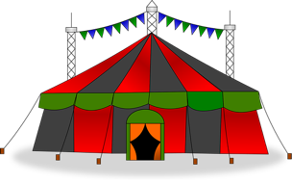
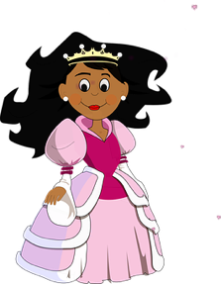
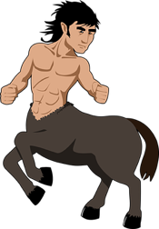
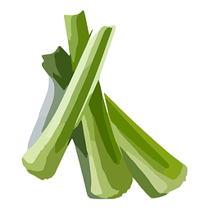
Look at the images below, can you spell what they are?
 |  |  |  | 100 Years

Slide 92
Answers:
Look at the images below, can you spell what they are?
 |  |  |  | 100 Years
circle | voice | circus | medicine | century
princess | celebrate | centaur | celery | pencil

Slide 93
Stage: 4 | The /s/ sound spelt c before ’i’ and ‘e’. Name:
List: 2
Spellings | 1st Attempt | 2nd Attempt | 3rd Attempt | 4th Attempt | 5th Attempt
circle
century
centaur
circus
princess
voice
medicine
celebrate
celery
pencil

Slide 94
Stage: 4 | The /s/ sound spelled ’c’ before ‘e’, ‘i’ and ’y’ Name:
List: 2
Cover your spellings for this task
Marvin has scored 0/10 in his spelling test.
Can you help him out by writing the correct spellings into this grid?
Spellings
circle
century
centaur
circus
princess
voice
medicine
celebrate
celery
pencil
sircle
sentury
sentaur
sircus
prinsess
voise
medisine
selebrate
selery
pencil

Slide 95
Stage: 4 | The /s/ sound spelled ’c’ before ‘e’, ‘i’ and ’y’ Answers:
List: 2
Cover your spellings for this task
Marvin has scored 0/10 in his spelling test.
Can you help him out by writing the correct spellings into this grid?
Spellings
circle
century
centaur
circus
princess
voice
medicine
celebrate
celery
pencil
sircle
sentury
sentaur
sircus
prinsess
voise
medisine
selebrate
selery
pencil
circle
century
centaur
circus
princess
voice
medicine
celebrate
celery
pencil

Slide 96
Spelling Curriculum
Stage 5
All elements of this curriculum are copyright © Education Shed Inc. and may not be redistributed without permission.

Slide 97
Spelling lists – Stage 5
Challenge Words
Challenge Words
Challenge Words
Challenge Words
Challenge Words
Challenge Words
Challenge Words
Challenge Words
Challenge Words
Challenge Words
Words with the short vowel sound /i/ spelled y
Words with the long vowel sound /i/ spelled with a y.
Adding the prefix ‘-over’ to verbs.
Convert nouns or verbs into adjectives using suffix ‘-ful.’
Words which can be nouns and verbs.
Words with an /o/ sound spelled ‘ou’ or ‘ow.’
Words with a ‘soft c’ spelled /ce/.
Prefix dis, un, over, im. Each have a particular meaning: dis – reverse; un – not; over – above/more; im – opposite
Words with the /f/ sound spelled ph.
Words with origins in other countries
Words with unstressed vowel sounds.
Words with endings /shuhl/ after a vowel letter.
Words with endings /shuhl/ after a consonant letter.
Words with the common letter string ’acc’ at the beginning of words.
Words ending in ’-ably.’
Words ending in ’-ible’
Adding the suffix ‘-ibly’ to create an adverb.
Changing ‘-ent’ to ‘–ence.’
-er, -or, -ar at the end of words.
Adverbs synonymous with determination.
Adjectives to describe settings
Vocabulary to describe feelings.
Adjectives to describe character
Grammar Vocabulary
Grammar Vocabulary
Mathematical Vocabulary

Slide 98
5
1
Challenge Words

Slide 99
5
Challenge Words
1
Challenge week
Choose an activity from the challenge week pack.
Spellings
muscle
prejudice
available
determined
rhyme
identity
accommodate
suggest
competition
existence

Slide 100
Stage: 5 | Challenge Words Name:
List: 1
Spellings | 1st Attempt | 2nd Attempt | 3rd Attempt | 4th Attempt | 5th Attempt
muscle
prejudice
available
determined
rhyme
identity
accommodate
suggest
competition
existence

Slide 101
Stage: 5 | Challenge Words Name:
List: 1
 |  |  |  |  | p |  | e | j |  |  | i |  | e
 | c |  | o |  |  | o |  | a | t
 |  |  |  |  |  |  |  |  | n |  |  | t | y
 |  |  |  |  |  |  |  | s | t |  | n |  | e
 |  |  |  |  |  |  |  |  |  |  |  | y | m
 |  |  |  |  |  |  |  |  |  |  |  | s | c
 |  |  |  |  |  |  |  |  | a |  |  | a | b | l
 | o |  | p | e | t | i |  | i | o
 |  |  |  |  |  |  |  | g | g |  | s
 |  |  |  |  |  |  |  | t |  |  | m |  | n | e | d
Spellings
accommodate
available
competition
determined
suggest
existence
identity
muscle
prejudice
rhyme
Insert the missing letters into your spellings to find a new challenge word.

Slide 102
Stage: 5 | Challenge Words Answers:
List: 1
 |  |  |  |  | p | r | e | j | u | d | i | c | e
a | c | c | o | m | m | o | d | a | t | e
 |  |  |  |  |  | i | d | e | n | t | i | t | y
 |  |  |  |  | e | x | i | s | t | e | n | c | e
 |  |  |  |  |  |  |  |  |  | r | h | y | m | e
 |  |  |  |  |  |  |  |  |  | m | u | s | c | l | e
 |  |  |  |  |  |  | a | v | a | i | l | a | b | l | e
c | o | m | p | e | t | i | t | i | o | n
 |  |  |  |  |  | s | u | g | g | e | s | t
 |  |  |  |  |  | d | e | t | e | r | m | i | n | e | d
Spellings
accommodate
available
competition
determined
suggest
existence
identity
muscle
prejudice
rhyme
Insert the missing letters into your spellings to find a new challenge word.

Slide 103
5
2
Challenge Words

Slide 104
5
Challenge Words
2
Challenge week
Choose an activity from the challenge week pack.
Spellings
accompany
average
conscience
develop
explanation
immediately
necessary
privilege
rhythm
symbol

Slide 105
Stage: 5 | Challenge Words Name:
List: 2
Spellings | 1st Attempt | 2nd Attempt | 3rd Attempt | 4th Attempt | 5th Attempt
accompany
average
conscience
develop
explanation
immediately
necessary
privilege
rhythm
symbol

Slide 106
Stage: 5 | Challenge Words Name:
List: 2
e | d | e | v | e | l | o | p | a | s | d | f | m | b | n | c
g | h | j | k | e | x | p | l | a | n | a | t | i | o | n | o
l | z | x | p | r | i | v | i | l | e | g | e | p | v | e | n
q | w | s | v | b | n | m | a | r | a | s | w | q | c | c | s
e | r | t | y | u | i | o | p | h | d | f | g | h | x | e | c
a | c | c | o | m | p | a | n | y | j | k | l | l | z | s | i
q | w | e | r | t | b | y | u | t | i | o | p | a | s | s | e
z | x | c | v | b | n | o | m | h | q | w | e | k | d | a | n
a | v | e | r | a | g | e | l | m | r | t | y | j | f | r | c
p | i | m | m | e | d | i | a | t | e | l | y | h | g | y | e
Spellings
accompany
average
conscience
develop
explanation
immediately
necessary
privilege
rhythm
symbol
Can you find your spellings hidden in this word search?

Slide 107
Stage: 5 | Challenge Words Answers:
List: 2
e | d | e | v | e | l | o | p | a | s | d | f | m | b | n | c
g | h | j | k | e | x | p | l | a | n | a | t | i | o | n | o
l | z | x | p | r | i | v | i | l | e | g | e | p | v | e | n
q | w | s | v | b | n | m | a | r | a | s | w | q | c | c | s
e | r | t | y | u | i | o | p | h | d | f | g | h | x | e | c
a | c | c | o | m | p | a | n | y | j | k | l | l | z | s | i
q | w | e | r | t | b | y | u | t | i | o | p | a | s | s | e
z | x | c | v | b | n | o | m | h | q | w | e | k | d | a | n
a | v | e | r | a | g | e | l | m | r | t | y | j | f | r | c
p | i | m | m | e | d | i | a | t | e | l | y | h | g | y | e
Spellings
accompany
average
conscience
develop
explanation
immediately
necessary
privilege
rhythm
symbol
Can you find your spellings hidden in this word search?

