Slide 1
2
2
The /j/ sound spelt –ge at the end of words. This spelling comes after all sounds other than the short vowels.

Slide 2
2
The /j/ sound spelt –ge at the end of words. This spelling comes after all sounds other than the short vowels.
2
Introduction | Words that end with a /j/ sound that is spelling ‘ge’ have a sound that is not a short vowel.
Main Teaching Activity | Ask children to listen to the words and spot the sound that is the same in each. Use the power point slide to show the spelling list. Ask children to copy the words on their whiteboards and circle the sound that comes before the /j/ sound. Feedback and discuss how this spelling occurs only in words without a short vowel sound.
Independent Activity | Using the spelling list words get children to work in pairs to try and find two new words that they can make from each word. For example: charge – rage – hag orange – range – ran
Spellings
age
huge
change
charge
bulge
village
range
orange
hinge
stage

Slide 3
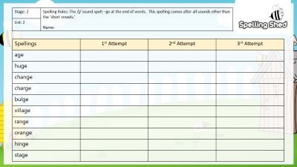
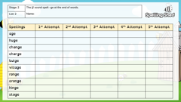
Stage: 2 | The /j/ sound spelt –ge at the end of words. Name:
List: 2
Spellings | 1st Attempt | 2nd Attempt | 3rd Attempt | 4th Attempt | 5th Attempt
age
huge
change
charge
bulge
village
range
orange
hinge
stage

Slide 4
Stage: 2 | The /j/ sound spelt –ge at the end of words. Name:
List: 2
Spellings
age
huge
change
charge
bulge
village
range
orange
hinge
stage
s | t | a | g | e | t | h | u | g | e
c | h | a | r | g | e | s | p | q | u
h | l | t | r | f | i | o | u | n | d
i | t | y | a | g | e | k | l | l | i
n | z | w | t | c | h | a | n | g | e
g | b | u | l | g | e | r | n | p | t
e | m | v | i | l | l | a | g | e | y
w | l | k | r | a | n | g | e | p | j
o | r | a | n | g | e | r | g | i | k
Can you find your spellings hidden in the word search?

Slide 5
Stage: 2 | The /j/ sound spelt –ge at the end of words. Answers:
List: 2
Spellings
age
huge
change
charge
bulge
village
range
orange
hinge
stage
s | t | a | g | e | t | h | u | g | e
c | h | a | r | g | e | s | p | q | u
h | l | t | r | f | i | o | u | n | d
i | t | y | a | g | e | k | l | l | i
n | z | w | t | c | h | a | n | g | e
g | b | u | l | g | e | r | n | p | t
e | m | v | i | l | l | a | g | e | y
w | l | k | r | a | n | g | e | p | j
o | r | a | n | g | e | r | g | i | k
Can you find your spellings hidden in the word search?

