Slide 1
5
2
To understand how a suffix changes the meaning or grammatical form of a word
To spell words ending in ‘-cious’
This week’s words: atrocious, conscious, delicious, ferocious, gracious, luscious, malicious, precious, spacious, suspicious

Slide 2

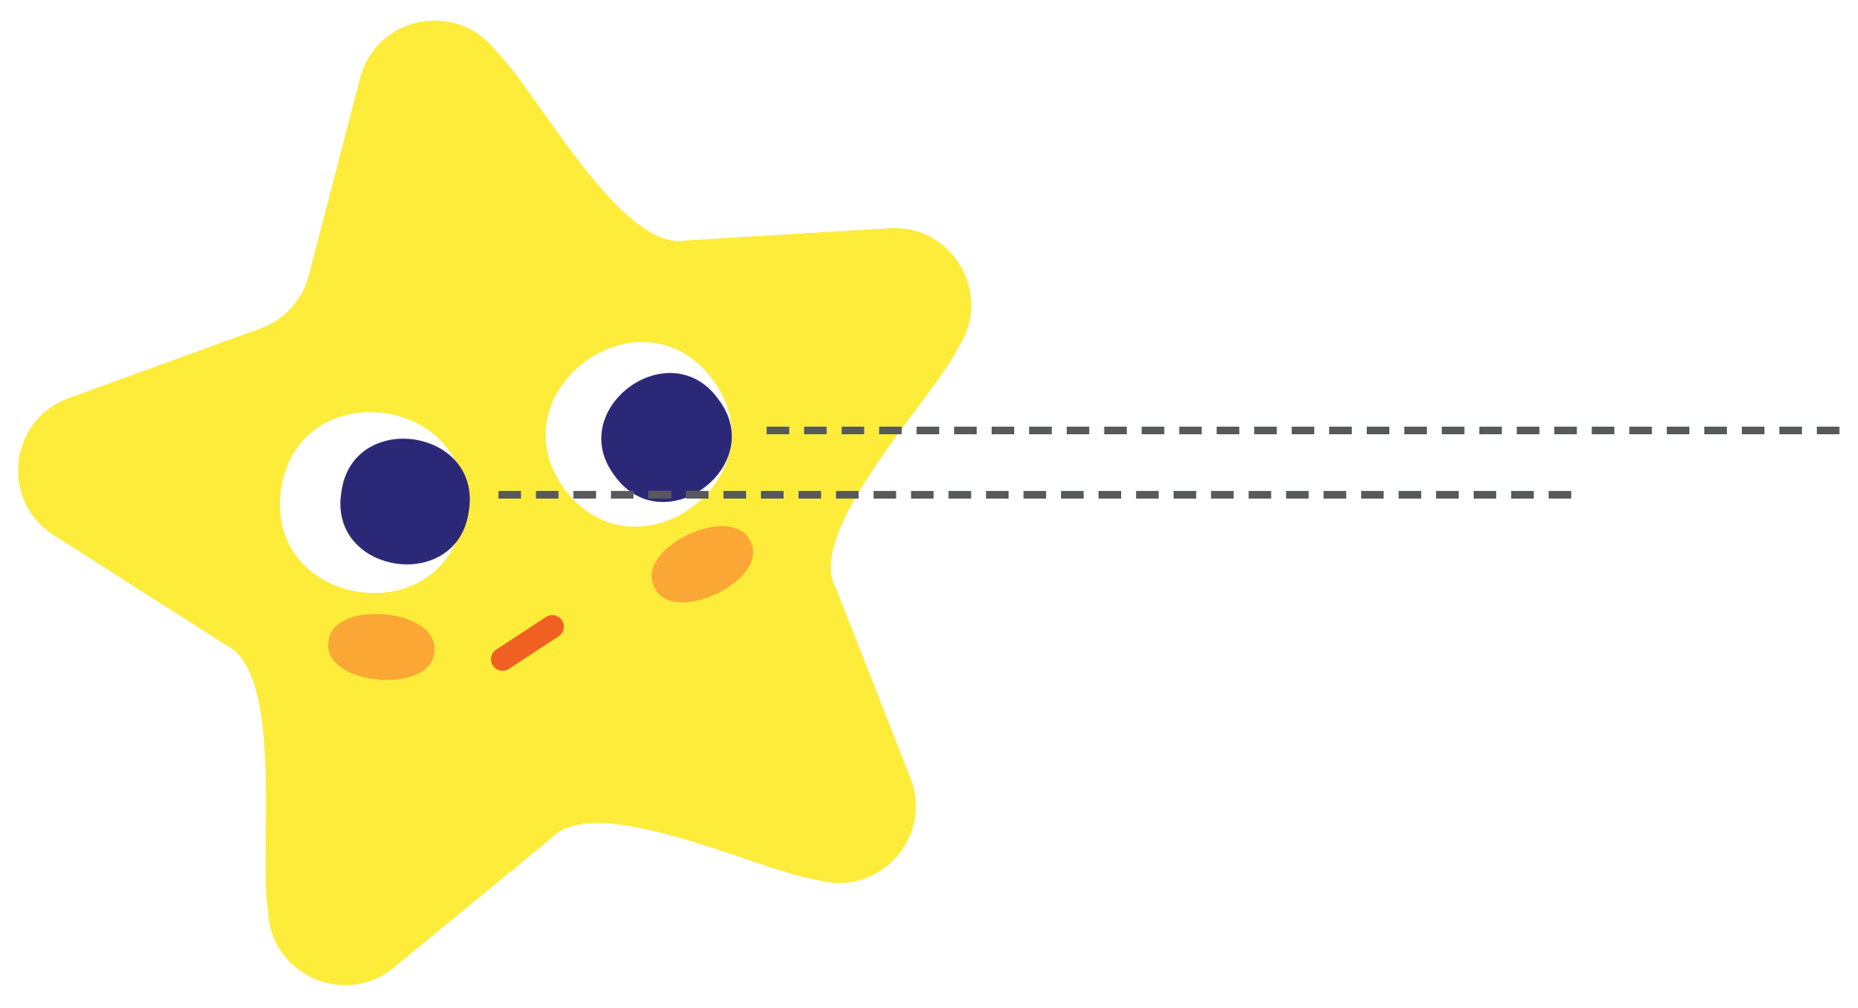
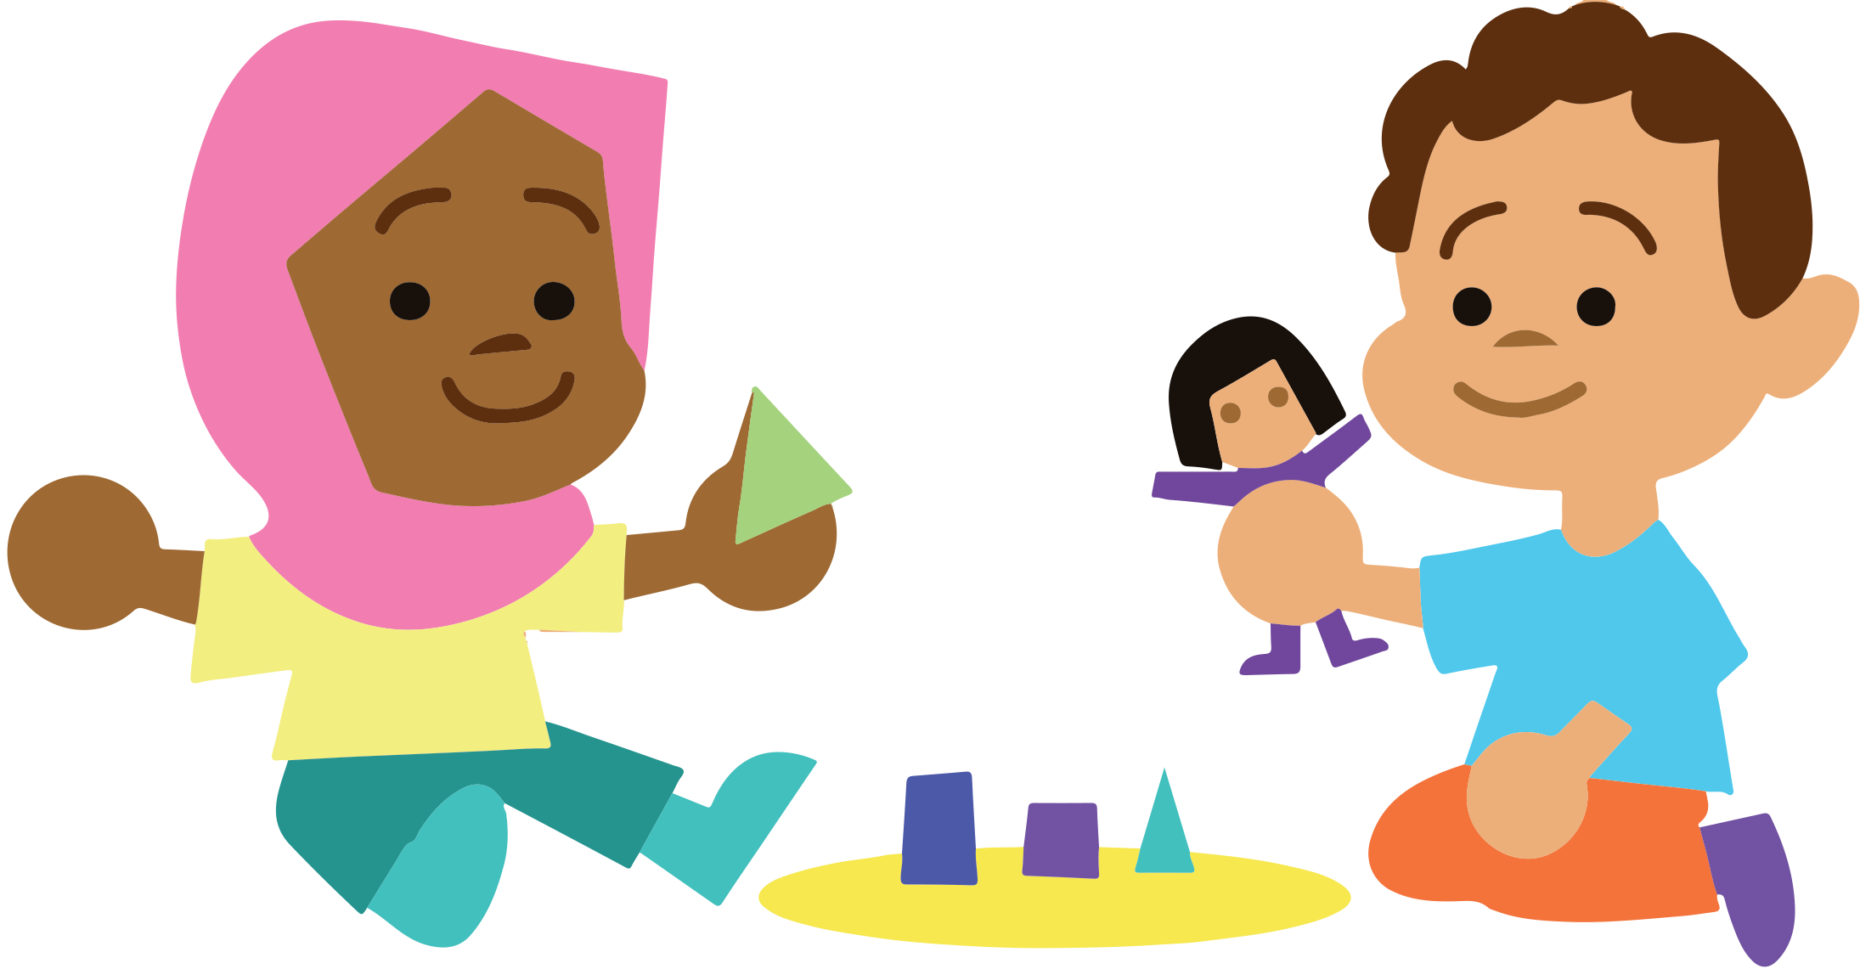


Starter
Climb the ladder by swapping one sound
each time to create a different word.
f
s c a r _
c
s _ a r e
t
s _ a r e
e
s h a r _
p
s h a r _
shark

Slide 3


This Week’s Words
Do you know what they all mean?
What do the words have in common?
suspicious
delicious
atrocious
malicious
luscious
precious
ferocious
conscious
spacious
gracious
This week’s words share the suffix
‘-cious’. What does it sound like?
Do this week’s words all belong to the same word class?

Slide 4
Words ending ‘-cious’
The suffix ‘-cious’ is part of the ‘-ious’ suffix. This suffix means ‘full of' or ‘having’.
If the noun form ends in ‘-ce’, it is removed before ‘-cious’ is added.
Which of this week’s words does this apply to?
Base Word
Remove ‘ce’
Add ‘-cious’ to become this week’s word
Meaning
grace
grace
gracious
Full of grace
space
space
spacious
Full of space
malice
malice
malicious
Full of malice

Slide 5
Words ending ‘-cious’
Sometimes the base word is not as obvious.
Which of this week’s words come from these base words?
Base Word
This Week’s Word
Meaning
fierce
ferocious
Vicious or savage.
(Full of wildness.)
science
conscious
Awake or alert.
(Full of awareness or knowledge.)
price
precious
Valuable or dear to someone.
(Full of value.)

Slide 6
Words ending ‘-cious’
Sometimes the root word comes from Latin.
Which of this week’s words come from these root words?
Root Word
This Week’s Word
Meaning
atrox
atrocious
Very bad or awful.
Having a pleasing taste or smell.
deliciosus
delicious
licius
luscious
Shortened form of ‘delicious’.
suspiciosus
suspicious
Full of suspicion/mistrust.

Slide 7


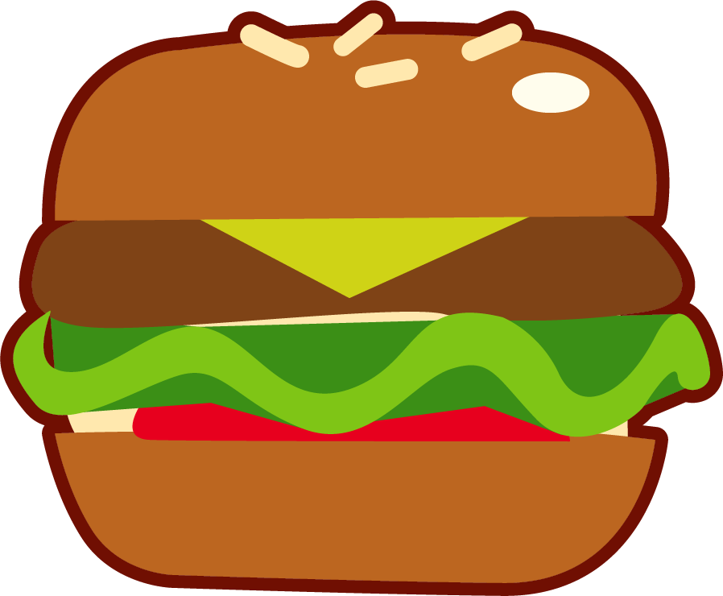




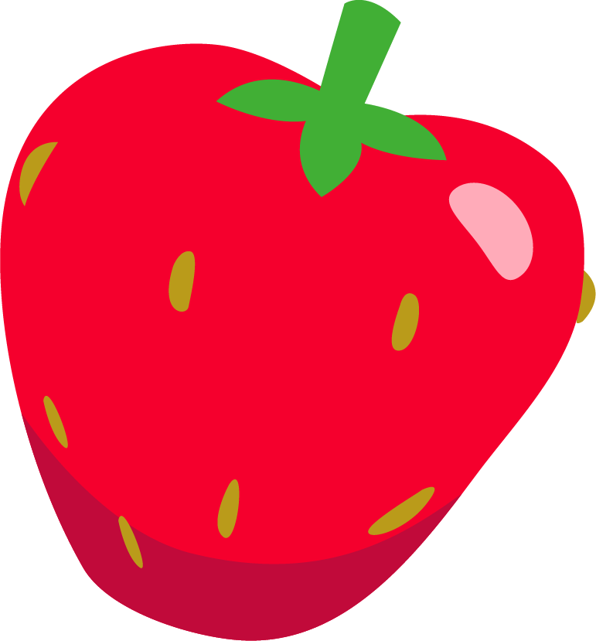
Etymology
Which word am I?
Since the 1300s it has meant ‘delightful to the senses, pleasing in the highest degree’.
From the Latin word delicere meaning a ‘delight, charm or allurement’.
From the Old French word
delicios.
delicious
It means ‘to allure, entice’ from de meaning ‘away’ and lacere meaning to ‘lure, entice’.

Slide 8
Syllable Sort
Can you sort the words according to the number of syllables?
conscious
malicious
delicious
luscious
suspicious
spacious
gracious
precious
atrocious
ferocious
2 Syllables
3 Syllables

Slide 9
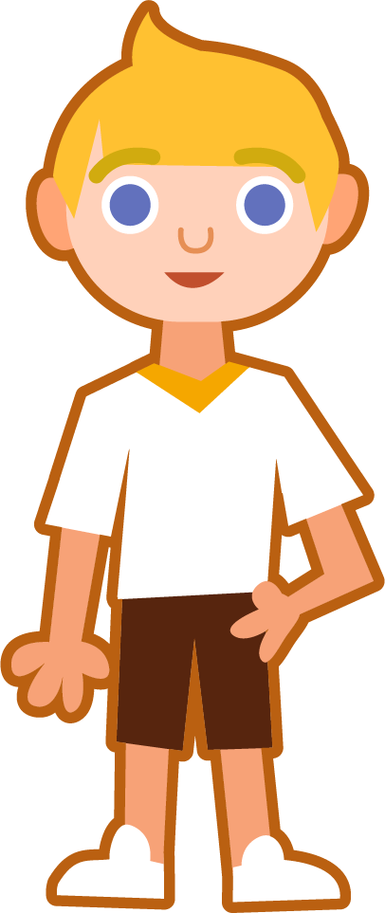


Sound Buttons and Syllables
Syllables are separated by long syllable breaks.
.
gracious
Draw a dot
below each single
letter sound. Use red sound buttons to show the adjacent consonants. When two or more letters represent one sound, we use a line.
gra|cious
2
atrocious
malicious
luscious
a|tro|cious
3
ma|li|cious
3
lu|scious
2

Slide 10
Word Maps
Read the word. Write each word out, drawing long lines for the syllable breaks. Write each word out again, adding the sound buttons for each phoneme.
Words | Syllable Breaks | Sound Buttons
delicious
conscious
luscious
spacious
suspicious
atrocious
ferocious
gracious
malicious
precious

Slide 11
Word Maps
Answers
Words | Syllable Breaks | Sound Buttons
delicious | de|li|cious | delicious
conscious | con|scious | conscious
luscious | lu|scious* | luscious
spacious | spa|cious | spacious
suspicious | sus|pi|cious | suspicious
atrocious | a|tro|cious | atrocious
ferocious | fe|ro|cious | ferocious
gracious | gra|cious | gracious
malicious | ma|li|cious | malicious
precious | pre|cious | precious
Notes:
The syllables for 'luscious' have been mapped to match 'conscious'.

Slide 12
Missing Words
Can you write the missing words to finish the sentences?
delicious
atrocious
conscious
ferocious
gracious
luscious
malicious
precious
spacious
suspicious
Mother bears can become _________ if their cubs are threatened.
This ring is very _________ to me.
The _________ smell began to fill the air.
The cakes were going to taste _________.
Peter couldn’t believe how _________ the new car was.
“Isn’t the weather _________ today?” asked Meena, who was drenched from head to toe.
He had a very _________ and pleasant smile.
The gossip being spread was untrue and _________.
Harry was _________ that someone was watching him.
The _________ looking vehicle was reported to police.

Slide 13
Missing Words
Answers
delicious
atrocious
conscious
ferocious
gracious
luscious
malicious
precious
spacious
suspicious
Mother bears can become _________ if their cubs are threatened.
This ring is very _________ to me.
The _________ smell began to fill the air.
The cakes were going to taste _________.
Peter couldn’t believe how _________ the new car was.
“Isn’t the weather _________ today?” asked Meena, who was drenched from head to toe.
He had a very _________ and pleasant smile.
The gossip being spread was untrue and _________.
Harry was _________ that someone was watching him.
The _________ looking vehicle was reported to police.
ferocious
precious
luscious
delicious
spacious
atrocious
gracious
malicious
conscious
suspicious

Slide 14
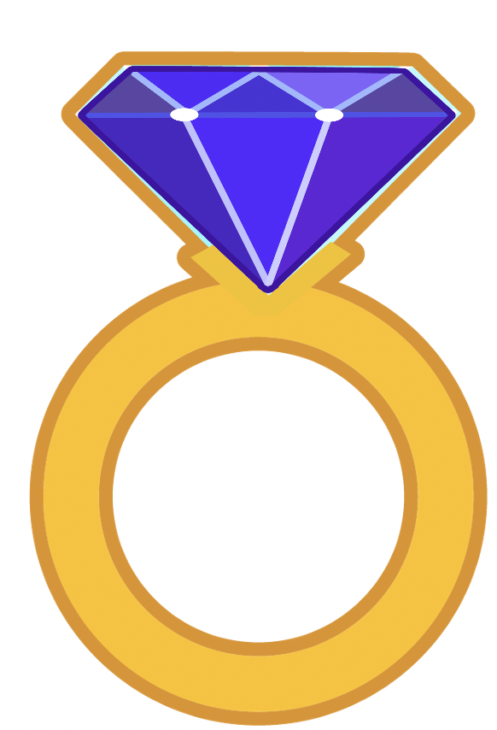


In a Sentence
Write a sentence about the pictures below.
Remember to include the word in your sentence.
precious
suspicious
delicious
spacious

Slide 15
Missing Words
Read the sentences and replace the
missing word with one of the blue words.
malicious
atrocious
conscious
ferocious
luscious
gracious
The weather has been ______________ all week.
She took a bite of the ______________ pear.
I became ______________ of the time and began to hurry.
With wild eyes, the ______________ dog pounced forwards.
Pardeep was ______________ enough to invite us to her party.
It was ______________ gossip, completely without substance.

Slide 16
In a Sentence
Possible Answers
precious
suspicious
This ring is precious to me because it belonged to my grandmother.
Ruth thought she had seen something suspicious.
delicious
spacious
Strawberries are the best fruit because they are delicious.
Our local park is spacious enough for a game of football.

Slide 17
Missing Words
Answers
malicious
atrocious
conscious
ferocious
luscious
gracious
The weather has been ______________ all week.
She took a bite of the ______________ pear.
I became ______________ of the time and began to hurry.
With wild eyes, the ______________ dog pounced forwards.
Pardeep was ______________ enough to invite us to her party.
It was ______________ gossip, completely without substance.
atrocious
luscious
conscious
ferocious
gracious
malicious

Slide 18
Definition
In a Sentence
ferocious
Synonyms
Antonyms

Slide 19
Definition
In a Sentence
Very aggressive or violent; very strong.
The misty jungle was full of ferocious animals just waiting to eat the lost explorers.
ferocious
Synonyms
Antonyms
brutal, fierce, frightful, merciless, ravenous, savage, vicious
calm, gentle, merciful, tame

Slide 20

Word Spotter
Clap your hands when you see one of this week’s words.
ambitious
various
cautious
infectious
malicious
spacious
nutritious
precious
mysterious
atrocious
suspicious
victorious
melodious
conscious
luscious
ferocious
gracious
delicious

Slide 21
Definition
In a Sentence
Synonyms
Antonyms

Slide 22
Word cards for Independent Extended Learning
suspicious | ferocious | luscious | gracious | precious
malicious | delicious | conscious | atrocious | spacious

Slide 23
Sorting Mat
5 Sounds
6 Sounds
7 Sounds
8 Sounds

Slide 24
Optional Activity One
Put your new words in alphabetical order.
atrocious
conscious
spacious
luscious
ferocious
conscious
delicious
ferocious
suspicious
atrocious
malicious
delicious
gracious
luscious
gracious
precious
malicious
precious
spacious
a b c d e f g h i j k l m n o p q r s t u v w x y z
suspicious

Slide 25
Optional Activity Two
The digraphs and trigraphs have been removed from this week’s words. Can you work out which words are which?
c
i
o
u
s
c
i
o
u
p r e _ _ _ _ s
l u _ _ _ _ _ s
c
i
o
u
c
i
o
u
s p a _ _ _ _ s
a t r o _ _ _ _ s
c
i
o
u
c
i
o
u
d e l i _ _ _ _ s
m a l i _ _ _ _ s
c
i
o
u
c
i
o
u
g r a _ _ _ _ s
f e r o _ _ _ _ s
c
i
o
u
s
c
i
o
u
s u s p i _ _ _ _ s
c o n _ _ _ _ _ s

Slide 26
Optional Activity Three
Which words match the clues?
Which three words begin with consonant blends?
Which two words have a trigraph?
Which word has this syllable map? _ _ _ | _ _ | _ _ _ _ _
Which word has the ‘tr’ consonant blend?
Which three words have this word map?
spacious
gracious
precious
luscious
conscious
sus | pi | cious
atrocious
malicious
delicious
ferocious

Slide 27
Optional Activity Four
How many syllables does each word have?
Draw in the syllable breaks to help you.
atrocious
delicious
ferocious
luscious
a|tro|cious
de|li|cious
fe|ro|cious
lus|cious
3
3
3
2
precious
suspicious
conscious
gracious
pre|cious
sus|pi|cious
con|scious
gra|cious
2
3
2
2
malicious
spacious
ma|li|cious
spa|cious
3
2

