Slide 1
5
1
To understand how a suffix changes the meaning or grammatical form of a word
To spell words ending in ‘-tious’ and ‘-ious’
This week’s words: ambitious, melodious, various, glorious, fictitious, infectious, victorious, nutritious, cautious, mysterious

Slide 2
Starter
Can you add the sound buttons to these words?
Use sound buttons for each phoneme. Draw a dot for each single letter sound,
a red dot for adjacent consonant, and a line when two or more letters represent one sound.
thoughtfully
hideous
collar
August
beautician

Slide 3
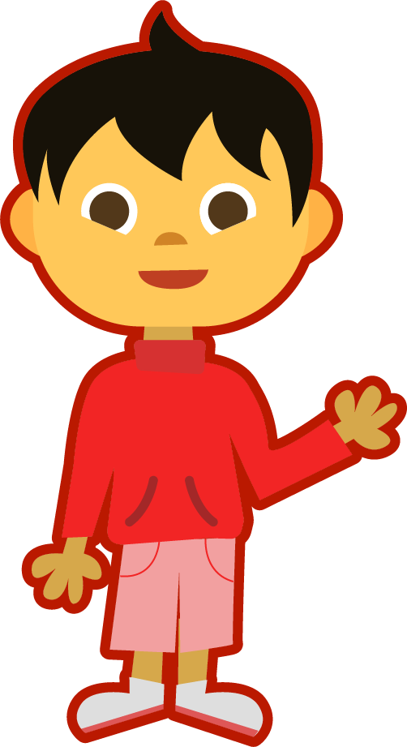
This Week’s Words
Do you know what they all mean?
What do the words have in common?
ambitious
melodious
infectious
various
fictitious
glorious
nutritious
victorious
cautious
mysterious
This week’s words have similar sounding endings.
Can you see two different word endings?

Slide 4
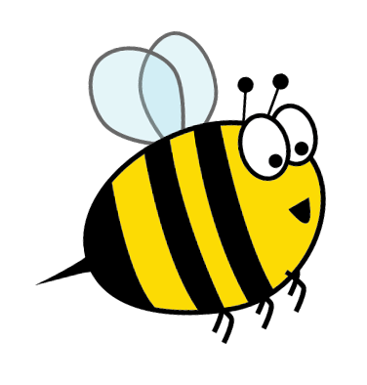
Words ending ‘-tious’
Look closely; words with a /shus/ sound end with ‘-tious’. The noun form of these words ends in ‘-tion’.
Which of this week’s words does this apply to?
noun form
adjective form
Can you turn these noun forms into this week’s words?
infection
infectious
caution
cautious
ambition
ambitious
nutrition
nutritious
The suffix ‘-tious’ means ‘full of’ or ‘having’.
So, ‘cautious’ means ‘full of caution’.
fiction
fictitious

Slide 5
Words ending ‘-ious’
The remainder of this week’s words end in ‘-ious’. This word ending sounds like /ee/ - /us/.
In this week’s words, the noun form ends in ‘y’, which is removed when the ‘-ious’ ending is added.
noun form
adjective form
Can you turn these noun forms into this week’s words?
melody
melodious
variety
various
glory
glorious
victory
victorious
The suffix ‘-ious’ means ‘full of’ or ‘having’.
So, ‘victorious’ means ‘full of victory’.
mystery
mysterious

Slide 6
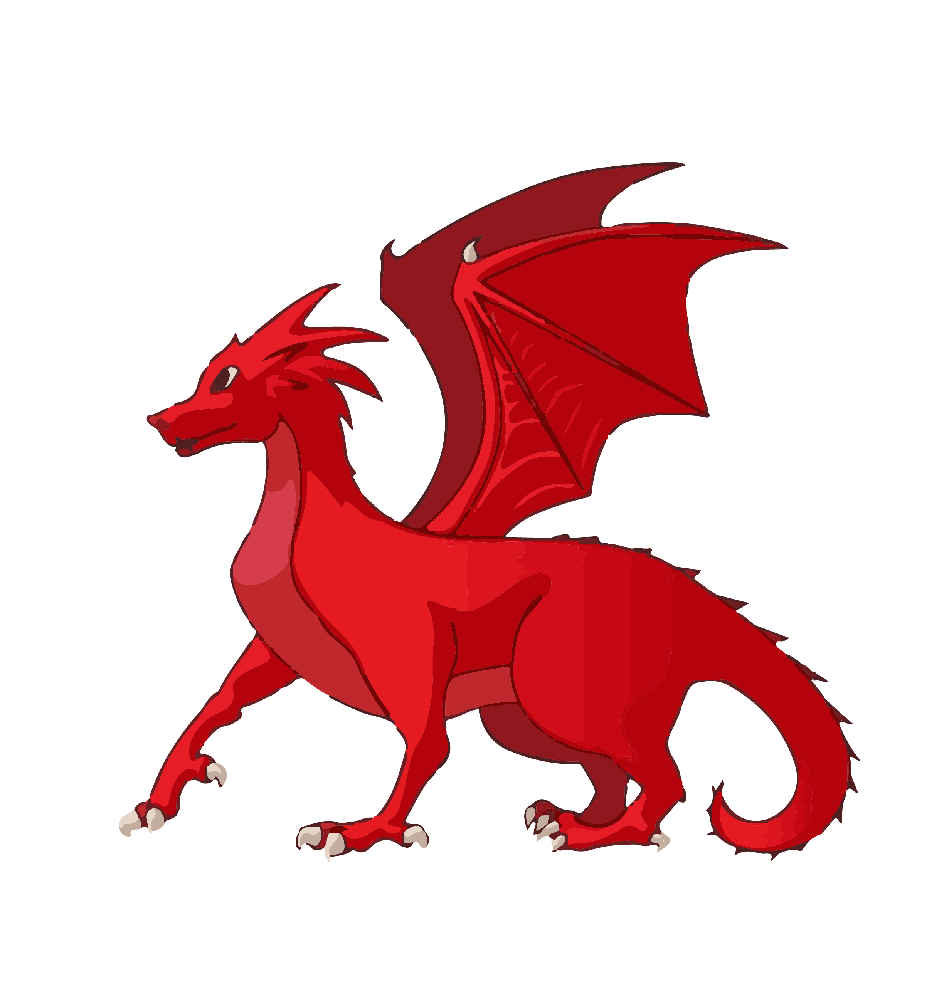
Etymology
Which of this week’s word is being described?
Clue 1 - In the 1610s, it had the meaning ‘artificial or counterfeit’.
Clue 2 - In the 1620s, it had the meaning ‘existing only in imagination’.
Clue 3 - Today this word means ‘something that is false or that does not exist.’
Clue 4 - It is from the Medieval Latin word ficticius and is related to the word ‘figment’ as in ‘a figment of your imagination’, and also ‘feigned’ and ‘false’.
fictitious

Slide 7
Morphology Matrix
How many new words can you create?
Prefix
Base Word
Suffix
s
un
infect
(to make a disease or an illness spread to other people)
tious*
re
ed
super
ing
dis
tion*
s
Possible Answers: uninfected, reinfect, reinfects, reinfected, reinfecting, reinfection, reinfections, superinfected, superinfection, superinfections, disinfect, disinfects, disinfected, disinfecting, disinfection, infects, infectious, infected, infecting, infection, infections
Notes:
* Here the ‘t’ from the base word is removed before the suffix is added.

Slide 8
Syllable Count
How many syllables are in each word?
ambitious
melodious
infectious
various
3
4
3
3
fictitious
glorious
nutritious
victorious
3
3
3
4
cautious
mysterious
2
4
I think there are
more words with three syllables. How many
words have four syllables?
2
3
4
Notes:
Click on the numbers to reveal.

Slide 9
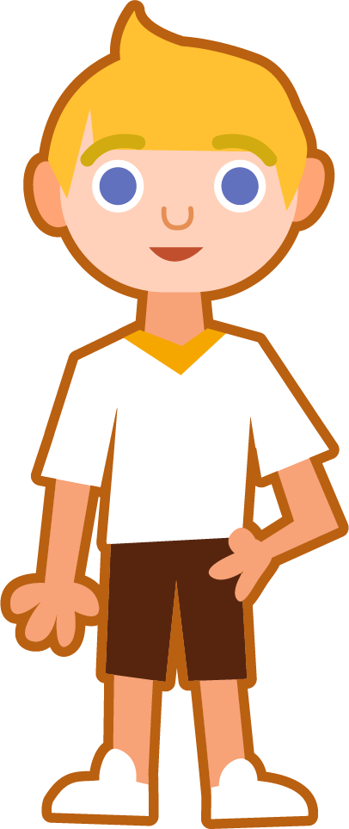
Sound Buttons and Syllables
Syllables are separated by long syllable breaks.
.
melodious
Draw a dot
below each single
letter sound. Use red sound buttons to show the adjacent consonants. When two or more letters represent one sound, we use a line.
me|lo|di|ous
4
infectious
victorious
various
in|fec|tious
3
vic|to|ri|ous
4
var|i|ous
3

Slide 10
Word Maps
Read the word. Write each word out, drawing long lines for the syllable breaks. Then write the noun form for each word.
Words | Syllable Breaks | Noun Form
infectious
victorious
glorious
ambitious
cautious
various
nutritious
melodious
fictitious
mysterious

Slide 11
Word Maps
Answers
Words | Syllable Breaks | Noun Form
infectious | in|fec|tious | infection
victorious | vic|to|ri|ous | victory
glorious | glo|ri|ous | glory
ambitious | am|bi|tious | ambition
cautious | cau|tious | caution
various | var|i|ous | variety
nutritious | nu|tri|tious | nutrition
melodious | me|lo|di|ous | melody
fictitious | fic|ti|tious | fiction
mysterious | mys|te|ri|ous | mystery

Slide 12
Missing Words
Can you identify the missing words in these sentences?
infectious
victorious
glorious
ambitious
cautious
various
nutritious
melodious
fictitious
mysterious
“All the people and events in my novel are __________,” declared the author.
Flu is highly __________, so please cover your mouth if you cough or sneeze.
The music by that composer is always so __________.
They had three weeks of __________ weather.
The rugby team were certain they would emerge __________.
He had given __________ speeches about how driven and __________ he was.
Fruit is a great choice when making a delicious and __________ smoothie.
The children were __________ as they searched for the __________ treasure.

Slide 13
Missing Words
Answers
fictitious
infectious
victorious
glorious
ambitious
cautious
various
nutritious
melodious
fictitious
mysterious
“All the people and events in my novel are __________,” declared the author.
infectious
Flu is highly __________, so please cover your mouth if you cough or sneeze.
melodious
The music by that composer is always so __________.
They had three weeks of __________ weather.
glorious
victorious
The rugby team were certain they would emerge __________.
various
ambitious
He had given __________ speeches about how driven and __________ he was.
nutritious
Fruit is a great choice when making a delicious and __________ smoothie.
cautious
The children were __________ as they searched for the __________ treasure.
mysterious

Slide 14
In a Sentence
Write a sentence about the pictures below.
Remember to include the word in your sentence.
melodious
fictitious
cautious
mysterious

Slide 15
Missing Words
Read the sentences and replace the
missing word with one of the blue words.
infectious
various
glorious
victorious
nutritious
ambitious
Amie packed ____________ things for her holiday.
Fruits and vegetables are very ____________.
The city came out to welcome back its ____________ team.
We sat on the beach and gazed at the ____________ sunset.
My aunt studies ____________ diseases.
The plans for the new school library were very ____________.

Slide 16
In a Sentence
Possible Answers
melodious
fictitious
The singer had a beautifully melodious voice.
I love to write stories containing fictitious animals, such as unicorns.
cautious
mysterious
Molly was always cautious when walking by the pond.
Peter could hear a mysterious noise coming from the kitchen.

Slide 17
Missing Words
Answers
infectious
various
glorious
victorious
nutritious
ambitious
Amie packed ____________ things for her holiday.
Fruits and vegetables are very ____________.
The city came out to welcome back its ____________ team.
We sat on the beach and gazed at the ____________ sunset.
My aunt studies ____________ diseases.
The plans for the new school library were very ____________.
various
nutritious
victorious
glorious
infectious
ambitious

Slide 18
Definition
In a Sentence
cautious
Synonyms
Antonyms

Slide 19
Definition
In a Sentence
Being careful about what you say or do.
The children were cautious when they crossed the street.
cautious
Synonyms
Antonyms
careful, wary, watchful, guarded
careless, reckless, thoughtless, inattentive

Slide 20
Which word?
Which of this week’s words begin with the letter ‘a’?
ambitious

Slide 21
Which word?
Which word means ‘invented by somebody rather than true’?
fictitious

Slide 22
Which word?
infection
infectious
Can you turn these noun forms into this week’s words?
caution
cautious
nutrition
nutritious

Slide 23
Which word?
melody
melodious
Can you turn these noun forms into this week’s words?
variety
various
glory
glorious
victory
victorious
mystery
mysterious

Slide 24
Definition
In a Sentence
Synonyms
Antonyms

Slide 25
Morphology Matrix
How many new words can you create?
Prefix
Base Word
Suffix

Slide 26
Word cards for Independent Extended Learning
ambitious | melodious | infectious | various | victorious
fictitious | glorious | nutritious | mysterious | cautious

Slide 27
Sorting Mat
Can you sort the words according to the suffix?
-tious
-ious

Slide 28
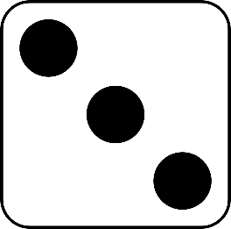
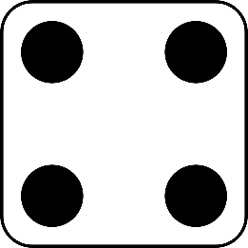
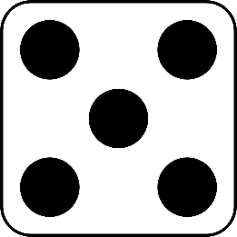
Roll and Read
Play with a partner. You will need a die and two different-coloured counters.
Take it in turns to roll a die.
Whichever number you land on, read a word from that column.
If you are correct, put a counter over the word.
The first person to get four counters in a row wins.
ambitious | melodious | infectious | various | victorious | fictitious
glorious | nutritious | mysterious | cautious | ambitious | melodious
various | infectious | fictitious | victorious | glorious | nutritious
cautious | mysterious | melodious | infectious | various | ambitious

Slide 29
Optional Activity One
Add the correct vowels to make this week’s words.
a
i
i
o
u
a
u
i
o
u
_ m b _ t _ _ _ s
c _ _ t _ _ _ s
o
i
o
u
a
i
o
u
g l _ r _ _ _ s
v _ r _ _ _ s
i
o
i
o
u
e
i
o
u
v _ c t _ r _ _ _ s
m y s t _ r _ _ _ s
u
i
i
o
u
i
e
i
o
u
n _ t r _ t _ _ _ s
_ n f _ c t _ _ _ s
e
o
i
o
u
i
i
i
o
u
m _ l _ d _ _ _ s
f _ c t _ t _ _ _ s

Slide 30
Optional Activity Two
Can you sort the words according to the number of syllables?
ambitious
melodious
infectious
various
fictitious
cautious
glorious
nutritious
victorious
mysterious
2 Syllables
3 Syllables
4 Syllables
infectious
nutritious
melodious
cautious
ambitious
victorious
glorious
various
mysterious
fictitious

Slide 31
Optional Activity Three
Which word matches each description?
Sounding musical.
Very good for you.
Being triumphant.
melodious
nutritious
victorious
Determined to succeed.
Several different options.
Not factual, imaginary.
Likely to spread a disease.
ambitious
various
fictitious
infectious
Bringing fame or admiration.
Difficult to understand or explain; strange.
Being careful to avoid danger.
glorious
mysterious
cautious

Slide 32
Optional Activity Four
Can you unscramble the words?
Digraphs have been kept together and underlined.
g r i o u s l o
o u n e t i s i f c
t t i u o u s n r i
b i o u s m t i a
glorious
infectious
nutritious
ambitious
l d o u s m i o e
v r i o u s a
y t m i o u s r s e
t i o u s c a u
melodious
various
mysterious
cautious
i t r i o u v o s c
f c t i o u i s i t
victorious
fictitious

