Slide 1
4
2
To use knowledge of common prefixes, suffixes and word origins, to spell more complex words
To spell words with the prefixes ‘in-’ and ‘sub-’
This week’s words: inactive, incorrect, indefinite, inadequate, invisible, subheading, subject, submarine, submerge, subtropical

Slide 2
Starter
Which of last week’s words matches the description?
A flying vehicle with wings.
Apart from, not including.
plane
except
The sun, wind, rain and fog, etc.
weather
Used to tie together
rope or string.
To say yes or receive
something willingly.
knot
accept

Slide 3





Starter
Which of last week’s words matches the picture?
piece
not
whether
peace
plain

Slide 4


This Week’s Words
Do you know what they all mean?
What do the words have in common?
inactive
incorrect
invisible
submarine
subject
indefinite
subtropical
submerge
subheading
inadequate
This week’s words have the prefixes ‘in-’ or ‘sub-’.
In these words, what do the prefixes mean?
How do they change the meaning of the base word?

Slide 5

Irregular Spelling Pattern
Why might ‘inactive’, ‘indefinite’ and
‘inadequate’ be tricky to sound out?
✗
inactive
indefinite
inadequate
✓
inactive
indefinite
inadequate
These words look like they have a split digraph at the end. However, they lack the long vowel sounds produced by a split digraph.
Words ending ‘ve’ with no split digraph
Words ending ‘te’ with no split digraph
have
love
give
remove
shove
negative
positive
pirate
accurate
opposite
private
granite
chocolate
Instead, it is the last two letters together which produce the final phoneme.

Slide 6
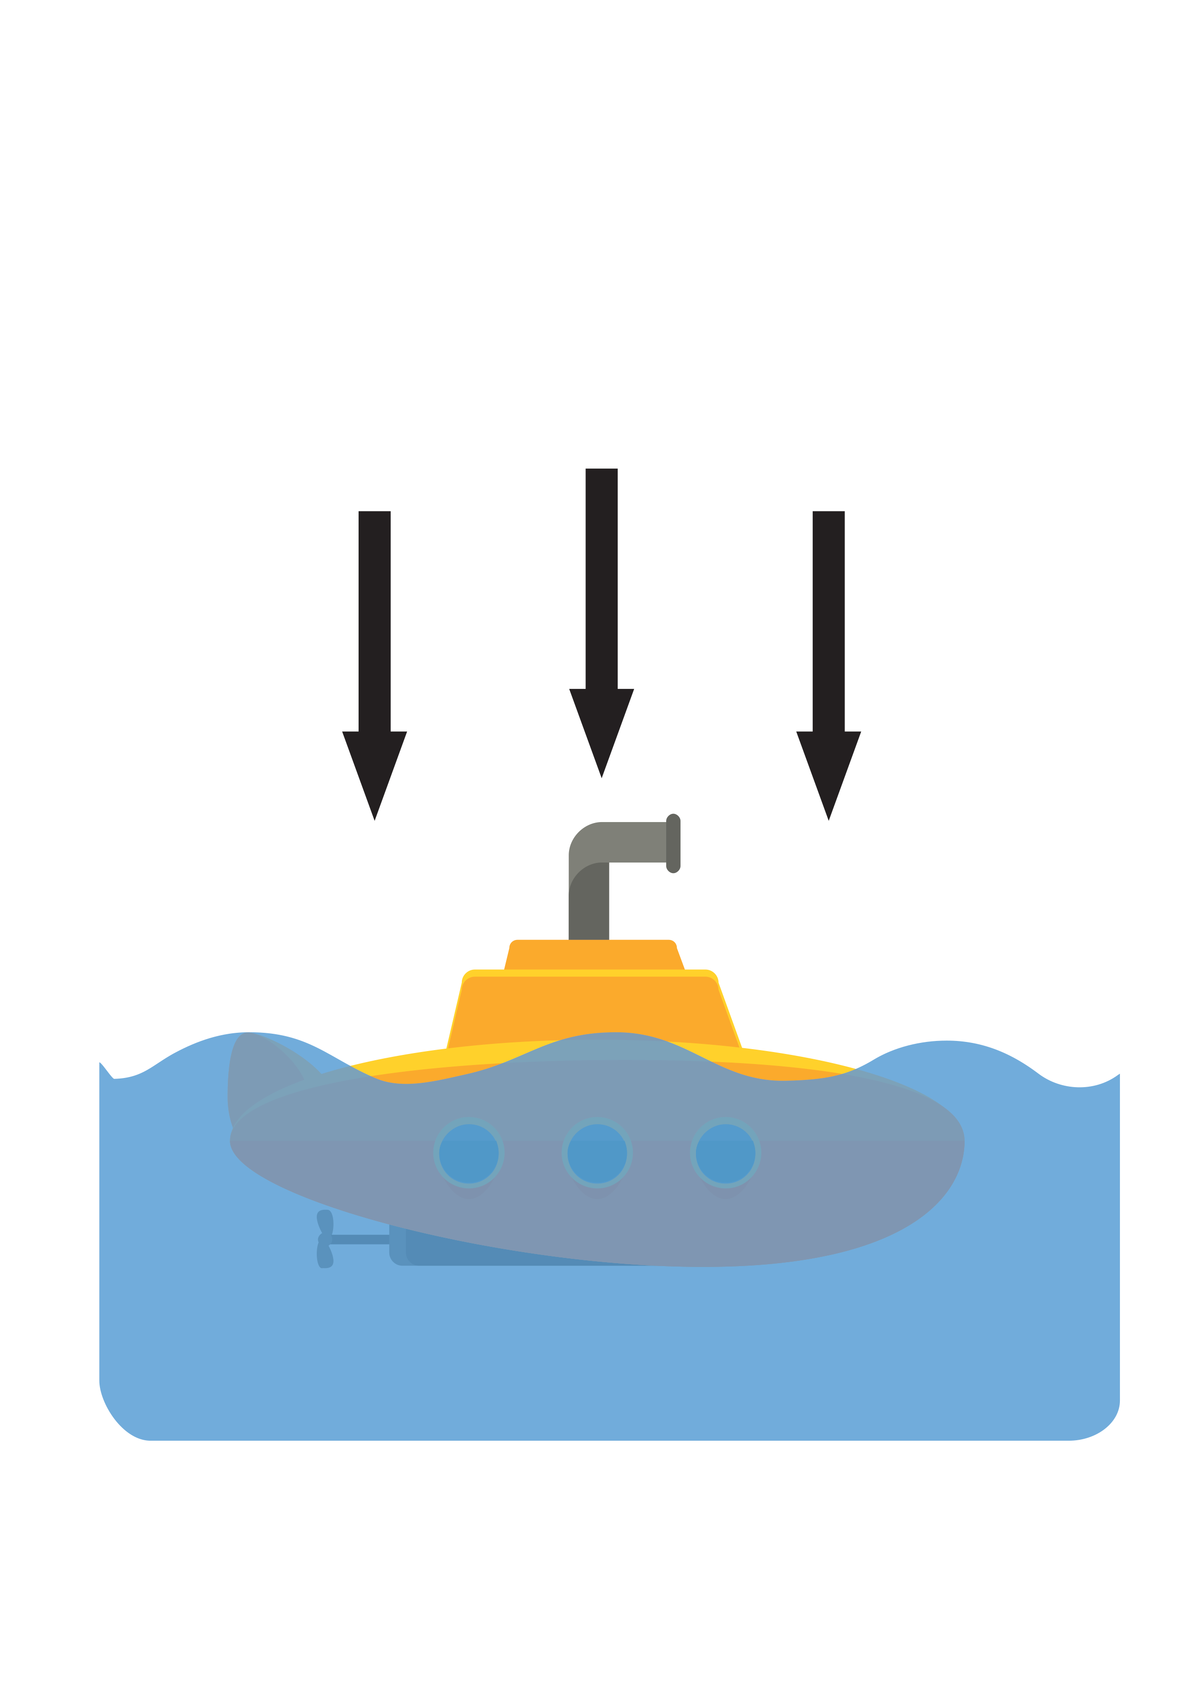

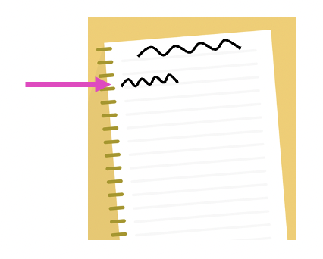
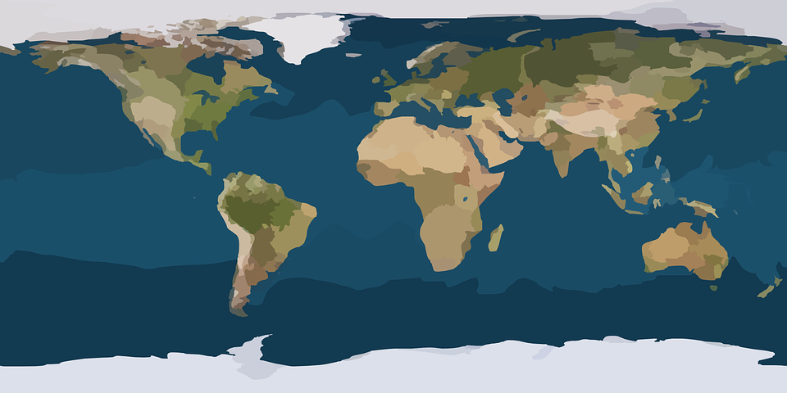
Word Meanings
In this week’s words, the prefix ‘sub-’ means ‘under or beneath’.
subject
submarine
subheading
The knowledge ‘which lies beneath’.
A vehicle capable of travelling deep underwater.
A heading underneath the main heading in writing.
subtropical
Subtropical region
Tropical region
A region that is near the tropical parts of the world.
submerge
Equator
Tropical region
To put into a liquid or to go below the surface of the water.
Subtropical region

Slide 7

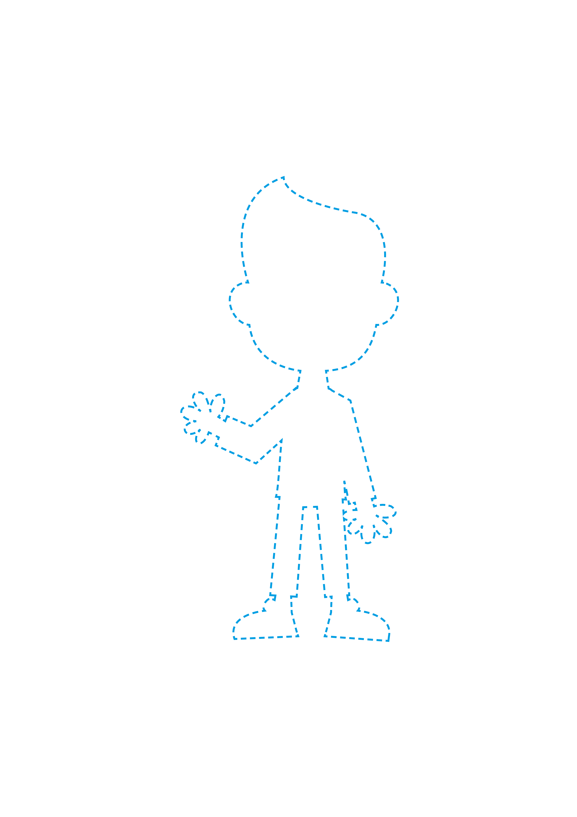
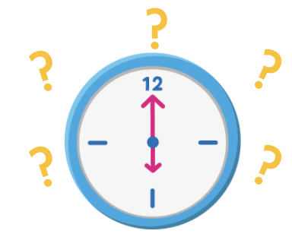

Word Meanings
In this week’s words, the prefix ‘in-’ means ‘not’.
inadequate
inactive
Below the expected standard or poor quality.
Not active; passive or sluggish.
invisible
incorrect
indefinite
Not able to be seen.
Not correct; wrong.
Not having fixed time limits.

Slide 8
Etymology
invisible
‘Invisible’ derives from the Old French word invisible, meaning ‘not perceptible, incapable of being seen’.
Videre gives us the
following words:
view - the act of looking at or seeing. Also, the area that can be seen from a particular point.
vision - the ability to see.
provide - to give what is needed for the future; to ‘look ahead’, and act with foresight.
evident - easily seen; clear.
It is from the Latin word invisibilis,
meaning ‘unseen, not visible’.
invisible
Latin prefix in
meaning ‘not’.
From Latin visibilis meaning
‘that may be seen’.
Visibilis comes from the Latin word videre which means ‘to see.’

Slide 9

Word Sort
Can you sort this week’s words by the number of syllables?
inactive
incorrect
invisible
submarine
Which
box will have the fewest words?
indefinite
subheading
inadequate
subtropical
subject
submerge
2 Syllables
3 Syllables
4 Syllables

Slide 10



Sound Buttons and Syllables
inactive
.
Syllables are separated by long syllable breaks.
Draw a dot
below each single
letter sound. Use red sound buttons to show the adjacent consonants. When two or more letters represent one sound, we use a line.
in|ac|tive
3
inadequate
submerge
subheading
in|ad|e|quate
4
sub|merge
2
sub|head|ing
3

Slide 11
Word Maps
Read each word and break it into syllables, drawing long lines for the syllable breaks. Write each word again adding the sound buttons for each phoneme. Finally, write the word out again.
Words | Syllable Breaks | Sound Buttons | My Word
invisible
subject
indefinite
submarine
inadequate

Slide 12
Word Maps
Answers
Words | Syllable Breaks | Sound Buttons | My Word
invisible | in|vis|i|ble | invisible | invisible
subject | sub|ject | subject | inflexible
indefinite | in|def|i|nite | indefinite | indefinite
submarine | sub|ma|rine | submarine | inadequate
inadequate | in|ad|e|quate | inadequate | inadequate

Slide 13
Alphabetical Order and Sentences
Put this week’s words in alphabetical order. Then write a sentence about
the pictures below. Remember to include the word in your sentence.
Alphabetical Order
incorrect
submarine

Slide 14
Alphabetical Order and Sentences
Answers
Alphabetical Order
inactive
I wrote the incorrect date in my book.
inadequate
incorrect
indefinite
incorrect
invisible
subheading
The submarine sailed deep under the
ice cap.
subject
submarine
submerge
submarine
subtropical

Slide 15
In a Sentence
Write a sentence about the pictures below.
Remember to include the word in your sentence.
subheading
incorrect
invisible
submarine

Slide 16
Missing Words
Read the sentences and replace the
missing word with one of the blue words.
inadequate
indefinite
subject
submerge
inactive
subtropical
Geography is the ____________ I like the most.
The crocodile began to ____________ as it waited for its prey.
We will be living here for an ____________ amount of time.
The volcano has been ____________ for 100 years.
The parking facilities are totally ____________.
____________ regions are cooler than equatorial regions.

Slide 17
In a Sentence
Answers
subheading
incorrect
I underlined the subheading with a ruler.
I wrote the incorrect date in my book.
invisible
submarine
The wind is invisible, but you can feel it.
The submarine sailed deep under the
ice cap.

Slide 18
Missing Words
Answers
inadequate
indefinite
subject
submerge
inactive
subtropical
Geography is the ____________ I like the most.
The crocodile began to ____________ as it waited for its prey.
We will be living here for an ____________ amount of time.
The volcano has been ____________ for 100 years.
The parking facilities are totally ____________.
____________ regions are cooler than equatorial regions.
subject
submerge
indefinite
inactive
inadequate
Subtropical

Slide 19
Definition
In a Sentence
incorrect
Words which also have the prefix ‘in-’ meaning ‘not’
(not this week’s words)
Antonyms
Synonyms

Slide 20
Definition
In a Sentence
I dialled the incorrect phone number.
Not correct; wrong.
incorrect
Words which also have the prefix ‘in-’ meaning ‘not’
(not this week’s words)
Antonyms
accurate, correct, precise, valid, true
false,
inaccurate,
mistaken, untrue
inability, inelegant,
inflexible, inconsistent
Synonyms

Slide 21

Word Spotter
Clap your hands when you see one of this week’s words.
weather
except
knot
peace
plain
subject
submarine
subheading
indefinite
inactive
plane
piece
accept
incorrect
invisible
submerge
inadequate
subtropical

Slide 22
Definition
In a Sentence
Synonyms
Antonyms

Slide 23
Sorting Mat
Can you sort this week’s words according to the prefix?
‘in-’ prefix
‘sub-’ prefix

Slide 24
Word cards for Independent Extended Learning
inactive | indefinite | incorrect | subheading | subject
submarine | submerge | subtropical | inadequate | invisible

Slide 25

Picture cards for Independent Extended Learning

Slide 26
Optional Activity One
Add the correct prefix to make this week's words.
merge
correct
visible
marine
submerge
incorrect
invisible
submarine
definite
heading
adequate
tropical
indefinite
subheading
inadequate
subtropical
ject
active
subject
inactive

Slide 27
Optional Activity Two
Which word matches the picture or definition?
Not moving.
To push under water.
inactive
submerge
Not perceptible by the eye.
Having no ending.
invisible
Not right.
submarine
indefinite
incorrect
subtropical
subheading
inadequate
subject

Slide 28
Optional Activity Three
How many syllables does each word have?
Add the syllable breaks to help you. Each syllable should contain a vowel sound.
inactive
incorrect
indefinite
inadequate
in|ac|tive
3
in|cor|rect
3
in|def|i|nite​
4
in|ad|e|quate
4​
invisible
subheading
subject
in|vis|i|ble
4​
sub|head|ing
3​
sub|ject
2
submarine
submerge
subtropical
sub|ma|rine
3​
sub|merge
2
sub|trop|i|cal
4

Slide 29
Optional Activity Four
Write a sentence for each sentence pair.
inactive, submarine
The submarine was inactive.
incorrect, subheading
The subheading I used in my writing was incorrect.
invisible, submerge
When I submerge the bowl, it becomes invisible.
inadequate, subtropical
The bank vault on the subtropical island was inadequate.
indefinite, subject
The time available to learn the new subject was indefinite.

