Slide 1
4
1
To read and write homophones and know how to use context to identify the correct spelling
To spell words that are homophones or near homophones
This week’s words: accept, except, knot, not, peace, piece, plain, plane, weather, whether

Slide 2
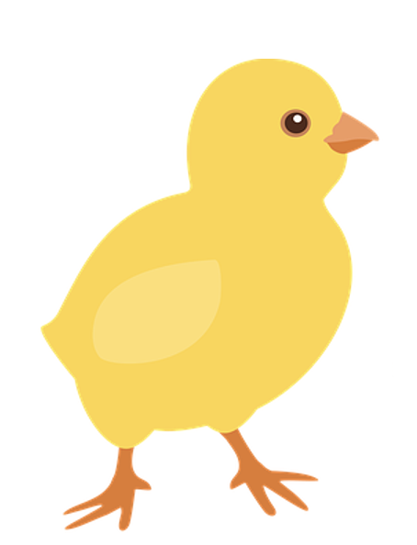
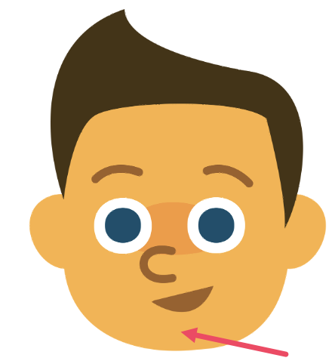
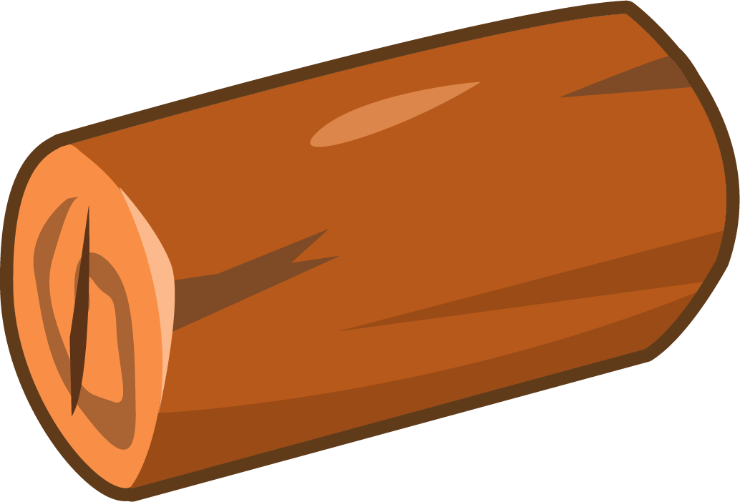
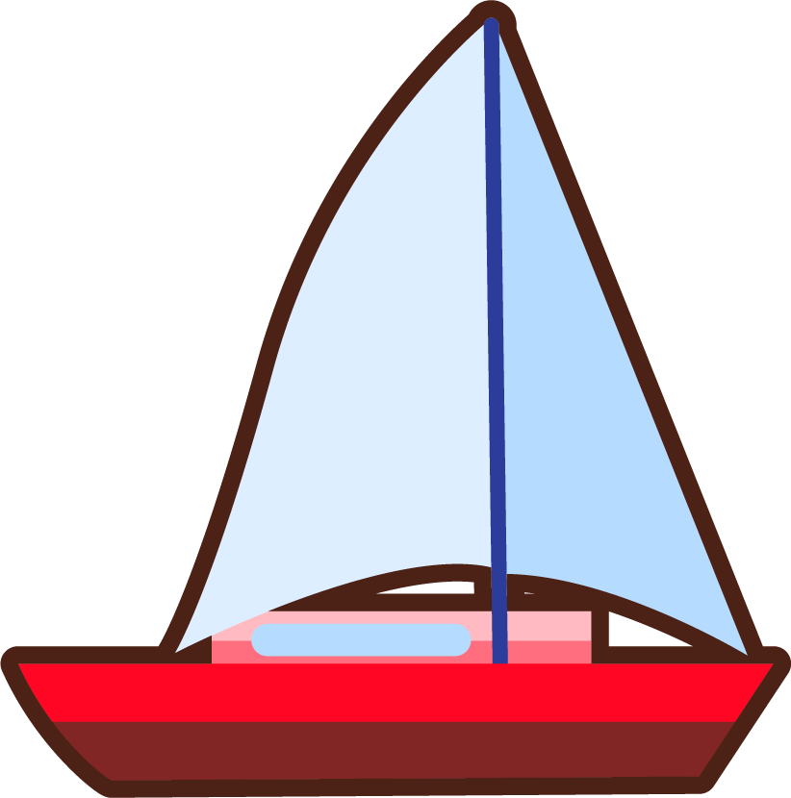
Starter
Climb the ladder by swapping one sound
each time to create a different word.
c k
c h i _ _
n
c h i _
i
c h _ p
c h
_ _ o p
o
s h _ p
ship

Slide 3
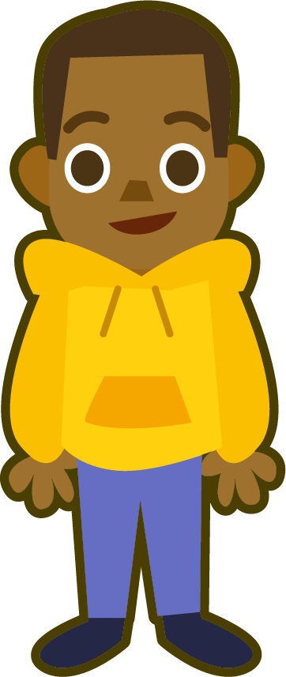
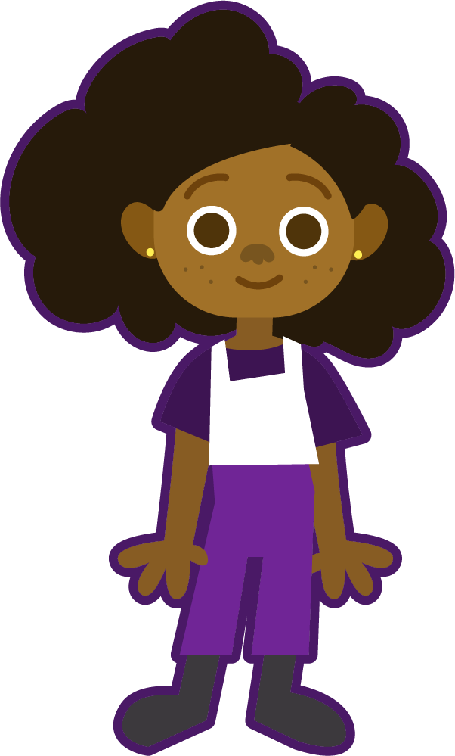
This Week’s Words
Do you know what they all mean?
What do they have in common?
accept
piece
weather
not
accept
piece
weather
not
plane
knot
plain
plane
knot
plain
peace
peace
except
whether
except
whether
This week’s words are all homophones
or near homophones.
Homophones sound the same (or nearly the same) as another word but have different meanings and spellings.
Can you find
the pairs of homophones or near homophones?

Slide 4
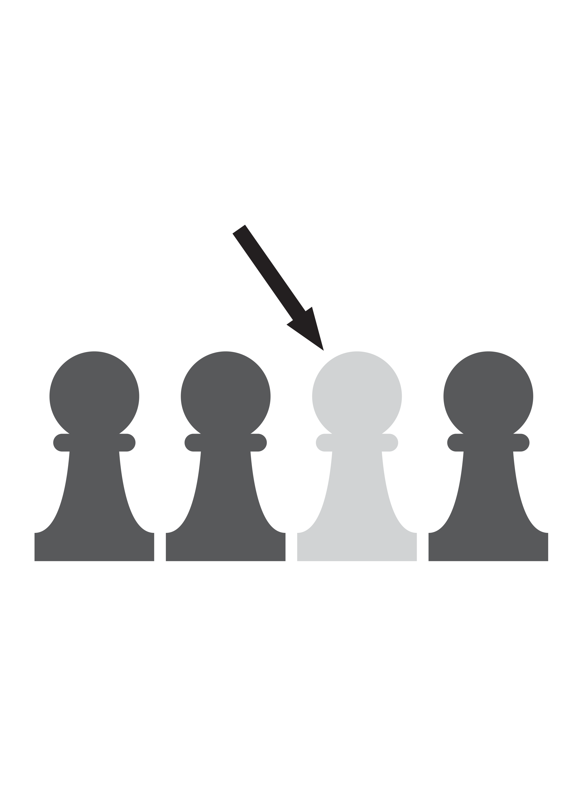
Word Meanings
Let’s look at what this week’s words mean.
accept
vs
except
knot
vs
not
To say yes or receive something willingly.
Used to tie together rope or string.
In no way, never.
Apart from, not including.
Notes:
Click on the meanings to find out which word it belongs to.

Slide 5
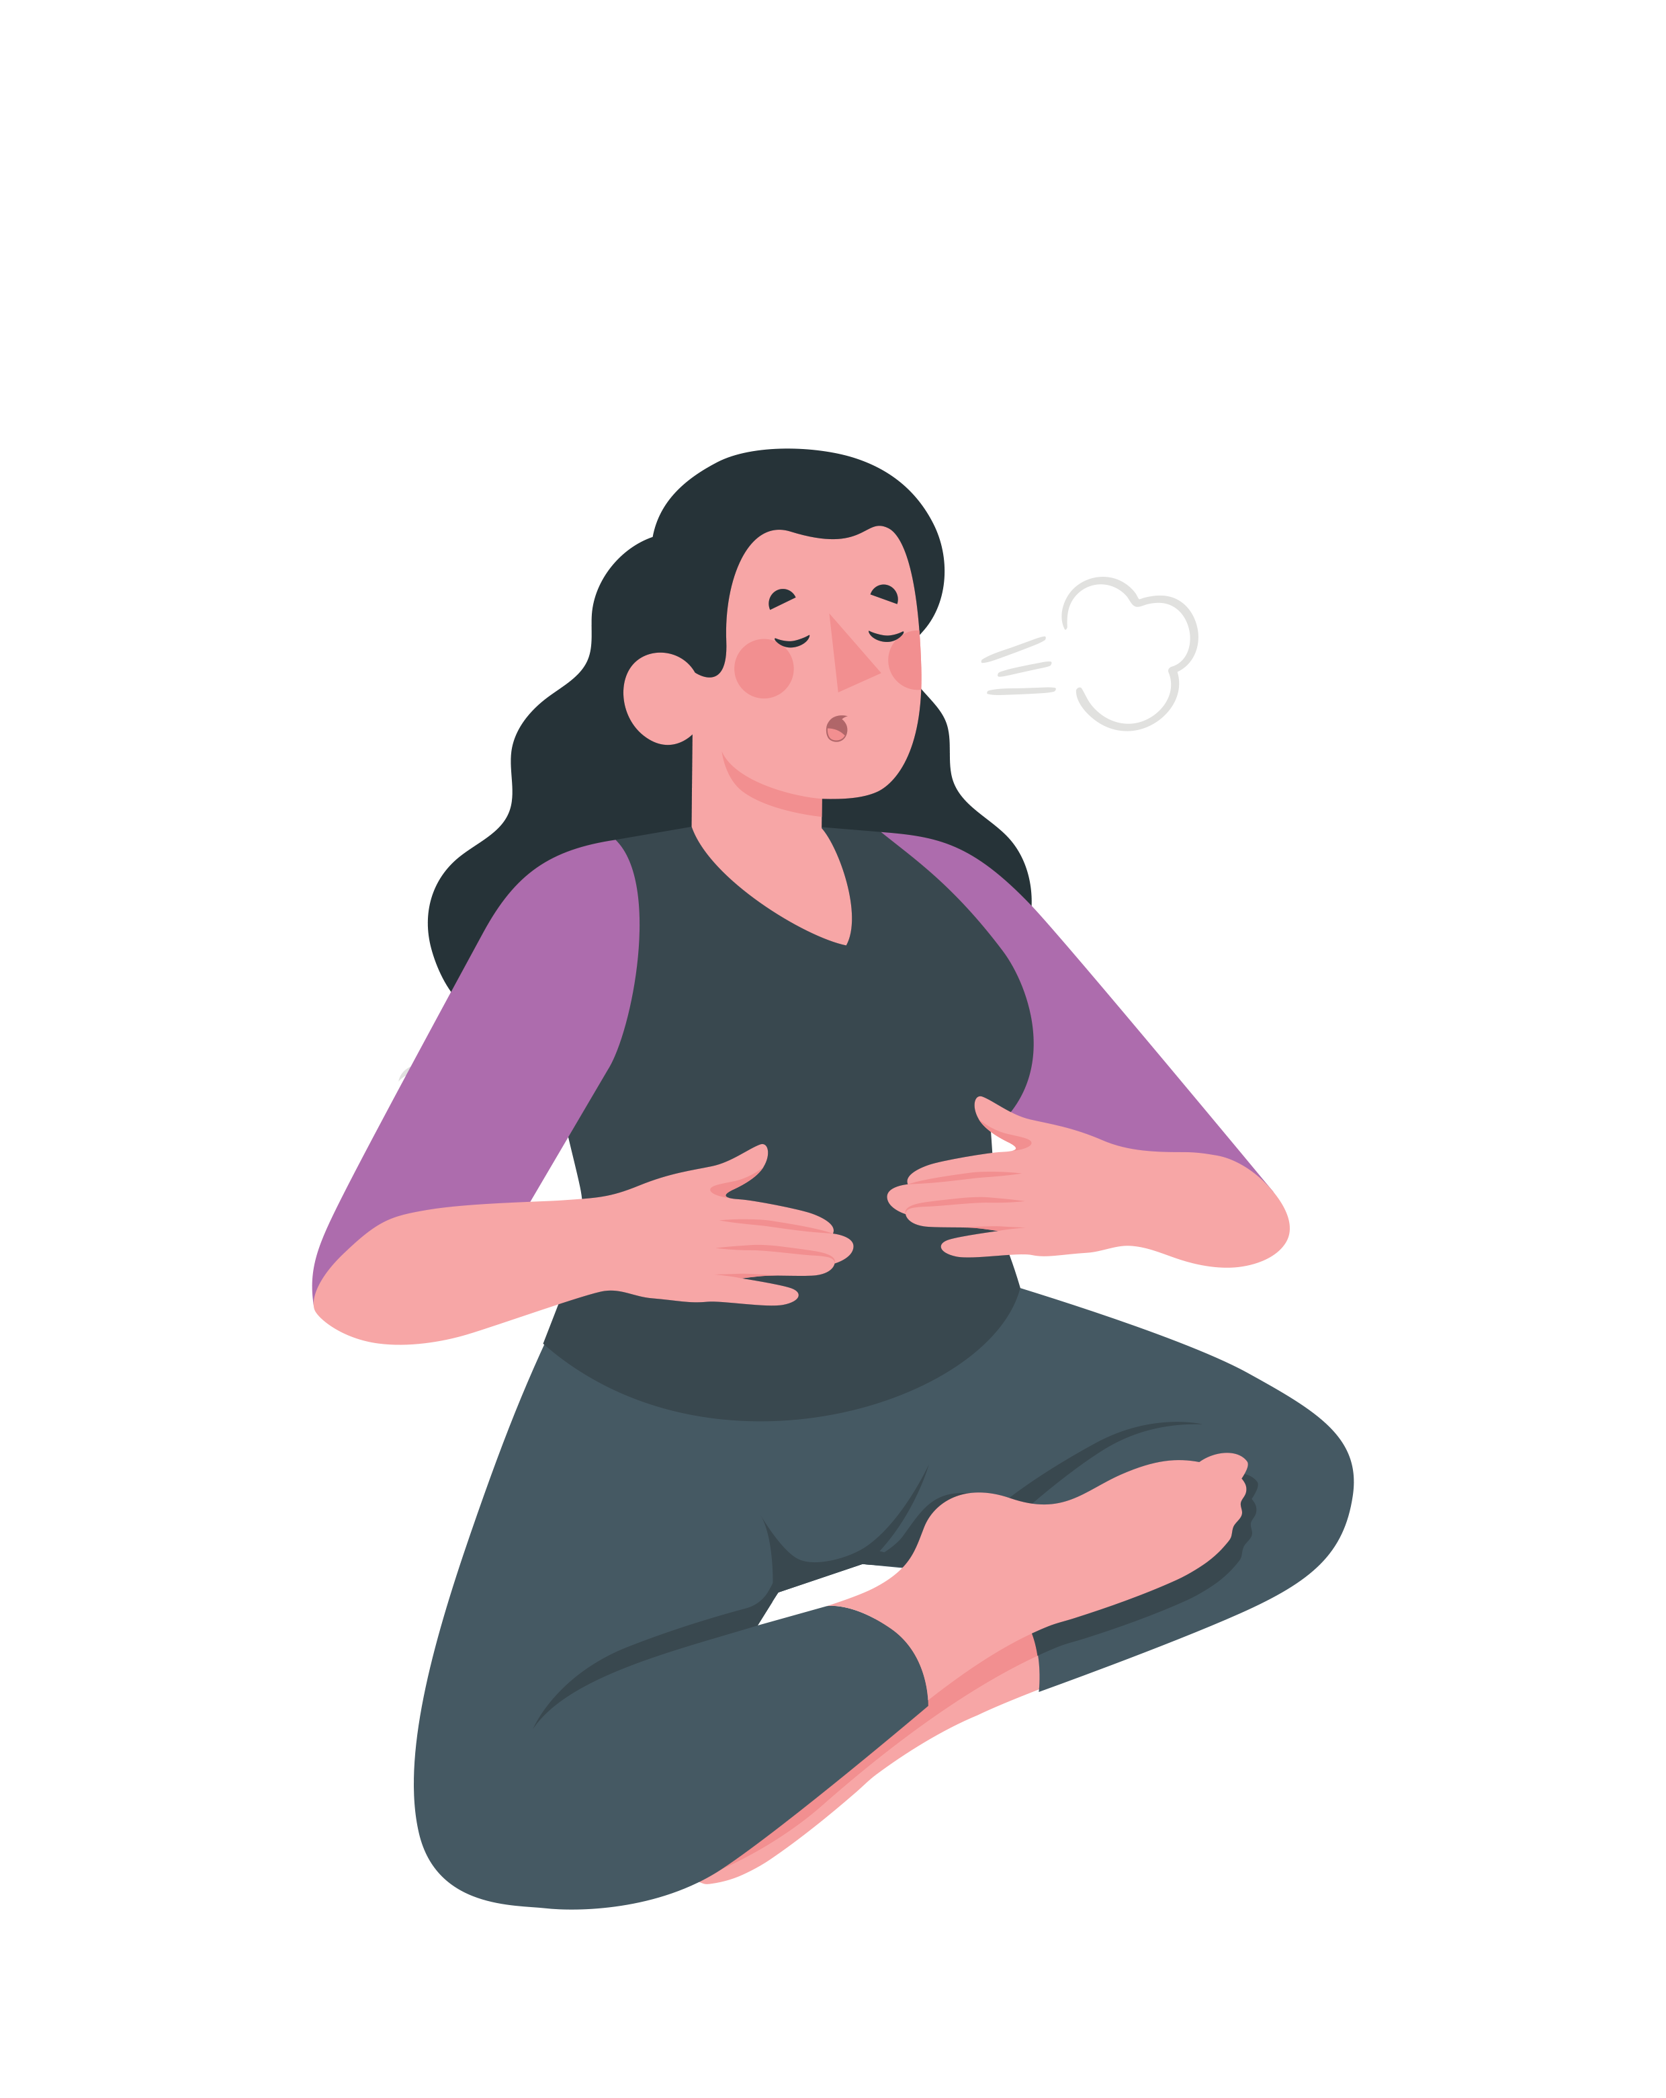
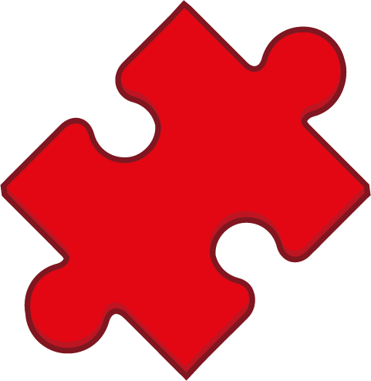
Word Meanings
Let’s look at what this week’s words mean.
peace
vs
piece
plain
vs
plane
A flying vehicle
with wings.
A small section or part of a whole.
A feeling of calm and quiet.
Blank; very simple in style.
Notes:
Click on the meanings to find out which word it belongs to.

Slide 6
Word Meanings
Let’s look at what this week’s words mean.
weather
vs
whether
Used to express a doubt or choice between two possibilities.
The sunshine, wind, rain, temperature and clouds.
Notes:
Click on the meanings to find out which word it belongs to.

Slide 7
Etymology
peace
Peace can be a state or feeling of calm and quiet or a state without fighting or war.
In the mid-1100s, the word pes meant ‘freedom from civil disorder, internal peace of a nation’.
From the Old French word pais, meaning ‘peace, reconciliation, silence, permission’.
The sense of ‘spiritual peace of the heart, soul or conscience; peace of mind’ dates from around 1200.

Slide 8
Word Sort
Can you sort our new words according to the number of syllables?
plain
except
weather
knot
piece
peace
not
accept
whether
plane
1 Syllable
2 Syllables
What is the most common number of syllables?

Slide 9
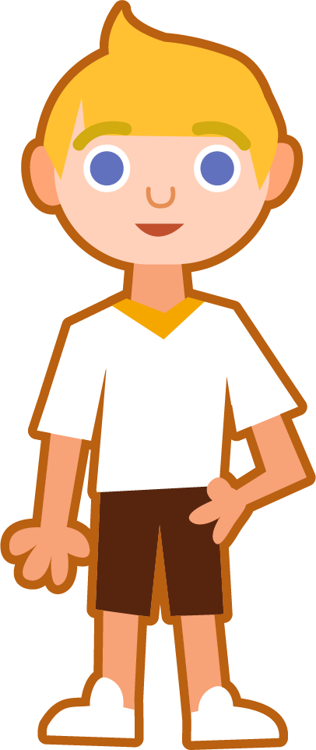
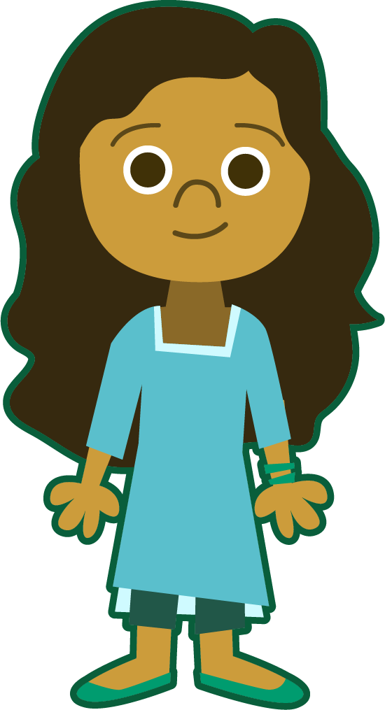
Sound Buttons and Syllables
weather
.
Syllables are separated by long syllable breaks.
Draw a dot below
each single letter sound. Use red sound buttons to show the adjacent consonants. When two or more letters represent one sound, we use a line. A split digraph is shown using underlined letters joined
by a curved line.
weath|er
2
peace
whether
plane
peace
1
wheth|er
2
plane
1

Slide 10
Word Maps
Read each word and break it into syllables, drawing long lines for the syllable breaks. Write each word again adding the sound buttons for each phoneme. Finally, write the word out again.
Words | Syllable Breaks | Sound Buttons | My Word
weather
piece
whether
knot
accept

Slide 11
Word Maps
Answers
Words | Syllable Breaks | Sound Buttons | My Word
weather | weath|er | weather | weather
piece | piece | piece | piece
whether | wheth|er | whether | whether
knot | knot | knot | knot
accept | ac|cept | accept | accept

Slide 12
Which Word?
Write the correct homophone to match the picture. Then choose
the correct homophone for each sentence and write it on the line.
I used a plain/plane piece of paper to sketch the landscape.
Imogen was deciding weather/whether or not she should go to the party.
All classes went swimming accept/except Year 1.
Think carefully because the homophones have different meanings.
Each child ate a piece/peace of fruit at break time.
My shoelaces were tied in a double not/knot.

Slide 13
Which Word?
Answers
accept
not
plane
peace
weather
plain
I used a plain/plane piece of paper to sketch the landscape.
whether
Imogen was deciding weather/whether or not she should go to the party.
except
All classes went swimming accept/except Year 1.
piece
Each child ate a piece/peace of fruit at break time.
knot
My shoelaces were tied in a double not/knot.

Slide 14
In a Sentence
Write a sentence to match each picture.
Remember to include the word in your sentence.
knot
not

Slide 15
Alphabetical Order and Word Meanings
Put this week’s words in alphabetical order. Then choose three
words and write the meaning and a sentence for each one.
Alphabetical Order
Word | Meaning | In a Sentence

Slide 16
In a Sentence
Possible Answers
knot
not
I struggled to undo the knot
in my shoelaces.
“That is not what I meant,” complained Jenna.

Slide 17
Alphabetical Order and Word Meanings
Answers
Alphabetical Order
Word | Meaning | In a Sentence
weather | The sunshine, wind, rain, temperature and clouds. | Sports Day was called off because the weather was so bad.
plane | A vehicle that flies through the air (short for aeroplane). | The pilot tried hard to guide the plane through the storm.
except | Apart from; not including. | Manny liked all vegetables except carrots.
accept
except
knot
not
peace
piece
plain
plane
weather
whether

Slide 18
Definition
In a Sentence
accept
Synonyms
Antonyms

Slide 19
Definition
In a Sentence
To agree to or
approve of something.
To take willingly something that is offered; to say ‘yes’ to an offer, invitation, etc.
The local charity shop will accept donations
of books and clothes.
accept
Synonyms
Antonyms
reject
decline
refuse
deny
take
allow
admit
get
obtain
welcome

Slide 20
Homophone Sentences
Which two homophones should be used to complete this sentence?
whether
Oliver wasn’t sure __________ the __________ was going to improve or not.
weather
whether
weather

Slide 21
Homophone Sentences
Which two homophones should be used to complete this sentence?
Mia drew a picture of a __________ on a __________ sheet of paper.
plane
plain
plane
plain

Slide 22
Homophone Sentences
Which two homophones should be used to complete this sentence?
Hudson felt at __________ as he placed down the last __________ of the jigsaw puzzle.
peace
piece
peace
piece

Slide 23
Homophone Sentences
Which two homophones should be used to complete this sentence?
I am __________ able to tie my shoelaces into a __________.
not
knot
not
knot

Slide 24
Homophone Sentences
Which two homophones should be used to complete this sentence?
Isla said that she would __________ all the parcels __________ one.
accept
except
accept
except

Slide 25
Definition
In a Sentence
Synonyms
Antonyms

Slide 26
Word cards for Independent Extended Learning
plain | peace | weather | knot | piece
except | accept | whether | not | plane

Slide 27
Picture cards for Independent Extended Learning

Slide 28
Optional Activity One
Write a sentence for each word pair.
accept, piece
I couldn't wait to accept a piece of cake.
The test went well, except for question four, which I could not answer.
except, not
weather, plane
The weather was so bad that our plane couldn't take off.
I will feel at peace when I have undone the knot in my shoelaces.
peace, knot
whether, plain
Peter was asked whether he needed plain or lined paper.

Slide 29
Optional Activity Two
How many sounds does each word have?
Add the word to a sound box to help you.
accept
except
knot
not
6
6
3
3
peace
piece
plain
plane
3
3
4
4
weather
whether
4
4

Slide 30
Optional Activity Three
How many syllables does each word have?
Draw in the syllable breaks to help you.
accept
except
knot
not
ac|cept
ex|cept
knot
not
2
2
1
1
peace
piece
plain
plane
peace
piece
plain
plane
1
1
1
1
weather
whether
wea|ther
whe|ther
2
2

Slide 31
Optional Activity Four
Can you unscramble the words?
Digraphs and trigraphs have been kept together and underlined.
o t k n
p c e i e
e a p c e
l n a i p
knot
piece
peace
plain
e r w h e t h
a-e l p n
t h w e r e a
whether
plane
weather
Which three words have no digraphs or trigraphs?
except
not
accept

