Slide 1
6
2
To use phonic knowledge of less-common grapheme-phoneme relationships to read and write increasingly complex words
To spell words where ‘y’ sounds like /i/
This week’s words: antonym, crystal, lyrics, mystery, cygnet, typical, symmetry, synchronise, Sydney, syllable

Slide 2
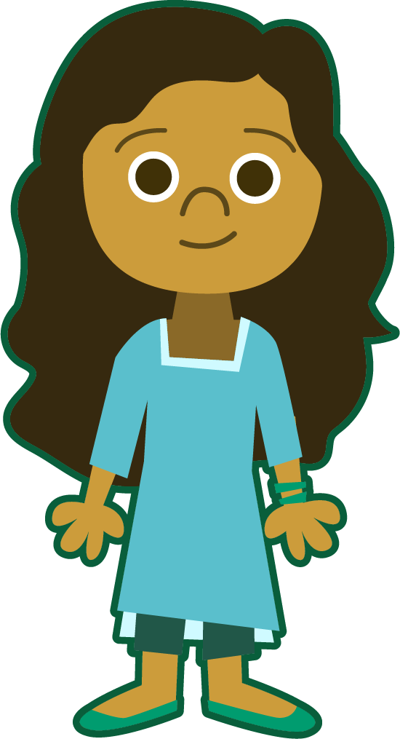
Starter
Can you put last week’s words in alphabetical order?
empty-handed
bad-tempered
green-eyed
cold-hearted
in-depth
empty-handed
man-eating
green-eyed
What should you do if any words start with the same letter?
bad-tempered
in-depth
little-used
know-it-all
old-fashioned
little-used
know-it-all
man-eating
cold-hearted
old-fashioned
stone-faced
stone-faced

Slide 3
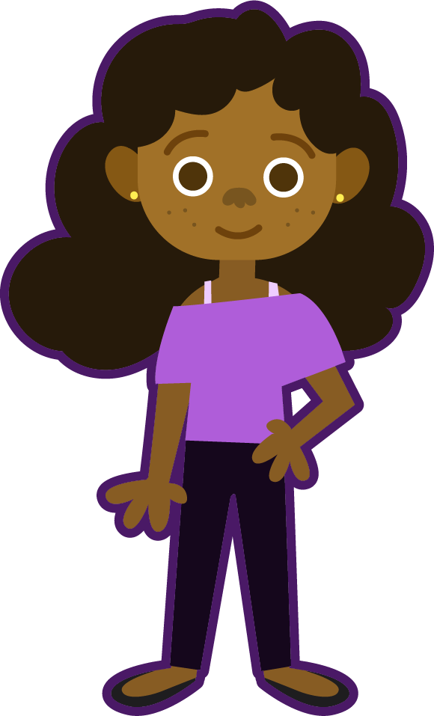
This Week’s Words
Do you know what they mean?
What do the words have in common?
y
y
cygnet
mystery
typical
y
y
Sydney
y
lyrics
y
syllable
y
crystal
y
antonym
y
y
synchronise
symmetry
These words all have a ‘y’ that sounds like /i/.
Can you
hear the short /i/ sound in these words?

Slide 4
Etymology
crystal
Cristal is an Old English word from around 1000AD.
It meant ‘clear ice’ or ‘transparent mineral’.
But where did it originate from?
crystal
From the Old French word cristal meaning ‘crystal’.
From the Greek word
krystallos meaning ‘frost’.
From the Latin crystallus meaning ‘crystal’ or ‘ice’.
Between 1440 and 1600, the spelling we are familiar with today came into use.

Slide 5
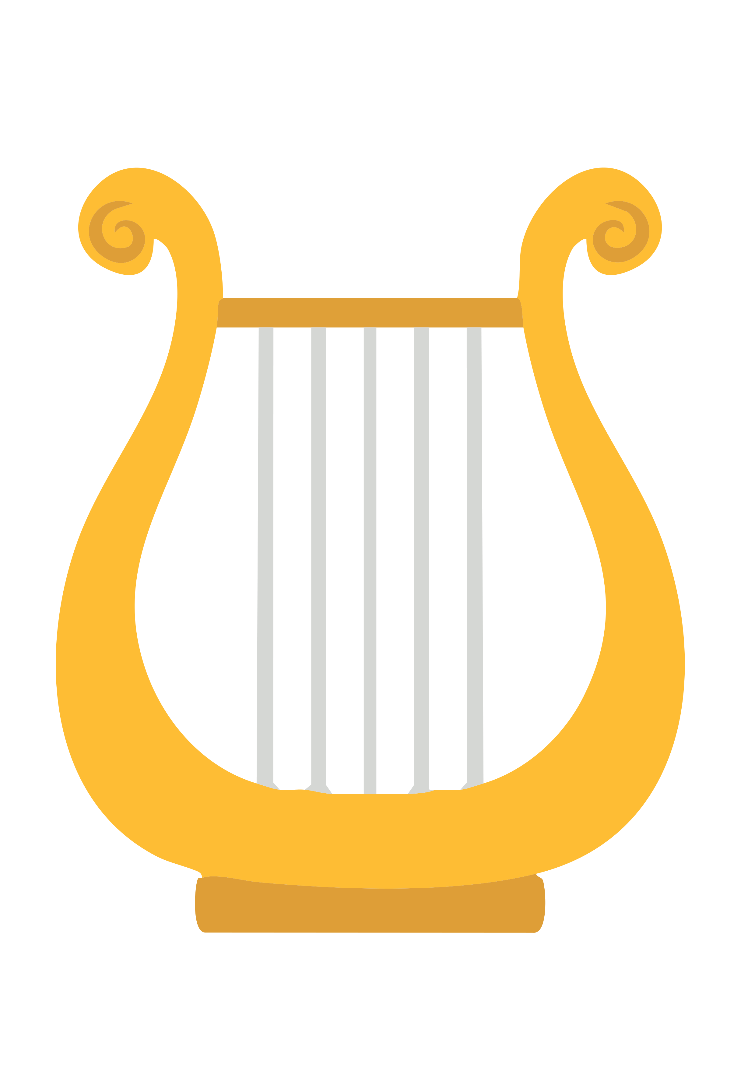

Etymology
lyrics
The word lyric has its origins in three different languages:
From the Middle French word lyrique.
From the Latin word lyricus.
Also, from the Greek word lyrikos, which means ‘singing to the lyre’.
What is a lyre?
The lyre was popular in Ancient Greece. It is a small stringed musical instrument that was played when reciting or singing poetry.

Slide 6
Irregular Spelling Pattern
The letter ‘y’ can appear anywhere in a word and makes a variety of sounds. Can you sort these words according to the sound represented by the letter ‘y’?
yellow
style
sky
year
cosy
cry
Egypt
antonym
yolk
cycle
sunny
yearn
gym
why
python
young
baby
yesterday
/igh/ sound
/y/ sound
/i/ sound
/ee/ sound
Notes:
Click on the words to move them to the correct box.
This can be done as a whole class or allow the children some time in pairs/small groups.

Slide 7
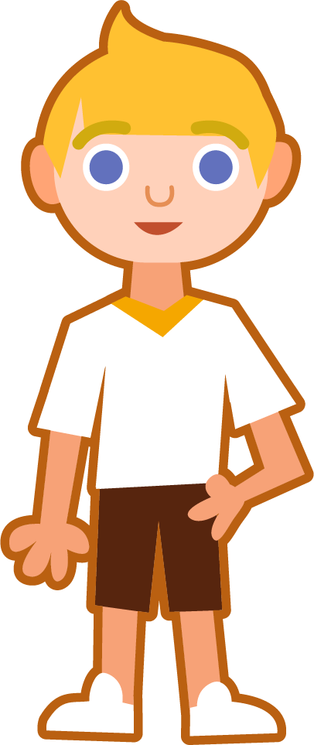

Sound Buttons and Syllables
Syllables are separated by long syllable breaks.
.
Sydney
Draw a dot
below each single
letter sound. Use red sound buttons to show the adjacent consonants. When two or more letters represent one sound, we use a line.
Syd|ney
2
symmetry
synchronise
sym|me|try
3
syn|chro|nise
3

Slide 8
Word Maps
Read each word and break it into syllables, drawing long lines for the syllable breaks. Count the number of syllables and finally, write the word out again.
Word | Syllable Breaks | Number of Syllables | Word
crystal
cygnet
antonym
symmetry
mystery
lyrics
synchronise
Sydney
typical
syllable

Slide 9
Word Maps
Answers
Word | Syllable Breaks | Number of Syllables | Word
crystal | crys|tal | 2 | crystal
cygnet | cyg|net | 2 | cygnet
antonym | an|to|nym | 3 | antonym
symmetry | sym|me|try | 3 | symmetry
mystery | mys|ter|y | 3 | mystery
lyrics | lyr|ics | 2 | lyrics
synchronise | syn|chron|ise | 3 | synchronise
Sydney | Syd|ney | 2 | Sydney
typical | typ|i|cal | 3 | typical
syllable | syl|la|ble | 3 | syllable

Slide 10
Missing Words
Can you write the missing words to finish the sentences?
crystal
cygnet
antonym
symmetry
mystery
lyrics
synchronise
Sydney
typical
syllable
Everyone joined in singing the ______________ to the pop song.
In mathematics, we were learning about the ______________ of shapes.
On a ______________ farm, there are a variety of animals, such as cows, hens and sheep.
Diamonds are a type of ______________.
A ______________ is a baby swan.
I love a good ______________ story, especially those which leave cliffhangers at the end.
The dancers had to ______________ their movements perfectly.
An ______________ is a word with the opposite meaning.
A ______________ is a unit of spoken words.
We visited ______________ for a week in January.

Slide 11
Missing Words
Answers
Everyone joined in singing the ______________ to the pop song.
crystal
cygnet
antonym
symmetry
mystery
lyrics
synchronise
Sydney
typical
syllable
lyrics
symmetry
In mathematics, we were learning about the ______________ of shapes.
typical
On a ______________ farm, there are a variety of animals, such as cows, hens and sheep.
Diamonds are a type of ______________.
crystal
cygnet
A ______________ is a baby swan.
mystery
I love a good ______________ story, especially those which leave cliffhangers at the end.
synchronise
The dancers had to ______________ their movements perfectly.
antonym
An ______________ is a word with the opposite meaning.
A ______________ is a unit of spoken words.
syllable
We visited ______________ for a week in January.
Sydney

Slide 12
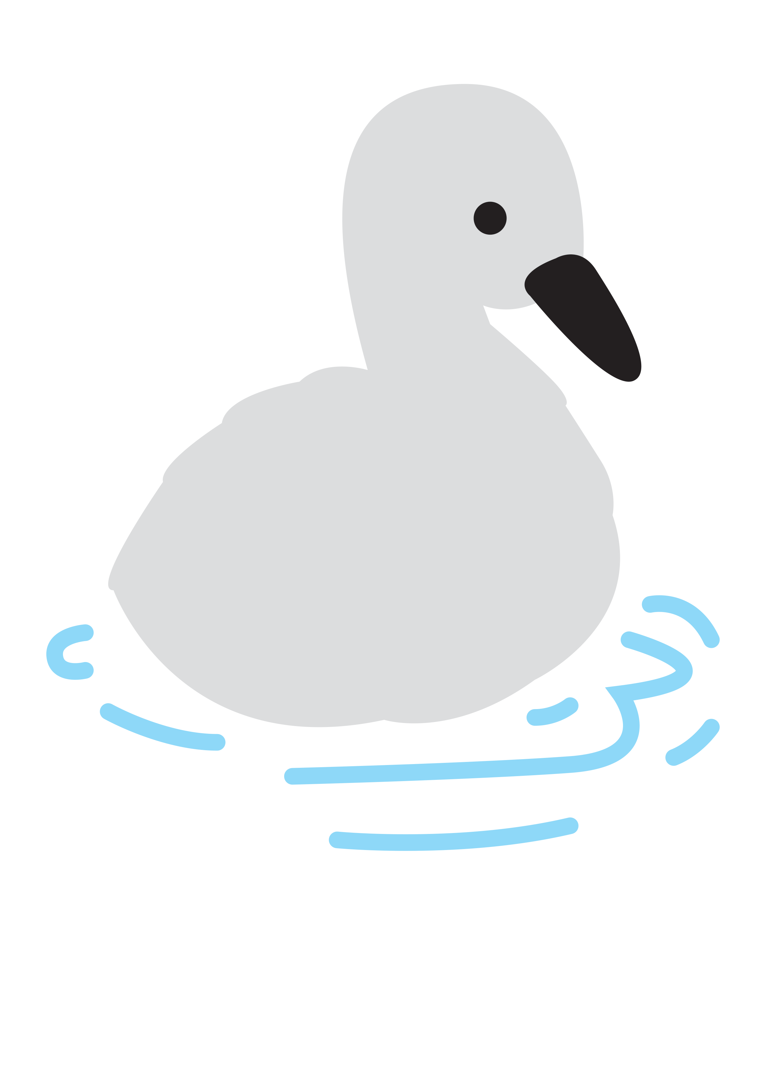

In a Sentence
Write a sentence about the pictures below.
Remember to include the word in your sentence.
crystal
cygnet
mystery
symmetry

Slide 13
Missing Words
Read the sentences and replace the
missing word with one of the blue words.
syllable
antonym
Sydney
lyrics
typical
synchronise
We wanted to ____________ our watches so we could meet at the right time.
‘Different’ is an ____________ for the word ____________.
The word ‘bird’ has one ____________ in it.
I wrote the ____________ and my friend wrote the music to our first song.
My friend moved to ____________ last year.

Slide 14
In a Sentence
Possible Answers
crystal
cygnet
The spikey, blue crystal sparkled in the torchlight.
The fluffy, grey cygnet swam across the lake.
mystery
symmetry
The mystery of who stole the diamonds is still unsolved.
There was a line of symmetry down the middle of the triangle.

Slide 15
Missing Words
Answers
syllable
antonym
Sydney
lyrics
typical
synchronise
We wanted to ____________ our watches so we could meet at the right time.
‘Different’ is an ____________ for the word ____________.
The word ‘bird’ has one ____________ in it.
I wrote the ____________ and my friend wrote the music to our first song.
My friend moved to ____________ last year.
synchronise
antonym
typical
syllable
lyrics
Sydney

Slide 16
Definition
In a Sentence
typical
Synonyms
Five words that begin with ‘ty’

Slide 17
Definition
In a Sentence
Having the distinct qualities of someone or something.
It was a typical Friday morning at school.
typical
Synonyms
Five words that begin with ‘ty’
normal, average, model, distinctive
tyrant, type, tyre, tying, typhoon

Slide 18

Word Spotter
Clap your hands when you see one of this week’s words.
synchronise
identity
familiar
profession
average
explanation
antonym
Sydney
symmetry
cygnet
programme
mystery
develop
soldier
syllable
crystal
lyrics
typical

Slide 19
Definition
In a Sentence
Synonyms
Antonyms

Slide 20
Word cards for Independent Extended Learning
cygnet | synchronise | antonym | symmetry | lyrics
Sydney | mystery | syllable | typical | crystal

Slide 21
Additional word cards for Independent Extended Learning
style
year
cosy
cycle
cry
young
yolk
baby
sunny
yearn

Slide 22
Sorting Mat
Can you sort your words according to the
sound represented by the letter ‘y’?
/igh/ sound
/y/ sound
/i/ sound
/ee/ sound

Slide 23
Optional Activity One
Can you sort the words by the number of syllables they have?
mystery
symmetry
Sydney
antonym
typical
cygnet
syllable
lyrics
crystal
synchronise
2 Syllables
3 Syllables

Slide 24
Optional Activity Two
Write the mistake that has been made for each of this week’s words. Then write the correct spelling for each word.
Word | Mistake | Correct Word
antonim | The ‘i’ should a ‘y’ | antonym
sydney | The ‘s’ should be a capital letter | Sydney
sylable | The ‘l’ should be a ‘ll’ | syllable
lyriks | The ‘k’ should be a ‘c’ | lyrics
simmetry | The ‘i’ should be a ‘y’ | symmetry
typpical | The ‘pp’ should be a ‘p’ | typical
syncronise | The ‘c’ should be a ‘ch’ | synchronise
cignet | The ‘i’ should be a ‘y’ | cygnet
mystry | There should be an ‘e’ after the ‘t’ | mystery
cristal | The ‘i’ should be a ‘y’ | crystal

Slide 25
Optional Activity Three
Which words match the clues?
Which words end in ‘al’?
Which word needs a capital letter?
Which word ends with the suffix ‘-ise’?
Which two words have double-letter digraphs?
Which word ends with the letter ‘m’?
Which remaining word has this syllable map? _ _ _ | _ _ _ | _
Which word means ‘song words’?
In which word does ‘c’ sound like /s/?
crystal
typical
Sydney
synchronise
symmetry
syllable
antonym
mys | ter | y
lyrics
cygnet

Slide 26
Optional Activity Four
Write a sentence for each word pair.
mystery, lyrics
The lyrics of the song were a mystery.
antonym, typical
Atypical is the antonym of the word typical.
As we landed in Sydney, we needed to synchronise our watches to the local time.
Sydney, synchronise
symmetry, syllable
The word symmetry has three syllables in it.
crystal, cygnet
My friend has a crystal cygnet on her bookshelf.

