Slide 1
6
1
To use and apply phonological and morphological knowledge to read and write multisyllabic words
To spell words with hyphens to avoid ambiguity
This week’s words: man-eating, little-used, old-fashioned, empty-handed, in-depth, bad-tempered, cold-hearted, stone-faced, green-eyed, know-it-all

Slide 2
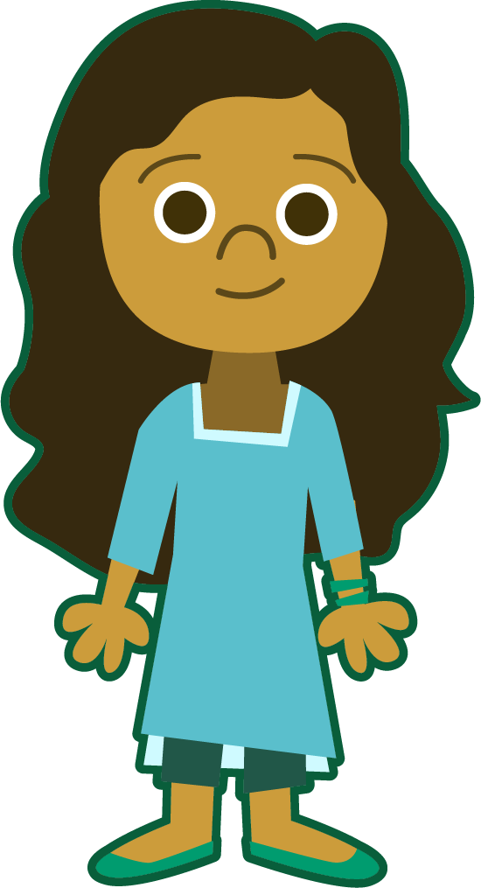

Starter
Can you add the sound buttons to these words?
sphere
Use sound buttons for each phoneme. Draw a dot for each single letter sound, a red dot for adjacent consonants, and a line when two or more letters represent one sound.
aquatic
although
knuckle
thankful

Slide 3
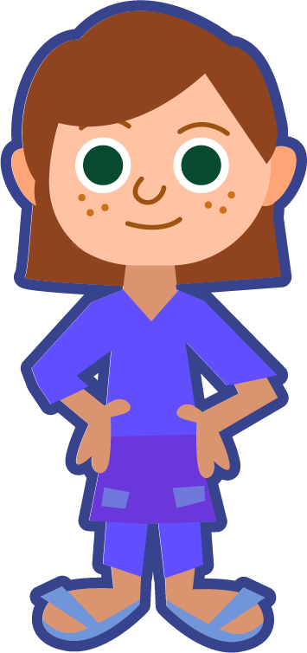
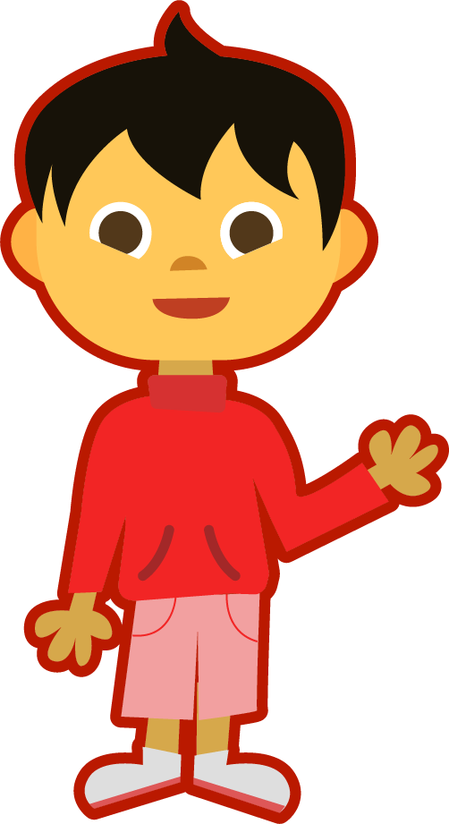
This Week’s Words
Do you know what they all mean?
What do the words have in common?
man-eating
empty-handed
old-fashioned
cold-hearted
little-used
bad-tempered
know-it-all
green-eyed
in-depth
stone-faced
A hyphen looks like this: -
Can you see them in our new words?
A hyphen is a
punctuation mark that can be used to join the parts of a compound word.

Slide 4
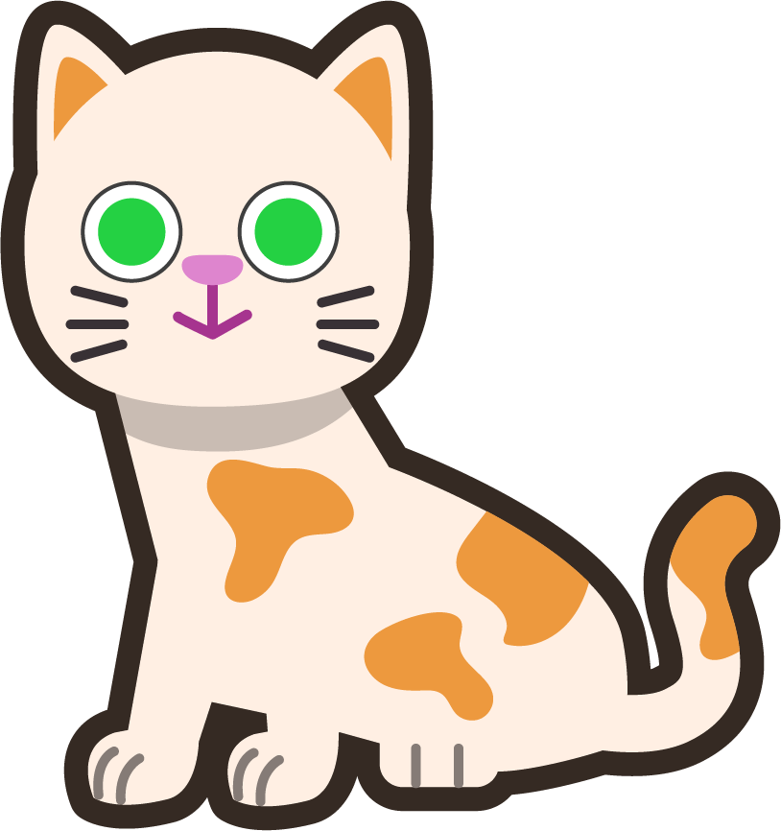
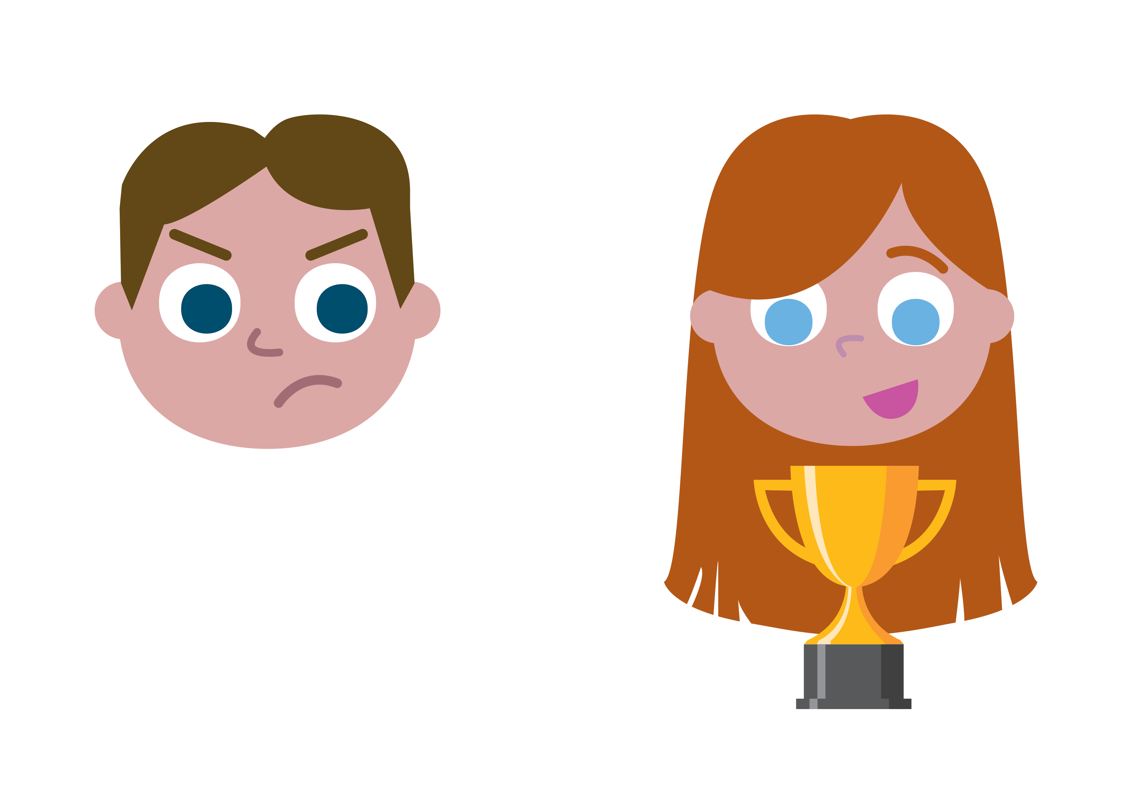
Etymology
green-eyed
‘Green-eyed’ can refer to eye colour.
“The green-eyed monster reared its ugly head when I saw Jenny win the trophy.”
“I’m green with envy about Jenny winning the trophy.”
“Have you met by beautiful, green-eyed cat?”
In 1604, William Shakespeare used the idiom ‘green-eyed monster’ in his play Othello. Iago tells Othello that he should beware of jealousy because, “It is the green-eyed monster,” which will torture him and drive him mad.
The colour green has long been associated with jealousy and envy of what others have. The term ‘green with envy’ means that you are full of jealousy or envy for someone's possessions or advantages.

Slide 5
Morphology Matrix
How many new words can you make?
Prefix
Base Word
Suffix
s
ing
n
un
(not)
know
ac
(towards/in addition)
(to have information
in your mind)
able
ledge
ment
Possible Answers: know, knows, knowing, known, knowledge, knowledgeable, unknown, unknowing, unknowledgeable, acknowledge, acknowledgement
Can you make a word that describes someone who knows a lot?
knowledgeable

Slide 6
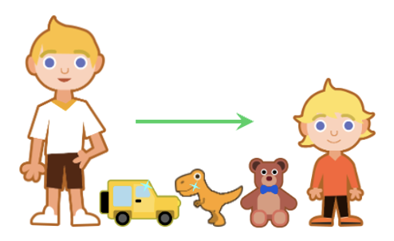
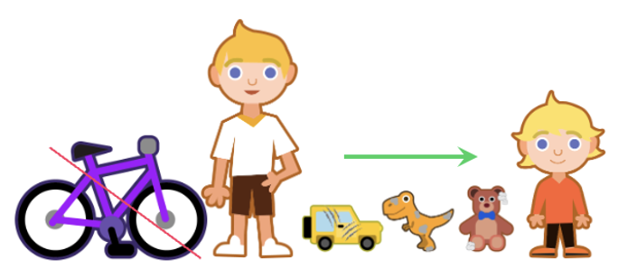
Hyphens
What is a hyphen and how can they help?
Hyphens can be used to join two words to make a compound adjective.
They can help to make our writing clearer.
How does a hyphen change the meanings of these two sentences?
James gave his little-used toys to his younger brother.
James gave his little, used toys to his younger brother.
Here, James is giving his brother some toys that have not been used very much. They have had little use.
Here, James is only giving his brother small toys that have been used.

Slide 7
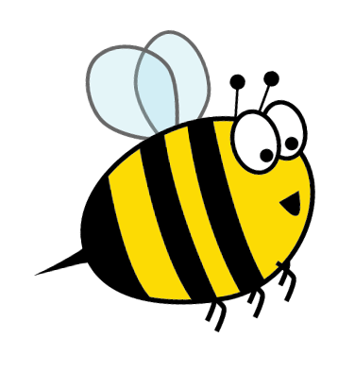
Word Meanings
We have just seen how hyphens can be used to join two words to make a compound adjective.
The individual words aren’t necessarily adjectives, but they collectively function as an adjective.
A shark capable of attacking and eating humans.
These compound adjectives can appear before the noun they are modifying.
man-eating
shark
Toys that have not been used very much.
little-used
toys
A deep and detailed discussion.
in-depth
discussion
Which nouns could they be describing?
A person who shows no kindness
or sympathy towards other people.
cold-hearted
person
Clothes that are no longer fashionable.
old-fashioned
clothes

Slide 8
Word Meanings
stone-faced
guard
A guard whose face is expressionless, like stone.
These compound adjectives can appear before the noun they are modifying.
A wizard with a bad temper.
bad-tempered
wizard
A girl with green eyes. Or a girl who is jealous.
green-eyed
girl
Which nouns could they be describing?
A thief who hasn’t stolen anything, leaving their hands empty.
empty-handed
thief

Slide 9
Word Meanings
One of this week’s hyphenated words is a compound noun.
Which word is it?
Most compound nouns are written with spaces between the words, e.g., theme park, primary school.
know-it-all
sister-in-law
stick-in-the-mud
Those with three or more words are hyphenated. Can you think of any more to fit the pattern?
man-of-war
jack-of-all-trades
matter-of-fact
merry-go-round

Slide 10
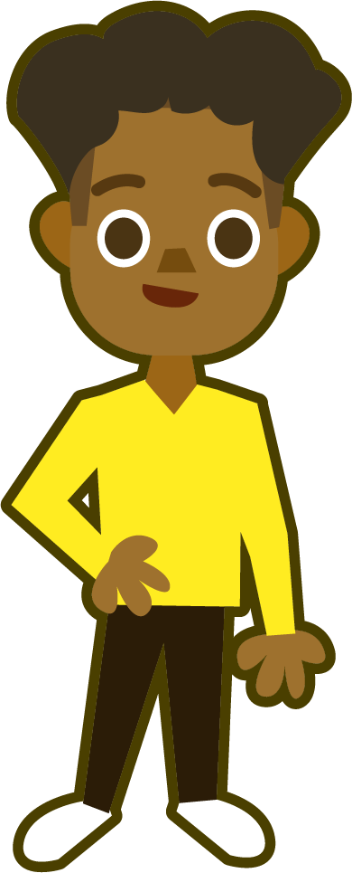
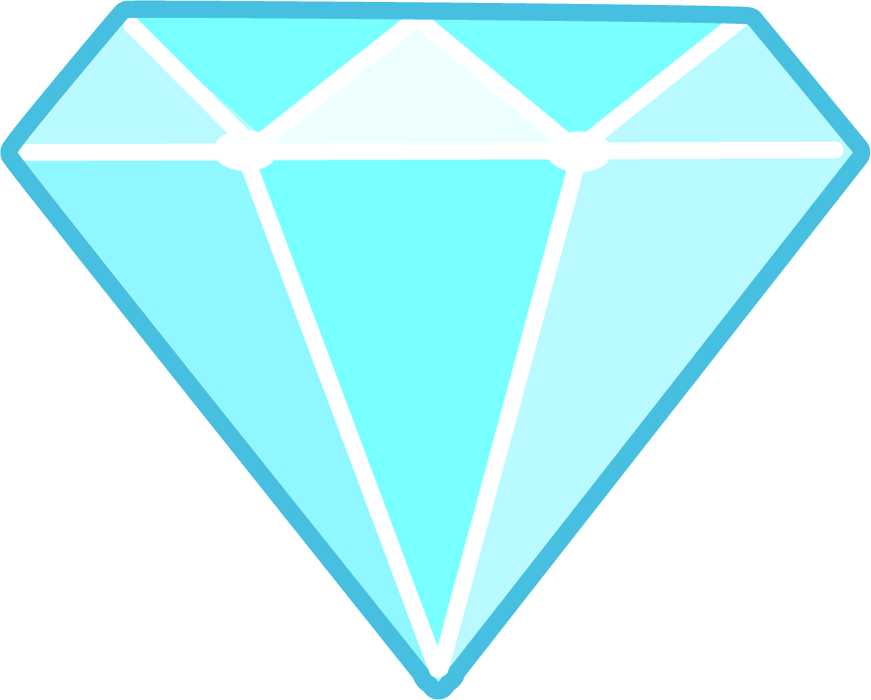
Syllable Count
How many syllables are in each word?
man-eating
empty-handed
old-fashioned
cold-hearted
3
4
3
3
little-used
bad-tempered
know-it-all
green-eyed
3
3
3
2
in-depth
stone-faced
2
2
I think there are
more words with three syllables. How many
words have four syllables?
2
3
4
Notes:
Click on the numbers to reveal.

Slide 11
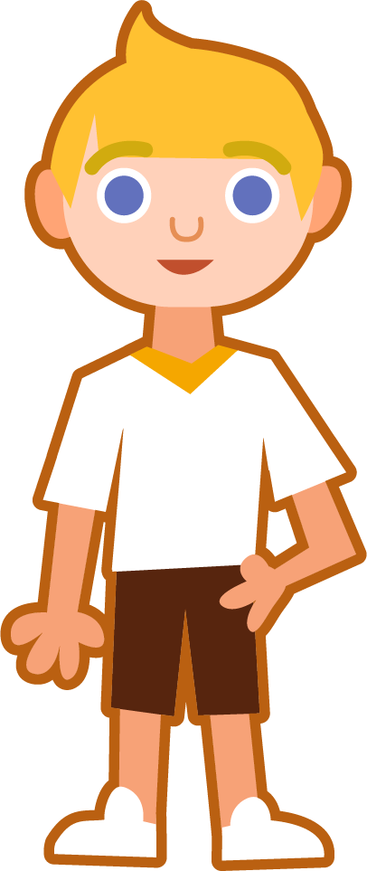
Sound Buttons and Syllables
cold-hearted
.
Syllables are separated
by long syllable breaks.
It’s important to be flexible when dividing
a word into syllables. There should be a vowel sound in each ‘beat’.
Draw a dot
below each single
letter sound. Use red sound buttons to show the adjacent consonants. When two or more letters represent one sound, we use a line.
cold|heart|ed
3
in-depth
know-it-all
man-eating
in|depth
2
know|it|all
3
man|eat|ing
3

Slide 12
Word Maps
Read each word and break it into syllables, drawing long lines for the syllable breaks. Write each word again adding the sound buttons for each phoneme.
Words | Syllable Breaks | Sound Buttons
know-it-all
green-eyed
stone-faced
cold-hearted
bad-tempered
in-depth
empty-handed
old-fashioned
little-used
man-eating

Slide 13
Word Maps
Answers
Words | Syllable Breaks | Sound Buttons
know-it-all | know|it|all | know-it-all
green-eyed | green|eyed | green-eyed
stone-faced | stone|faced | stone-faced
cold-hearted | cold|heart|ed | cold-hearted
bad-tempered | bad|tem|pered | bad-tempered
in-depth | in|depth | in-depth
empty-handed | emp|ty|hand|ed | empty-handed
old-fashioned | old|fash|ioned | old-fashioned
little-used | lit|tle|used | little-used
man-eating | man|eat|ing | man-eating

Slide 14
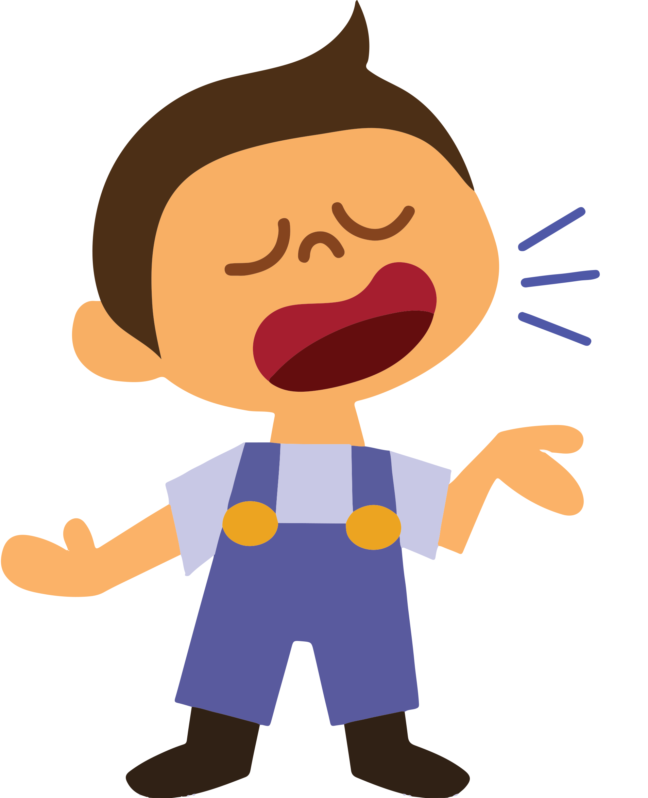
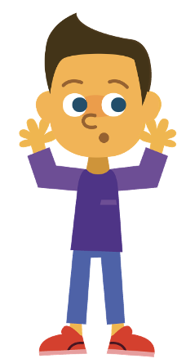
In a Sentence
Write a sentence about the pictures below.
Remember to include the word in your sentence.
know-it-all
empty-handed
bad-tempered
green-eyed

Slide 15
Missing Words
Read the sentences and replace the
missing word with one of the blue words.
old-fashioned
in-depth
stone-faced
cold-hearted
man-eating
little-used
Peter had many ____________ books in his bedroom.
Can anyone be safe if a ____________ lion is at large?
The museum had a display of ____________ telephones.
He sat in the corner, ____________, staring at the floor.
Only the most ____________ viewers will fail to be moved by the story.
We conducted nearly 100 ____________ interviews to find the answer to this mystery.

Slide 16
In a Sentence
Possible Answers
know-it-all
empty-handed
My sister's friend is a real know-it-all, he is always telling me how to do things.
I won’t go to the party empty-handed; I’ll take some snacks for everyone.
bad-tempered
green-eyed
We were chased by a bad-tempered wasp at our picnic.
The green-eyed monster struck me when I didn’t win first place.

Slide 17
Missing Words
Answers
old-fashioned
in-depth
stone-faced
cold-hearted
man-eating
little-used
Peter had many ____________ books in his bedroom.
Can anyone be safe if a ____________ lion is at large?
The museum had a display of ____________ telephones.
He sat in the corner, ____________, staring at the floor.
Only the most ____________ viewers will fail to be moved by the story.
We conducted nearly 100 ____________ interviews to find the answer to this mystery.
little-used
man-eating
old-fashioned
stone-faced
cold-hearted
in-depth

Slide 18
Alphabetical Order and Definitions
Put this week’s words in alphabetical order.
Then write a definition for each word.
Alphabetical Order | Definition

Slide 19
Alphabetical Order and Definitions
Answers
Alphabetical Order | Definition
bad-tempered
Easily annoyed or angered.
cold-hearted
Not showing any love or sympathy for other people; unkind.
empty-handed
Not getting what you wanted; without taking something to somebody.
green-eyed
Having eyes that are green. Also, a feeling of jealousy because somebody has something you wish you had.
in-depth
Very detailed, careful and complete.
know-it-all
A person who behaves as if they know everything.
little-used
Not used much, or as much as other items.
man-eating
Used to describe an animal that attacks and eats humans.
old-fashioned
Dated; not modern; no longer fashionable.
stone-faced
Not showing any feelings or emotions.

Slide 20
Definition
In a Sentence
cold-hearted
Synonyms
Antonyms

Slide 21
Definition
In a Sentence
Mitchell was tired of cold-hearted people, so decided to find some better friends.
Not showing any love or sympathy for other people; unkind.
cold-hearted
Synonyms
Antonyms
detached, indifferent, uncaring, unkind, unfeeling, harsh
caring, kind, pleasant, amiable, sympathetic, compassionate

Slide 22

Word Spotter
Clap your hands when you see one of this week’s words.
delicious
precious
calendar
morning
bad-tempered
central
man-eating
know-it-all
women
green-eyed
suspicious
ambitious
special
in-depth
little-used
old-fashioned
cold-hearted
stone-faced

Slide 23
Definition
In a Sentence
Synonyms
Antonyms

Slide 24
Word cards for Independent Extended Learning
man-eating | little-used | old-fashioned | empty-handed | in-depth
bad-tempered | cold-hearted | stone-faced | green-eyed | know-it-all

Slide 25
First part of the compound adjectives for Independent Extended Learning
man | little | old | empty | in
bad | cold | stone | green

Slide 26
Second part of the compound adjectives for Independent Extended Learning
eating | used | fashioned | handed | depth
tempered | hearted | faced | eyed

Slide 27
Sorting Mat
Can you sort this week’s words according to the
first and second parts of the compound adjective?
First Part
Second Part
-

Slide 28

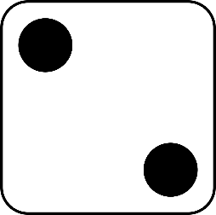
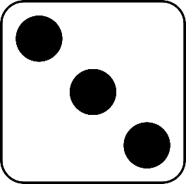
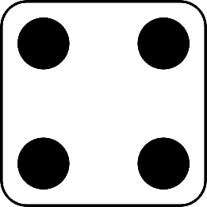
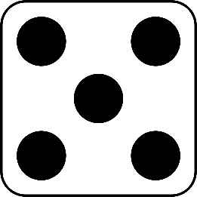
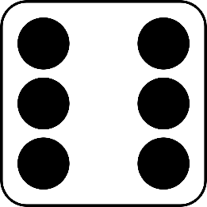
Roll and Read
Play with a partner. You will need a die and two different-coloured counters.
Take it in turns to roll a die.
Whichever number you land on, read a word from that column.
If you are correct, put a counter over the word.
The first person to get four counters in a row wins.
man-eating | little-used | old-fashioned | empty-handed | in-depth | bad-tempered
cold-hearted | stone-faced | green-eyed | know-it-all | man-eating | little-used
empty-handed | old-fashioned | bad-tempered | in-depth | cold-hearted | stone-faced
know-it-all | green-eyed | little-used | old-fashioned | empty-handed | man-eating

Slide 29
Optional Activity One
How many syllables does each word have?
Draw in the syllable breaks to help you.
man-eating
little-used
old-fashioned
empty-handed
in-depth
green-eyed
bad-tempered
cold-hearted
stone-faced
know-it-all
2 Syllables
3 Syllables
4 Syllables

Slide 30
Optional Activity Two
Which word matches each description?
Very detailed
Not used much
A feeling of jealousy
in-depth
little-used
green-eyed
An animal that eats humans
Easily annoyed or angered
Not getting what you wanted
Not showing any feelings or emotions
man-eating
bad-tempered
empty-handed
stone-faced
A person who behaves as if they know everything.
Not modern; no longer fashionable
Not showing any love or sympathy for other people
know-it-all
old-fashioned
cold-hearted

Slide 31
Optional Activity Three
Choose five word pairs and write a sentence for each pair.
know-it-all
green-eyed
stone-faced
cold-hearted
bad-tempered
in-depth
empty-handed
old-fashioned
little-used
man-eating
My green-eyed grandma loves to wear old-fashioned dresses with long sleeves and skirts.
The cold-hearted scientist did in-depth research on the ocean, learning many interesting facts about the creatures that live there.
Marcia did not arrive at the library empty-handed; she had bought plenty of little-used books to donate.
I listened, stone-faced, as my know-it-all cousin began to tell me what he thought I should do.
The bad-tempered, man-eating dog barked at everyone who walked past the fence.

Slide 32
Optional Activity Four
How many syllables does each word have?
Draw in the syllable breaks to help you.
man-eating
old-fashioned
stone-faced
little-used
man|eat|ing
old|fa|shioned
stone|faced
lit|tle|used
3
3
2
3
cold-hearted
bad-tempered
know-it-all
green-eyed
cold|heart|ed
bad|tem|pered
know|it|all
green|eyed
3
3
3
2
empty-handed
in-depth
emp|ty|hand|ed
in|depth
4
2

