Slide 1
2
2
To use knowledge of blending and segmenting to read and write words
To spell words where the digraph ‘ge’ sounds like /j/
This week’s words: change, charge, range, orange, hinge, strange, dungeon, sponge, pigeon, fringe

Slide 2

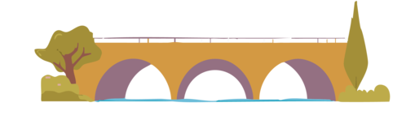


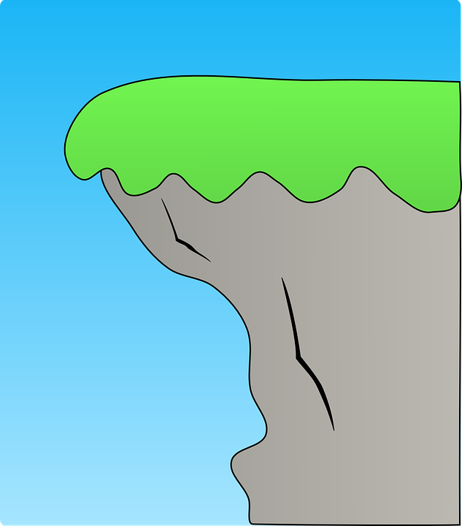

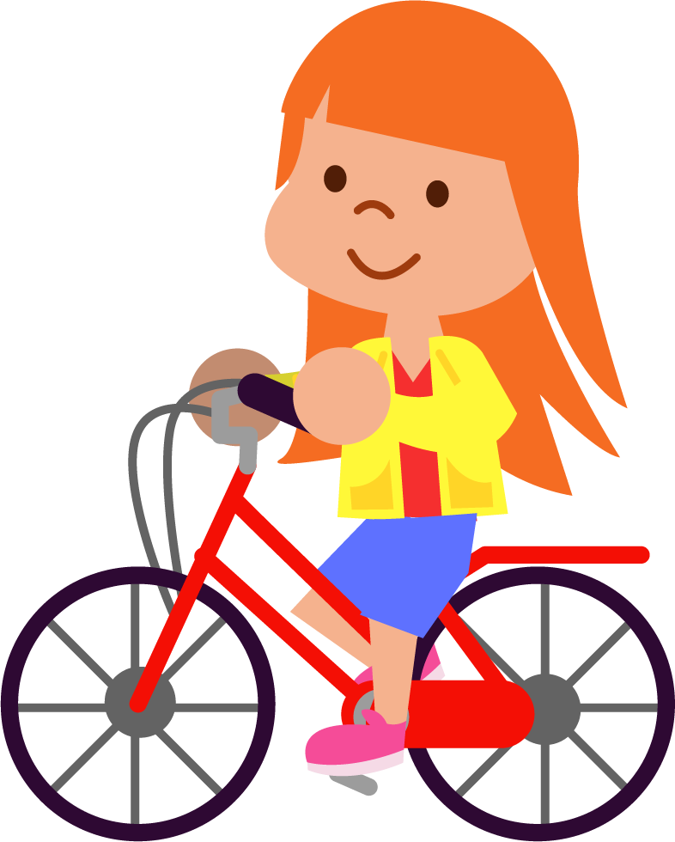
Starter
Can you write the word that matches the picture?
bridge
judge
wedge
badge
lodge
edge

Slide 3
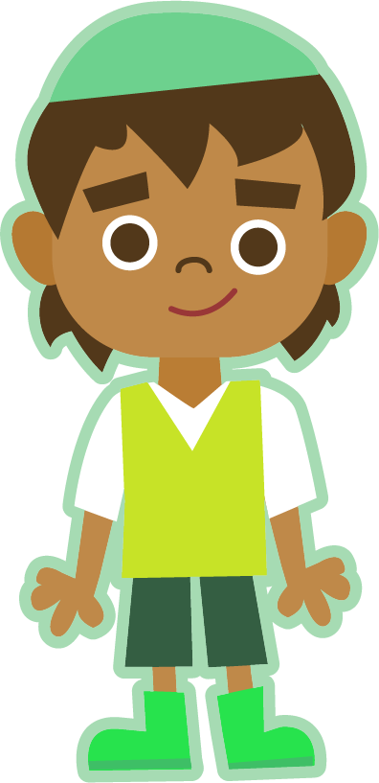

This Week’s Words
Do you know what they all mean?
What do the words have in common?
ge
change
orange
sponge
ge
ge
hinge
charge
ge
ge
pigeon
ge
ge
fringe
range
strange
ge
ge
ge
dungeon
This week’s words all have the digraph ‘ge’. What does it sound like?
Does the sound occur in the same place in all the words?

Slide 4
Word Sort
Can you sort this week’s words by how many sounds are in each word? Can you think of any other words that match the patterns?
charge
change
strange
orange
dungeon
‘Change’ has four sounds:
ch-a-n-ge
pigeon
hinge
range
fringe
sponge
3
4
5
6
m-e-ss-a-ge
v-i-ll-a-ge
s-ur-ge-o-n
p-l-u-n-ge
l-ar-ge
f-or-ge
m-er-ge
l-ou-n-ge
p-o-s-t-a-ge
Notes:
Click on the words to move them to the correct box.

Slide 5
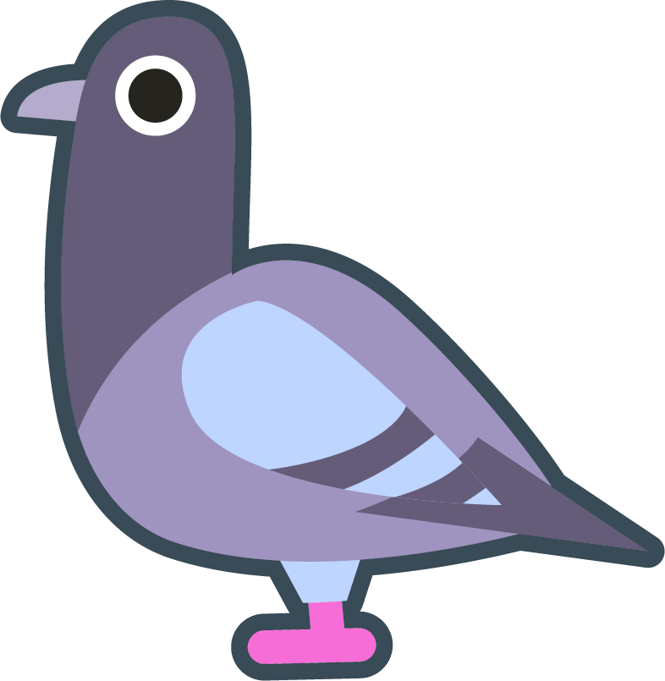
Etymology
Etymology is the study of the origin and meaning of words. It tells us which other languages words come from and how their meanings may have changed over time.
Where does this week’s word ‘pigeon’ come from?
etymology
The word ‘pigeon’ comes from the Old French word ‘pijon’, used in the 1400s to mean a ‘young dove’.
This comes from the Late Latin word ‘pipio’
meaning ‘a young chirping bird’.
From the Greek word ‘etymos’ meaning ‘true’.
From the Greek word ‘logia’ meaning ‘word’ or ‘study’.

Slide 6
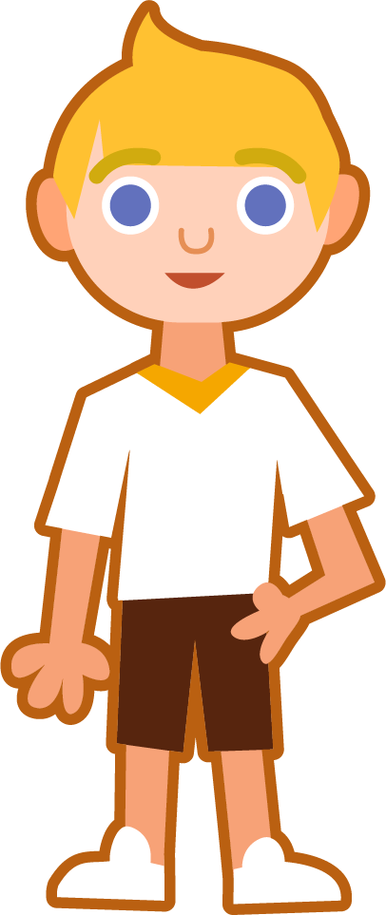
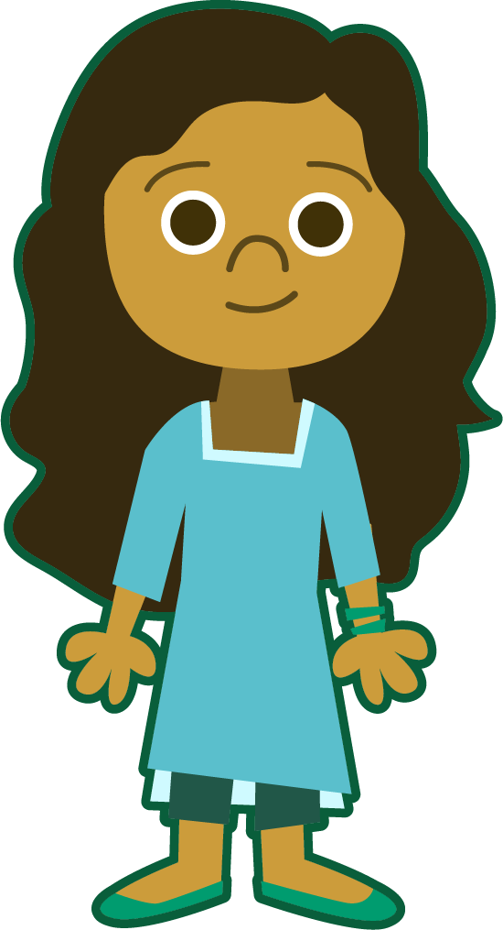

Sound Buttons and Syllables
Syllables are separated by long syllable breaks.
.
orange
Draw a dot
below each single
letter sound. Use red sound buttons to show the adjacent consonants. When two or more letters represent one sound, we use a line.
or|ange
2
charge
pigeon
strange
charge
1
pi|geon
2
strange
1

Slide 7
Word Maps
Write this week’s words next to the correct phoneme map.

Slide 8
Word Maps
Answers
orange
pigeon
sponge
charge
fringe
range
dungeon
hinge
strange
change

Slide 9
Grapheme Scramble and Sentences
Use the underlined digraphs and red consonant blends to help you unscramble this week’s words. Then complete the sentence activities.
Scrambled Word | This Week’s Words
r n f i ge
n r t s ge a
ge h n i
ge ch n a
o ge p n s
ar ge ch
ge a n r
p n ge i o
d n ge o u n
a o n ge r
Write the word ‘fringe’ in a sentence.
Choose two other words to write in a sentence.

Slide 10
Grapheme Scramble and Sentences
Answers
Scrambled Word | This Week’s Words
r n f i ge | fringe
n r t s ge a | strange
ge h n i | hinge
ge ch n a | change
o ge p n s | sponge
ar ge ch | charge
ge a n r | range
p n ge i o | pigeon
d n ge o u n | dungeon
a o n ge r | orange
Write the word ‘fringe’ in a sentence.
She stared at me from beneath her fringe.
Choose two other words to write in a sentence.
I used the orange sponge to wash the dishes.

Slide 11
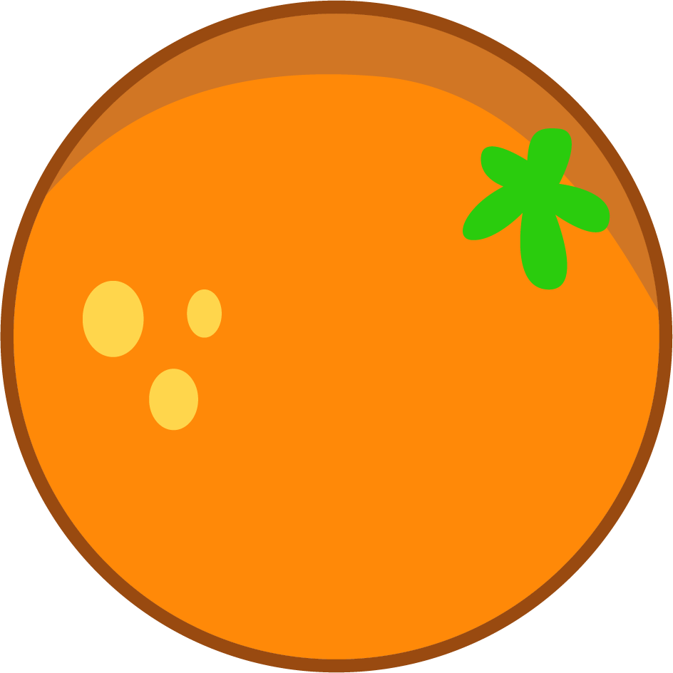
Sentences and Synonyms
Write a sentence about the pictures below. Remember to include the word in your sentence. Then read the sentences and replace the underlined word with one of the blue words.
orange
sponge
change
charge
strange
dungeon
There was an unusual sound coming from the forest.
“Attack!” shouted Ben.
Can I swap seats with you?
The cell was cold and dark.

Slide 12
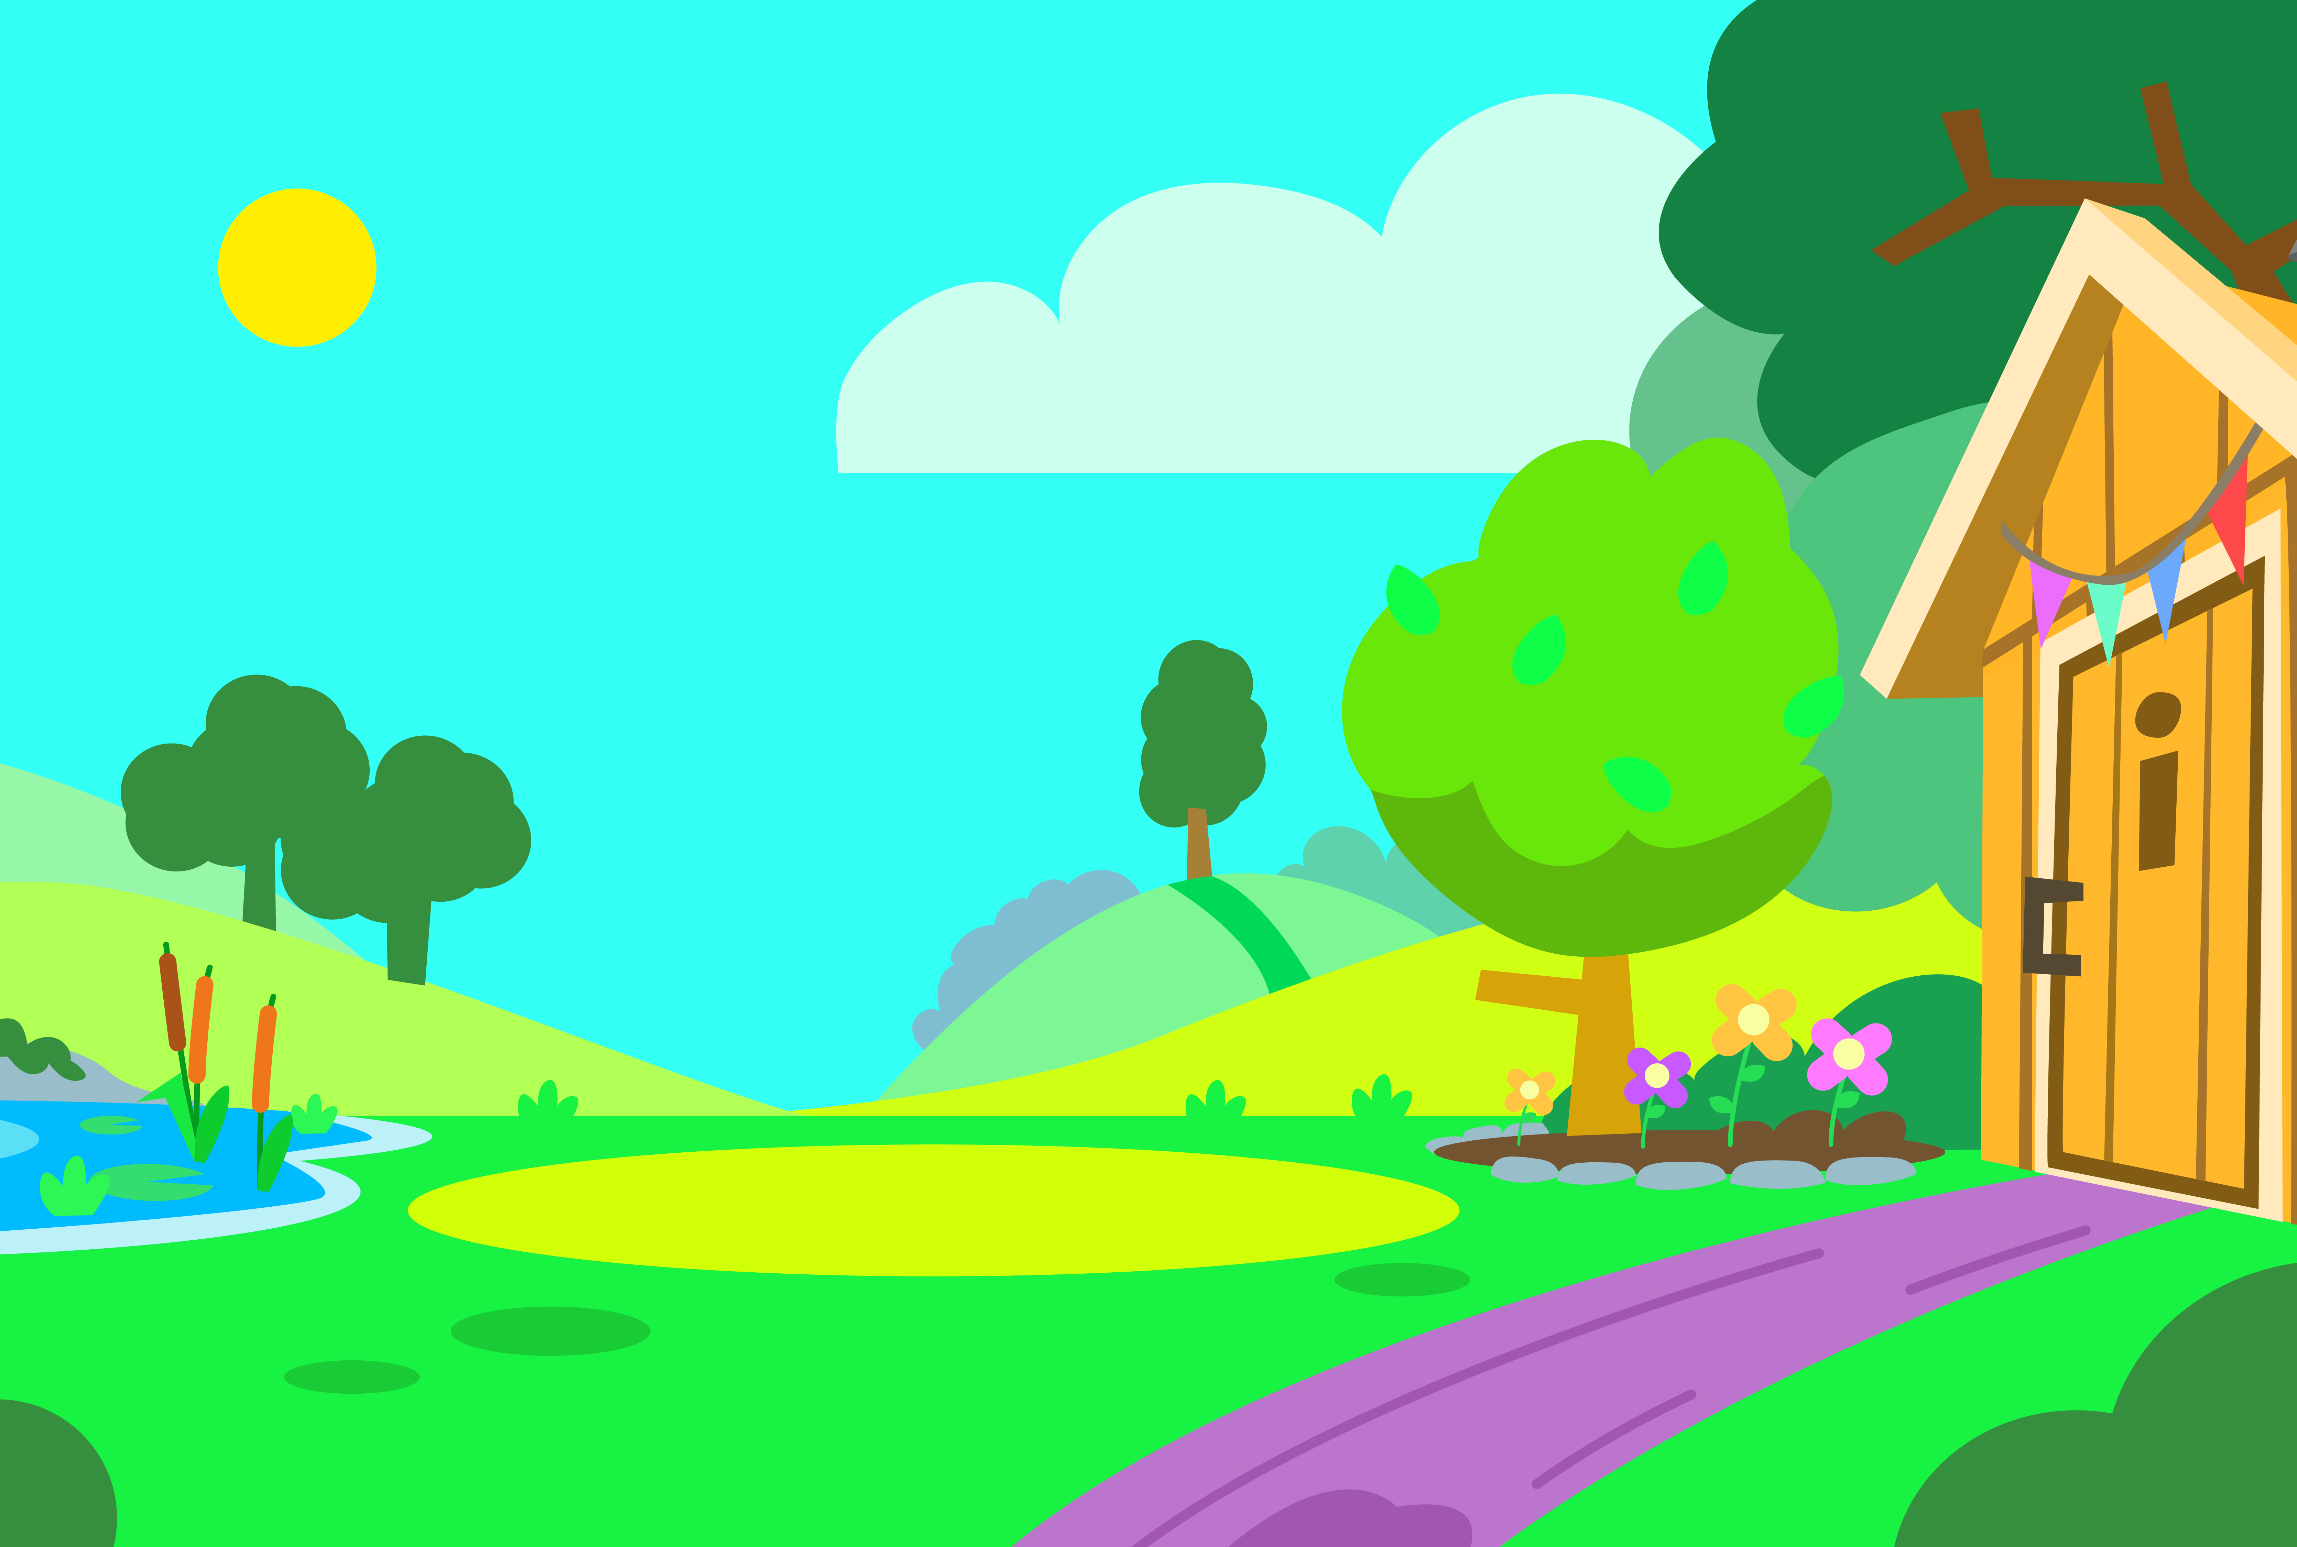

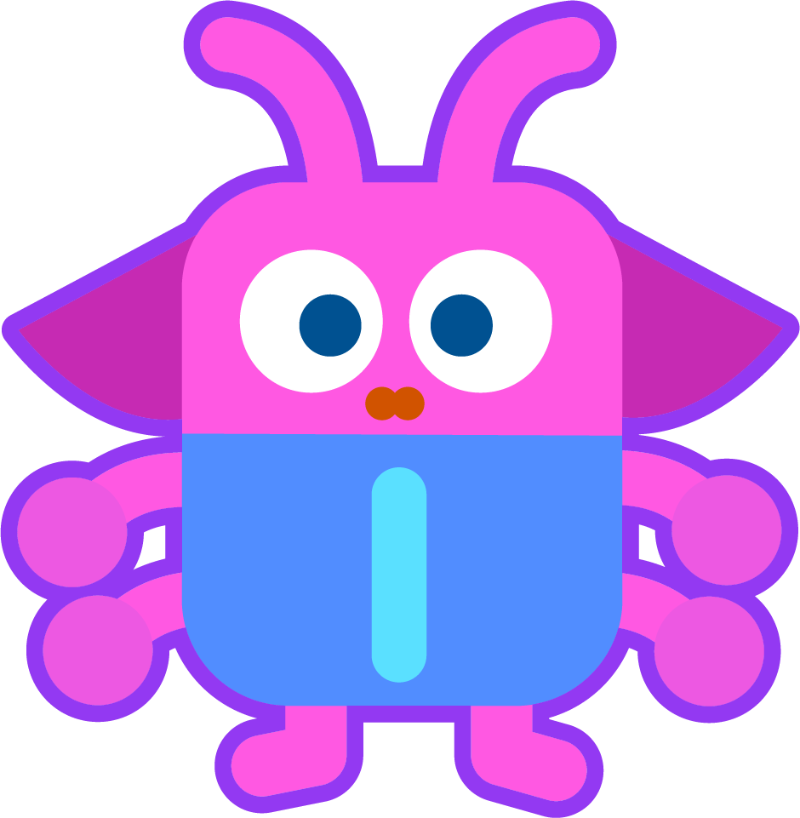
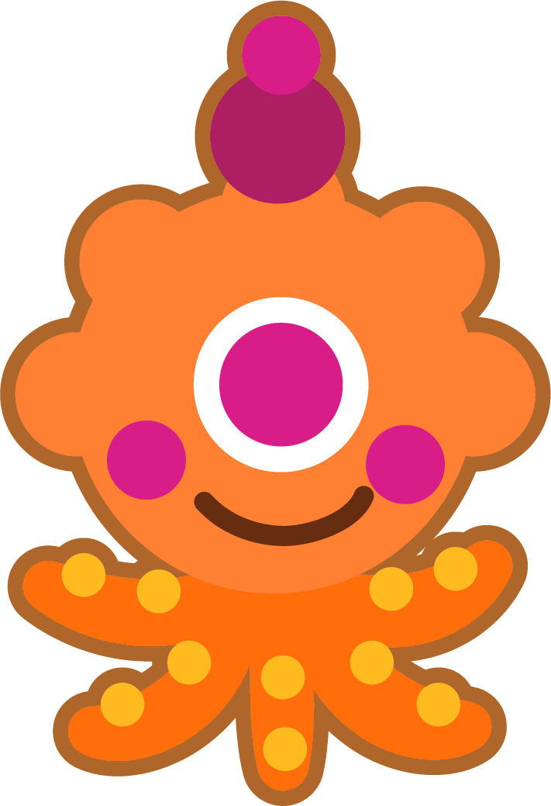
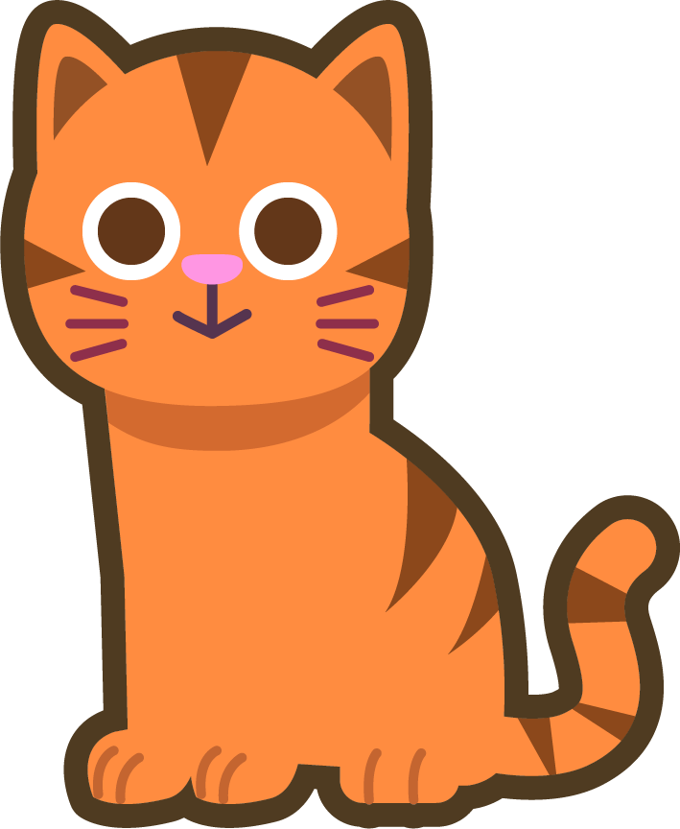
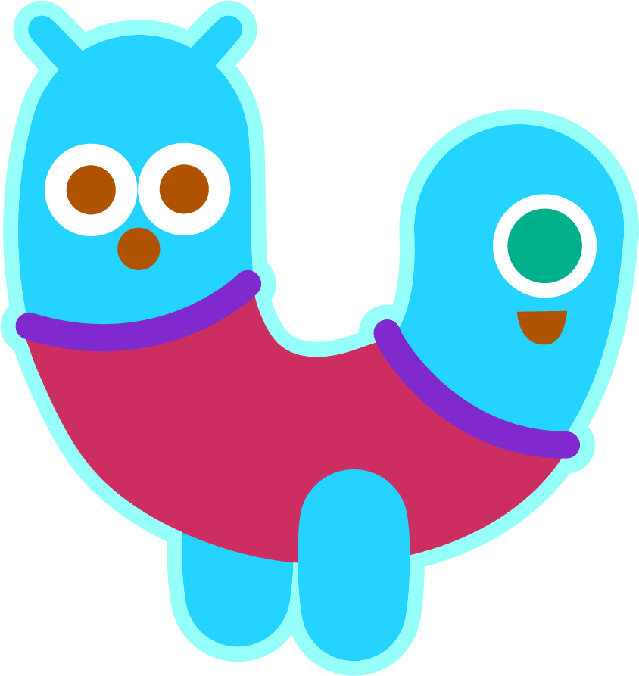
Words in Action
Can you write a description of this picture?
Words to include: orange, pigeon, strange

Slide 13
Sentences and Synonyms
Answers
orange
sponge
My favourite fruit is an orange because they’re so tasty.
You can use a sponge to clean things.
change
charge
strange
dungeon
There was an unusual sound coming from the forest.
“Attack!” shouted Ben.
Can I swap seats with you?
The cell was cold and dark.
strange
Charge
change
dungeon

Slide 14
Words in Action
Possible Answer
Words to include: orange, pigeon, strange
The pigeon and the orange cat saw some very strange things in the garden.

Slide 15

Word Spotter
Clap your hands when you see one of this week’s words.
charge
orange
range
sponge
change
badge
dungeon
hinge
fringe
ridge
fudge
strange
smudge
lodge
wedge
pigeon

Slide 16
Word cards for Independent Extended Learning
charge | orange | strange | sponge | fringe
change | range | hinge | dungeon | pigeon

Slide 17
Sorting Mat
Can you sort the words according to the number of syllables?
1 Syllable
2 Syllables

Slide 18
Optional Activity One
The consonants have been removed from this week’s words.
Can you work out which words are which?
f
r
n
g
p
g
n
c
h
n
g
_ _ i _ _ e
_ i _ e o _
_ _ a _ _ e
r
n
g
s
p
n
g
d
n
g
n
o _ a _ _ e
_ _ o _ _ e
_ u _ _ e o _
r
n
g
c
h
r
g
h
n
g
_ a _ _ e
_ _ a _ _ e
_ i _ _ e
s
t
r
n
g
_ _ _ a _ _ e

Slide 19
Optional Activity Two
Which words match the clues?
Which word has a three-letter consonant blend?
Which two words have the digraph ‘ch’?
Which two words have the ‘ge’ digraph in the middle?
Which three words have this word map?
Which two words have this word map?
strange
charge
change
pigeon
dungeon
fringe
sponge
orange
range
hinge

Slide 20
Optional Activity Three
Can you unscramble the words?
Digraphs have been kept together and underlined.
t n r s a g e
i o g e p n
i g e h n
o n p ge s
strange
pigeon
hinge
sponge
g e n a c h
c h g e a r
r i g e f n
r a o g e n
change
charge
fringe
orange
n o d u n g e
n a r g e
dungeon
range

Slide 21
Optional Activity Four
How many sounds does each word have?
Add the sound buttons to help you.
dungeon
change
fringe
range
6
4
5
4
charge
strange
hinge
sponge
3
6
4
5
orange
pigeon
5
5

